Slide 1
EGI-InSPIRE: Current Status & Future Plans
Steven Newhouse
EGI-InSPIRE Project Director

Slide 2
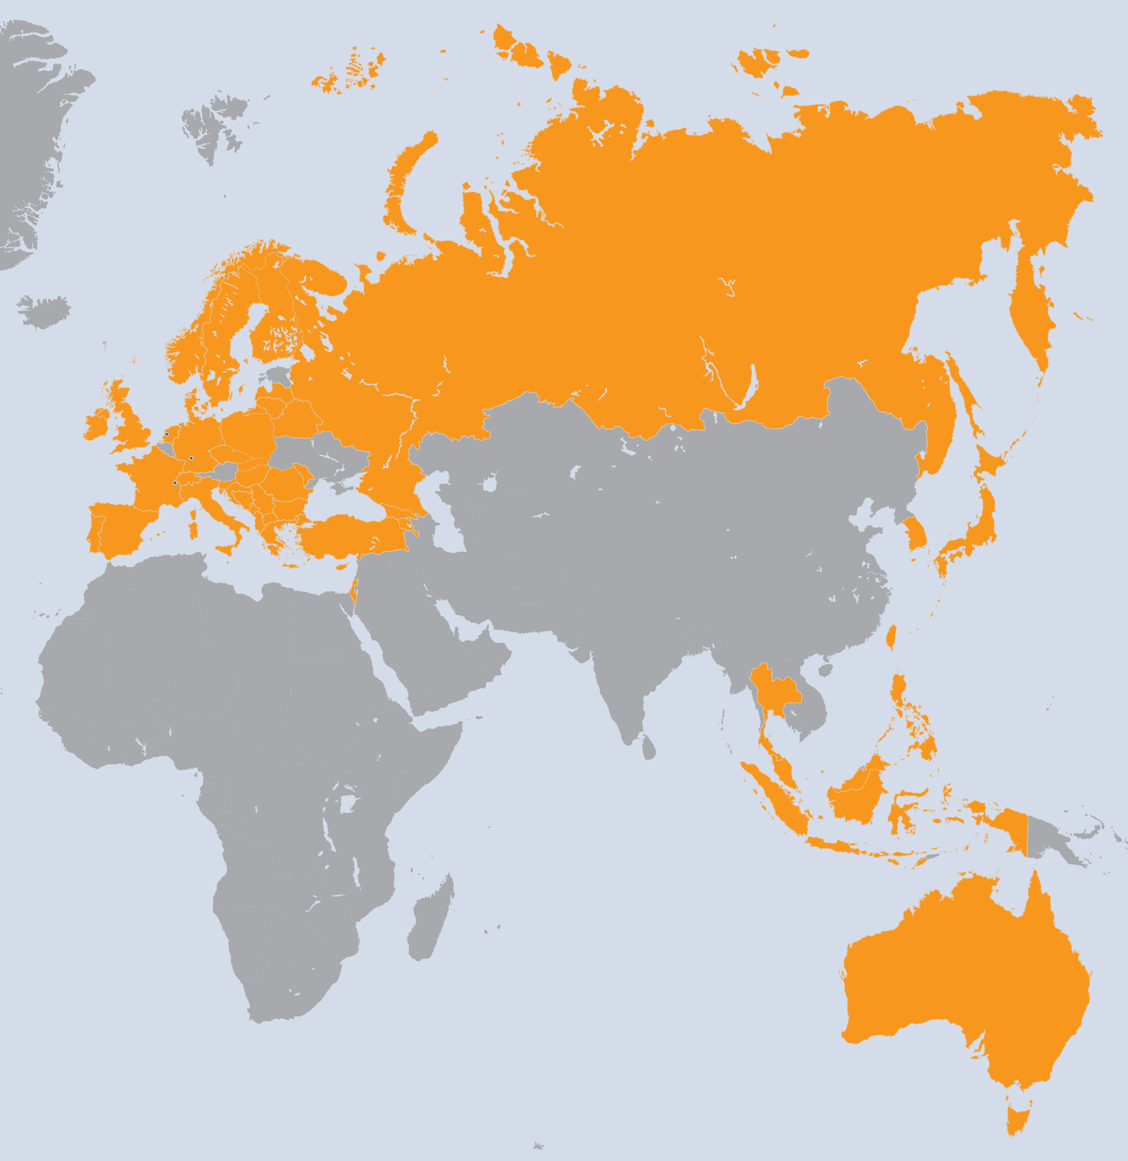
EGI-InSPIRE Overview
Current Status
Future Plans
EGI Technical Forum
A 4-year €72M project ~190FTE with €25M EC contribution with ~€330M additional activities May 2010 → April 2014
Project Partners (50)
EGI.eu, 38 NGIs, 2 EIROs
Asia Pacific (9 unfunded)

Slide 3
Project Objectives
A sustainable federated production infrastructure
Resource providers in Europe and worldwide
With new technologies as they mature
Support structured international research
Attract new international user communities
Technical services to ease wider adoption

Slide 4
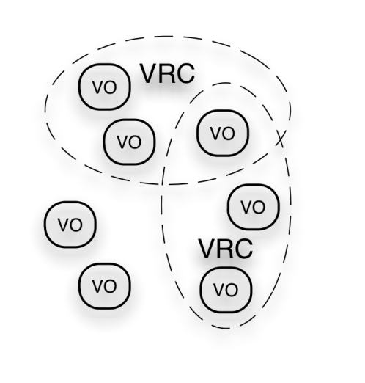
EGI Ecosystem
User Community
EGEE-III
EGI-InSPIRE
Service & Resource Providers
Public Funding Bodies
Technology Providers
European Commission
EGI.eu
Open Source Providers
National Research Councils
Resource Infrastructure Providers
Commercial Providers

Slide 5
EGI Collaboration
NGI
EIRO
NGI
NGI
EIRO
NGI
NGI
Virtual Research Community
Virtual Research Community
Virtual Research Community
EGI.eu
NGI: National Grid Initiative
EIRO: European Intergovernmental Research Organisation

Slide 6
EGI Technical Governance
EGI Council
EGI.eu Executive Board
Technology
Technical Coordination Board
Security
Operations Management Board
Users
User Community Board
Security Coordination Group
Operations
Terms of
Reference
(ToR)
Policy
Development
Process
(PDP)
Common
Glossary
(GCG)
http://www.egi.eu/policy/groups/
http://go.egi.eu/policies_and_procedures

Slide 7
A Virtuous Service Cycle
National
Resource Providers
European Grid Infrastructure
Ecosystem
Used by Researchers
Gathering New Requirements
New Technology Assessed
Deployed Infrastructure Services
Current User Communities
MoUs & OLAs
MoUs
http://www.egi.eu/collaboration/
VRCs: WeNMR, LSGC, Hydro-Meteorology
Letters of Intent: DARIAH & CLARIN
Technology Providers: EMI, IGE, StratusLab, SAGA
Resource Providers: Latin America, South Africa
Projects: MAPPER, GISELA, gSLM, eScienceTalk, ScalaLife, DECIDE, CHAIN, SIENA
EGI.eu
MoUs & SLAs
LoIs
New User Communities
Technology Providers

Slide 8
PY1 Achievements
Established EGI.eu
New legal organisation employing 21 people
Transitioned to national infrastructures
38 independent European NGIs
Supported Virtual Research Communities
Software & centrally provided services
Established open sustainable processes
For requirements & policy development
Ran two large community building events
For the whole EGI community & its ecosystem

Slide 9
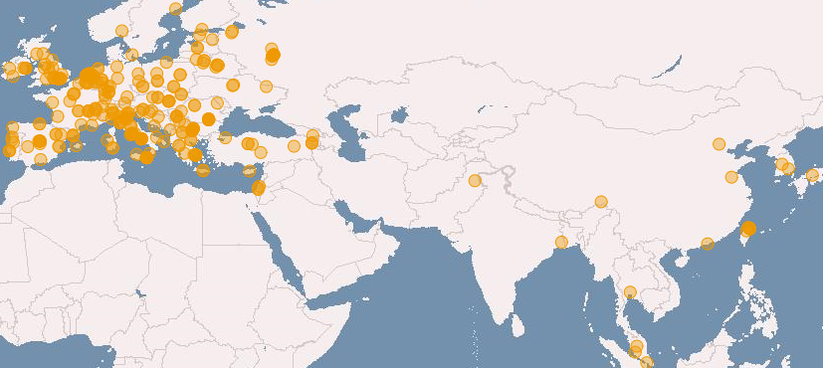
European Grid Infrastructure (July 2011 and increase from Apr 2010)
Logical CPUs (cores)
248,424 EGI (+29.3%)
337,608 All
106.7 PB disk and 112.8 PB tape
Resource Centres
329 EGI
346 All (+6.8%)
93 supporting MPI (+6.8%)
Countries (+11.5%)
50 EGI
57 All
38 NGIs providing resources
26 National Operations Centres
12 NGIs in 4 Federated Operations Centres
1 EIRO providing resources (CERN)
19 countries in 4 non-European Operations Centres

Slide 10
UMD Releases
UMD 1.0.0 (11 July 2011)
29 EMI products
Security (8), Information (3), Operations (2), Storage (1), Data (1), Compute (10) and Clients (4)
UMD 1.1.0 (1 August 2011)
2 new EMI products and 5 updated EMI products
Security (2), Information (3), Storage (1), Compute (1)
UMD 1.2.0 (13 September 2011)
5 new EMI and IGE products, and 4 updated EMI products
Security (2), Information (1), Storage (2), Data (1), Compute (2), Clients (1)
http://repository.egi.eu

Slide 11
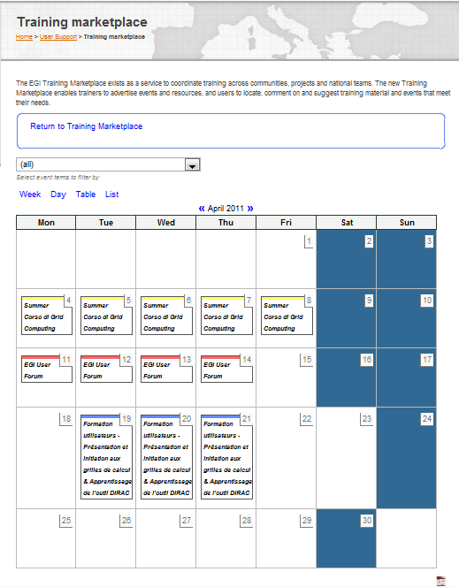
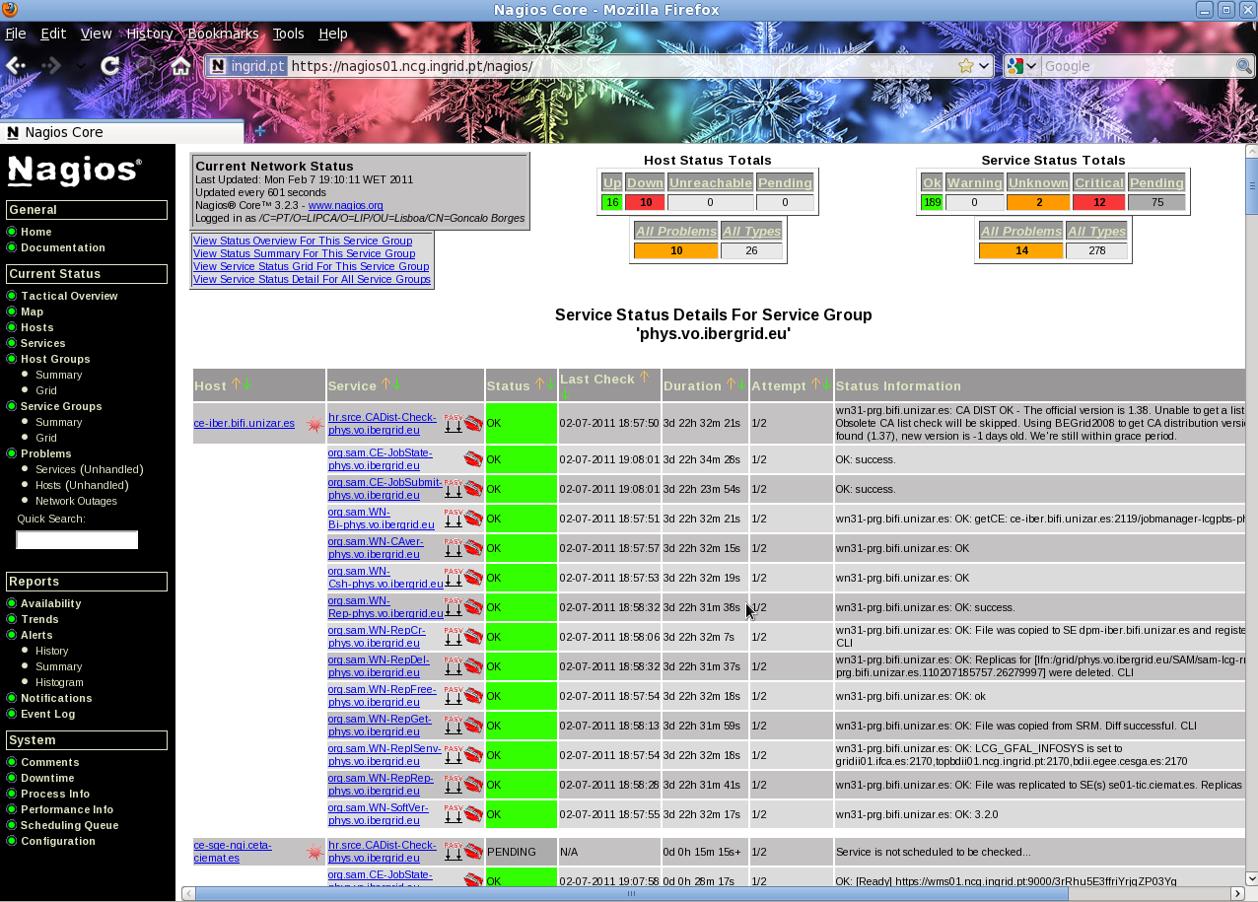
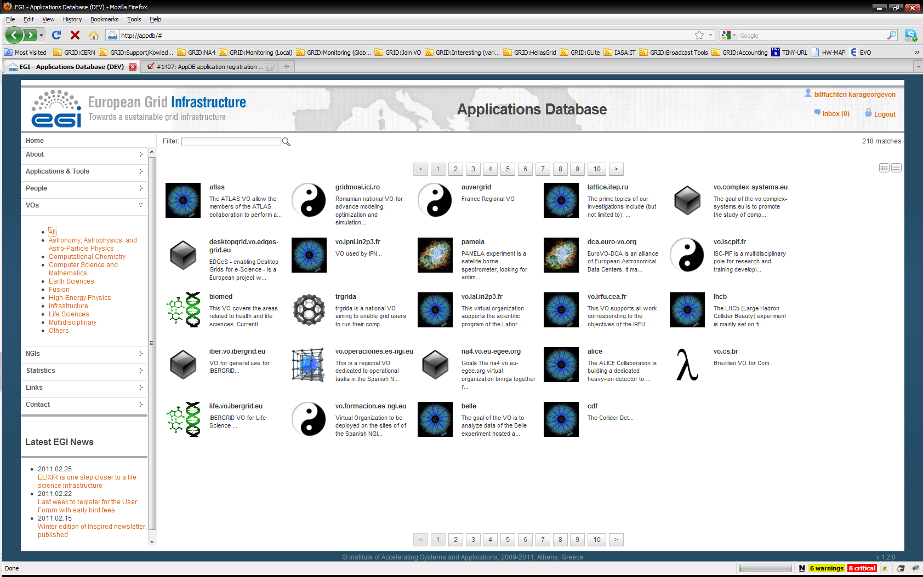
Software & Services
Central Services
Software: Dashboards, AppDB, Training, Ganga, DIANE, ….
Support: MPI, Workflow, VO, ….
Domain Services
HEP, LS, ES, A&A
Community Services
NGIs, projects, …
EGI Gadgets
www.egi.eu/user-support/gadgets
www.egi.eu/user-support/gadgets/appdb
www.egi.eu/user-support/gadgets/rt
www.egi.eu/user-support/gadgets/training

Slide 12
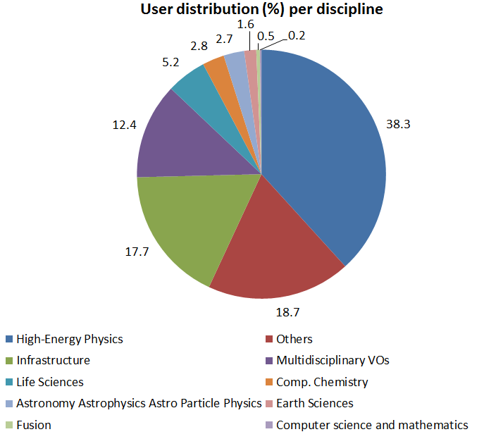
EGI Usage (July 2011)
Average usage May 2010-July 2011 vs 2009-2010
28.9M jobs/month, 949,000 jobs/day (+ 90%)
79.5M CPU wall clock hours/month (+31%)
2.8M jobs/month for non-HEP users (+47%)
Year to Year Increase
19,980 End-users (+61%)
278 VOs (+17.7%)
~30 high activity VOs (no change)
User Communities
Archeology
Astronomy
Astrophysics
Civil Protection
Comp. Chemistry
Earth Sciences
Finance
Fusion
Geophysics
High Energy Physics
Life Sciences
Multimedia
Material Sciences
…

Slide 13
PY1 – EC Assessment
Technical:
All activities established and working well
Delivering to the DoW in PY1
Administrative:
Concern about inconsistent cost & effort
Better monitoring of EGI Global Tasks costs

Slide 14
EC Recommendations
Concern about lack of integrated planning
NGIs & EGI.eu about sustainability
Growth and outreach to new communities
Technical planning to support new users
Demonstrating added European value
EGI
Change EGI & EGI.eu governance models
Better EGI financial monitoring, review & control
Business models to support NGI & EGI.eu
Specific technical issues
Website, UMD testing, security, metrics, cloud, ….

Slide 15
Key EC Message
A production infrastructure is necessary…
But it is no longer sufficient for project success
We need to go beyond our comfort zones
Sustainability: What can we truly afford to do?
New User Communities: What do they want?
Technology: How do we relate to the cloud?
To succeed we will have to change
EGI-InSPIRE provides the means for change

Slide 16
Alignment to the Cloud
Virtual Research Communities
(Users)
Key
Ecosystem
Partners
NGIs + EIRO EGI.eu
Software
Central Services
Domain Services
Community Services
Services
Planning & Coordination
Platforms
gLite
UNICORE
dCache
ARC
Globus
Infrastructure
Support
NGI
NGI
EIRO
NGI
NGI

Slide 17
Planning & Implementation
Marketing Campaign
Community Outreach
New Users
Technical Support
Strategic Planning
Marketing Campaign
Community Outreach
New Users
Technical Support
Strategic Planning
Need integrated planning
Strategic aims & messages
Communication & support
Need strong implementation
The same structures as operations
The same focused, dedicated effort
We need your cooperation and contribution
Improving the delivery of non-operational tasks

Slide 18
Non-operational Coordination
National & European Policy, Planning and Funding
NGI
NGI
SPP
SPP
EGI.eu
M
M
NGI Coordinator
NGI Coordinator
CO
CO
TO
Strategic Plans & Policy
TO
Marketing
Community Outreach
Technical Outreach
User Communities

Slide 19
Looking to Lyon & beyond
Agreement this week on the next steps
We have suggestions from the EC Reviewers
Start implementing these new structures
Provide consolidated non-operational activities
Focus on new communities & sustainability
Refine plans and implement by the end of PY2

Slide 20
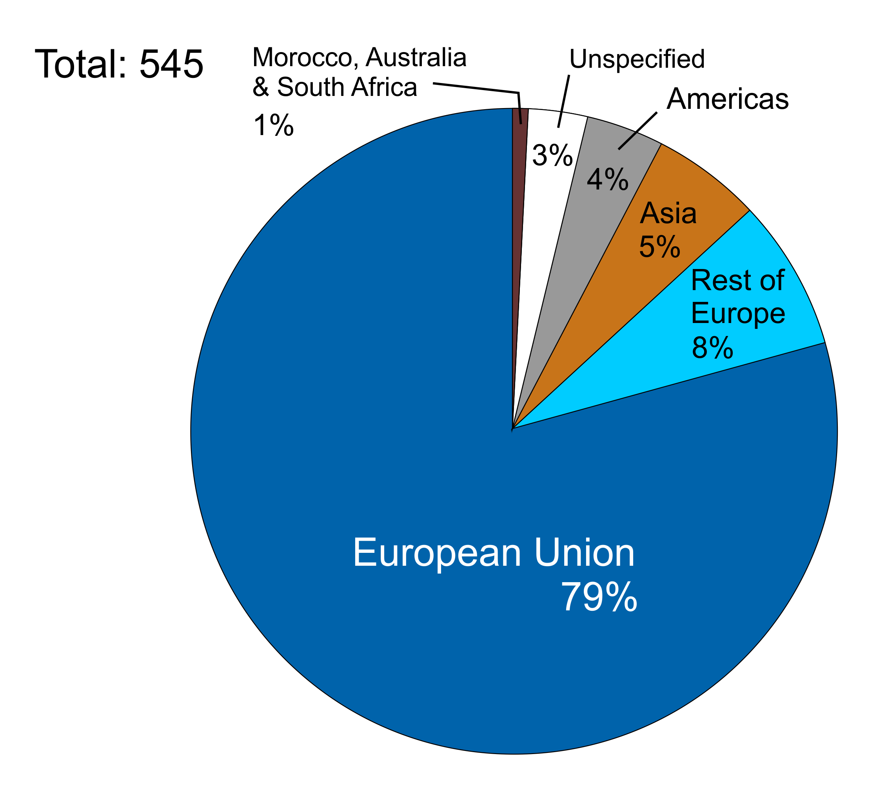
Registered Attendees

Slide 21
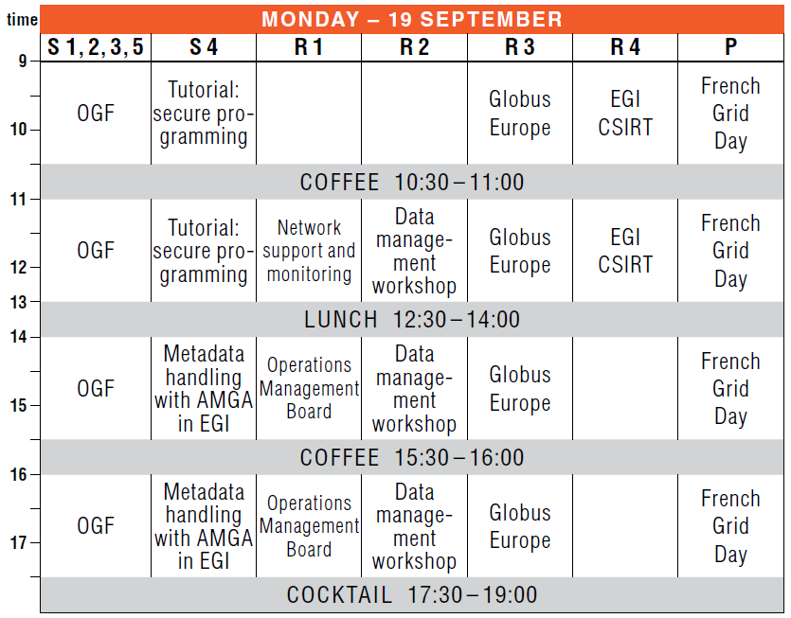
OGF
OGF

Slide 22
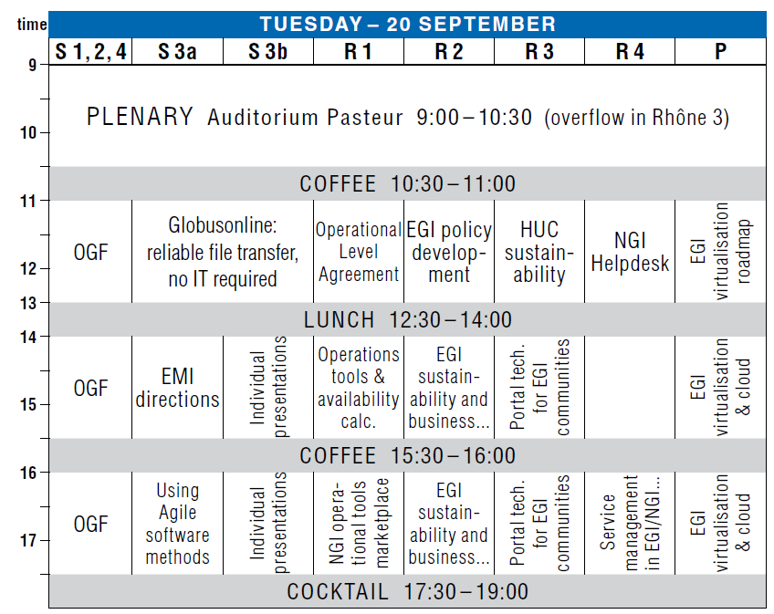
Standards
Services
Clouds
Globus
Online
Sustainability
Portals
Visits to the new CC-IN2P3 computer room are available daily at:
10:30
15:30
Meet at the registration desk
OGF
Individual
presentations
(Portals)

Slide 23
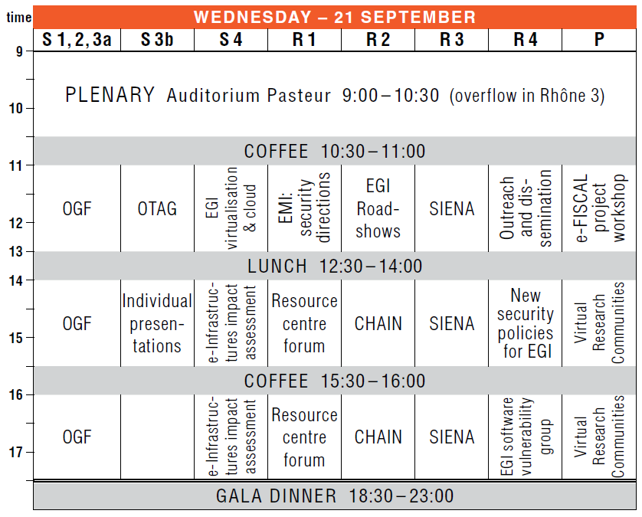
Gala Dinner
Meet at the quay on the river by 6.30pm. Bring your invitation! At the end of the dinner:
One bus to Bellecour
One bus to Les Terreaux
One bus to Part-Dieu
LCC
Standards
DCIs
Operations
VRCs
Best Demo & Poster
Voting slips are provided
Ballot box at the registration desk
Voting closes at 17:30 on Wednesday
Put the name of the demo/poster and its number!
New gadgets – email ucst@egi.eu
QUAY

Slide 24
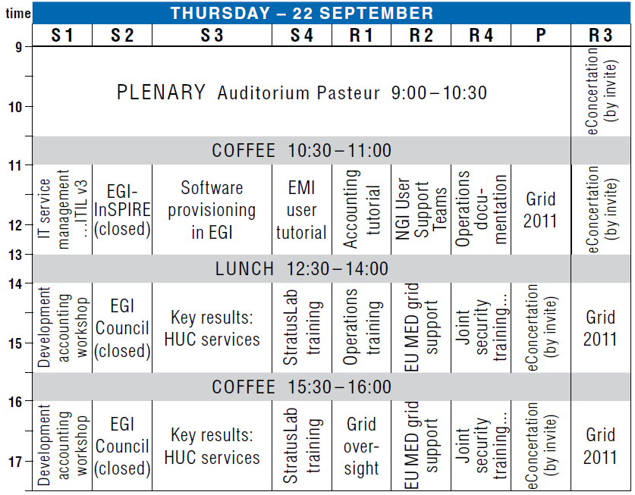
Accounting
Roadmap
Conference
HUC Activity
eConcertation

Slide 25
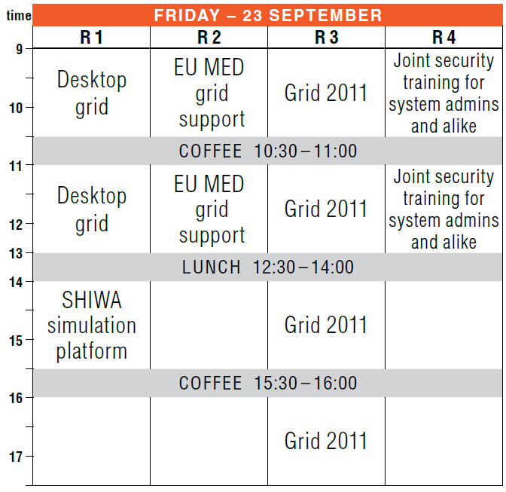
Security Training
eConcertation

Slide 26
Follow EGI live online
Read the conference blog at www.gridcast.org
Follow EGI on at http://twitter.com/egi_inspire (#egitf11)
Photos will appear on our stream at http://www.flickr.com/photos/european_grid_initiative (use the egitf11 tag for your own photos)
Videos online on at http://www.youtube.com/europeangrid
Read the EGI blog at www.egi.eu/blog

Slide 27
And finally…
Enjoy the conference
Meeting new friends & old
Enjoy Lyon
The place to eat & drink
Enjoy being part of a community
A group with a shared common vision

