Slide 1
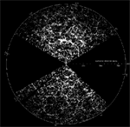
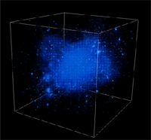
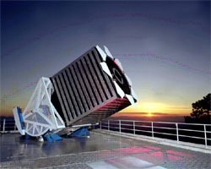
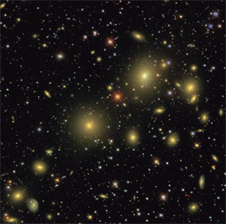
Extreme Data-Intensive Computing in Science
Alex Szalay
The Johns Hopkins University

Slide 2
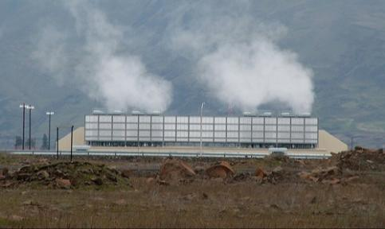
An Exponential World
Scientific data doubles every year
  caused by successive generations
  of inexpensive sensors +
  exponentially faster computing
  Moore’s Law!!!!
Changes the nature of scientific computing
Cuts across disciplines (eScience)
It becomes increasingly harder to extract knowledge
20% of the world’s servers go into centers by the “Big 5”
  Google, Microsoft, Yahoo, Amazon, eBay
So it is not only the scientific data!

Slide 3
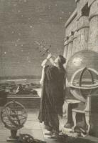
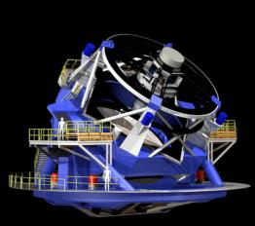
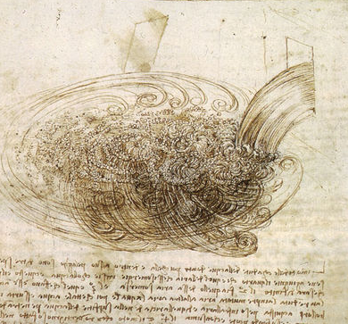
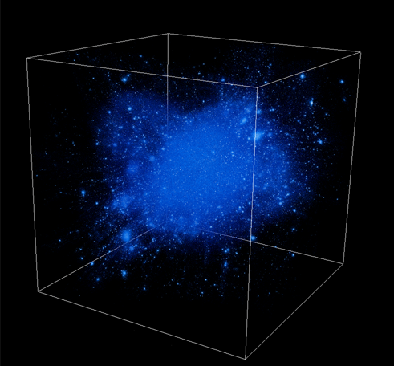
Science is Changing
THOUSAND YEARS AGO
science was empirical
describing natural phenomena
LAST FEW HUNDRED YEARS
theoretical branch using models, generalizations
LAST FEW DECADES
a computational branch simulating
complex phenomena
TODAY
data intensive science, synthesizing theory,
experiment and computation with statistics
►new way of thinking required!

Slide 4
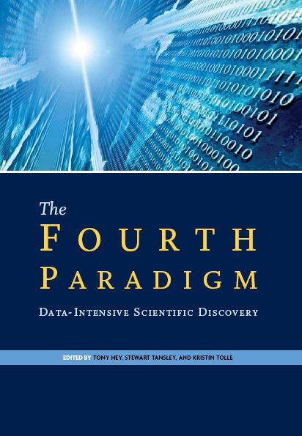
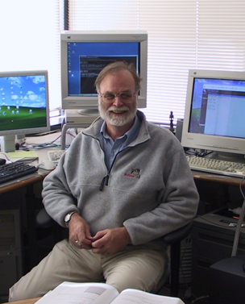
Gray’s Laws of Data Engineering
Jim Gray:
Scientific computing is revolving around data
Need scale-out solution for analysis
Take the analysis to the data!
Start with “20 queries”
Go from “working to working”

Slide 5
Scientific Data Analysis Today
Scientific data is doubling every year, reaching PBs
Data is everywhere, never will be at a single location
Architectures increasingly CPU-heavy, IO-poor
Data-intensive scalable architectures needed
Databases are a good starting point
Scientists need special features (arrays, GPUs)
Most data analysis done on midsize BeoWulf clusters
Universities hitting the “power wall”
Soon we cannot even store the incoming data stream
Not scalable, not maintainable…

Slide 6
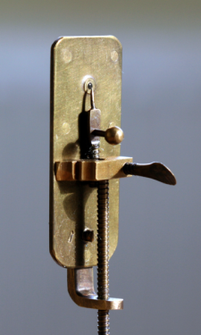
Non-Incremental Changes
Astronomy has always been data-driven….
now becoming more generally accepted
Science is moving from hypothesis-driven to data-
driven discoveries
Need new randomized, incremental algorithms
  Best result in 1 min, 1 hour, 1 day, 1 week
New computational tools and strategies
… not just statistics, not just computer science,
not just astronomy…
Need new data intensive scalable architectures

Slide 7

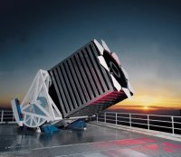

Sloan Digital Sky Survey
“The Cosmic Genome Project”
Two surveys in one
  Photometric survey in 5 bands
  Spectroscopic redshift survey
Data is public
  2.5 Terapixels of images => 5 Tpx
  10 TB of raw data => 120TB processed
  0.5 TB catalogs => 35TB in the end
Started in 1992, finished in 2008
Database and spectrograph
built at JHU (SkyServer)

Slide 8
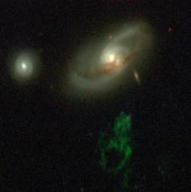
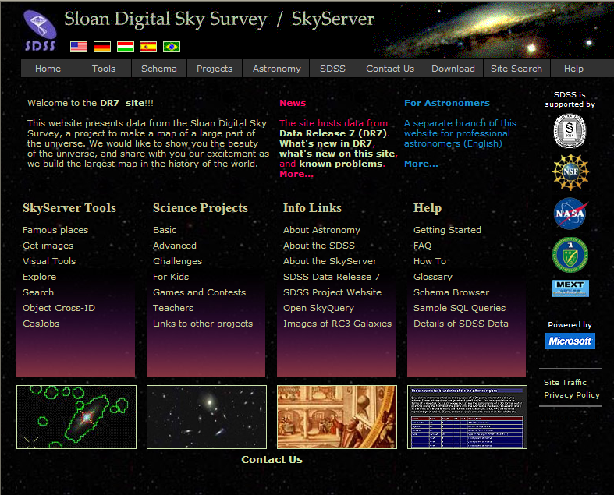
Skyserver
Prototype in 21st Century data access
  840 million web hits in 9 years
  The world’s most used astronomy facility today
  1,000,000 distinct users vs. 10,000 astronomers
  The emergence of the “Internet scientist”
GalaxyZoo (Lintott et al)
  40 million visual galaxy classifications by the public
  Enormous publicity (CNN, Times, Washington Post, BBC)
  300,000 people participating, blogs, poems…
  Amazing original discoveries (Voorwerp, Green Peas)

Slide 9
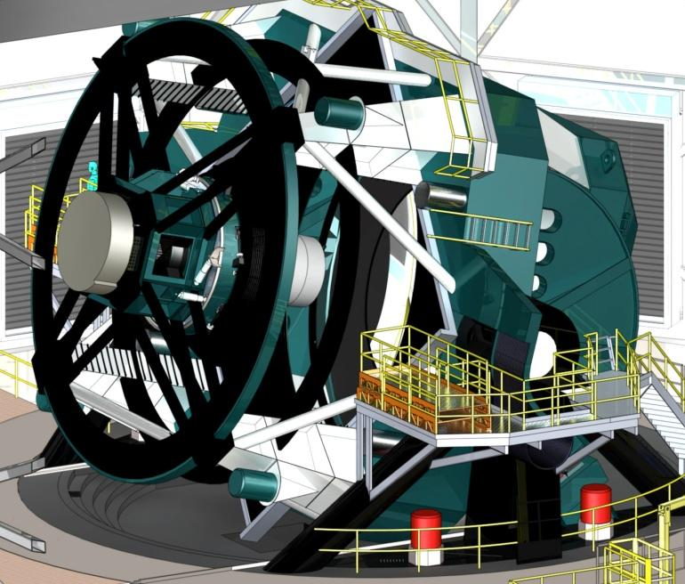
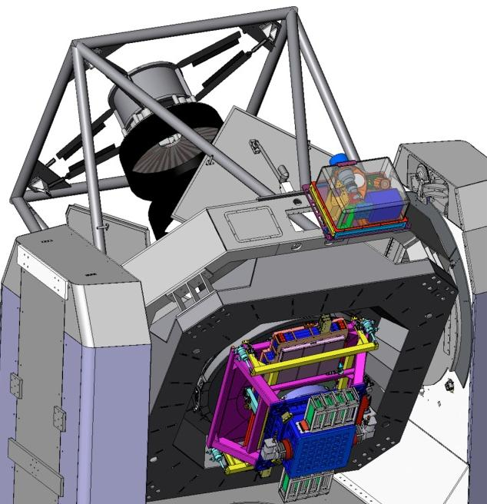
SDSS
2.4m 0.12Gpixel
LSST
8.4m 3.2Gpixel
PanSTARRS
1.8m 1.4Gpixel

Slide 10
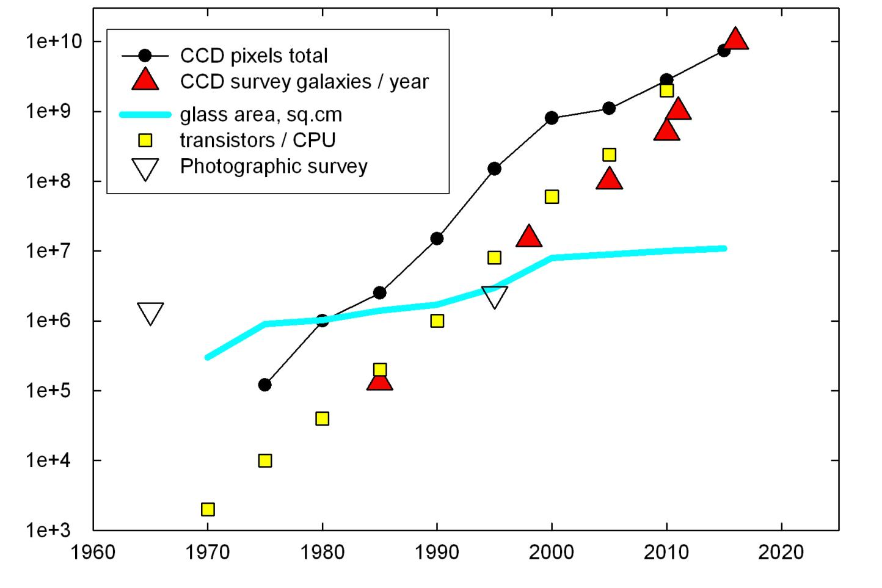
Survey Trends
T.Tyson (2010)

Slide 11
Impact of Sky Surveys

Slide 12
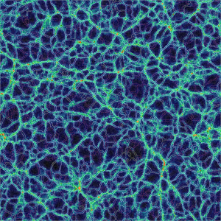
Continuing Growth
How long does the data growth continue?
High end always linear
Exponential comes from technology + economics
  rapidly changing generations
  like CCD’s replacing plates, and become ever cheaper
How many generations of instruments are left?
Are there new growth areas emerging?
Software is becoming a new kind of instrument
  Value added data
  Hierarchical data replication
  Large and complex simulations

Slide 13
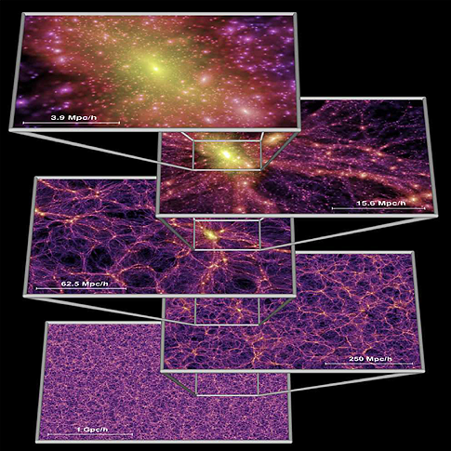
Cosmological Simulations
In 2000 cosmological simulations had 10¹⁰ particles and
produced over 30TB of data (Millennium)
Build up dark matter halos
Track merging history of halos
Use it to assign star formation history
Combination with spectral synthesis
Realistic distribution of galaxy types
Today: simulations with 10¹² particles and PB of output are under way (MillenniumXXL, Silver River, etc)
Hard to analyze the data afterwards -> need DB
What is the best way to compare to real data?

Slide 14
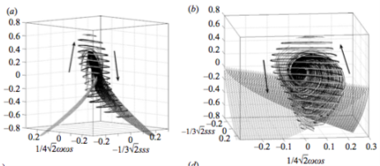
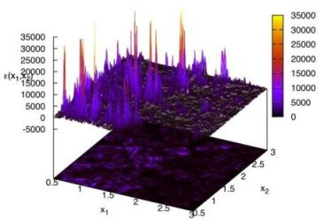
Immersive Turbulence
“… the last unsolved problem of classical physics…” Feynman
Understand the nature of turbulence
  Consecutive snapshots of a large
  simulation of turbulence:
  now 30 Terabytes
  Treat it as an experiment, play with
  the database!
  Shoot test particles (sensors) from
  your laptop into the simulation,
  like in the movie Twister
  Next: 70TB MHD simulation
New paradigm for analyzing simulations!
with C. Meneveau, S. Chen (Mech. E), G. Eyink (Applied Math), R. Burns (CS)

Slide 15
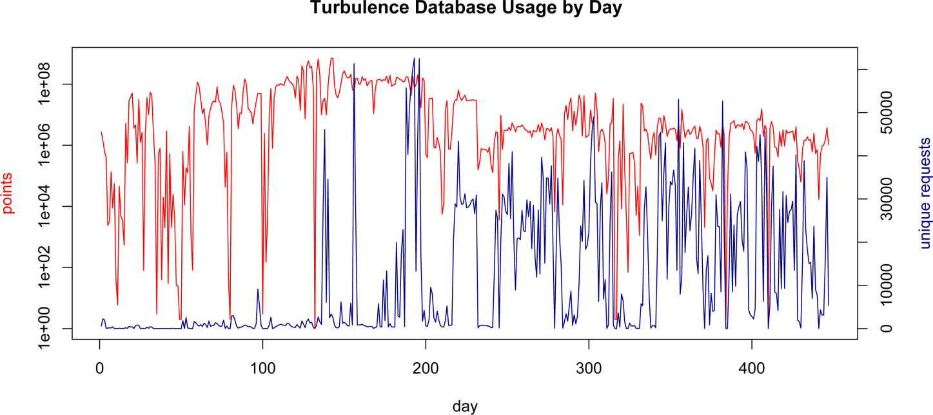
Daily Usage

Slide 16
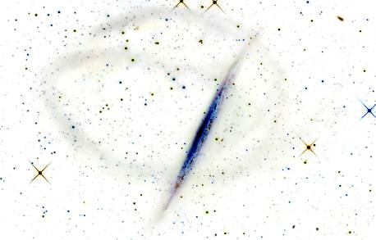
The Milky Way Laboratory
Use cosmology simulations as an immersive laboratory for general users
Via Lactea-II (20TB) as prototype, then Silver River (50B particles) as production (15M CPU hours)
800+ hi-rez snapshots (2.6PB) => 800TB in DB
Users can insert test particles (dwarf galaxies) into
system and follow trajectories in
pre-computed simulation
Users interact remotely with
a PB in ‘real time’
Madau, Rockosi, Szalay, Wyse, Silk,
Lemson, Westermann, Blakeley

Slide 17
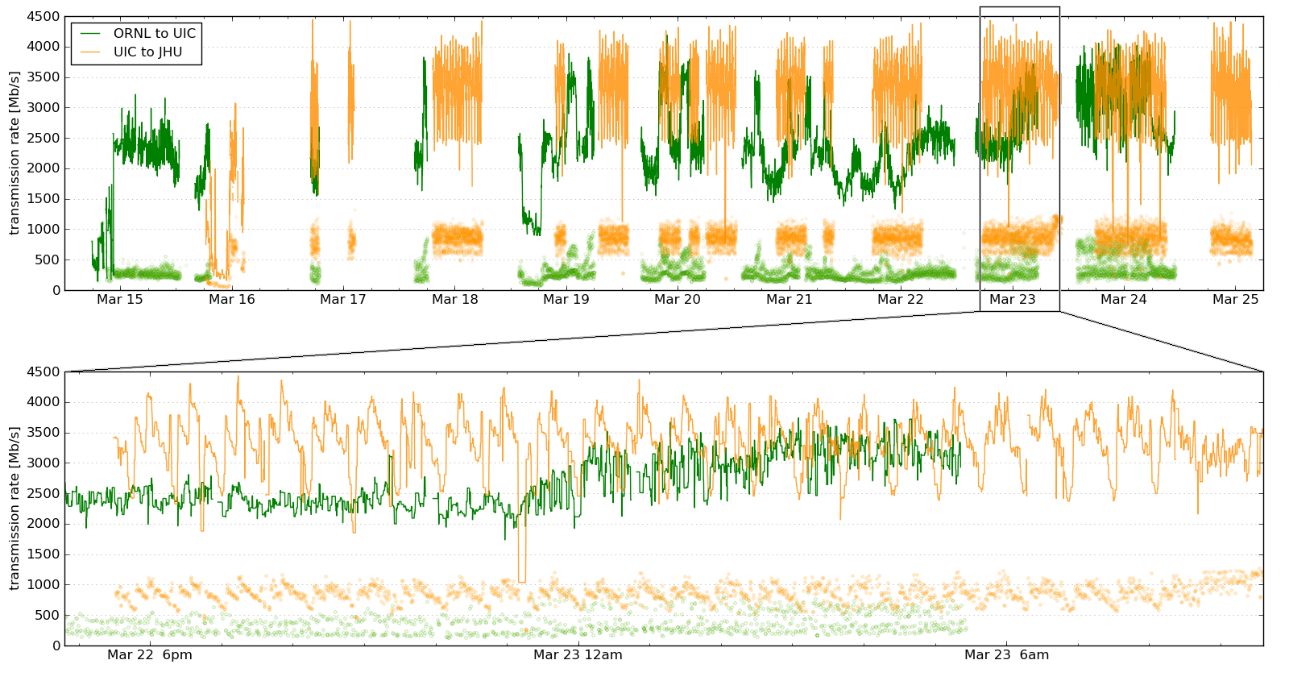
Silver River Transfer
150TB in less than 10 days from Oak Ridge to JHU
using a dedicated 10G connection

Slide 18
Visualizing Petabytes
Needs to be done where the data is…
It is easier to send a HD 3D video stream to the user
than all the data
Interactive visualizations driven remotely
Visualizations are becoming IO limited:
precompute octree and prefetch to SSDs
It is possible to build individual servers with extreme data rates (5GBps per server… see Data-Scope)
Prototype on turbulence simulation already works:
data streaming directly from DB to GPU
N-body simulations next

Slide 19


Slide 20
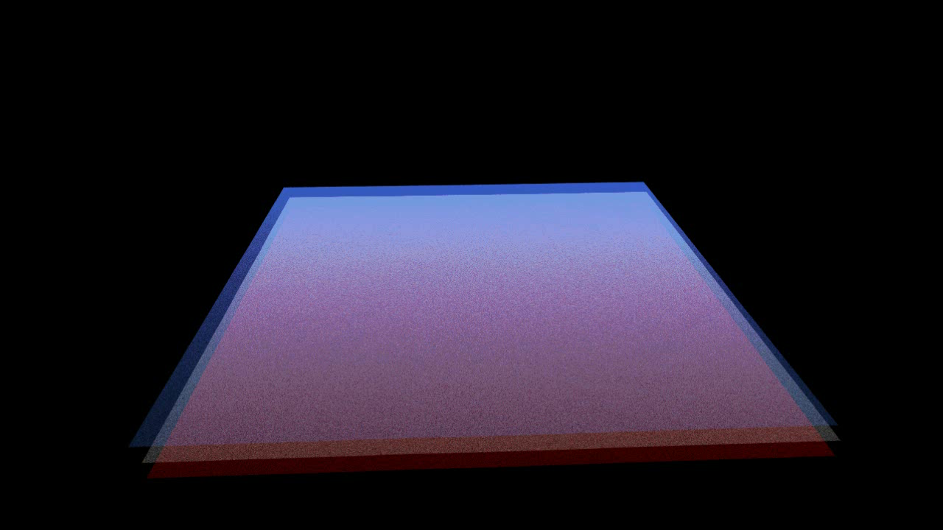
3D Vorticity in a Turbulent Flow
Kai Buerger, Technische Universitat Munich

Slide 21
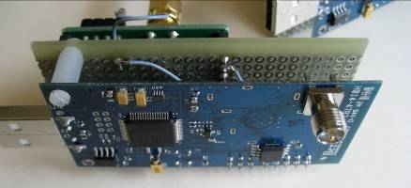
Life Under Your Feet
Role of the soil in Global Change
  Soil CO₂ emission thought to be
  >15 times of anthropogenic
  Using sensors we can measure it
  directly, in situ, over a large area
Wireless sensor network
  Use 100+ wireless computers (motes),
  with 10 sensors each, monitoring
    Air +soil temperature, soil moisture, …
    Few sensors measure CO₂ concentration
  Long-term continuous data, 180K sensor days, 30M samples
  Complex database of sensor data, built from the SkyServer
  End-to-end data system, with inventory and calibration databases
with K.Szlavecz (Earth and Planetary), A. Terzis (CS)
http://lifeunderyourfeet.org/

Slide 22
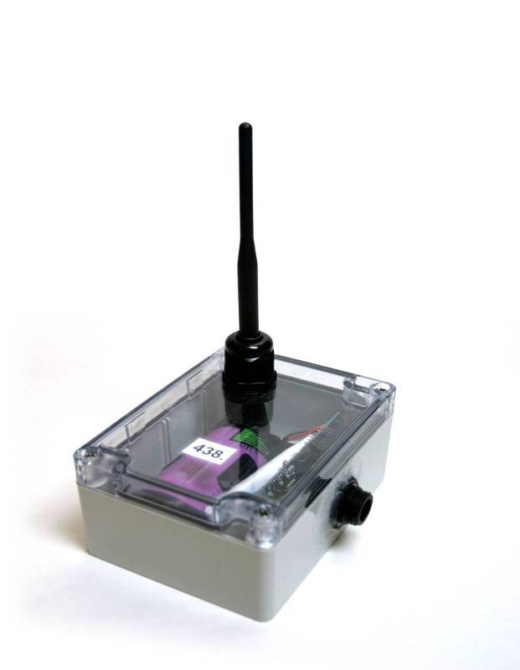
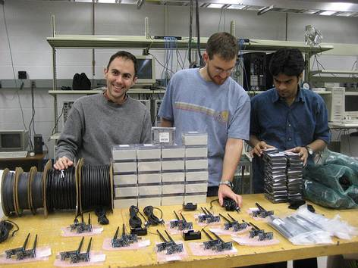
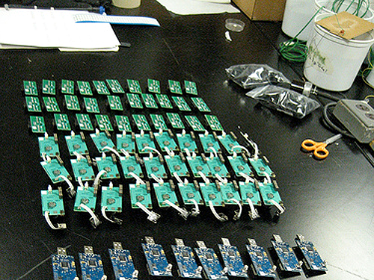
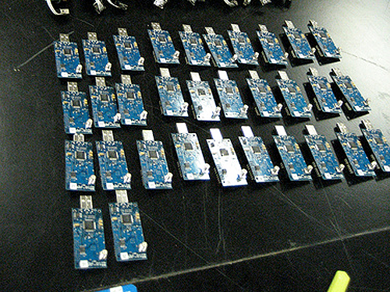
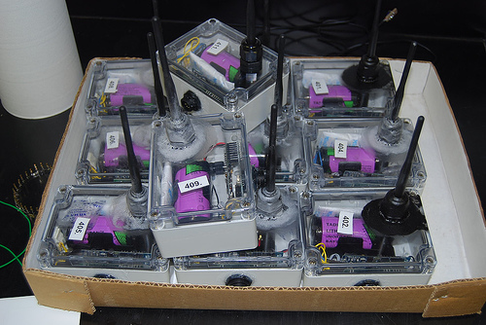
Current Status
Designed and built 2nd generation mote platform
  Telos SkyMote + own DAQ board
Hierarchical network architecture (Koala)
Improved mote software
  Support for large-scale deployments
  Over-the-air reprogramming
  Daily log file written
  Increased power efficiency
  (2 years on a single battery)

Slide 23
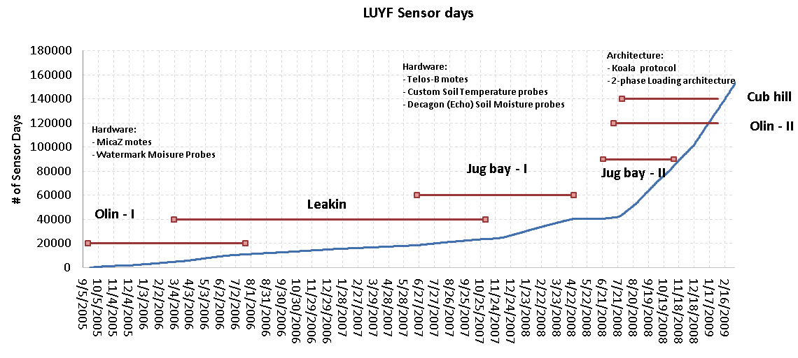
Cumulative Sensor Days

Slide 24
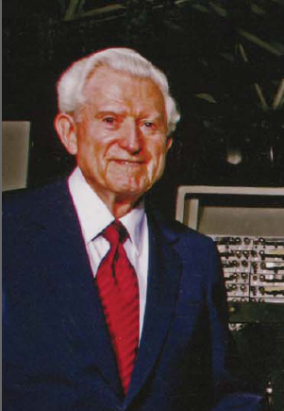
Amdahl’s Laws
Gene Amdahl (1965): Laws for a balanced system
Parallelism: max speedup is S/(S+P)
One bit of IO/sec per instruction/sec (BW)
One byte of memory per one instruction/sec (MEM)
Modern multi-core systems move farther
away from Amdahl’s Laws
(Bell, Gray and Szalay 2006)

Slide 25
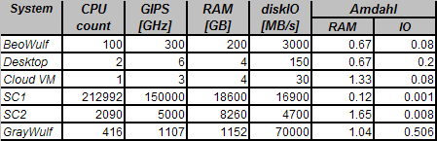
Typical Amdahl Numbers

Slide 26
Amdahl Numbers for Data Sets
Data Analysis

Slide 27
The Data Sizes Involved

Slide 28
DISC Needs Today
Disk space, disk space, disk space!!!!
Current problems not on Google scale yet:
  10-30TB easy, 100TB doable, 300TB really hard
  For detailed analysis we need to park data for several months
Sequential IO bandwidth
  If not sequential for large data set, we cannot do it
How do can move 100TB within a University?
  1Gbps 10 days
  10 Gbps 1 day (but need to share backbone)
  100 lbs box few hours
From outside?
  Dedicated 10Gbps or FedEx

Slide 29
Tradeoffs Today
Stu Feldman: Extreme computing is about tradeoffs
Ordered priorities for data-intensive scientific computing
  Total storage (-> low redundancy)
  Cost (-> total cost vs price of raw disks)
  Sequential IO (-> locally attached disks, fast ctrl)
  Fast stream processing (->GPUs inside server)
  Low power (-> slow normal CPUs, lots of disks/mobo)
The order will be different in a few years...and scalability may appear as well

Slide 30
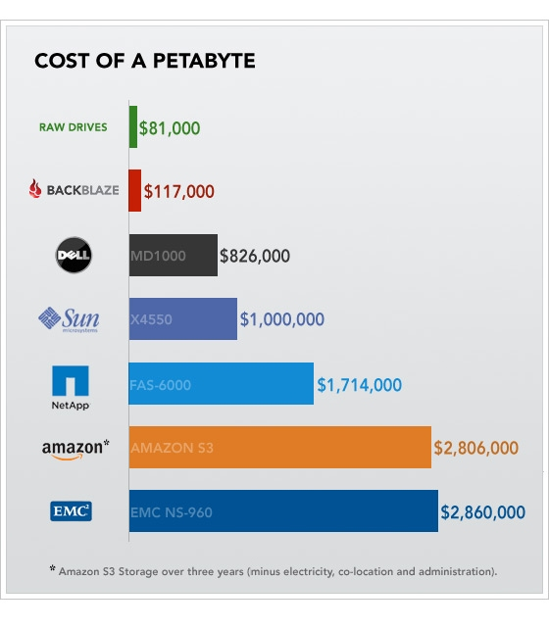
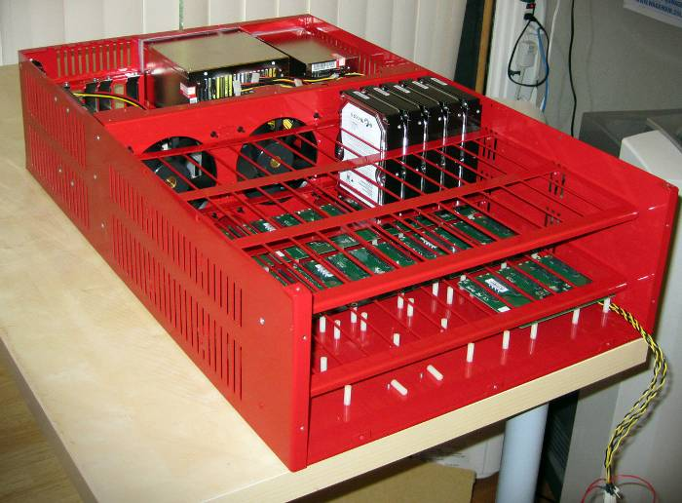
Cost of a Petabyte
From backblaze.com
Aug 2009

Slide 31
JHU Data-Scope
Funded by NSF MRI to build a new ‘instrument’ to look at data
Goal: 102 servers for $1M + about $200K switches+racks
Two-tier: performance (P) and storage (S)
Large (5+PB), cheap , fast (400+GBps), but …
. ...it is a special purpose instrument...
 | Revised
 | 1P | 1S | All P | All S | Full
servers | 1 | 1 | 90 | 6 | 102
rack units | 4 | 34 | 360 | 204 | 564
capacity | 24 | 720 | 2160 | 4320 | 6480 | TB
price | 8.8 | 57 | 8.8 | 57 | 792 | $K
power | 1.4 | 10 | 126 | 60 | 186 | kW
GPU* | 1.35 | 0 | 121.5 | 0 | 122 | TF
seq IO | 5.3 | 3.8 | 477 | 23 | 500 | GBps
IOPS | 240 | 54 | 21600 | 324 | 21924 | kIOPS
netwk bw | 10 | 20 | 900 | 240 | 1140 | Gbps

Slide 32
Proposed Projects at JHU
Discipline | data [TB]
Astrophysics | 930
HEP/Material Sci. | 394
CFD | 425
BioInformatics | 414
Environmental | 660
Total | 2823
A total of 19 projects proposed for the Data-Scope, more coming, data lifetimes on the system between 3 mo and 3 yrs

Slide 33
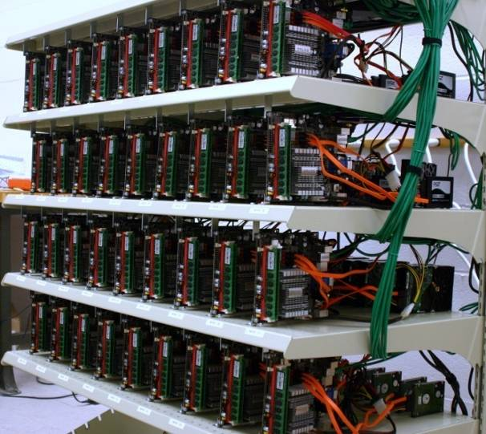
Cyberbricks?
36-node Amdahl cluster using 1200W total
  Zotac Atom/ION motherboards
  4GB of memory, N330 dual core Atom, 16 GPU cores
Aggregate disk space 43.6TB
  63 x 120GB SSD = 7.7 TB
  27x 1TB Samsung F1 = 27.0 TB
  18x.5TB Samsung M1= 9.0 TB
Blazing I/O Performance: 18GB/s
Amdahl number = 1 for under $30K
Using the GPUs for data mining:
  6.4B multidimensional regressions
  in 5 minutes over 1.2TB
  Ported RF module from R in C#/CUDA
Szalay, Bell, Huang, Terzis, White (Hotpower-09)

Slide 34
Increased Diversification
One shoe does not fit all!
Diversity grows naturally, no matter what
Evolutionary pressures help
  Large floating point calculations move to GPUs
  Fast IO moves to high Amdahl number systems
  Large data require lots of cheap disks
  Stream processing emerging
  noSQL vs databases vs column store etc
Individual groups want subtle specializations
Larger systems are more efficient
Smaller systems have more agility

Slide 35
The Data Explosion is Here
No real data-intensive computing facilities available for scientific use
Even HPC projects choking on IO
Cloud hosting currently very expensive
  Commercial cloud tradeoffs different from science needs
Scientists are “frugal”, also pushing the limit
  We are still building our own…
  We see campus level aggregation
  May become the gateways to future cloud hubs

Slide 36

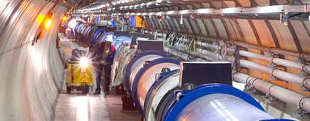
Summary
Science is increasingly driven by large data sets
We need a new instrument: a “microscope” for data
The data explosion is present on all physical scales
Changing sociology:
  Data collection in large collaborations (VO)
  Analysis done on the archived data, possible for individuals
A new, Fourth Paradigm of Science is emerging…

Slide 37
“If I had asked people what they wanted, they would have said faster horses…”
  Henry Ford
From a recent book by Eric Haseltine:
“Long Fuse and Big Bang”

