Slide 1
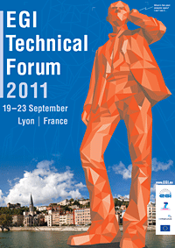
Supporting Identity Federations in Science Gateways
R. Rotondo (riccardo.rotondo@ct.infn.it)
INFN Catania - Italy

Slide 2
Outline
Introduction
Design
Identity Federations
Implementation & use within Science Gateways
Conclusions

Slide 3




Reference Model
Embedded Applications
Administrator
Power User
Basic User
Appl 1
Appl 2
Appl N
Science
Gateway
Grid Services
Users from different organisations having different roles and privileges
Other Middleware

Slide 4
Motivations
The distributed nature of Grid requires strong security mechanisms;
No expert-users struggle to comply with complex security rules:
  Create certificates, create proxy, update credentials and so on;
Some institutions want to maintain the control of their users’ authentication and the service available:
  Science Gateways have to be able to interact with other services.

Slide 5
Federated AAI
In the web technology arena many approaches are available to federate the authentication among different entities;
A standard provided by OASIS defines the Security Assertion Markup Language (SAML);
Shibboleth is one of the most famous SAML-based tools:
  Implement the SAML standard;
  Allows different approaches to manage users:
    LDAP, CAS, Plain text, etc.;
  Deployed in many universities and research institutes;
  Free and Open Source;
  Easy to integrate with Liferay;
Shibboleth has been selected for the integration.
Notes:
Security Assertion Markup Language (SAML) is an XML-based open standard for exchanging authentication and authorization data between security domains, that is, between an identity provider (a producer of assertions) and a service provider (a consumer of assertions)
The Organization for the Advancement of Structured Information Standards (OASIS) i

Slide 6






A&A Schema
Science Gateway
Authorisation
Authentication
1. Register to a Service
GrIDP
(WAYF)
(“catch-all”)
IDPCT
IDP_x
IDP_y
IDP_z
2. Sign in
(“catch-all”)
LDAP
CAS
.........
.........

Slide 7
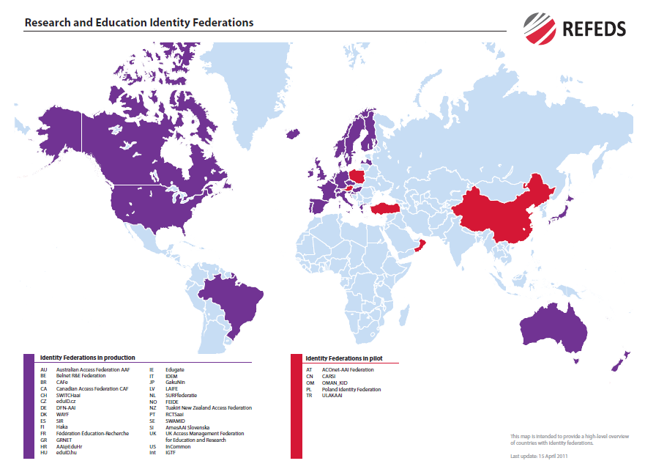
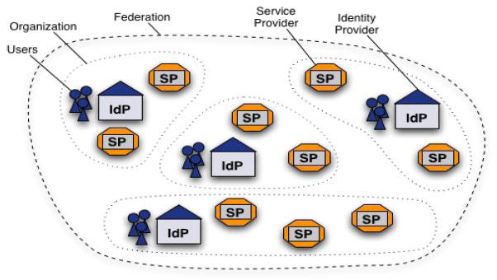
The GARR-IDEM Identity Federation
(www.idem.garr.it)
IDEM figures:
30 Members;
54 IDentity Providers;
34 Service Providers;
>2,700,000 end users (as of October 2010);
~50% of the Italian higher education & research community
e-identified students in EU

Slide 8
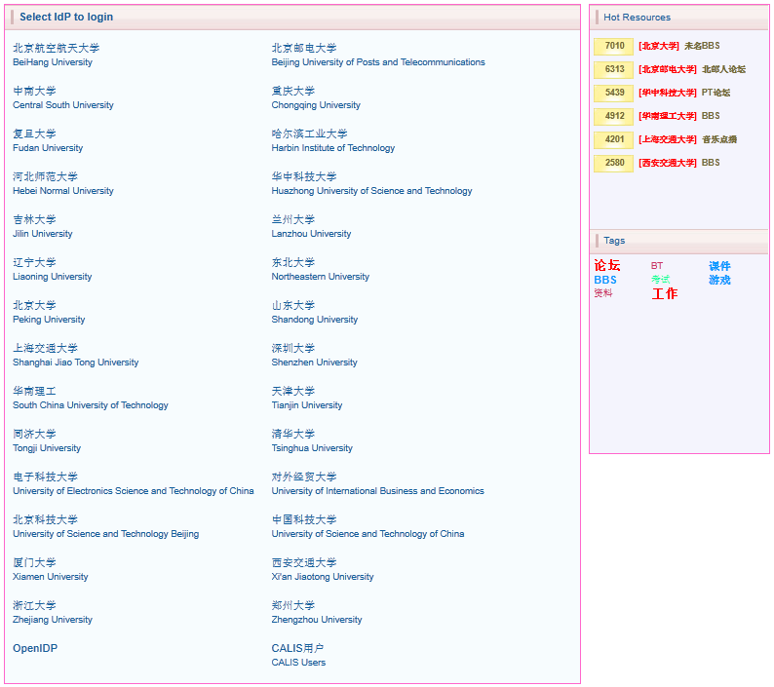
The CARSI Identity Federation
(www.carsi.edu.cn)
CARSI figures:
Established in 2006 and managed by CERNET, one of the Chinese NRENs;
33 Members (30 Universities and 3 Federation Partners;
28 IDentity Providers;
30 Servicre Providers;
>700,000 end users;
>30,000 logins since January 2011;
In progress to go in production mode.
CARSI
CERNET Authentication and Resource Sharing Infrastructure

Slide 9
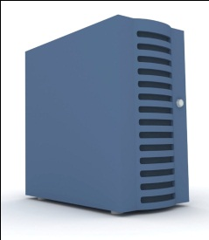



Usage Workflow
eTokenServer
3. Verify ACL
4. Get proxy from robot
Science Gateway
5. Perform action
Credentials exchange
1. Portal Login
2. Actions request
6. Results
Lyon 2011-09-20

Slide 10
Role Mapping
Authorisation is centralised in an LDAP registry;
Robot proxy may have VOMS attributes corresponding to the roles in LDAP:
  For each application and user profile a LDAP role and a VOMS attribute is defined;
Users have to explicitly request the authorisation for the roles they need:
  A group of experts evaluates the requests;
If users try to access Grid resources with other tools they do not gain more privileges;
Roles coming from the federation are currently not accepted:
  For other projects they could be granted.

Slide 11
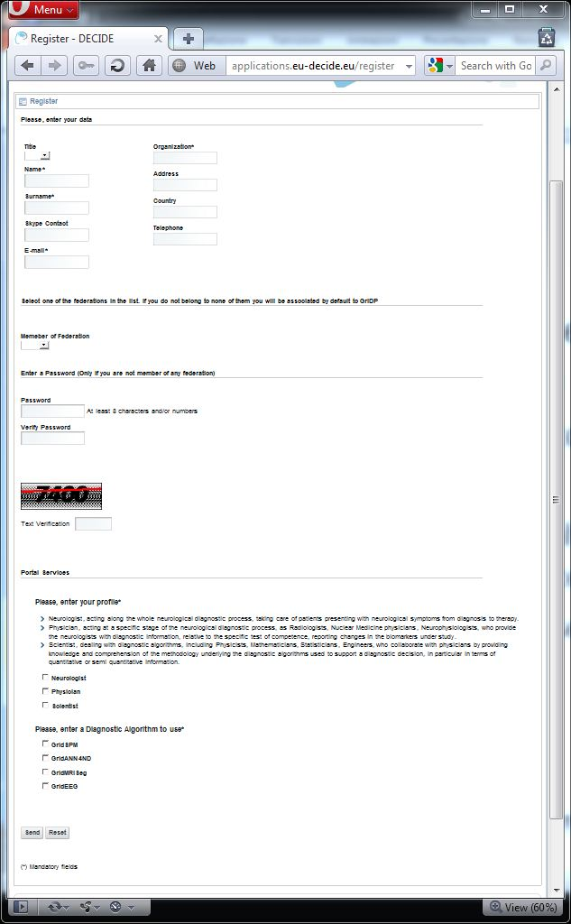
User Registration
Authenticated users without authorisation are not logged-in;
Registration to the Science Gateway is mandatory:
Users can run only the applications they have explicitly requested and obtained authorisation for;
This is a requirement in several projects.

Slide 12
Implementation
Shibboleth-based authentication is not available in Liferay by default;
A library for account operation has been developed and the following operations have been implemented:
  Login with email provided by Shibboleth SAML attributes;
  Local logout from the service;
  Authorisation check against LDAP accounts.

Slide 13
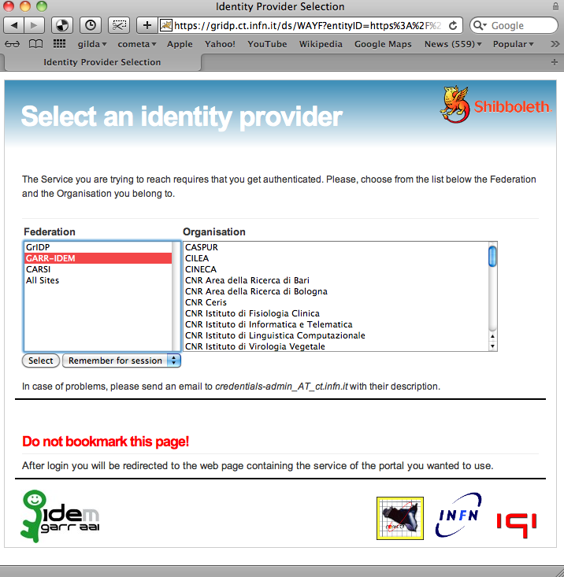
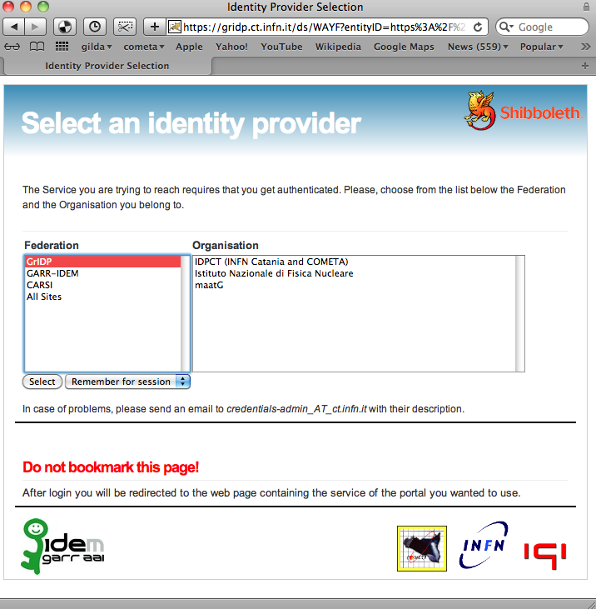
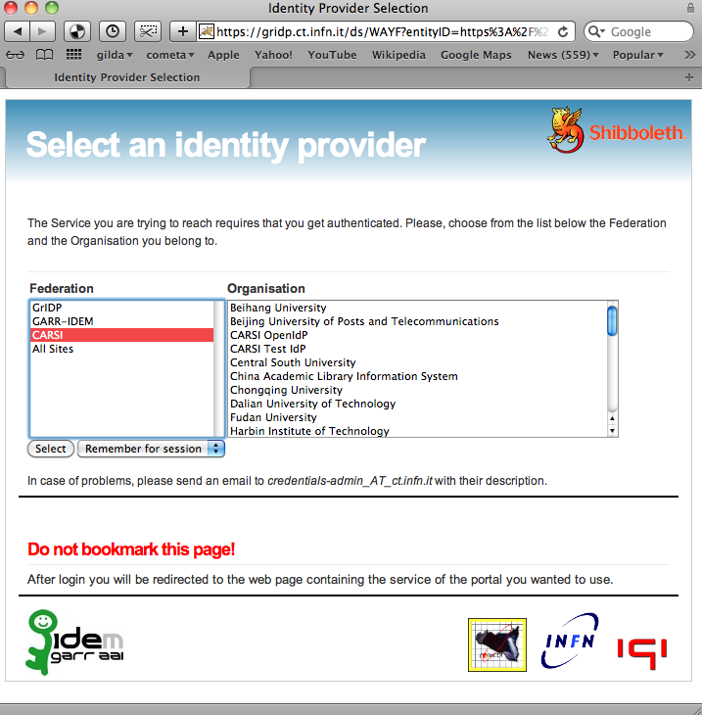
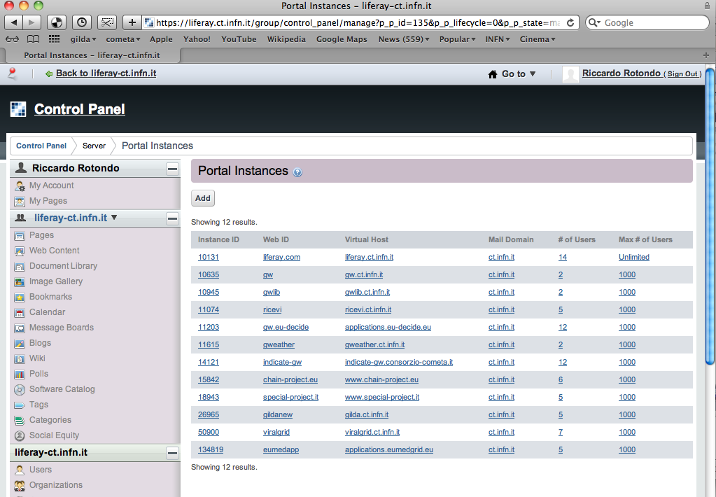




Current Status
12 Liferay-based Science Gateways are currently powered by Shibboleth at INFN Catania;
3 Federations supported: GrIDP (“catch-all”) GARR-IDEM and CARSI;
3 instances are registered as official IDEM Service Providers (a 4th one is in progress)
3 Identity Providers are available in GrIDP:
  A “catch-all” IdP created at Catania;
  The maat-G (enterprise) IdP;
  INFN-AAI IdP (all INFN researchers and associates).

Slide 14
Conclusions
In this work we presented an Authentication and Authorisation Infrastructure (AAI) implementation for several Science Gateways;
A simple access to Science Gateway is provided for those users who are members of an Identity Provider registered in one of the supported federations;
An LDAP server linked with a Liferay-based multi-host portal is responsible for the authorisation;
Authentication is based on Shibboleth which implements a SAML2.0-based SSO across different Identity Federations;
Thanks to the adoption of a standard technology related to federated web services, our Science Gateways are available to a huge number of potential users who are able to access them using the e-identities they already have.

Slide 15
Credits & Acknowledgments
Credits
Acknowledgments
Valeria Ardizzone (COMETA);
Roberto Barbera (UNICT & INFN)
Riccardo Bruno (COMETA);
Antonio Calanducci (COMETA);
Marco Fargetta (COMETA)
Elisa Ingrà (GARR);
Giuseppe La Rocca (INFN)
Salvatore Monforte (INFN);
Fabrizio Pistagna (INFN);
Rita Ricceri (INFN);
Diego Scardaci (INFN);
Vincenzo Ciaschini (INFN);
Enrico Fasanelli (INFN);
Maria Laura Mantovani (GARR);
Barbara Monticini (GARR);
Simona Venuti (GARR)

