Slide 1
Service Operations Security Policy
the new generalised site operations security policy
David Groep, FOM-Nikhef and NL-NGI for EGI global task O-E-15
This work is supported by EGI-InSPIRE under NA2

Slide 2
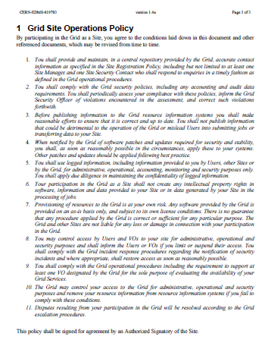
Current (old) policy
Once upon a time: the Grid Site Operations Policy
targeted at sites, being the only providers of resources and services
mixed security and operational policy
with a few procedures thrown in
part of the security policy framework, but with an explicit request for the Grid to ensure compliance by authorized signatories to the agreement

Slide 3
Service Security aims
New deployment models inspired an integrated security policy for any kind of service
Generalised policy for services
Address both physical and virtual systems & sites
Target resource providers, VM managers, VO operators
Align with EGI Terminology
But exclude
Operational items without security implication
Procedures and technical non-security bits
And still try to keep it short & sweet

Slide 4
Approval Process
Drafted by a small Editorial Team
Discussed widely in Security Policy Group (SPG) with the NGI representatives and invited experts
Circulated for Public Comment in June to all NGIs, OMB, and operational bodies
Few questions received (mainly text clarifications) – have been addressed in the final version
So, what does the new security policy comprise?

Slide 5
Preamble
This policy is one of a set of documents hat together define the Security Policy [R1]. This individual document must be considered in conjunction with all the policy documents in the set

Slide 6
Service Ops Security Policy
By running a Service on the IT Infrastructure, by providing a service that is part of the IT Infrastructure, or retaining state that is related to the IT Infrastructure, either provided as an independent service or hosted in a Resource Centre, You agree to the conditions laid down in this document and other referenced documents, which may be revised from time to time.
You shall provide and maintain accurate contact information to the Infrastructure Organisation and any Resource Centres involved, including but not limited to at least one Security Contact who shall respond to enquiries in a timely fashion.
You shall comply with all security policies and procedures of the Infrastructure Organisation and of any Resources Centres involved in operating Your service.

Slide 7
Service Ops Security Policy
You are held responsible by the Infrastructure Organisation and by any Resource Centres involved for the safe and secure operation of the Service. You shall not mislead Users regarding the suitability of a Service for their needs, nor mislead the IT Infrastructure, Infrastructure Organisation, or any Resource Centres involved about your Service. The Service shall not be detrimental to the IT Infrastructure and any Resource Centres involved.
You should follow IT security best practices that include pro-actively applying software patches, updates or configuration changes related to security. When notified by the Infrastructure Organisation or any Resource Centres involved of software patches, updates or configuration changes required for security, You shall apply these to your services within the specified time period.

Slide 8
Service Ops Security Policy
You shall collect and retain sufficient auditing information as defined in the Tracability and Logging Policy and procedures, and must assist the Infrastructure Organisation and any Resource Centres involved in security incident response.
You shall use logged information, including information provided to you by Users, other Resource Centres, Service operations or by the Infrastructure Organisation, only for administrative, operational, accounting, monitoring and security purposes. You shall apply due diligence in maintaining the confidentiality of logged information.
Your provisioning of Services shall not in itself create any intellectual property rights in software, information and data provided to your Service or in data generated by your Service.

Slide 9
Service Ops Security Policy
Provisioning of Services is at your own risk. Any software provided by the Infrastructure Organisation is provided on an as-is basis only, and subject to its own license conditions. There is no guarantee that any procedure applied by the Infrastructure Organisation is correct or sufficient for any particular purpose. The Infrastructure Organisation and other Resource Centres acting as service hosting providers are not liable for any loss or damage in connection with your participation in the IT Infrastructure.
You may control access to Your Service for administrative, operational and security purposes and shall inform the affected users if you limit or suspend their access. You shall comply with all relevant incident response procedures regarding the notification of security incidents.

Slide 10
Service Ops Security Policy
The Infrastructure Organisation and any Resources Centres involved may control your access to the IT Infrastructure or Resource Centres for administrative, operational and security purposes if you fail to comply with these conditions.

