Slide 1
User Support in EGI
Reactive and proactive services
Gergely Sipos
gergely.sipos@egi.eu

Slide 2
The EGI virtuous cycle
National
Resource Providers
European Grid Infrastructure
Ecosystem
Used by Researchers
Gathering New Requirements
New Technology Assessed
Deployed Infrastructure Services
Current User Communities
MoUs & OLAs
MoUs
EGI.eu
MoUs & SLAs
LoIs
New User Communities
Technology Providers

Slide 3

Stakeholders of user support
This talk
EGI dissemination
EGI.eu User Community Support Team
This talk
Scientific communities
Research group
This talk
EGI User Community
Support Services
Researchers and scientists
Application
developers
Next talks
Local System administrators
Research leader
National and specialist user support teams
Next talks
Different user types collaborate within a research group
Support teams available across 50 countries

Slide 4
Services from EGI.eu
Gathering and tracking requirements
Applications Database
Training marketplace
NGI-EGI roadshow model
Workshops
Simplifying certification of users and portals
Web gadgets
Dissemination, marketing, outreach

Slide 5
The EGI requirement gathering and tracking process
The EGI Community
Channels for Operation requirements
UCST and EGI-InSPIRE developers
HUCs
1)
2)
EGI technology providers
VOs
Channels for User requirements
EGI
Requirements Tracker
TCB
EIROs
UCB
3)
4)
5)
VRCs
NGIs
projects
ESFRIs
EMI
IGE
SAGA,
...
Helpdesks
(EGI, NGIs, projects,...)

Slide 6
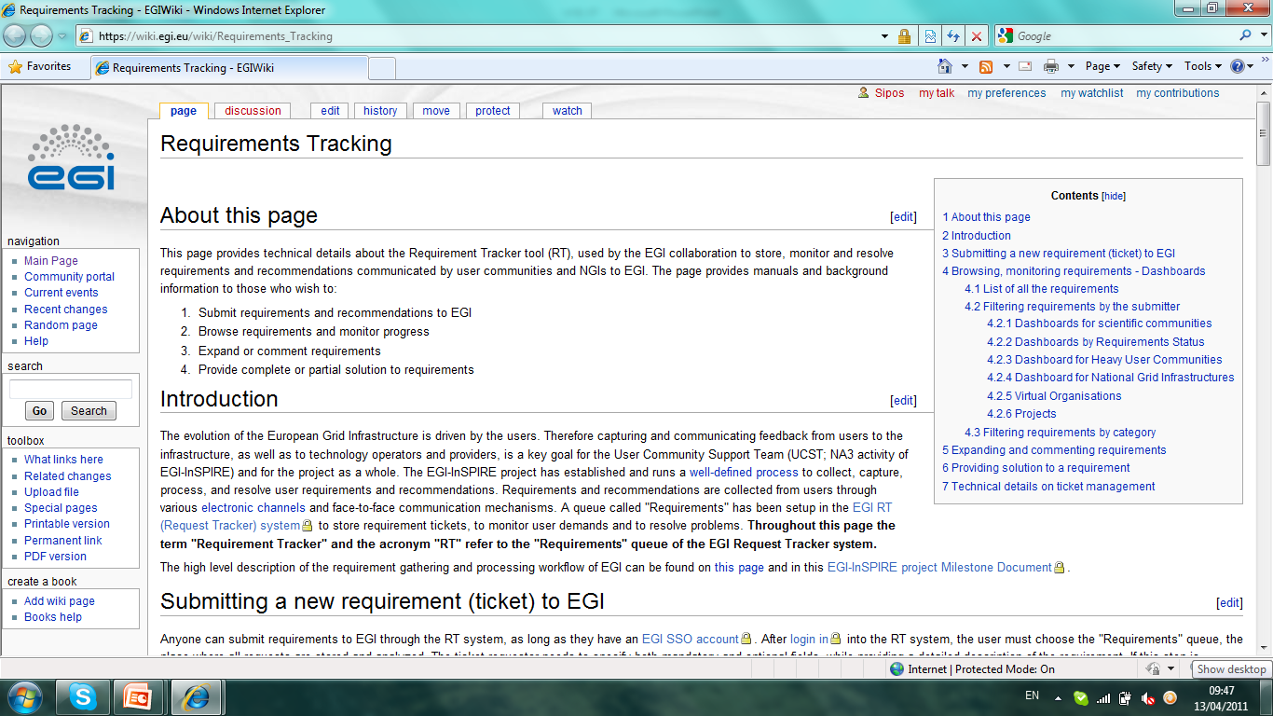
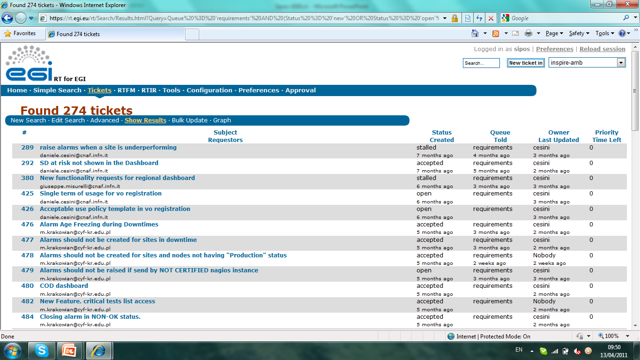
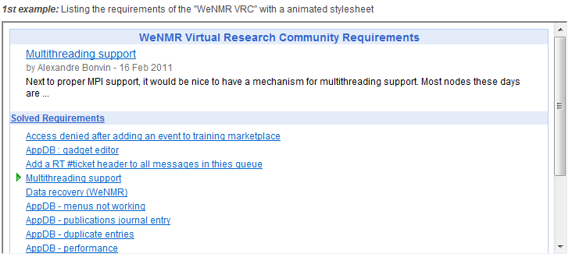
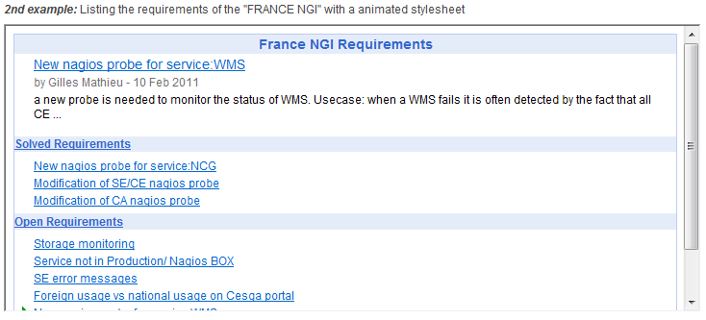
EGI Requirements Tracker: http://www.egi.eu/user-support/getting_help
Permanent storage for EGI
requirements
  User
  Operational
Complete transparency
  For user communities
  For NGIs
  For technology providers
Web interfaces:
  Public browsing
  Authenticated commenting, replying
  (with EGI SSO)
NEW: web gadgets
  To list your requirements
  To submit requirements
  Complete customisability

Slide 7
User Community Board
Develops the strategy and defines the priorities for the human and technical user community support services provided by EGI
Monthly meetings (https://www.egi.eu/indico/categoryDisplay.py?categId=21)
Representatives of EGI VRCs and Heavy User Communities http://www.egi.eu/user-support/vrc_gateways:
  Structural Biology and NMR
  High Energy Physics
  Digital Research Infrastructure for the Arts and Humanities
  Research Infrastructure for Language Resources
  Life Sciences
  Earth Science
  Computational Chemistry and Material Science
  Fusion
  The study of e-Science
  Astronomy and Astrophysics
  Hydrometeorology

Slide 8
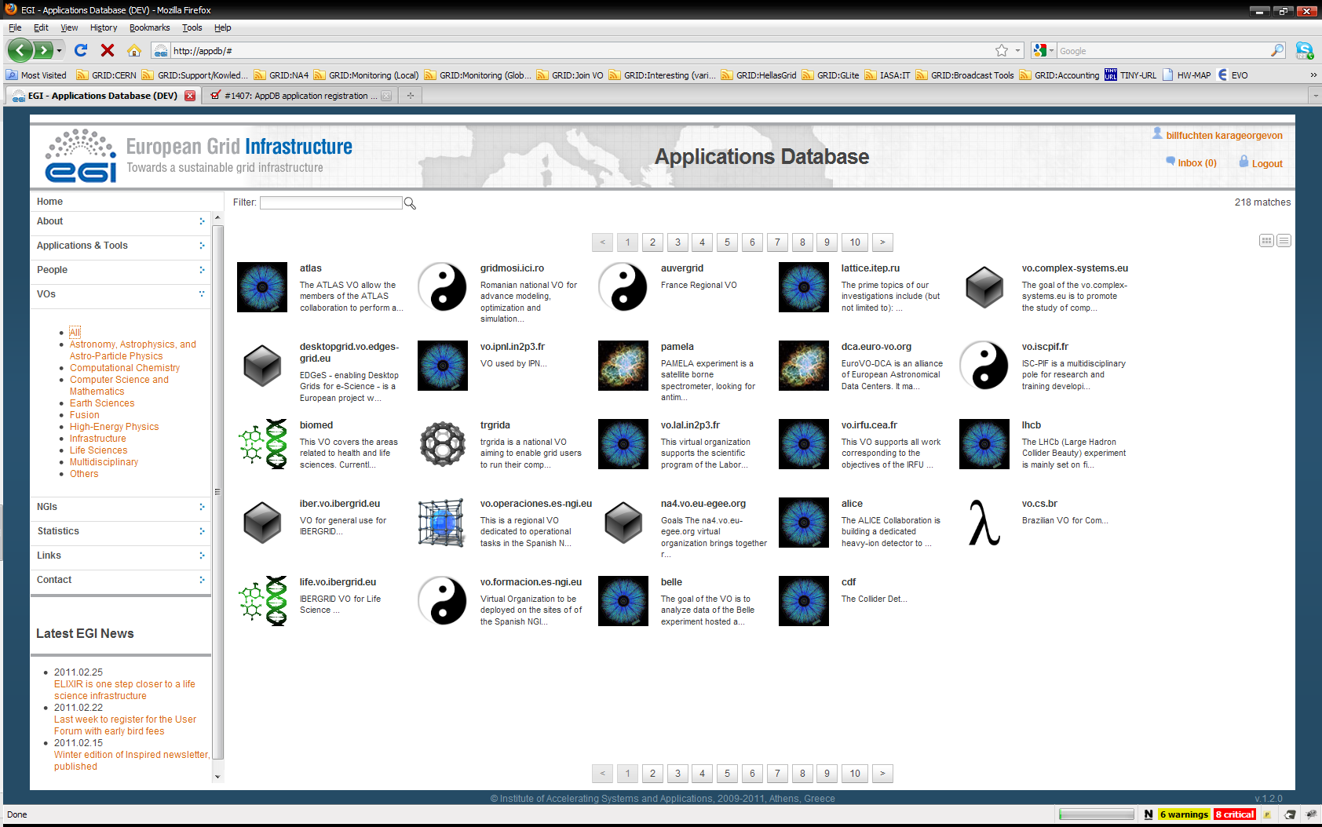
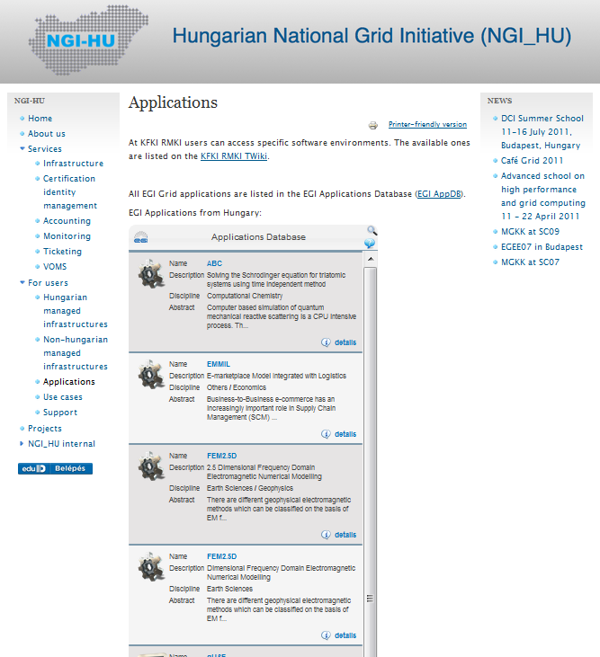
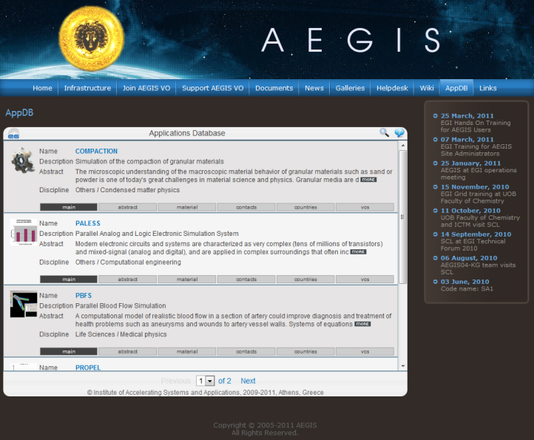
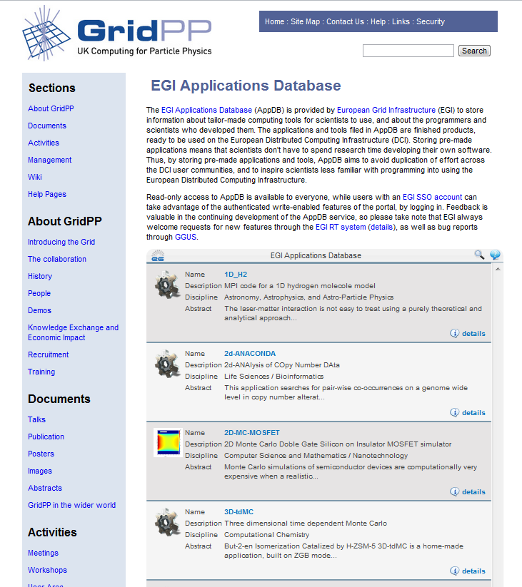
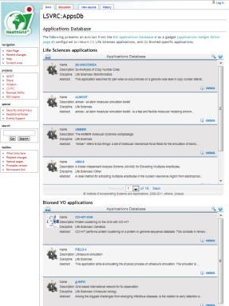
EGI Applications Database
Benefits:
Gives recognition to reusable Scientific applications and application developer tools
Gives recognition to application developers
Access through web page AND web gadget
Achievements since April:
Improved search services
Commenting and rating
Problem reporting page
“Related applications” lists
Improved performance
REST API for custom integration

Slide 9
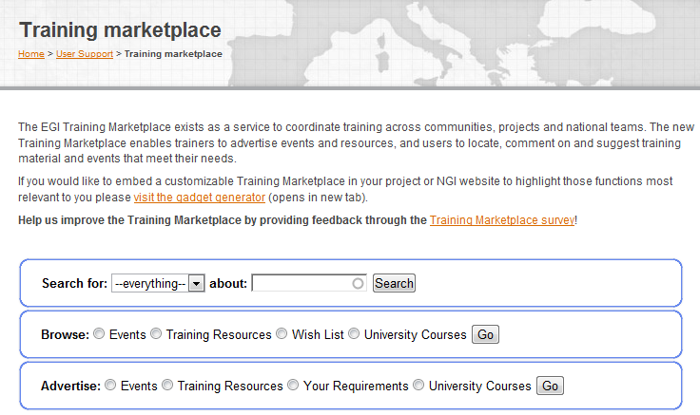
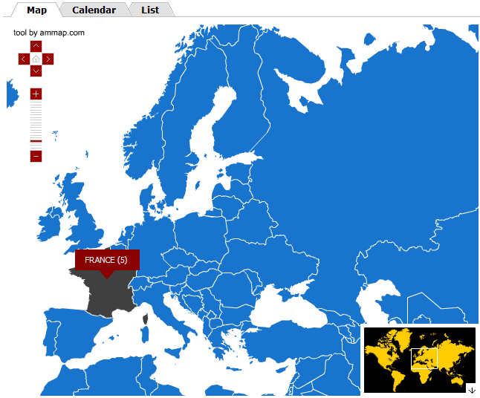
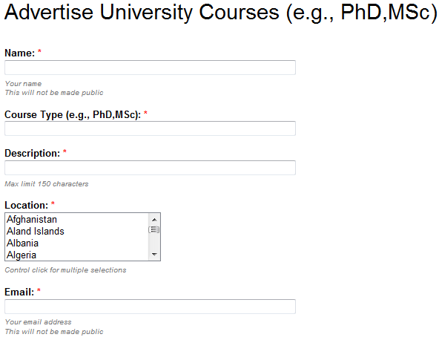
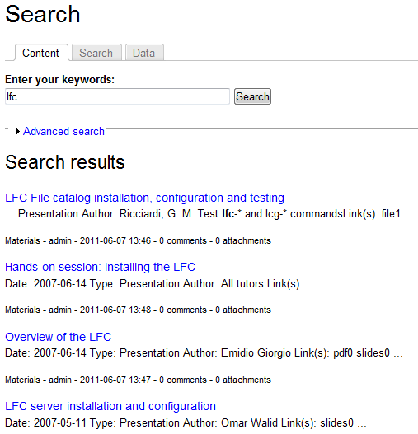
Training Marketplace
Benefits:
Register
  training events, expertise, services, materials, resources, university courses
Browse and search
Request training services
Access through web page and web gadget
Achievements since April:
Improved browse services
Integrated search for all object types
Support for requests/wishes
Web gadgets

Slide 10
NGI-EGI roadshows
To reach new communities within NGIs
To harmonise outreach activities within NGIs
To integrate NGI contributions into outreach activities
To integrate other community contributions into EGI outreach (e.g. from EMI)
Run by NGIs, but facilitated by an event model by EGI.eu
  Model was introduced and discussed yesterday (11:00 Room R2 → link)

Slide 11
Workshops
To investigate and develop some of the key themes emerging from the community
Interest for 10 topics: http://go.egi.eu/aaxdz
First set of workshops this week:
  Data Management; Portal technologies; VRCs; EGI/NGI Roadshows
Planning the next set of workshops:
  One or two topics in conj. With Cracow Grid Workshop
  Agile software development (with StratusLab and SixSq)
  Workflows (with SHIWA)
  Portal technologies (in conj. With HealthGrid 2012)
Host a workshop in your institute or NGI!
  Email ucst@egi.eu

Slide 12
Certificates for users and portals
Access to EGI resources requires e-Science certificates:
  Most of the existing users have personal certificates from National CAs (www.igtf.net)
  Terena Online Certificate services are available in many NGIs (http://www.terena.org/activities/tcs/participants.html)
  Some of the national CAs provide robot certificates for portals
EGI.eu UCST expands Terena and robot certificate usage by:
  Promoting Terena certificates to NGIs where the service already exists
  Developing simple methods for institutes to become “federated identity providers” within Terena
  Lobbing at national CAs (through NGIs) to introduce robot certificates

Slide 13
Web gadgets
An alternative way of offering services on the web
Benefits
  Customisability
  Reusability
  Compatibility
Existing gadgets:
  Application Database
  Training Marketplace
  Requirement Tracker
Use and develop EGI gadgets!
Go to www.egi.eu/user-support/gadgets

Slide 14
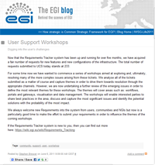
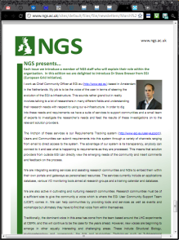
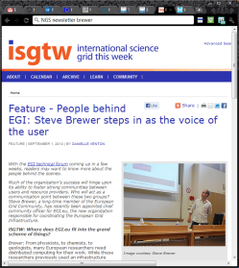
Dissemination (Marketing)
Dissemination teams exist in EGI.eu and (some) NGIs
    EGI Blog (www.egi.eu/blog)
    Newsletters
    Web news
A key EC message from EGI-InSPIRE review:
  A production infrastructure is necessary but it is no longer sufficient for project success
  Non-technical activities will be improved and better integrated between EGI.eu and the NGIs
    Marketing, community outreach, policy development

Slide 15
Next steps
Integrated planning for outreach and user support
  Strategic aims & messages (EGI value proposition)
  Communication & support (NGI coordinators)
Need strong implementation
  The same structures as operations (analysis and evaluation of tools – by EGI.eu and by communities)
  The same focused, dedicated effort (closer monitoring)
Focus on new communities & sustainability
  More proactivity & cooperation in these fields

Slide 16
Thank you
ucst@egi.eu

