Slide 1
User Support in NGI-DE
Technical Forum Lyon 2011-09-22
Torsten Antoni, Sabine Reißer

Slide 2
GridKA School
Sommer school for Grid und Cloud Computing
4(½) days
50% auditorium lectures, 50% hands-on tutorials and workshops
Introduction lecture on Monday, closing keynote on Friday
Security Workshop on Friday afternoon
hands-on tutorials and workshops in parallel sessions
2 social events: Alsatian flame pie evening, school dinner
Target groups: users, developers, admins

Slide 3
GridKA School
Partner projects
International: SwiNG, EGI, EMI, IGE
National: D-Grid/NGI-DE, HGF Alliance ‘Physics at the Tersascacle’
KIT: KCETA
History
GKS was founded in 2003
Oldest annually running international summer school for grid computing in Europe
Webpage
http://www.kit.edu/gridka-school

Slide 4
On-site experiment contacts
GridKA has dedicated people for LHC experiments on-site since spring 2010
Single point of contact between experiments and GridKA
Direct follow-up of experiment specific issues
Experiment representatives combine experiences from both perspectives
Supporting service admins, become (already are!) experts for services their experiment uses

Slide 5
On-site experiment contacts
Involved in solving technical issues of all production critical services
Easing the coordination of T1 activities of experiments within GridKA
All above result in improved formal and informal communication on both sides at T1 level, and not only

Slide 6
xGUS Helpdesk Template
xGUS provides easy access to an own helpdesk system for NGIs or User Communities
GGUS interfaced
Administration (support units, problem types, etc.) via web
No local deployment/installation: Operation and maintenance at KIT
Notes:
xGUS provides easy access to an own helpdesk system for NGIs or User Communities
GGUS interfaced
Tickets can be routed from GGUS to xGUS helpdesks and vice versa. Changes in either ticket system are synchronized. – see also later slide
Administration (support units, problem types, etc.) via web
Client NGI or User Community can edit the lists which are displayed on the portal in ticket_search, ticket_info and ticket_submit: problem type, Vos, sites, Responsible units. They can also edit the links on the mainpage and the support page which are displayed on the portal. – see also later slide
No local deployment/installation: Operation and maintenance at KIT
xGUS is hosted at KIT. Development in harmony with GGUS developments.

Slide 7
Some xGUS Features
Attachments
Ticket relations: Parent/Child, Master/Slave
Duplicate tickets
Ticket update and creation via mail
Private Dashboard
News module
Statistics
Notes:
Attachments
can be added by submitter or by support staff
Ticket relations: Parent/Child, Master/Slave
Parent cannot be closed before Child tickets are solved
Master solution solves all slave tickets
Duplicate tickets
If ticket cannot be solved by one support unit, it can be duplicated up to 15 times. Then, the duplicated tickets can be assigned to different support units.
Ticket update and creation via mail
Private Dashboard
Personal list of interesting tickets. Every ticket can be added to this list by clicking the ‚Add to my dashboard‘ -link
News module
Announcement of events, maintenances etc., will be displayed on the main page of the portal
Statistics
Average solution times, Tickets created per support unit per week, diagrams

Slide 8
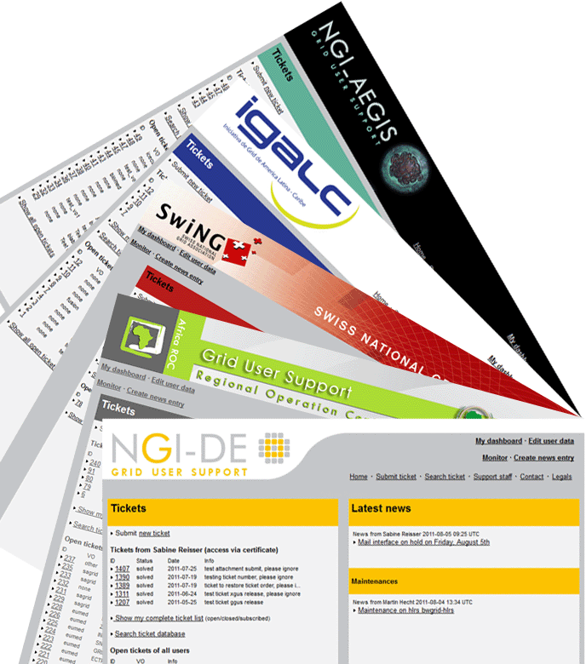
xGUS Instances
helpdesk.aegis.rs
xgus.ggus.eu/igalc
xgus.ggus.eu/ngi_ch
support.africa-roc.org
helpdesk.ngi-de.eu
Notes:
NGI_AEGIS: Serbia
IGALC: Latin America
NGI_CH: Switzerland
AFRICA_ROC: Africa
NGI_DE: Germany
Currently being set up: CHINA_ROC

Slide 9
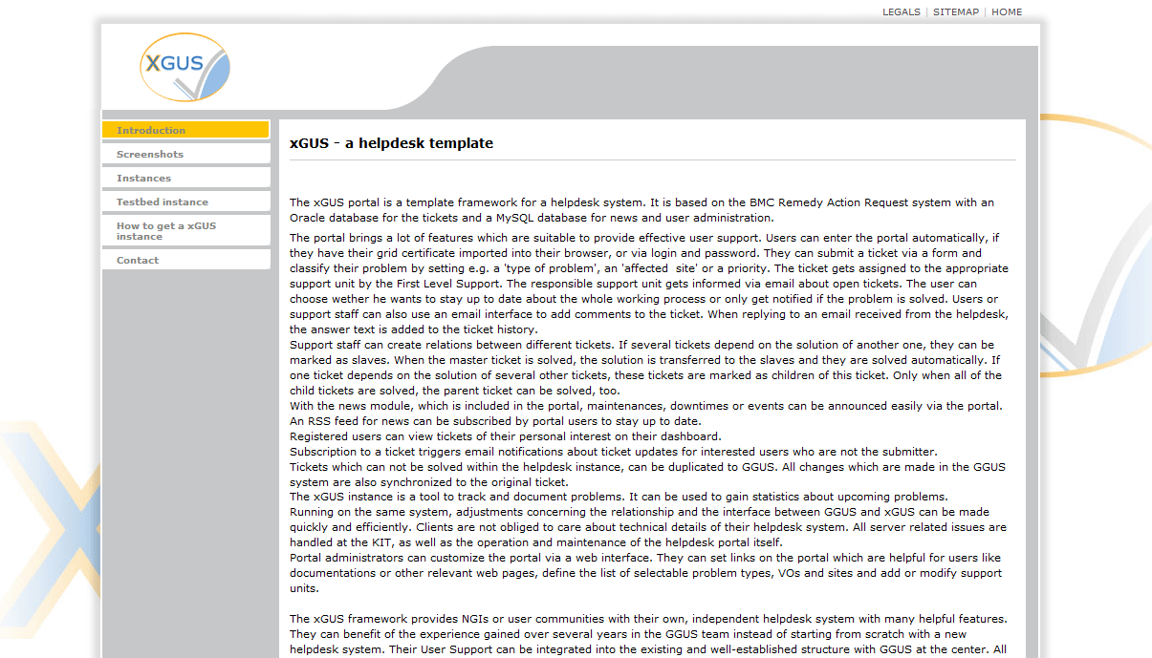
xGUS Homepage
http://xgus.ggus.eu
Screenshots
List of instances
Test instance
How to get an
xGUS instance
Information

Slide 10
Thanks for your attention!

