Slide 1
Service Availability Monitoring (SAM)
Marian Babik, David Collados, Wojciech Lapka, Pedro Andrade, Paloma Fuente
(CERN)
Emir Imamagic
(SRCE)
Christos Triantafyllidis (AUTH)

Slide 2
Overview
SAM overview/ SAM Architecture
Description and recent changes for all components
Documentation
Distribution
Operations and support
Messaging

Slide 3
SAM Scope
SAM grid monitoring (SAM-Gridmon)
central services (Web, API, availability)
SAM-Nagios
Monitoring platform supporting multiple configurations:
NGI-Nagios
VO-Nagios¹
Site-Nagios
Operations Tools-Nagios (ops-monitor)
¹ initial guide by Gonçalo Borges (NGI_IBERGRID)

Slide 4
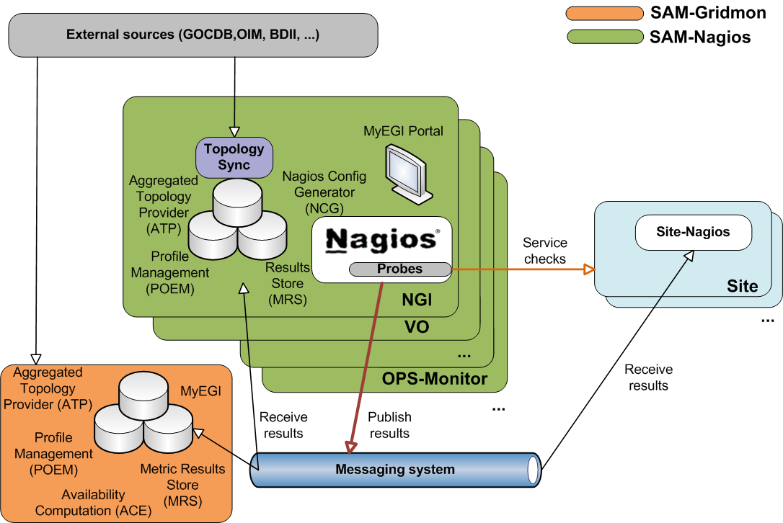
SAM Architecture

Slide 5
Aggregated Topology Provider (ATP)
Service aggregating grid topology information and downtimes from different external sources (GOCDB, OIM, CIC, BDII, GSTAT, feeds)
Recent changes
regionalization
VO feeds
configuration via YAIM (ATP_VO_FEED)
sanity checking
integration of changes in GSTAT, VO cards
improvements in logging

Slide 6
Profile Management (POEM)
Replaces MDDB (metric description database)
Defines and groups metrics into profiles (e.g. ROC_CRITICAL)
metrics
VO
topological groups (optional) – region, site, ngi
Profiles are used to generate Nagios configuration
Regionalized:
multiple POEM WEB instances (central, regional)
synchronization of profiles from any number of sources
namespace concept (e.g. ch.cern.sam-ROC_CRITICAL)

Slide 7
Nagios Configuration Generator (NCG)
Generates Nagios configuration files
Recent Changes
support for failover instance
integration of Globus5 and UNICORE probes
improved integration with Operations Portal
notification improvements

Slide 8
Failover instance
Backup instance constantly monitors resources, but it has the following features:
alarms are not sent to Operations portal
results are not sent to the central MRS database.
email notifications are disabled
Configuration
via BACKUP_INSTANCE
activated simply by removing the variable

Slide 9
Probes
Development policy document [1]
languages, constraints, naming and package conventions
Probe status document [6]
Development of Grid monitoring probes in transition to EMI
Support

Slide 10
Metric Store (MRS)
Stores metric output and computes service statuses
Recent changes
performance tuning
performance measurements
new probe to indicate MRS status [5]

Slide 11
Web and API (MyEGI)
SAM Web and application interfaces
Recent changes
Added Gridmap-style features
visualization per site status, flavour, VO, profile
historical and current status views
topology view by regions and tiers
Service Availability (on the central instance [3])
Performance and validation of Web service API
throttling and limits

Slide 12
Documentation
New structure [2]
User’s guide (in progress)
Administrator’s guide
organized based on the supported nodetypes (SAM-Gridmon, SAM-Nagios)
Developer’s guide
development policy document
web service specifications
Support
EGI Milestones (MS707)
Release notes
Note: please don’t refer to the former twiki.cern.ch documentation

Slide 13
Distribution
Improvements in meta-packages and dependencies
sam-nagios
sam-gridmon
Release cycles
four weeks cycle
since April, 5 releases, 451 tickets
Quality assurance
nightly validation
EMI-1 aspects
probe integration testing (deployment process)

Slide 14
Operations and support
2nd level support established
3rd level support in rota with 3 week cycle
Central services deployed (grid-monitoring.cern.ch)
Transition to new availability computation engine
Production and pre-production line established for central services

Slide 15
Messaging
EGI usage policy [4] (OMB)
Deployment of authentication
Enforcing the ACLs to the topics

Slide 16
Summary
SAM-Nagios running stably
SAM-Gridmon deployed and operated
Smooth transition to new Availability Computation Engine (ACE)
Development of new features ongoing (POEM, ATP history)
Future plans (MS707, EGI milestones)

Slide 17
References
https://tomtools.cern.ch/confluence/display/SAMDOC/Probes+Development+Policy
https://tomtools.cern.ch/confluence/display/SAMDOC
http://grid-monitoring.cern.ch/myegi
https://wiki.egi.eu/wiki/PROD_MSG

Slide 18
References
https://tomtools.cern.ch/confluence/display/SAM/Central+Data+Warehouse+Monitoring ¹
https://tomtools.cern.ch/confluence/display/SAM/Probes ¹
¹ work in progress (final version will be moved to the public space)

Slide 19
Backup slides

Slide 20
Plans
MS707
Integration of UNICORE
POEM integration
History in Aggregated Topology Provider (ATP)
Regionalization
[EGI #2791] SAM to monitor services and sites not in gocdb
[EGI #2792] Multi VO SAM/Nagios
[EGI #2793] SAM Run Custom Probes
ATP: support for multiple GOCDB endpoints

