Slide 1
xGUS The EGI Helpdesk Template
Technical Forum Lyon 2011-09-20
Sabine Reißer, Helmut Dres, Günter Grein, GGUS

Slide 2
What is xGUS?
xGUS provides easy access to an own helpdesk system for NGIs or User Communities
GGUS interfaced
Administration (support units, problem types, etc.) via web
No local deployment/installation: Operation and maintenance at KIT
Notes:
xGUS provides easy access to an own helpdesk system for NGIs or User Communities
GGUS interfaced
Tickets can be routed from GGUS to xGUS helpdesks and vice versa. Changes in either ticket system are synchronized. – see also later slide
Administration (support units, problem types, etc.) via web
Client NGI or User Community can edit the lists which are displayed on the portal in ticket_search, ticket_info and ticket_submit: problem type, Vos, sites, Responsible units. They can also edit the links on the mainpage and the support page which are displayed on the portal. – see also later slide
No local deployment/installation: Operation and maintenance at KIT
xGUS is hosted at KIT. Development in harmony with GGUS developments.

Slide 3
Some xGUS Features
Attachments
Ticket relations: Parent/Child, Master/Slave
Duplicate tickets
Ticket update and creation via mail
Private Dashboard
News module
Statistics
Notes:
Attachments
can be added by submitter or by support staff
Ticket relations: Parent/Child, Master/Slave
Parent cannot be closed before Child tickets are solved
Master solution solves all slave tickets
Duplicate tickets
If ticket cannot be solved by one support unit, it can be duplicated up to 15 times. Then, the duplicated tickets can be assigned to different support units.
Ticket update and creation via mail
Private Dashboard
Personal list of interesting tickets. Every ticket can be added to this list by clicking the ‚Add to my dashboard‘ -link
News module
Announcement of events, maintenances etc., will be displayed on the main page of the portal
Statistics
Average solution times, Tickets created per support unit per week, diagrams

Slide 4
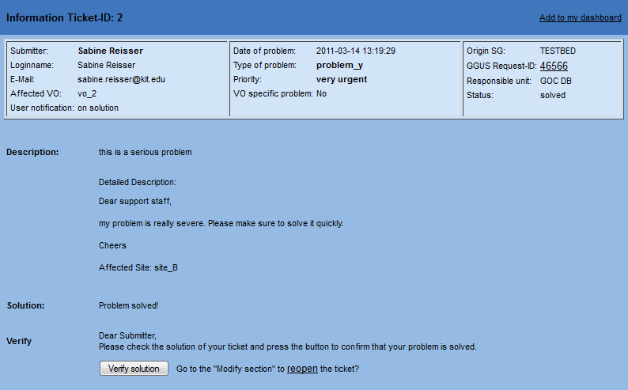
Ticket Information
1
2
3
4
Notes:
1 Infobox contains summarized information of the ticket. If ticket has come or has gone to GGUS, it has a GGUS id. Link to GGUS ticket.
2 Description of the problem as entered by user
3 Solution
4 If ticket is solved, submitter can verify the solution if he/she is content, Afterwards the ticket cannot be edited anymore. If user is not content, he can reopen the ticket.

Slide 5
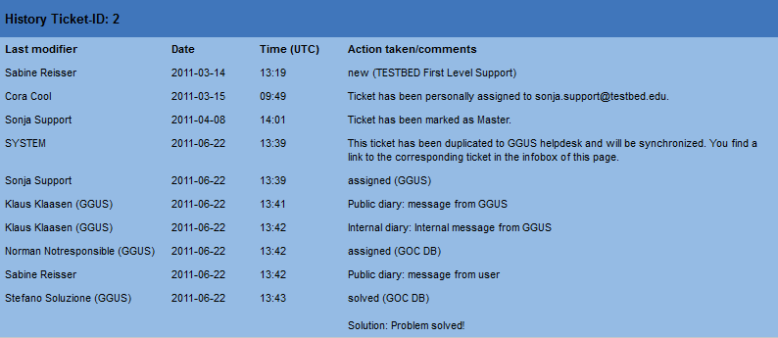
Ticket History
1
2
3
4
Notes:
1 Ticket history lists all steps that have been done including Last Modifier, Date, Time. If ticket has changed status or responsible unit, it is shown like status (Responsible Unit)
2 Message generated by the system if ticket gets assigned to a GGUS support unit und thus duplicated to GGUS.
3 If somebody edits the corresponding GGUS ticket, it is indicated by the suffix ‚(GGUS)‘ behind the Last Modifiers name
4 Internal/Public Diary: Public diary is visible for all users, internal diary only for support staff. Serves technical details etc. that the user doesn‘t need to know about

Slide 6
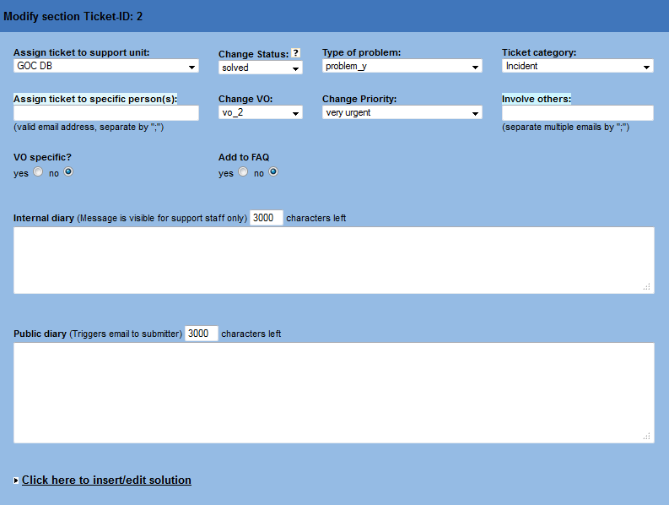
Ticket Modify (1)
1
2
3
4
Notes:
1 Assign ticket to a responsible unit
2 Change parameters like Problem type, priority, ticket category, vo
3 Internal diary field
4 Public diary field

Slide 7
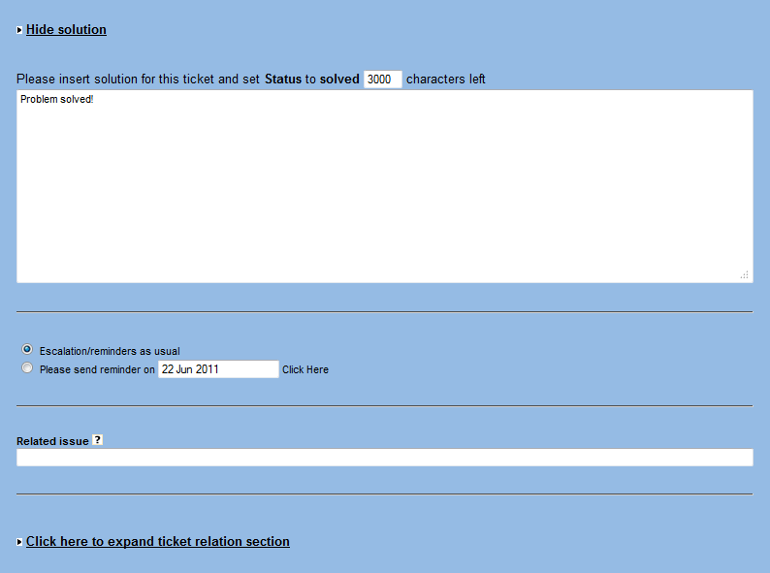
Ticket Modify (2)
1
2
Notes:
1 Solution field. Should be formulated in a way that satisfies the user.
2 If ticket is in status ‚on hold‘ or ‚waiting for reply‘, request a reminder for the ticket here. Might be of use if you are waiting for a software update etc.

Slide 8
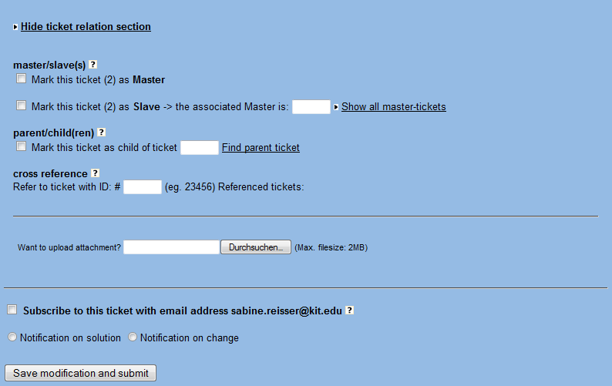
Ticket Modify (3)
1
2
3
4
Notes:
Ticket relations
1 Master solves all master tickets -> slave tickets depend on the solution of one master ticket
2 Parent ticket depends on the solution of several child tickets.
3 Upload a screenshot, error log file etc.
4 Ticket subscription
If you are not submitter and not in the responsible unit, you can subscribe to the ticket to receive notifications about changes/solution

Slide 9
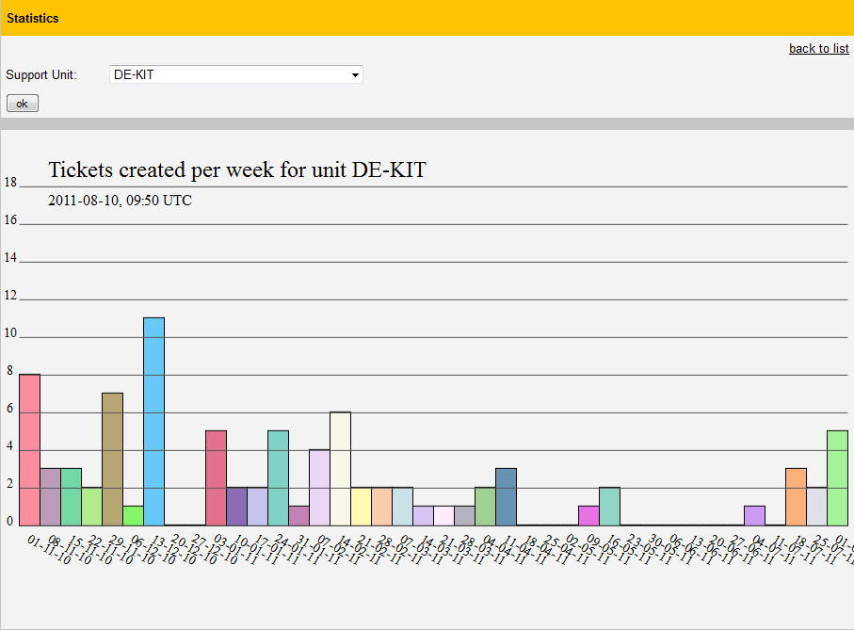
Statistics generator (1)
Notes:
Tickets created for a support unit in the last 40 weeks.

Slide 10
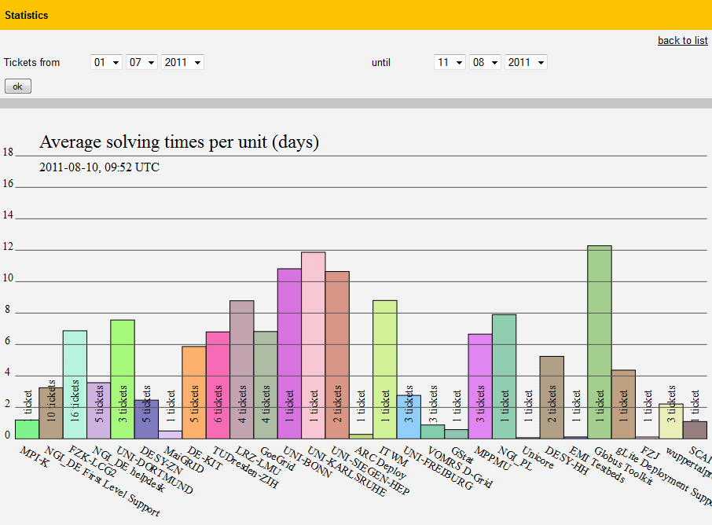
Statistics generator (2)
Notes:
Average solving times for each support unit for ticket created in the given timeframe.

Slide 11
Portal Administration
Portal administrators can customize via web
Support Units
Problem types
VOs
Sites
Links on main page
Links for support staff
Portal colors

Slide 12
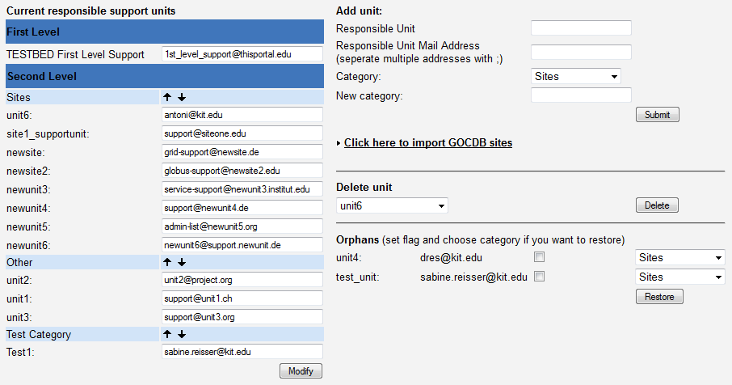
Portal Administration
Notes:
Adding, deleting, modifying of support units.
-> Site support units can be imported from GOCDB.
Orphans: Deleted units are still in the database, can be restored if necessary

Slide 13
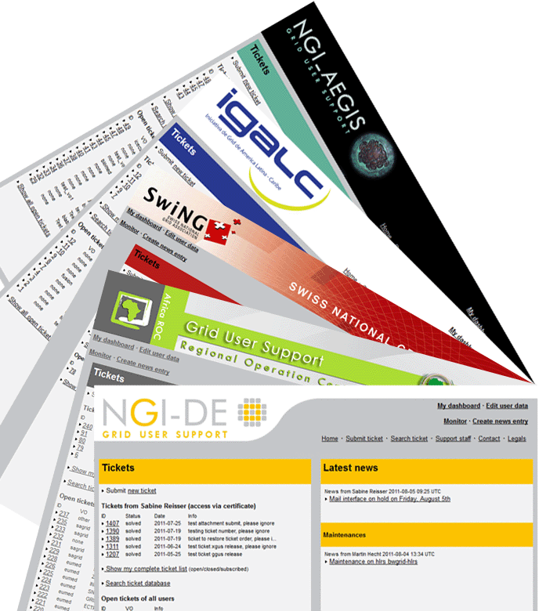
xGUS Instances
helpdesk.aegis.rs
xgus.ggus.eu/igalc
xgus.ggus.eu/ngi_ch
support.africa-roc.org
helpdesk.ngi-de.eu
Notes:
NGI_AEGIS: Serbia
IGALC: Latin America
NGI_CH: Switzerland
AFRICA_ROC: Africa
NGI_DE: Germany
Currently being set up: CHINA_ROC

Slide 14
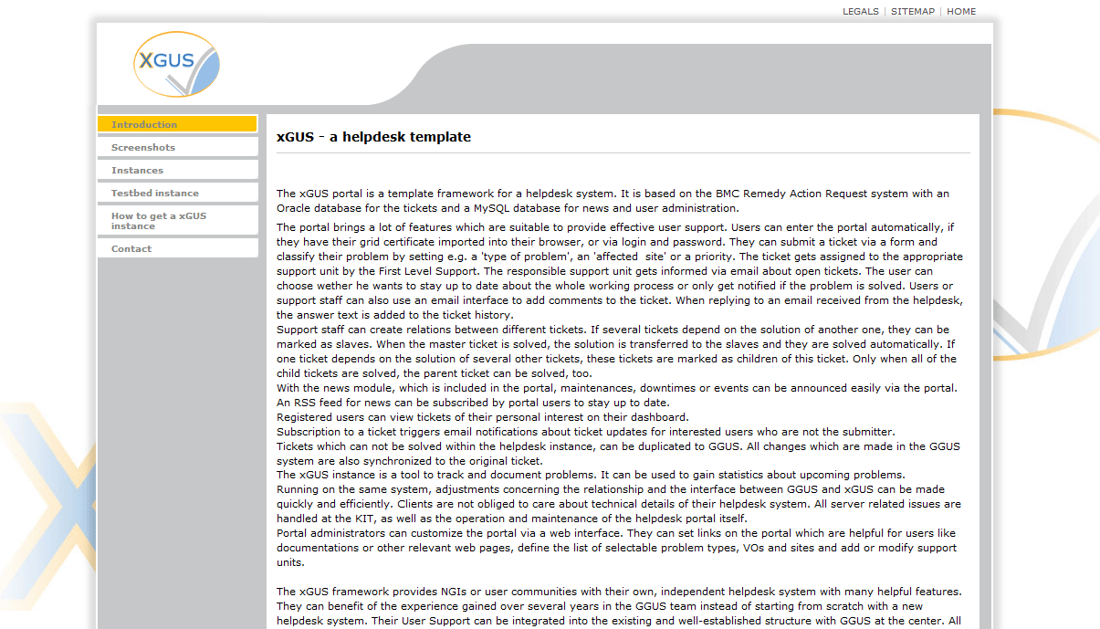
xGUS Homepage
http://xgus.ggus.eu
Screenshots
List of instances
Test instance
How to get an
xGUS instance
Information

Slide 15
Thanks for your attention!

Slide 16
Backup slides

Slide 17
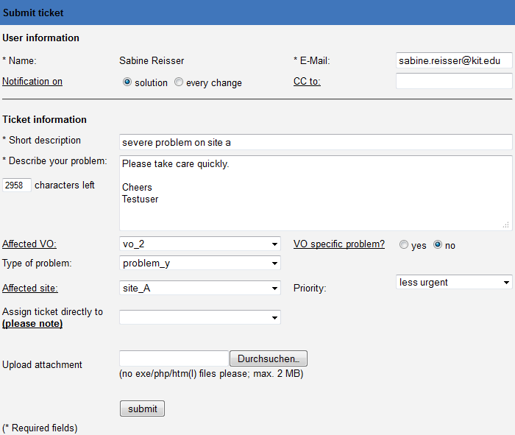
Ticket Submit

Slide 18
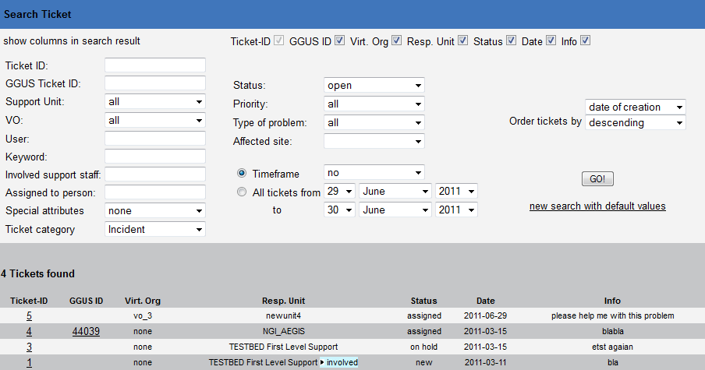
Ticket Search

Slide 19
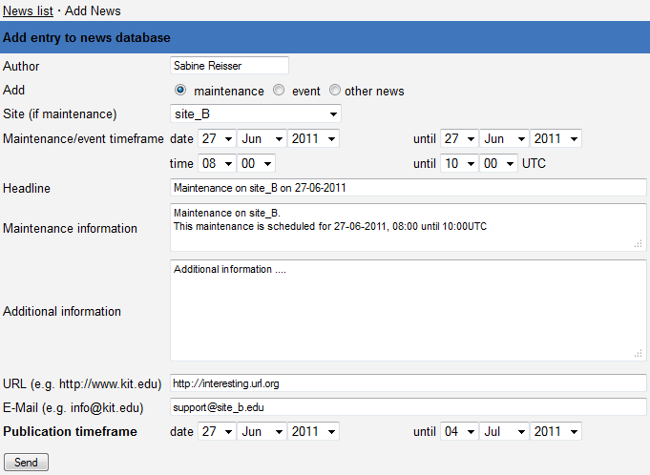
Create maintenance announcement

