Slide 1
The PRACE Initiative
Catherine RIVIERE, CEO of GENCI

Slide 2
A few words about GENCI Grand équipement national de calcul intensif
A French legal entity taking the form of a « société civile » with 5 shareholders
A group dynamics aiming to:
Settle the major computer equipment for the French computer centers for civilian research
Over 600 Tflop/s for the French scientists
Promote the organization of a European HPC ecosystem
GENCI represents France in PRACE (Partnership for Advanced Computing in Europe)
GENCI coordinates French policy in the HPC field
GENCI is ensuring HPC capacities at a regional level in France
Promote the use of modeling, simulation and HPC, in fundamental and industrial research

Slide 3
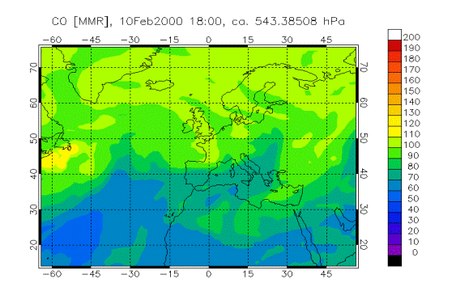
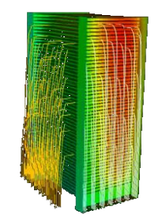
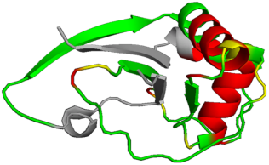
PRACE The Partnership for Advance Computing in Europe is the European HPC Research Infrastructure
Enabling world-class science through large scale simulations
Providing HPC services on leading edge capability systems on a diverse set of architectures
Operating up to six Tier-0 systems as a single entity including user and application support
Offering its resources through a single pan-European peer review process
PRACE is providing services since August 2010

Slide 4
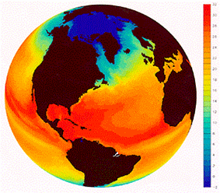
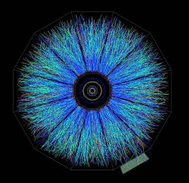
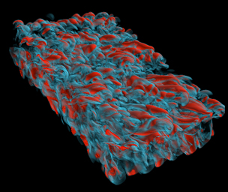
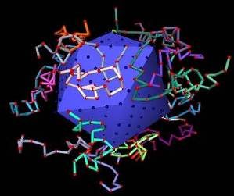
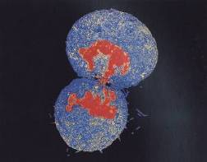
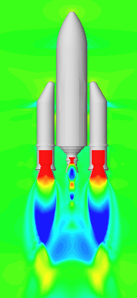
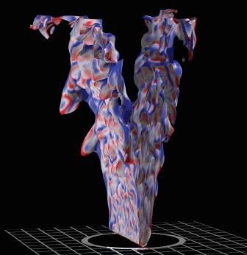
What for?
Weather, Climatology, Earth Science
Degree of warming, scenarios for our future climate.
Understand and predict ocean properties and variations
Weather and flood events
Astrophysics, Elementary particle physics, Plasma physics
Systems, structures which span a large range of different length and time scales
Quantum field theories like QCD, ITER
Material Science, Chemistry, Nano-science
Understanding complex materials, complex chemistry, nano-science
Determination of electronic and transport properties
Life Science
System biology, chromatin dynamics, large scale protein dynamics, protein association and aggregation, supra-molecular systems, medicine
Engineering
Complex helicopter simulation, biomedical flows, gas turbines and internal combustion engines, forest fires, green aircraft,
Virtual power plant

Slide 5
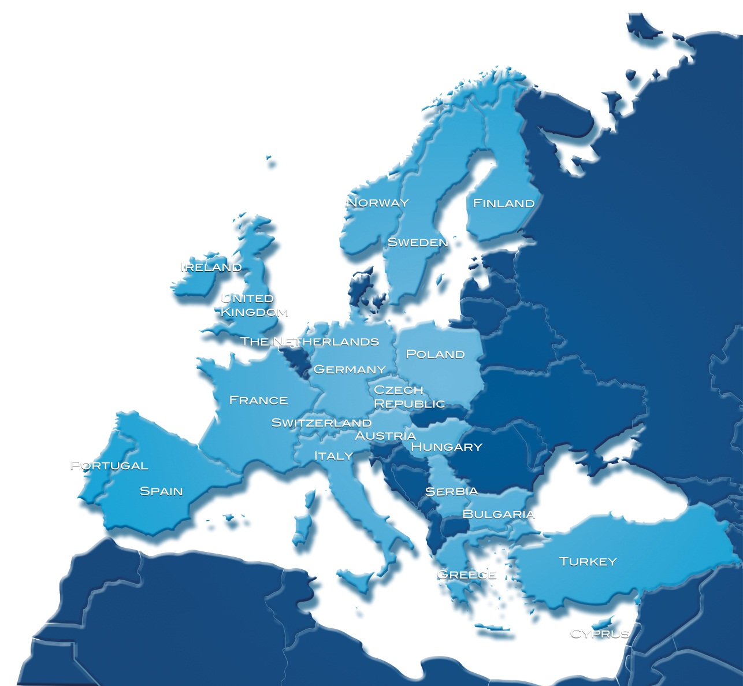
How did it start?

Slide 6
HPC in ESFRI roadmap 2006
The European Roadmap for Research Infrastructures is the first comprehensive definition at the European level
Research Infrastructures are one of the crucial pillars of the European Research Area
A European HPC service - impact foreseen:
strategic competitiveness
attractiveness for researchers
supporting industrial development

Slide 7
The ESFRI vision for a European HPC service
European HPC-facilities at the top of
an HPC provisioning pyramid
Tier-0: 3 to 6 European Centres for Petaflop
Tier-0: ? European Centres for Exaflop
Tier-1: National Centres
Tier-2: Regional/University Centres
Creation of a European HPC ecosystem
Scientific and industrial user communities
HPC service providers on all tiers
European HPC hard-and software industry
Other e-Infrastructures
Tier-0
European centres
> 1 Pflop/s
Tier-1
National centres
Tier-2
Regional/University centres
< 50 Tflop/s

Slide 8
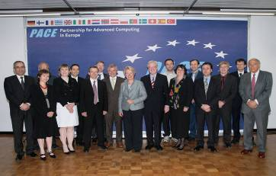
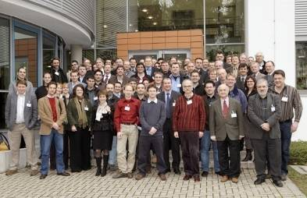
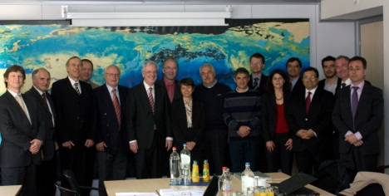
PRACE timeline
HPCEUR
HET
PRACE MoU
PRACE Preparatory
2004
2005
2006
2007
2008
EU-Grant: INFSO-RI-211528, 10 Mio. €
PRACE Operation
Phase
PRACE Implementation Phase (1-IP, 2-IP…)
04.23.2010
2009
2010
2011
2012
2013
PRACE AISBL created

Slide 9
How THE ESFRI VISION IS REALIZED?

Slide 10
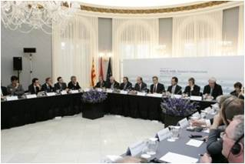
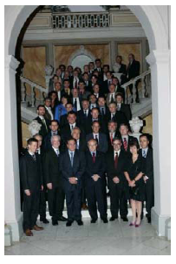
PRACE Research Infrastructure created
PRACE RI is in operation since April 2010
PRACE AISBL created with 20 countries, head office in Brussels
Association Internationale Sans But Lucratif
Now 21 country members
PRACE is providing Tier-0 services since August 2010
Funding secured for 2010-2015
400 Million€ from France, Germany, Spain and Italy Provided as Tier-0 services on TCO basis
70+ Million € from EC FP7 for preparatory and implementation Grants INFSO-RI-211528 and 261557 Complemented by nearly 60 Million€ from PRACE members
1st Council
June 9, 2010

Slide 11
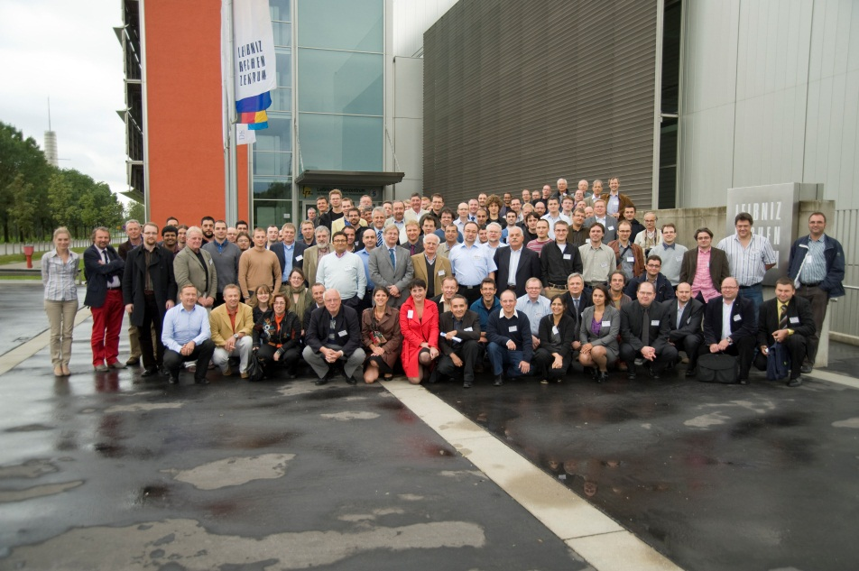
Support by FP7 funded projects
Technical, organizational and legal support
The First Implementation Phase Project (PRACE-1IP) started on July 1, 2010
The Second Implementation Phase Project (PRACE-2IP) started on September 1, 2011
PRACE project achievements in a nutshell
Prepared the creation of the AISBL as a legal entity
Established the PRACE brand
Provided extensive HPC Training
Deployed and evaluated promising architectures
Ported and petascaled applications
PRACE 1-IP kick-off

Slide 12
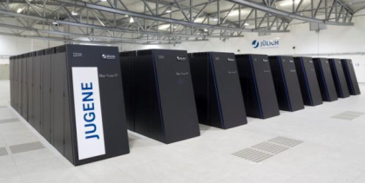
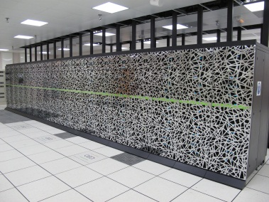
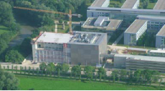
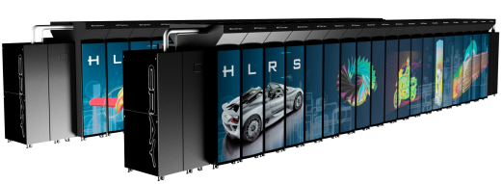
PRACE is building the top of the pyramid...
Tier-0
Tier-1
First production system available:
1 Petaflop/s IBM BlueGene/P (JUGENE) at GCS (Gauss Centre for Supercomputing) partner FZJ (Forschungszentrum Jülich)
Tier-2
Italy and Spain expect to deploy their own Tier-0 systems from 2012.
Second production system available: Bull Bullx CURIE at GENCI partner CEA. Full capacity of 1.8 Petaflop/s reached by late 2011.
Third production system available by the end of 2011: 1 Petaflop/s Cray (HERMIT) at GCS partner HLRS (High Performance Computing Center Stuttgart). Upgrade to 4-5 Petaflop/s planned in 2013.
Fourth production system available by mi 2012: 3 Petaflop/s IBM (SuperMUC) at GCS partner LRZ (Leibniz-Rechenzentrum).

Slide 13
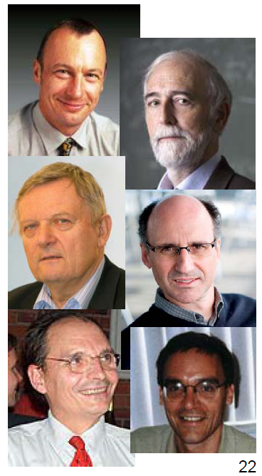
And supports best science on the highest level through
SSC « Bootstrap » Group
Richard Kenway (UK, Part. Phys., Chair)
E.J. Baerends (Netherland, Chemistry)
Kurt Binder (Germany, Cond. Matter)
Miquel Coll (Spain, Biology)
Filippo Giorgi (Italy, Climate)
Olivier Pironneau (France, Math)
Scientific Steering Committee
Responsible for giving opinions on all matters of a scientific and technical nature
Access committee, responsible for:
Giving opinions on the scientific use of Tier-0 Infrastructure
Providing recommendations on the allocation of PRACE resources based on the Peer Review process
Peer review process
A single process for evaluating proposals
Expert assessment
Transparency and confidentiality
Right to reply

Slide 14
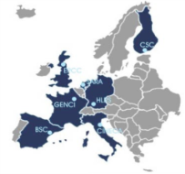
PRACE is integrating Tier-1 services
Tier-0
Tier-1
Tier-2
Building on and integrating the successful work of DEISA (Distributed European Infrastructure for Supercomputing Applications)
PROJECT SCOPE: provide Tier-1 services through DECI calls and virtual community support
First synchronized call for Tier-0 and Tier-1 resources from May 2, 2011 to June 22, 2011
Benefiting from HPC Europa2
PROJECT SCOPE: allow young European researchers who need HPC resources to visit and collaborate with local researchers in their research field
Network of more than 700 hosting departments and research institutes in Europe
Transnational Access model could be used in PRACE
Peer review used for Tier-1 access model in PRACE

Slide 15
What are the concrete results?

Slide 16
An access model focused on a sole criterion: scientific excellence
Free-of-charge
Three types of resource allocations
Preparatory access: optionally with support from PRACE experts
Project access (every 6 months) : for a specific project, grant period ~ 1 year
Programme access: resources managed by a community and allocated over longer periods, possibly for projects comprising a range of scientific goals
An invitation to submit “Expressions of Interest for Programme Access” has been issued in July
Submission deadline: October 1, 2011
www.prace-ri.eu

Slide 17
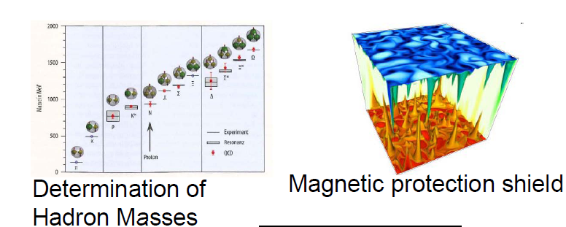
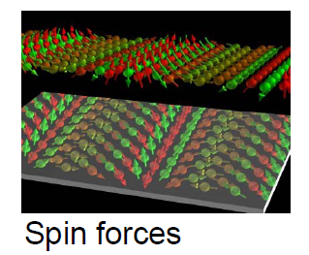
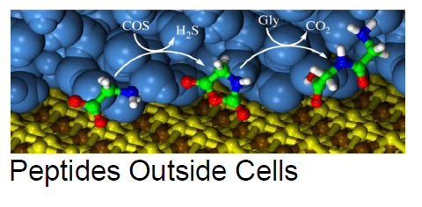
Scientific Application Highlights

Slide 18
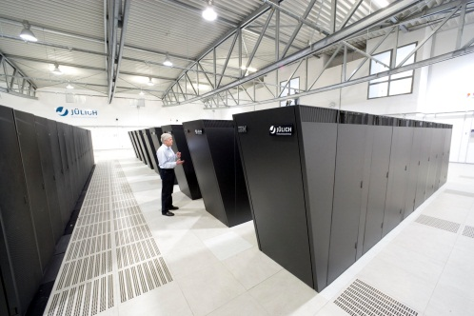
Focus on some (French!) examples
Droplet growth in turbulent and warm clouds: kinetics, fluctuations, and universality
SCOPE: understand how it works
Need of direct simulations with high resolution on long timescale
PRACE resources awarded: 50 Mh core-hours
Molecular simulations for Alzheimer’s disease
SCOPE: shed light on some key issues of the chemistry of Alzheimer's disease
Need to test the scalability of the used numerical code
PRACE resources awarded: 50 000 core-hours
1st Regular Call
Preparatory Access

Slide 19
The ESFRI vision is on the way of achievement
Tier-0
European centres
The HPC pyramid is strengthened
4 existing Tier-0
Provision of Tier-1 services
Exploration of the next steps
PRACE paves the way to a European HPC ecosystem
Providing services to scientific and industrial user communities
In coordination with HPC service providers on all tiers
In cooperation with the European HPC hard and software industry
In cooperation with other e-Infrastructures
Tier-1
National centres
Capability
Tier-2
Regional/University centres
# of systems

Slide 20
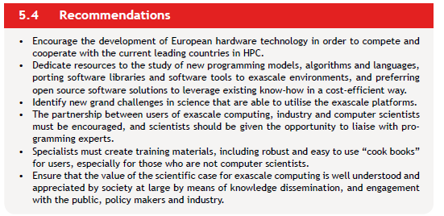
And the next steps?

Slide 21
PRACE is also looking at the next challenge, EXASCALE, by implication of PRACE partners in:
Tier-0
Tier-1
Tier-2
EESI: European Exascale Software Initiative
TARGET: build a European vision and roadmap to address the challenges of performing scientific computing on the new generation of systems which will provide multi-Petaflop performances in the next few years and Exaflop performances in 2020
Exascale projects: the example of Mont Blanc
TARGET: bring European HPC technology to the front line in the race towards the first Exaflop systems, and prepare European HPC centers for the paradigm change that such Exaflop systems will represent
Put together a purely European consortium composed of industrial technology providers (Bull, ARM, Gnodal) and research supercomputing centers from the 4 Tier-0 hosting members in PRACE (Germany, France, Italy and Spain)

Slide 22
PRACE Research Infrastructure is operational Provide world-class resources for European scientists at the same level as US and Chinese A group dynamics involving around 300 people

