Slide 1
WMSMonitor 3.0
Danilo Dongiovanni
INFN-CNAF

Slide 2
WMSMonitor Tool Overview
WHAT SERVICES IT MONITORS:
A pool of geographically distributed WMS/LB instances, EMI services in charge of job workload management
WHY IS IT USEFUL:
Detects failures affecting the services and supports administrators in fault prevention
WHAT UTILITIES AND STATISTICS IT PROVIDES:
Notifications to NAGIOS Alarming system in case of failures
Metric based load balancing system
Reports a variety of service usage statistics, aggregated per WMS / VO / TIME on: Users activity, Grid resource utilization, JSS Errors

Slide 3
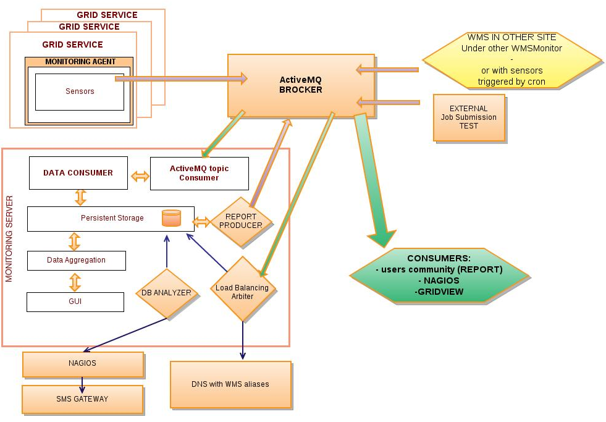
WMSMonitor Tool Architecture
Main page: WMS / LB monitored instances status overview
FUTURE
WORK
FUTURE
WORK
FUTURE
WORK
FUTURE
WORK

Slide 4
WMSMonitor Tool Web Tour
Main page: WMS / LB monitored instances status overview

Slide 5
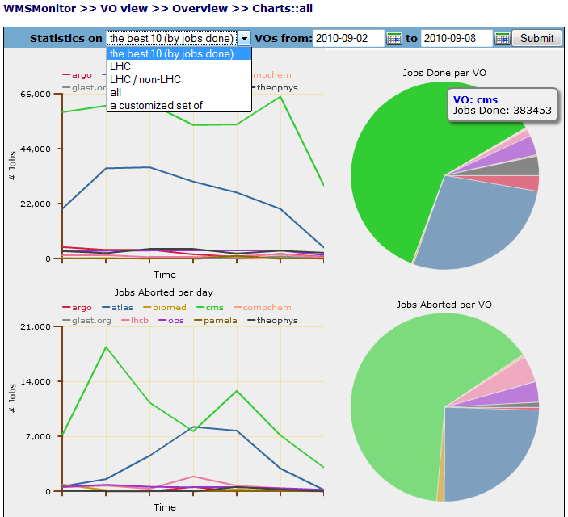
WMSMonitor Tool Web Tour
VO job workload management Stats:
daily rates of jobs submitted, done/aborted grouped by VO

Slide 6
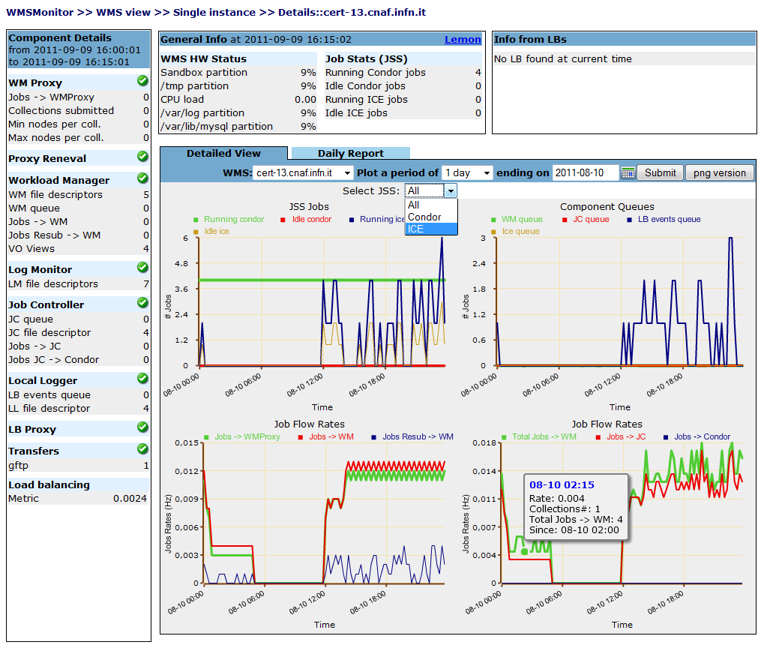
WMSMonitor Tool Web Tour
WMS Instance details page:
demons status
components queues
list of used LB instances
charts reporting job processing rates over configurable time intervals

Slide 7
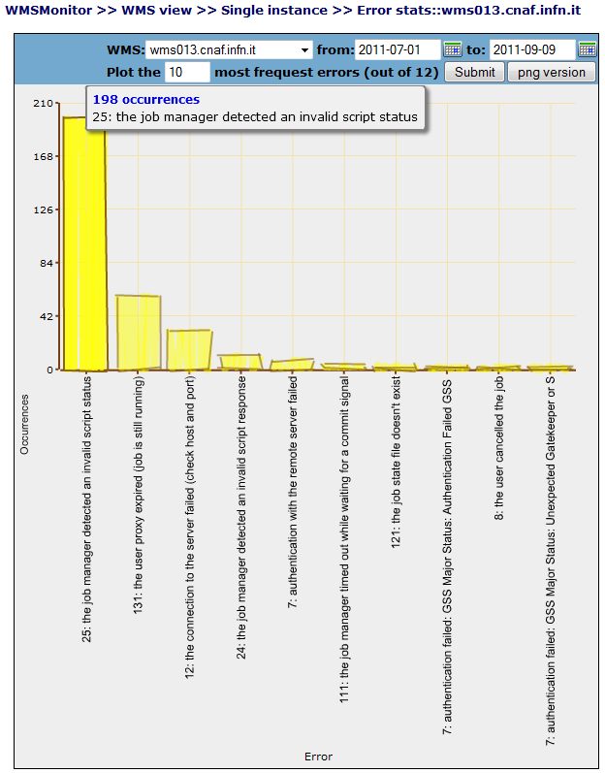
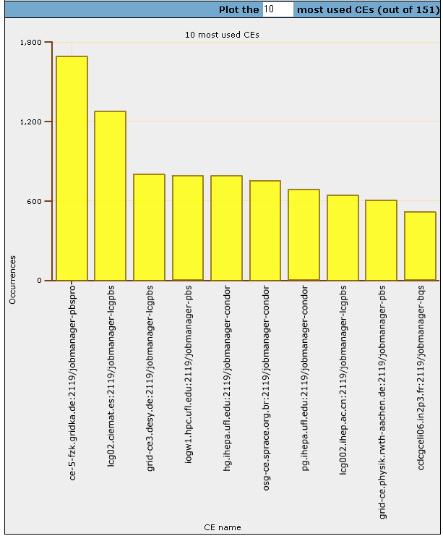
WMSMonitor Tool Web Tour
Job Submission Service Error Stats: Globus errors occurrences by type
CE Resources Utilization Stats:
Number of jobs per CE queue

Slide 8
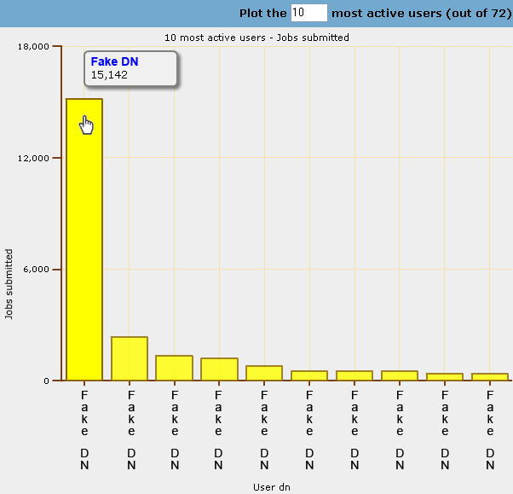
WMSMonitor Tool Web Tour
Users Job Workload Management Stats:
number of jobs submitted, Done / Aborted per DN, over configurable time intervals

Slide 9
WMSMonitor 3.0
Version 2.1
In production since 2009
Monitoring of gLite 3.1 SL4 WMS/LB
Version 3.0 ( NEW ! ):
Monitoring EMI SL5/64 WMS/LB
New web Interface
Data collection is now asynchronous
Messaging is now based on Active MQ
LB api to extract job rates data
Both Globus and EMI ICE/CREAN JSS case is now handled
Globus JSS error statistics available
Deployment Status:
Sensors available for pre-view and deployable on your instances
Server hosted at INFN-CNAF
EMI WMS/LB version supported, no pre-EMI/post-EMI hybrid version support

Slide 10
Links
DOCUMENTATION
https://twiki.cnaf.infn.it/twiki/bin/view/WMSMonitor/WebHome
WMSMonitor 2.1 server production instance:
https://wmsmonitor.cnaf.infn.it:8443/wmsmon/main/main.php
WMSMonitor 3.0 server pre-view instance:
https://cert-wms-03.cnaf.infn.it:8443/wmsmon/main/main.php

