Slide 1
On the EGI Operational Level Agreement Framework
Tiziana Ferrari, EGI.eu
EGI Chief Operations Officer

Slide 2
Outline
EGI Service Infrastructure
Operational level agreements
Scope
Negotiation
Reporting
Service level agreements
Sustainability and business model
Future work and conclusions

Slide 3
EGI Resource Infrastructure
EGI Participant: National Grid Initiatives (NGIs), European Intergovernmental Research Organisations (EIROs)
Layer II. Resource Infrastructure
The federation of Resource Centres, which are interconnected by the National Research and Education Networks (NRENs) and GÉANT.
Resource infrastructure Provider (RP)
The legal organisation responsible for any matter that concerns the respective Resource Infrastructure
Layer III.
EGI Resource Infrastructure
NGI/EIRO
Network
Resource Provider
Resource Infrastructure
EGI.eu
Resource Infrastructure
Resource Centres
MoUs
Resource Centres
Resource Provider
Resource Infrastructure
Resource Centres
Resource Centres
Peer infrastructures:
accessible to EGI users, but relying on own operational services, e.g. Open Science Grid (USA)
Layer I. Resource Centre (RC)
A localised or geographically distributed administration domain, where EGI resources (CPUs, data storage, instruments and digital libraries) are managed and operated to be accessed by end-users
Resource Centres
Integrated Infrastructures:
operated by a non-EGI-InSPIRE partner but relying on EGI operational services, e.g. Latin American and Caribbean
Resource Centres

Slide 4
EGI Service Infrastructure
The service infrastructure enables secure, interoperable and reliable access to distributed resources.
EGI services are provided locally by Operations Centres and globally by EGI.eu.
and partners
Service categories:
Global Services
Resource Infrastructure
Resource Infrastructure
Infrastructure Services →
Tools
Resource Infrastructure
Resource Infrastructure
Resource Infrastructure
II. Technical Services →
Grid middleware
III. Support Services →
Helpdesk and Support Teams
Local Services
IV. Human Services →
Service Level Management, security, documentation, coordination
Operations Centres
Operations Centres
Operations Centres

Slide 5
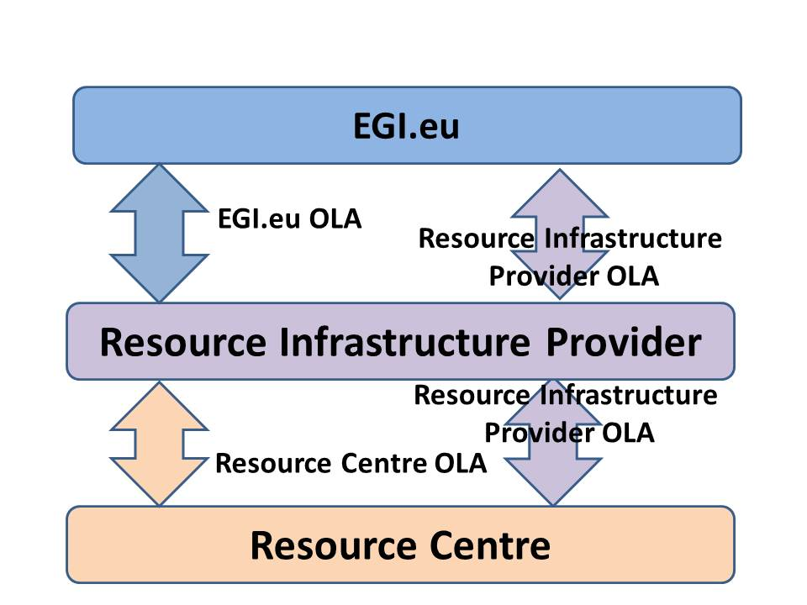
Operational Level Agreements 1/2
Resource Centre OLA - approved
Resource Infrastructure Provider OLA (Local Services) – in progress
EGI.eu OLA (Global Services) – to be defined

Slide 6
Operational Level Agreements 2/2
Parties
(Minimum set of ) services exchanged
Service hours
Metrics and the minimum service targets
The reporting period (where available)
Penalties (if defined)
suspension

Slide 7
Negotiation
The EGI OLAs can be customised by the Parties to meet local requirements, consistency must be ensured
All OLAs and their updates are approved by the Operations Management Board (OMB)
Resource Centre OLA
Its acceptance (including the updates) is a pre-requisite for being a certified Resource Centre
The Resource Provider is responsible of handling the negotiation and to record the agreement
Resource Provider OLA
EGI participants:
discussion within the OMB, acceptance is a pre-requisite for integration
Others: negotiation is part of the Resource Infrastructure Provider MoU

Slide 8
Monitoring and Reporting
Monitoring
All Resource Centre services are monitored
Monitoring of local and global service is in progress
Reporting
on a monthly/yearly basis depending on the metric
Follow-up
A central support team is responsible of identifying underperforming Resource Centres, of collecting justifications and of performing suspension as needed
penalties for Resource Providers and EGI.eu to be defined

Slide 9
EGI Service Level Agreements: Technology Providers
Steering the EGI software evolution
Publish the Unified Middleware Distribution (UMD) Roadmap
Collect and prioritise strategic requirements
Engage with external Technology Providers
Provision software for the EGI community
Ensure the quality of delivered software
Provide a software repository for UMD and other components
Provide 2nd level support for the deployed middleware
MoU
SLA
Technology Providers
MoUs & SLAs
New Technology Assessed
Notes:
Two major processes:
1) Strategic software evolution
2) Operational Software Provisioning and support

Slide 10
EGI Service Level Agreements: users
Being developed to define service targets of Grid middleware services facing user applications. Based on
the conventional model of IT resources owned by the end-user
Availability/reliability of Grid middleware services
Issues
Customers vs end-users
Different negotiation protocols possible involving multiple organizations
VO/VRC → EGI.eu (NGIs)
VO/VRC → NGIs
End-user perceived quality
Different end-users may request different service targets
Monitoring and reporting frameworks have to be extended accordingly

Slide 11
Business models
Business models and sustainability being investigated
Strong push from the EGI-InSPIRE reviewers towards
Commercially defendable SLAs
New business models
New mechanisms for provisioning of services
New business models will have an impact on current service management processes

Slide 12
The Way Ahead…
Moving out of our comfort zones
Changing for services previously free?
Examining what needs to be sustained
How can a service be sustained and by who?
Sustaining the EGI ecosystem
We are as strong as our weakest part!
Across EGI as a whole:
Strategy → Plan → Implementation
Check back at the Community Forum 2012

Slide 13
NGI/EIRO Survey on Sustainability and BMs
Goals: explore
Maturity of Business Models
Awareness of Business Model design
Value proposition of
NGIs to Resounce Centres
EGI.eu to NGIs/EIROs
EGI to ERA
Criticality of EGI-InSPIRE funding
Revenue streams alternative to EC funding

Slide 14
Who has (not) answered
Belgium
CERN
Czech Republic
France
Germany
Israel
Italy
Netherlands
Poland
Serbia
Slovakia
Spain
Switzerland
Turkey
UK
Bulgaria
Cyprus
Croatia
Denmark
Estonia
Finland
Ireland
Greece
Hungary
Latvia
Lithuania
Luxembourg
Macedonia
Moldova
Montenegro
Norway
Portugal
Romania
Slovenia
Sweden
yes
no
Survey open for submission from 27 Jul for 1 month
42% answers → 54% answers if weighted on Council vote power

Slide 15
Survey Results and Analysis https://documents.egi.eu/document/797

Slide 16
Findings
Lack of formalized Business Models
Action: increase awareness, develop common ground, work together to create BM prototypes and patterns for reusability
Need for everybody!!!
First concrete step:
EGI Sustainability and Business Model Workshop, EGI TF 2011, 20/09
http://go.egi.eu/egitf11-sustainability-workshop

Slide 17
Findings
Usage-based pricing
For applicable services, billing employing institution or NGI -> need to adapt accounting systems
Charging individual users is not seen as viable
Dependency on EGI-InSPIRE funding
Some NGI is critically dependent -> action: diversify revenue streams, track and plan for:
Horizon 2020:
https://documents.egi.eu/document/800
Structural Funds:
https://documents.egi.eu/document/799

Slide 18
Findings
Value Proposition:
Important to achieve common view on value proposition in all provider-consumer relationships of the EGI ecosystem; need to evolve the analysis to consider all meaningful relationships
Tech. Provider to User Communities
Tech. Provider to EGI Collaboration
EGI.eu to NGIs/EIROs
EGI.eu to User Communities
NGIs to User Communities
NGIs to Resource Centres
Resource Centres to User Communities
EGI Collaboration to User Communites
For each of these provider-consumer relationship, one or more BMs should be defined

Slide 19
Next Steps
EGI Sustainability Plan
First version, D2.7 (Mar11)
https://documents.egi.eu/document/313
Second version, D2.13 planned for Feb12
Proposal to move to Apr12, to also include strategic goals and plans endorsed by the EGI Council
Develop engagement with EGI Ecosystem entities to collaboratively explore the various business models and link them to the strategy and to SLM

Slide 20
Future work/OLAs
Improvement of the RC performance
Finalization of the OLA framework (2011)
Monitoring: extension of the Service Availability Monitoring framework and of the reporting system for
monitoring of new services (e.g. EGI.eu central services)
customisation of service level targets
Reporting: increasing automation
Follow-up: automated proactive control systems fully relying on the existing incident management system and processes
Development of a SLA framework involving the end-users

Slide 21
Future work/business models
EGI Sustainability Plan
First version, D2.7 (Mar11) - https://documents.egi.eu/document/313
Second version, D2.13 planned for Feb12
Proposal to move to Apr12, to also include strategic goals and plans endorsed by the EGI Council
Develop engagement with EGI Ecosystem entities to collaboratively explore the various business models and link them to the strategy and to SLM

