Slide 1
Data Management
Onedata features and status
Baptiste Grenier & Giuseppe La Rocca
EGI Foundation

Slide 2
Release notes – v18.02.1-rc13
The new versions provides many improvements and new features, from which the most important are:
Add fixes to improve the stability with Oneprovider.
Improved speed of indexing of large datasets.
Implementation of user defined data indexes, used for querying the data based on specific metadata.
WebDAV support.
Improvements in the metadata extraction, ingestion and manipulation.
Improved data monitoring API allowing to monitor the changes in data and depending on the type of the change invoking actions, i.e. data replication.
AAI: Support for OIDC.
PID management: Handle.net/B2Handle integration.
Cataloguing and discovery: B2Find integration.
Data-intensive computation: Integration with the EGI Notebooks.
APIs updated.

Slide 3
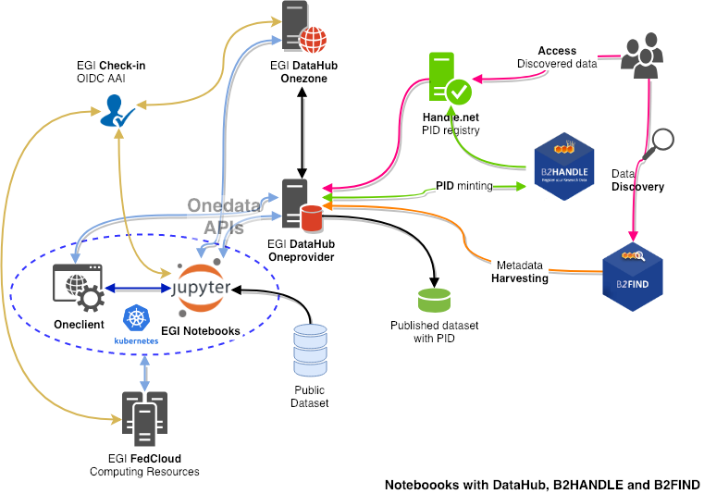
Perform data analysis on large volume of data
Demo at CS3
Analysis
Notebooks / JupyterLab
FedCloud resources
Data management
DataHub / Onedata
Space
Onezone
Oneprovider
Oneclient
AAI (OIDC)
Check-in
PID management
B2HANDLE
Handle.net
Cataloguing and discovery
B2FIND

Slide 4
Next steps
Move the service in Beta
To be discussed during the next SSB meeting.
Finalize the OLA for Onezone/Oneprovider.
PANOSC WP6:
Evaluation of the solution for possible pilots.
Training:
Organizing a session about data platforms for data processing during the EOSC-hub week.
Preparation of a training for EGI staff

Slide 5
Links
EGI DataHub
https://datahub.egi.eu/
https://community.egi.eu/c/egi-services/datahub
https://egi-datahub.readthedocs.io/
https://wiki.egi.eu/wiki/EGI_Federated_Data
System requirements
https://onedata.org/docs/doc/system_requirements.html
Official Onedata documentation
https://onedata.org
https://onedata.org/#/home/documentation
Getting started
https://github.com/onedata/getting-started
Source code: https://github.com/onedata

