Slide 1
The XDC Use Cases and Requirements

Slide 2
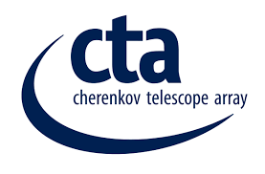
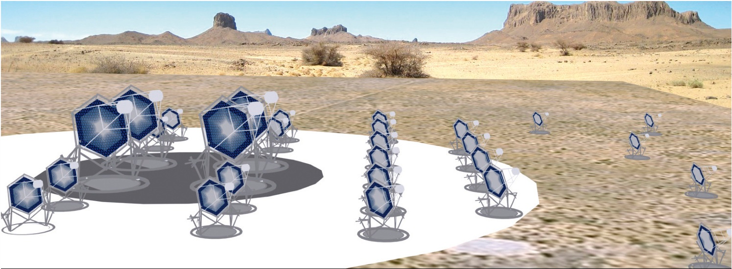
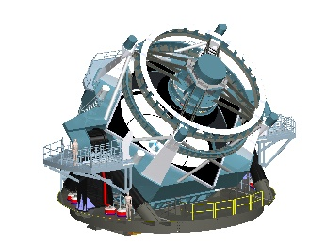
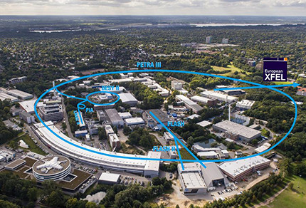
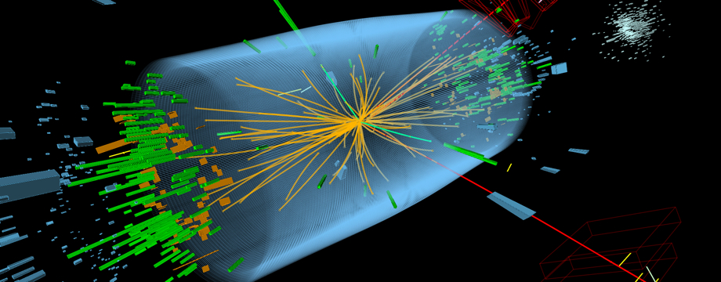
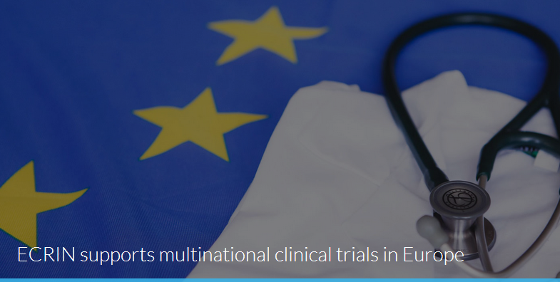
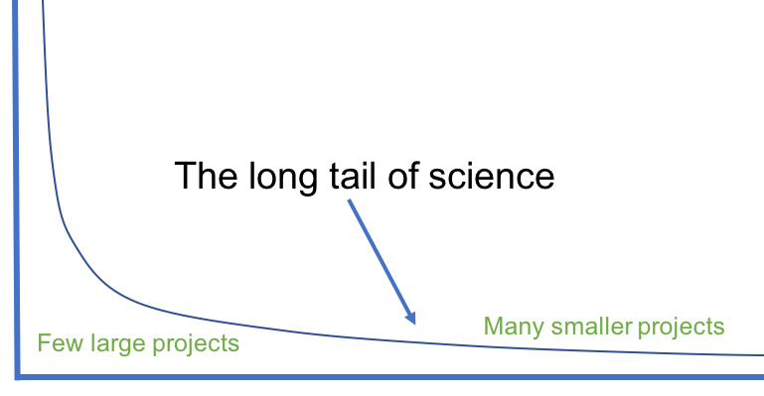
Represented research communities

Slide 3
Research Communities
LifeWatch ERIC is the e-Science European Research Infrastructure for Biodiversity and Ecosystem Research, which aims to advance in these disciplines by bringing Information and Communication Technologies closer to the final researcher
Biodiversity
The Cherenkov Telescope Array or CTA is a multinational, worldwide project to build a new generation ground-based gamma-ray instrument in the energy range extending from some tens of GeV to about 300 TeV
Astrophysics
ECRIN provides support for the development and implementation of multinational clinical research projects in Europe. These are mostly investigator initiated clinical trials, run by non-commercial clinical trials units (CTUs) based within universities or hospitals, though ECRIN does also support trials initiated by biotech and medical device small and medium enterprises (SMEs).
Clinical Research

Slide 4
Research Communities
The Worldwide LHC Computing Grid (WLCG) project is a global collaboration of more than 170 computing centers in 42 countries, linking up national and international grid infrastructures. The mission of the WLCG project is to provide global computing resources to store, distribute and analyze the ~50 Petabytes of data expected in 2018, generated by the Large Hadron Collider (LHC) at CERN on the Franco-Swiss border.
Particle
Physics
The 3.4 km long European XFEL generates extremely intense X-ray flashes to be used by researchers from all over the world. The flashes are produced in underground tunnels and will allow scientists to map atomic details of viruses, film chemical reactions, and study the processes in the interior of planets.
Photon
Science

Slide 5
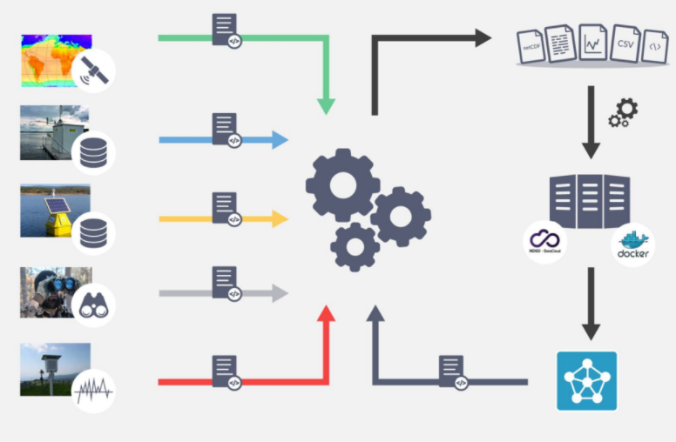
LifeWatch Use Case
Problem: Life Cycle Management of data related to Water Quality involving heterogeneous data sources
Satellite, Real-time monitoring, meteorological stations.
Goal: Integrate data sources and different types of modelling tools to simulate freshwater masses in a FAIR data environment
Use of standards like EML (Ecological Metadata Language)
XDC Solution:
Onedata
Metadata management and discovery, Digital Identifier minting, storage
PaaS Orchestrator
automatic preprocessing for data harmonization and model deployment

Slide 6
User stories (for data integration)
As a user, I can search with keywords to get a list of all relevant datasets from heterogeneous data sources
As a user, I can add new metadata to the datasets obtained externally
As a user, I can select from a list of processing tools/models and a set of input datasets to feed the processing tools/models
As a manager, I can add new data sources to ingest new data in the system
As a manager, I can run specific software to curate the data (calibrate, clean, form transfer, save, add metadata etc.)

Slide 7
Requirements
Functional Requirements
Integration data from various resources
Obtain data from heterogeneous resources (need for data access interface extensible to various protocols, data transfer)
Curation and preprocess the data (need for format converters, data check, management)
Metadata management (creation, bind to dataset, search)
Data analysis (platform with a list of models/tools , workflow engine, VREs)
Visualization (rich plots, handle large data)
Performance Requirements
Wait time to connect remote resources <30s
File download time < 1m

Slide 8
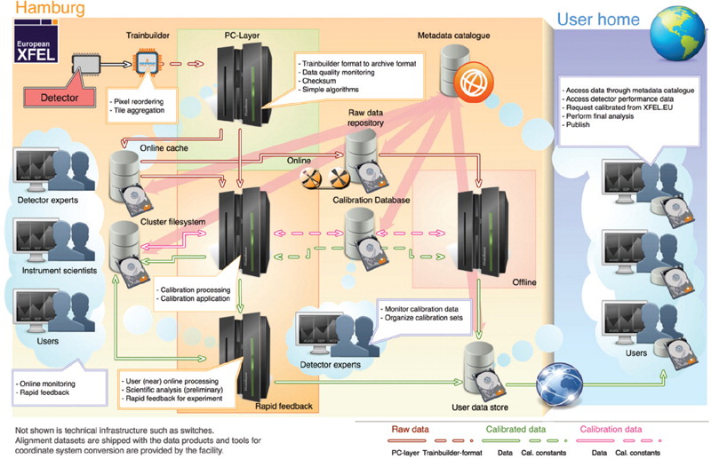
XFEL Use Case
Problem: Data Lifecycle Management for the XFEL facilities, ACL and Embargo period control
Online:
Exclusive access to cluster during beam time, only from experiment rooms. Perform preliminary, On-the-fly analysis
Offline:
Calibrated data provision for analysis on the HPC Cluster and in the OpenStack cloud environment.
Solution: dChace + Orchestrator

Slide 9
User Stories ( handling event driven large scale experiment data at real time)
As a data manager, I need to
easily and quickly store data created by users during a beamtime
monitor how data flows through various lifecycle stage and check whether the storage system transfers data accordingly
Aggregate data to make handling it in the backend storage system more effective
Move data between different storage or to partner institutes
Ensure data arrive from remote locations gets treated according to specified rules (replicated, QoS changed) automatically
As a user, I need to
retrieve beam data for analysis (usingHPC or Cloud)
Check and manage permissions on data
Deploy custom event driven workflow pipelines
Be informed when certain events occurs in the data lifecycle or when data that is currently taken meets certain criteria

Slide 10
Requirements
Functional Requirements
Distributed
Some processing tasks have latency constraints
Automatic triggering capabilities are essential
Parallelization of processing tasks is desirable
Performance Requirements
Large number of comparatively small files
Bursty ‘ingestion rates with very high peaks’ (as in most photon science applications
Very large amount of data
Scalability is crucial
Polling across file system no longer feasible
Data rate: >1GB/s & 50 files/s
Scalability: > 4nodes

Slide 11
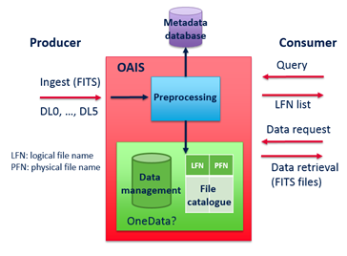
CTA Use Case
Problem: Complex and Big Data management in distributed archives. Data quality Assurance
The CTA distributed archive lies on the « Open Archival Information System » (OAIS) ISO standard.
Event data are in files (FITS format) containing all metadata.
Goal: Metadata are extracted from the ingested files, with an automatic filling of the metadata database.
Metadata will be used for querying of archive.
The system should be able to manage replicas, tapes, disks, etc, with data from low-level to high-level
XDC Solutions
Onedata
Metadata management and discoverability
PaaS Orchestrator + QoS

Slide 12
User stories (Big Data Archive Management)
As an Archive Manager, I can define rules based on matadata
To archive files on tape only or on disc&tape
To duplicate archive files on tape and on low latency storage to be soon quickly retrieved
To create replicas on a specific data center
to prevent deletion of tiles
As an Archive Manager, I can monitor the archive ( replication performance, effor& read/write rate, location of the files/replicas, query/retrieve response time)
As an Archive Manager, I can handle metadata (extract metadata during preprocessing operation, update metadata for all stored data less than a day)
As an Archive User, I can
query the archive based on metadata,
move data from one type of storage to another,
execute a migration plan to migrate data onto new storage media suitable for future technology

Slide 13
Requirements
Performance requriements
Data rate: >500 files/s
Query execution time: <5s over 1 billion files
Time to retrieve data
On disc: <1 s
On Tap <1d

Slide 14
WLCG Use Case
Problem: Growing needs on storage space
up to 900 PB in 2027
Data ready to be used/exploited in a very distributed environment
Goal: Reduce costs, resource aggregation, smart data allocation
Smart Caching technologies
Resource Federation
Multi-site storage - the “DataLake”.
Dynamic extension of sites to remote locations
Data management and QoS
XDC Solution:
QoS (policies definition),
Xcache (smart caching),
EOS (data caching).

Slide 15
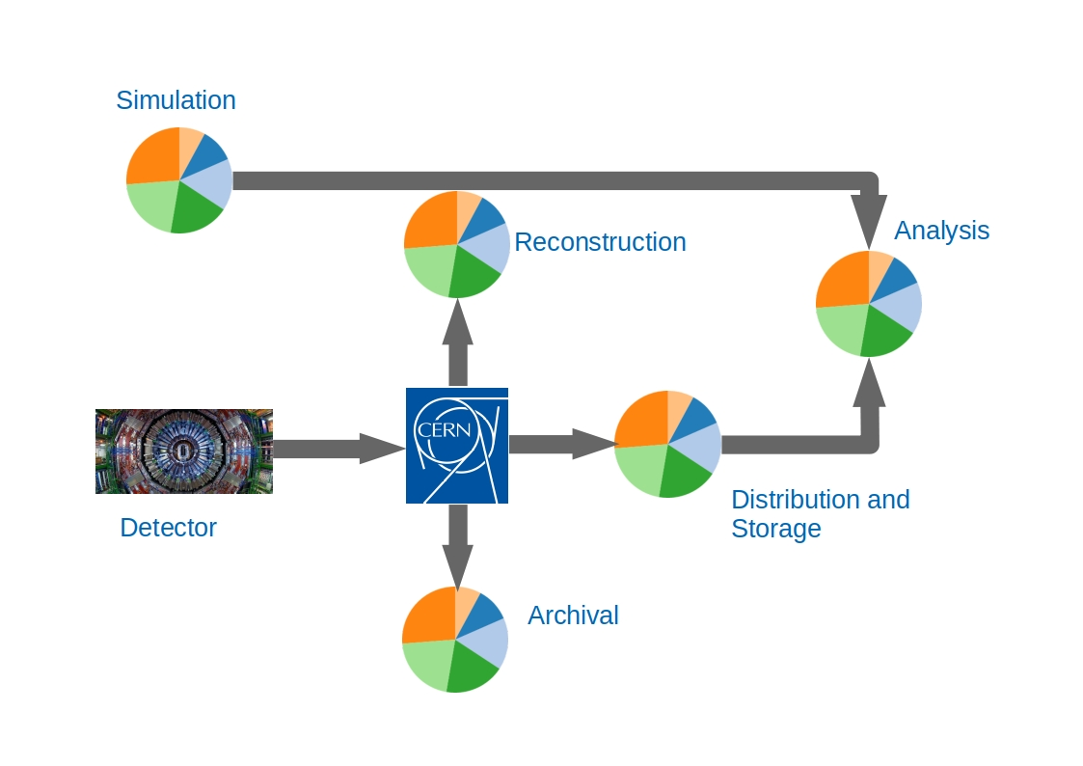
WLCG Use Case
Workflows
>50% the CPU goes on simulation.
Most of the rest is reconstruction.
The remainder is analysis.

Slide 16
User Stories for Smart Catching
As a system admin, I want to
setup a system to proxy the HTTP requests to the storage frontend of site providing the data
choose the population algorithm for the cache
Set the QoS service of the data
As a user, I want to
Authenticate to the caching system with a VOMS proxy
Authenticate with OpenID Connect credentials for the caching system
Set the QoS service of a particular data set

Slide 17
Requirements
Performance requirements
Handle HTTP requests to the storage > 1000 requests /m
Communication with the remote storage is minimised and clients served by the acquired CPUs benefit from locality and faster response time. CPU efficiency should be >90%

Slide 18
ECRIN Use Case
Problem: Distributed files and data objects across different repositories. Metadata heterogeneity. Sensitive Data
Goal: Single environment to make clinical trial data objects available for sharing with others. Sources are spread over
a variety of access mechanisms
several different locations
growing number of general and specialised data repositories
trial registries
Publications
the original researchers’ institutions
XDC Solution: Onedata
Metadata management and discovery
Harvesting
Secure Storage

Slide 19
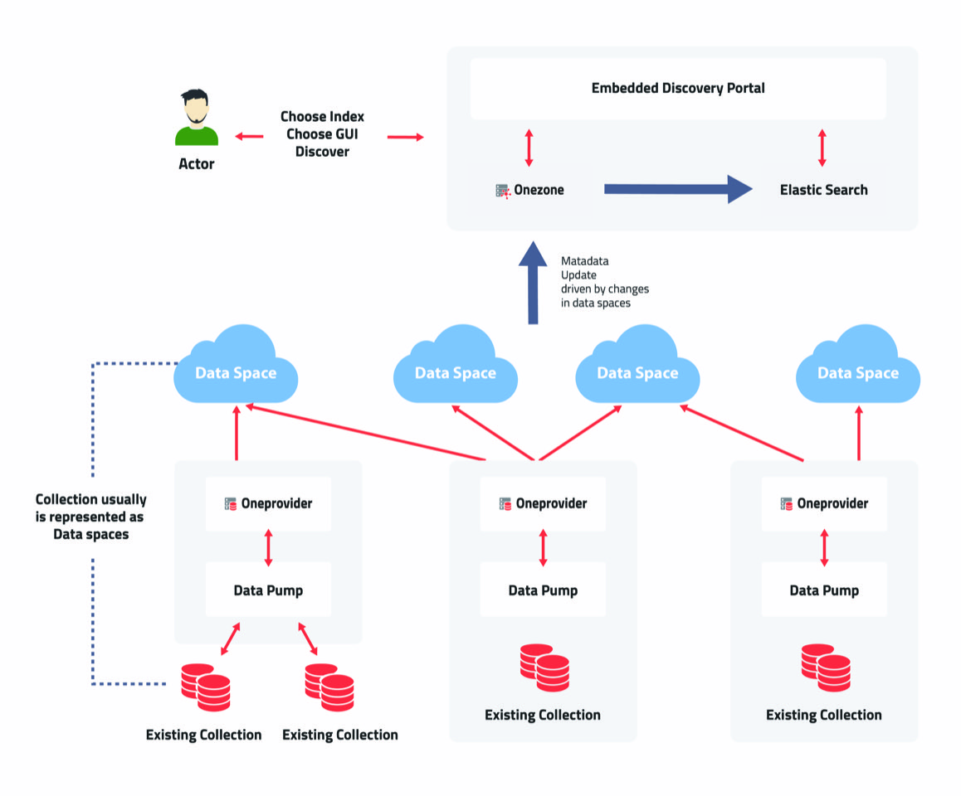
ECRIN Use Case Diagram

