Slide 1
Demand for EOSC services
SVI (Surfaces, Glasses, Interfaces)
CNRS – Saint-Gobain Research joint laboratory

Slide 2
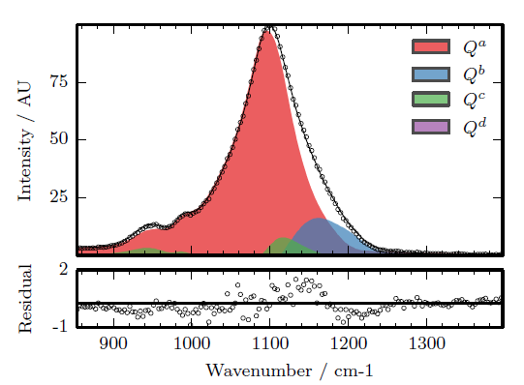
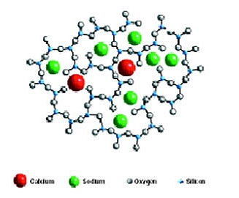
Introduction
Statistical analyses of Raman spectra of glasses
Based on machine learning
Applications: inference of glass structure, separation of sources, prediction of composition…

Slide 3
Main Use case
What?
Raman spectroscopy data
Share experimental results
Standardized Treatments in pre-configured environment (Python package)

Slide 4
Main Use case
How?
Database (SQL?)
To be filled by a custom script (to be created) from the proprietary datafiles
Access
SSH+X11 forwarding; Web Server
< 10 simultaneous connections
Computing and storage
4 cores ; RAM = 16 Gb; Disk space = 300 Gb
Software
Scientific Python suite (eg Anaconda: scikit-learn, numpy, scipy, matplotlib, Jupyter)
DB management

Slide 5
Main Use case
Who?
Three labs
SVI
B. Hahlen’s lab
C. Le Losq’s lab
Administrators
User lambda (PhD students, Interns, …)

