Slide 1
T10.3 Meeting introduction
Diego Scardaci
EOSC-hub T10.3 leader and AMB co-chair
Dissemination level: Public/Confidential If confidential, please define:
Disclosing Party: (those disclosing confidential information)
Recipient Party: (to whom this information is disclosed, default: project consortium)

Slide 2
SOCRM-04 Provide technical support
Procedure available at https://wiki.eosc-hub.eu/display/EOSC/SOCRM-04+Provide+technical+support
Still open for comments!
Deadline Fri March 8th

Slide 3
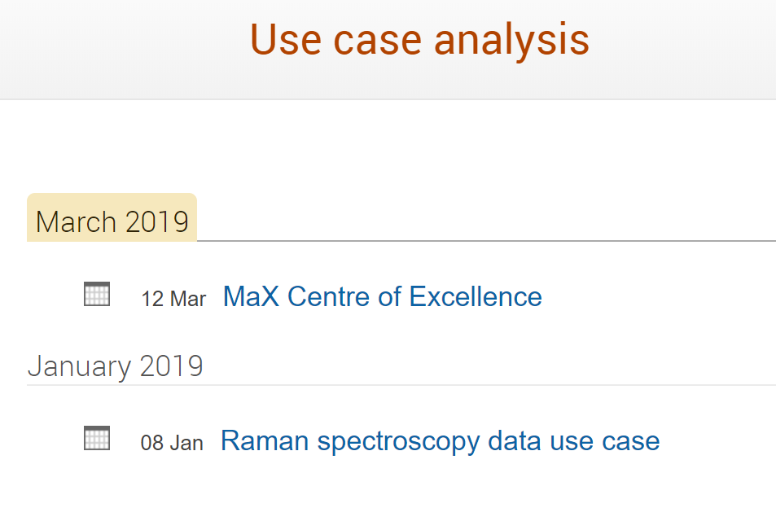
Indico entry for meetings with communities
https://indico.egi.eu/indico/category/272/

Slide 4
T10.3 google folder
https://drive.google.com/open?id=0B8jWMwAsaTo-MWRhZTVEUTV5ekk
Send me your google e-mail address to grant you the edit rights

Slide 5
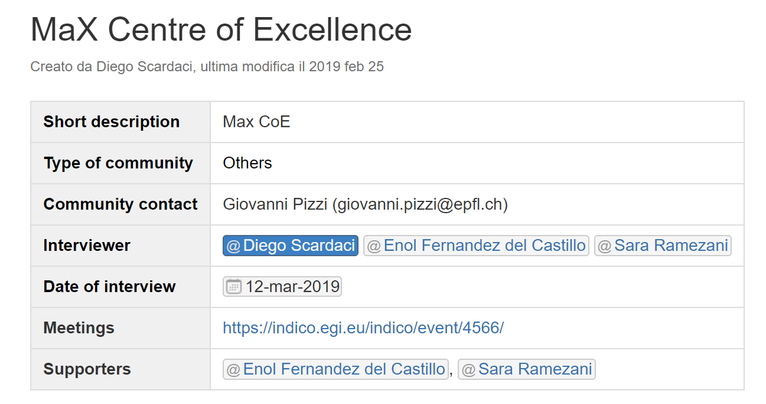
Changes on the Community Requirement DB
Community requirements DB available at https://wiki.eosc-hub.eu/display/EOSC/Community+requirements+DB

Slide 6
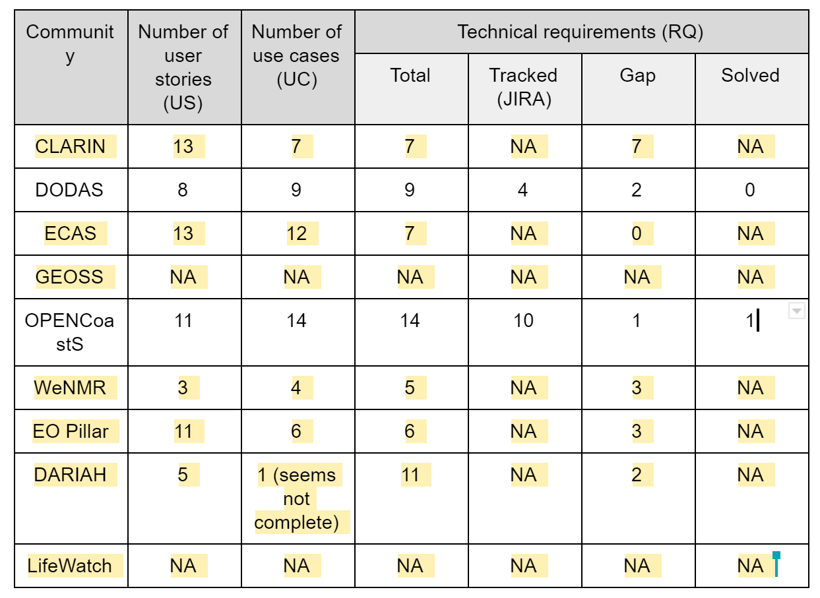
D10.5
https://docs.google.com/document/d/1Cb6eYBHITz8JiFALk4U9y2EulLdLDWu2sU21VERoiYc

