Slide 1
Disclaimer:
Slides are based on 1/Mar/2019 status of https://wiki.eosc-hub.eu/display/EOSC/Community+requirements+DB
Report about WP8 use cases and requirements
Gergely Sipos (WP8 coordinator)
Dissemination level: Public

Slide 2
Status
8 Competence Centres in the project
All of them have Requirement DB entries, but only 6 with content
CCs:
8.1 ELIXIR
8.2 Fusion
8.3 Marine
8.4 EISCAT_3D
8.5 EPOS-ORFEUS
8.6 Radioastronomy (LOFAR)
8.7 ICOS-eLTER
8.8 Disaster Mitigation
Ready for and require WP10 support
Working with them to get content
On the next slides RED TEXT indicates requirements already submitted to JIRA

Slide 3
8.1 ELIXIR
Establish a federation of cloud sites, each providing storage and compute capacity for researchers. Replicate reference datasets to these sites using the ELIXIR RDSDS service
Clouds: EBI, CSC, CESNET
Access the setup with ELIXIR AAI (Cloud providers, data providers, researchers)
RDSDS: Prototype available as container with Kubernetes based on FTS and Globus Online.
Provide a central FTS that the ELIXIR service can use as back-end → Jira #21
EOSC-hub to provide a ‘Kubernetes as a service’ interface for the EGI Cloud → Jira #22

Slide 4
8.2 Fusion
Two use cases:
A multi-cloud VO with opportunistic access to run containerized workflows
Setup a cloud federation (new VO) → Jira #73
Kubernetes access on the federation for PROMINENCE → EGI Cloud user guide was sent to the CC
Intermediate data can remain visible in the cloud, final data should be accessible from user’s home institute
Storage to copy and safely store scientific data from fusion sites
Setup a B2SAFE allocation → Jira #44
2 copies (besides the generating fusion site)
Embargo period with restricted access
Common needs to both use case:
AAI interoperability (EGI cloud – Check-in, B2SAFE – B2ACCESS; PROMINENCE – IAM) → Jira #xx (link to be fixed)
Data access with the “data access mechanism (UDA)” protocol

Slide 5
8.3 Marine
Two areas of work: 1. Argo; 2. SeaDataNet
Argo use case:
Dropbox-like system that makes relevant data files visible for each user in his/her ‘personal folder’ which can be accessed from Jupyter.
SeaDataNet use case:
Assess DataHub for caching and remote access to data from cloud compute applications
Requires a DataHub testbed: CYFRONET? Others? → Jira #77

Slide 6
8.4 EISCAT_3D
Finalise the EISCAT_3D Portal which will provide access to EISCAT scientific data, metadata, community applications and compute-data resources where all these can be combined.
Setup based on DIRAC, B2*, Integrated AAI
Cloud capacity test recently started at CSC (not an EGI Cloud site)
Capacity and technical development within the CC members
The big question will be the long-term provisioning → A case for procurement?

Slide 7
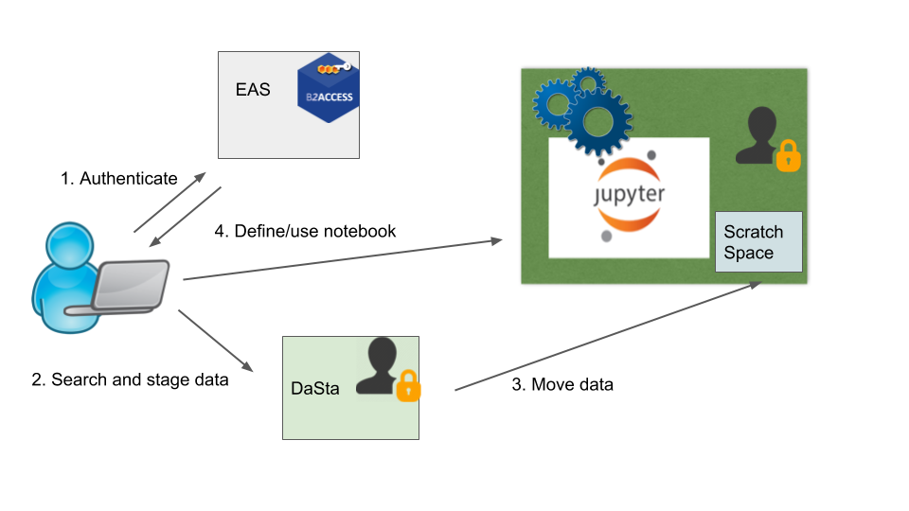
8.5 EPOS-ORFEUS
Access and calculate with data from EIDA sites via Jupyter(s)
Accessing 4 iRODs-B2SAFE storage sites from a single EGI Notebook → Jira #66
Adding custom kernels to EGI Jupyter → Jira #65
Personal data folder with staged data available for mounting in the Jupyter notebook → Jira #64
A catalogue of data management policies (e.g replication policies)? – Is there such a service in EOSC? Will there be?

Slide 8
8.6 Radioastronomy
SSO access to federated storage and compute resources to access LOFAR data and run containerised workflows on them:
12 requirements in Confluence, 5 Jira tickets (for now):
(RQ1-RQ2-3) Federated AAI for LOFAR services with Check-in → Jira #80
(RQ4) LOFAR-scoped PID service → Assumed to be provided by SurfSARA EPIC service (in CC)
(RQ5-6) B2SHARE with LOFAR metadata schema, sharable links, capacity → Jira #81
(RQ7) B2FIND that can use the LOFAR metadata model and PIDs → Jira #82
(RQ8) CVFMS mounting on processing clusters → Jira #83
(RQ9) Support for Singularity containers on processing clusters → Jira #84
(RQ10) Support for CWL workflow framework → Jira #85
(RQ11) New dCACHE features (Webdav, Macaroons, …) → dCACHE team in the CC
(RQ12) Integrate storage and compute systems in accordance with LOFAR processing workflows → CC members
Capacity requirements are also provided

Slide 9
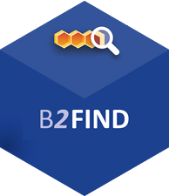
8.7 ICOS
Handle, Datacite
B2FIND, DEIMS,
FLUXNET, EOSC catalogue, …
ICOS linked open data
catalogue and repository
B2SAFE Trusted Repository
Cloud processing
Ansible, CSC OpenStack
AAI, User visualisation/analysis
e.g. Jupyter Lab/Hub
Field instruments
Containerized data processing module, Ansible orchestration, OpenStack
Community Linked Open Data repository (RDF, SparQL endpoint) publishes to global (meta)data systems (GEO, WMO, DataCite)
FAIR, data license, identification, usage tracking essential
No content in Requirement DB.
All this developed by CSC in WP8 → No need for WP10 involvement

Slide 10
Next steps
In WP10
Assign JIRA tickets to owners
Indicate and communicate progress
Set ticket into progress state; Have an owner; add progress info as comment; Present status at CC meetings
Make sure every service is available as ‘component’ in Jira so we can assign issues to them (e.g. EGI Notebooks missing)
In WP8
Collect input from remaining CCs (ICOS, Disaster mitigation)
Open further tickets as needed

Slide 11
Feedback on WP10 Jira entry form
Task number – don’t make this compulsory, OR add link to Task list
TCOM area – don’t make this compulsory. BTW when to use this? What to choose e.g. for Notebooks.
'Service components' – It’s sub-components actually (because Services are called Components in the Jira GUI).
Change the name and provide explanation
'GAP' - provide explanation, make 'AP' lowercase (it's not an acronym)

