Slide 1
OMB March 2019
Matthew Viljoen – EGI Foundation
EGI Operations Manger

Slide 2
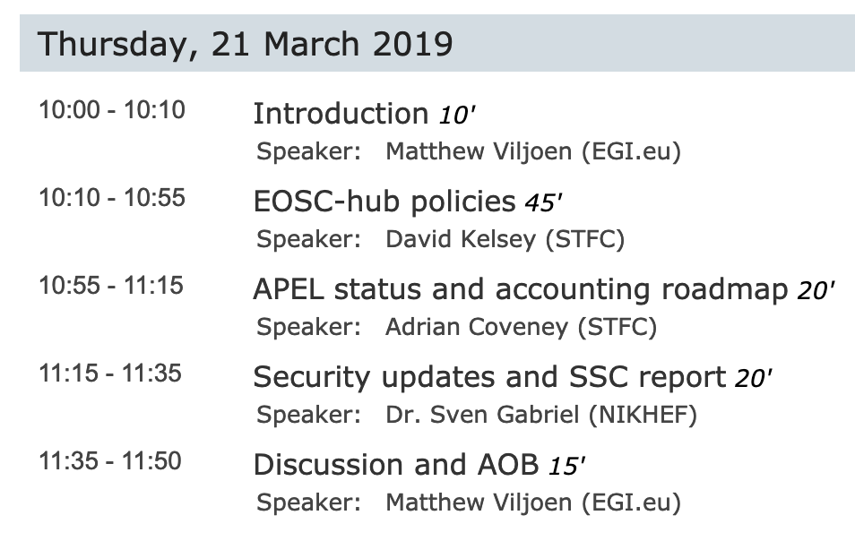
Agenda

Slide 3
HTCondor-CE integration - Status
Procedure: https://wiki.egi.eu/wiki/PROC19
Ticket: https://ggus.eu/index.php?mode=ticket_info&ticket_id=139377
Accounting:
Successfully tested the data accuracy @Liverpool (with APEL 1.8.0) https://twiki.cern.ch/twiki/bin/view/LCG/HtCondorCeAccounting
Need to involve more sites
Integration with UMD:
Product UMD card created
Working on ansible files for automated deployment to make easier the verification tests
Monitoring:
Discussion ongoing about the nagios probes

Slide 4
DP Legacy end of support – Migration to Dome
on Jun 1st 2019 the support to DPM Legacy (LCGDM) is going to end
since DPM 1.10.3 release, it is possible enabling the non-legacy mode DOME (Disk operations Management Engine)
97 sites (112 servers) involved
Testing on-going with some WLCG sites
No rush (yet) for the migration:
Found some issues that are going to be fixed in DPM 1.12.0 (not yet in EPEL)
Waiting for some more tests before giving the OK
One more month or so
Start the campaign after tests with DPM 1.12.0 are OK
With DOME enabled, the DPM legacy mode (SRM protocol) can be kept to allow a smooth migration

Slide 5
UMD 4.8.2
released including updates for CentOS7 and SL6, details here:
http://repository.egi.eu/2019/03/11/release-umd-4-8-2/
Notes:
11 Mar

Slide 6
Accounting check
Looking at could accounting data, investigated on suspicious drops (>50%) of VO/site resources' usage in the last months
Findings:
there is a spike on July 2018, probably related to cASO upgrade triggering previously-missed records → nothing to do
2 minor temporary drops in Sept-Oct 2018 on two different use cases
Still under investigations

Slide 7
IPv6 readiness
APEL-SSM → IPv6-ready ✅
ARC → IPv6-ready ✅
lcmaps-plugins-scas-client → IPv6 compliant ✅
NGI_CH → almost done (4/6 sites dual stack) ☑️
NGI_FRANCE → almost done ☑️
NGI_IL → almost done (2/3 sites dual stack) ☑️
NGI_NDGF → READY (waiting for VOMS to get IPv6 compliant) ✅
NGI_SI → DONE! ✅
NGI_TR → almost done (6/8 sites dual stack) ☑️
NGI_UA → in progress (some services still running IPv4 only) ☑️
https://wiki.egi.eu/w/index.php?title=IPV6_Assessment

Slide 8
Finally and Next OMB
Finally…
High level Ops objectives for 2019 in next EGI newsletter
EGI Conference 2019 (6-8 May, Amsterdam)
https://indico.egi.eu/indico/event/4431/program
Next OMB
Move to monthly meetings to cover all Operations tools
During May EGI Conference (also poss. 18 Apr, if necessary)
To be confirmed on ML
After EGI Conference, may move back to monthly

