Slide 1
Updates about the EGI Applications on Demand service
Giuseppe La Rocca
EGI Foundation

Slide 2
What does the Service offer ?
It is an “open platform” to share and reuse applications.
The service consist of:
A pool of cloud compute resources for both compute/data intensive applications and for hosting of scientific services.
Applications enabling tools (e.g.: Science Gateways and portals).
A simplified access to the EGI infrastructure (based on EGI AAI Check-In + robot).
A portfolio of scientific applications offered “as a services” through online graphical environments.
A network of consultants who can provide guidance on the use of the service.

Slide 3
The high-level service overview
App. 1
…
App. K
App. 1
…
App. L
Application hosting framework 1
Application hosting framework 2
Cloud compute and storage resources
The EOSC Marketplace
Usage stats
EGI Accounting system
Users
Application hosting framework 3
Application hosting framework X
Scientific publications
Identity vetting
Approve,suspend users
App. 1
…
App. M
App. 1
…
App. N
Support teams
Usage stats
The Marketplace is the entry point to access the Service and request the available applications

Slide 4
The EGI Applications on Demand service components

Slide 5
The Service Components
Application portals, Science Gateways, VREs
Elastic Cloud Computing Cluster (EC3)
HNSciCloud vouchers
Open-Source Serverless Computing Platform for Data-Processing Applications that can be deployed on multi-Clouds.
FutureGateway Science Gateway (FGSG)
WS-PGRADE/gUSE
The EGI VMOps dashboard
Catch-all instance of the EGI Notebooks service (➔ Gergely’s presentation)
Scientific applications (hosted in the gateways/portals/VREs)
Chipster, Galaxy, AutoDock Vina, NAMD, RStudio, REPAST, other tools
A pool of resources that the applications can use
3 Cloud providers are supporting the service (CESGA, IN2P3-IRES and INFN-CATANIA-STACK) with 210+ vCPU cores, 700GB+ of RAM and 1.2TB of block storage.
A Credentials Management System
Based on X.509 and Per-User Sub-Proxy certificates

Slide 6
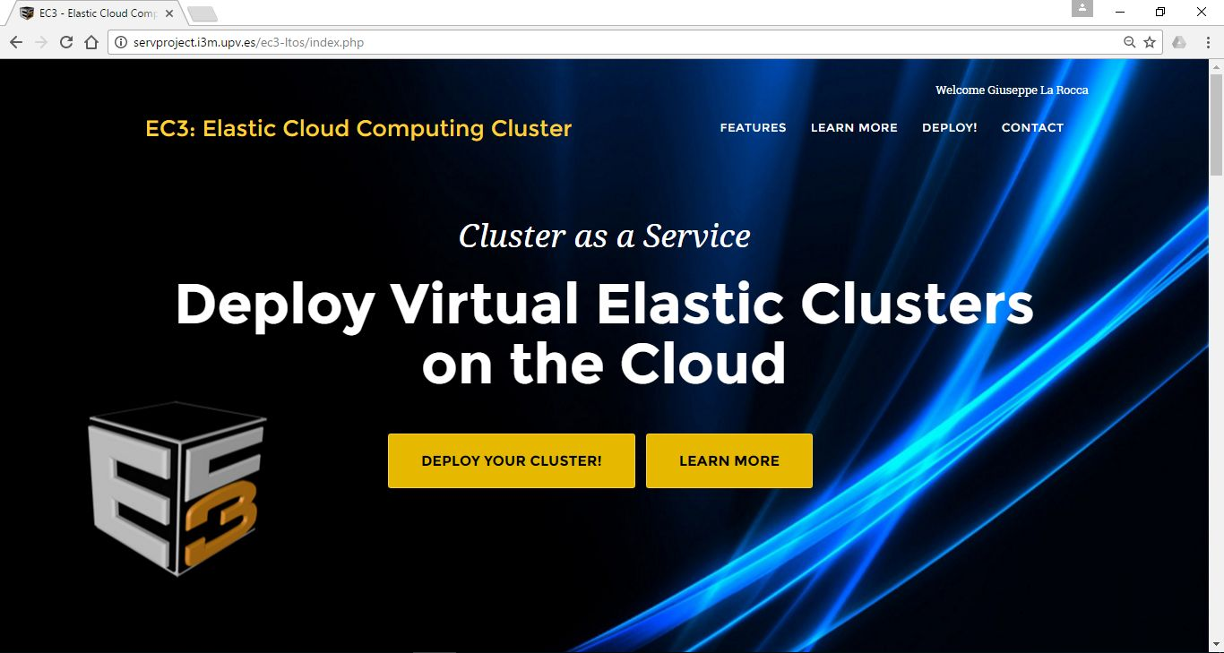
Elastic Cloud Compute Cluster (EC3)
The Elastic Cloud Compute Cluster (EC3) is an open-source software platform to dynamically deploy complex scientific virtual computing infrastructures on top of IaaS
Developed by the Polytechnic University of Valencia (UPV)
EC3 Webinar

Slide 7
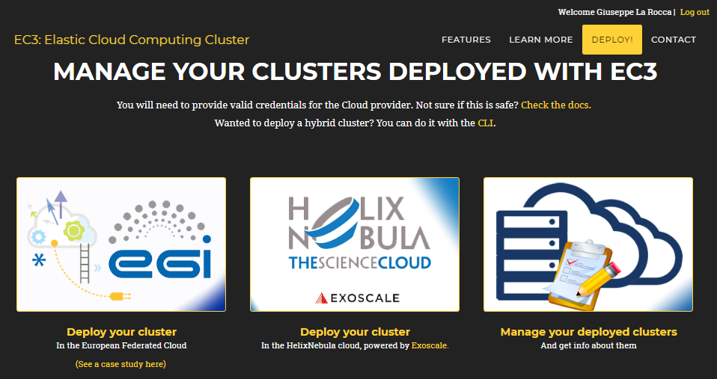
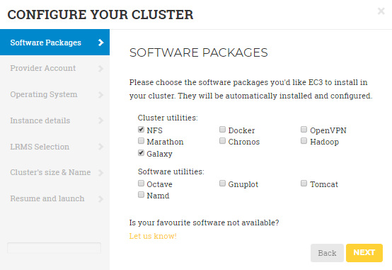
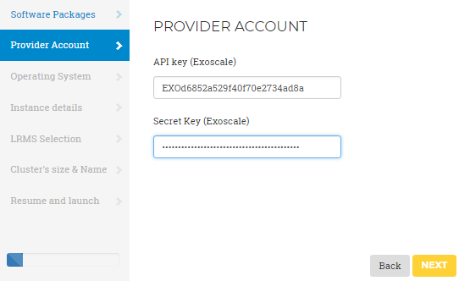
Scaling applications on HNSciCloud hybrid cloud infrastructure
Last year, the EC3/IM of the Applications On Demand platform was connected to the HNSciCloud contractors

Slide 8
The HNSciCloud voucher scheme
CERN and STFC are sponsoring the long-tail of science using the Exoscale vouchers (1 voucher = 250 EUR worth of compute and storage).
The pricing model & instances type

Slide 9
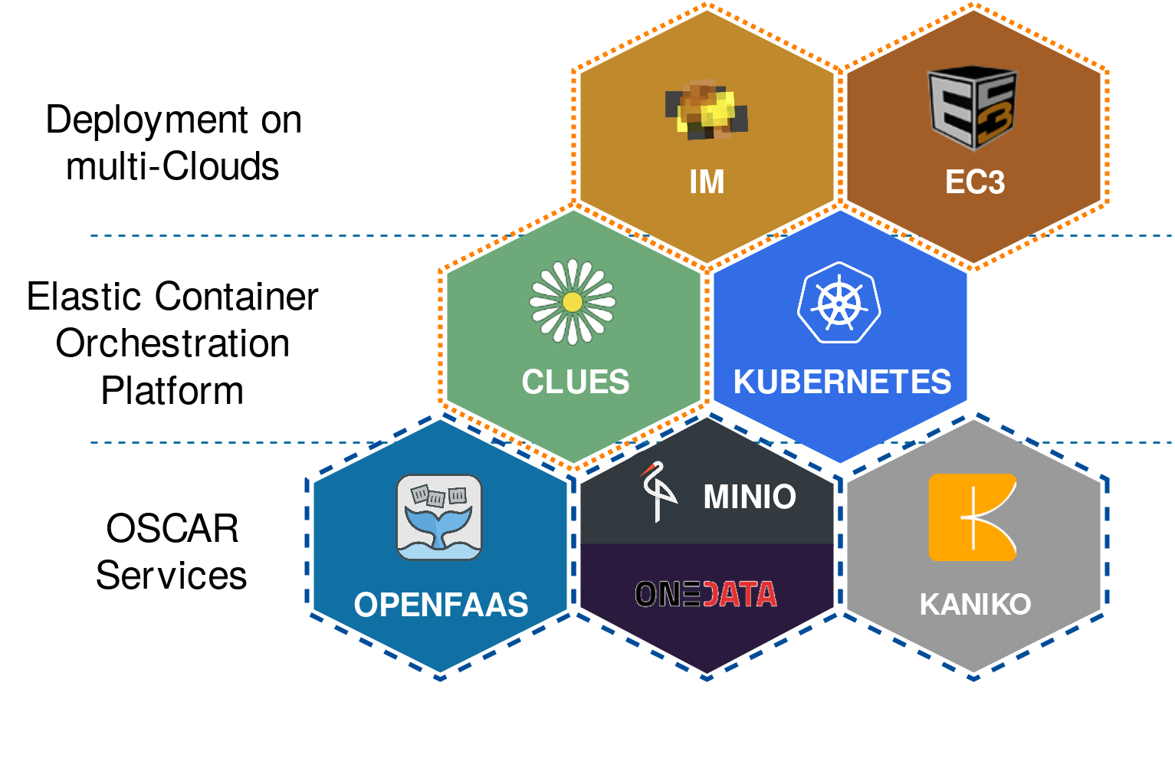
OSCAR
OSCAR: Open-Source Serverless Computing Platform for Data-Processing Applications that can be deployed on multi-Clouds.
https://github.com/grycap/oscar
Creates highly-parallel event-driven file-processing serverless applications:
Executes customized runtime environments provided by Docker containers run on an elastic Kubernetes cluster (dynamic provision of nodes).
Users upload files to a storage back-end triggering the parallel invocation of a function that runs a user-defined script in charge of processing each file.
Integrated with EGI Applications on Demand, EGI Federated Cloud and EGI DataHub.

Slide 10
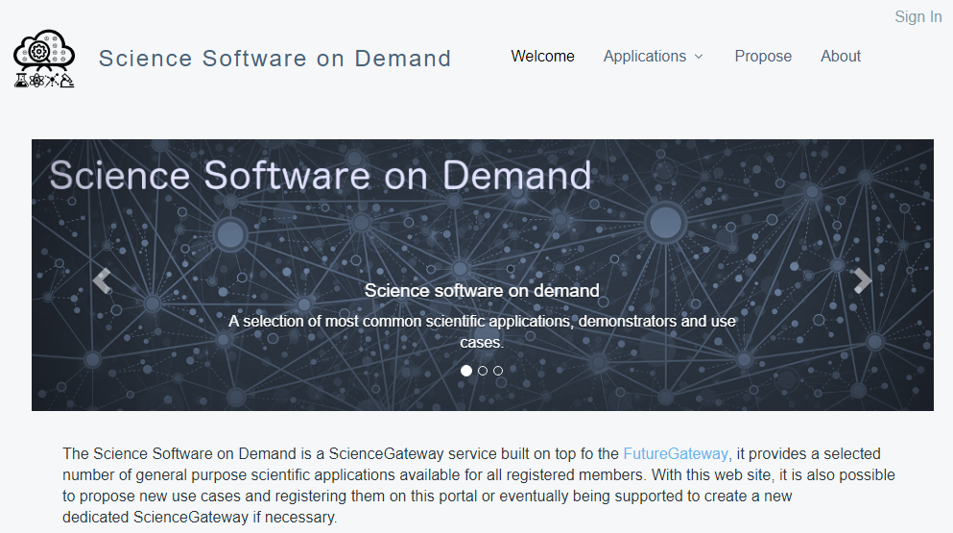
FutureGateway Science Gateway
The CSGF was upgraded with the FutureGateway Framework developed in the context of the Indigo-DataCloud project.
Developed by INFN-CATANIA

Slide 11
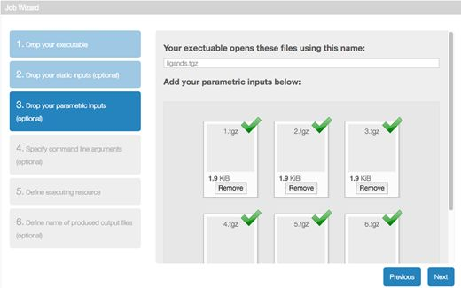
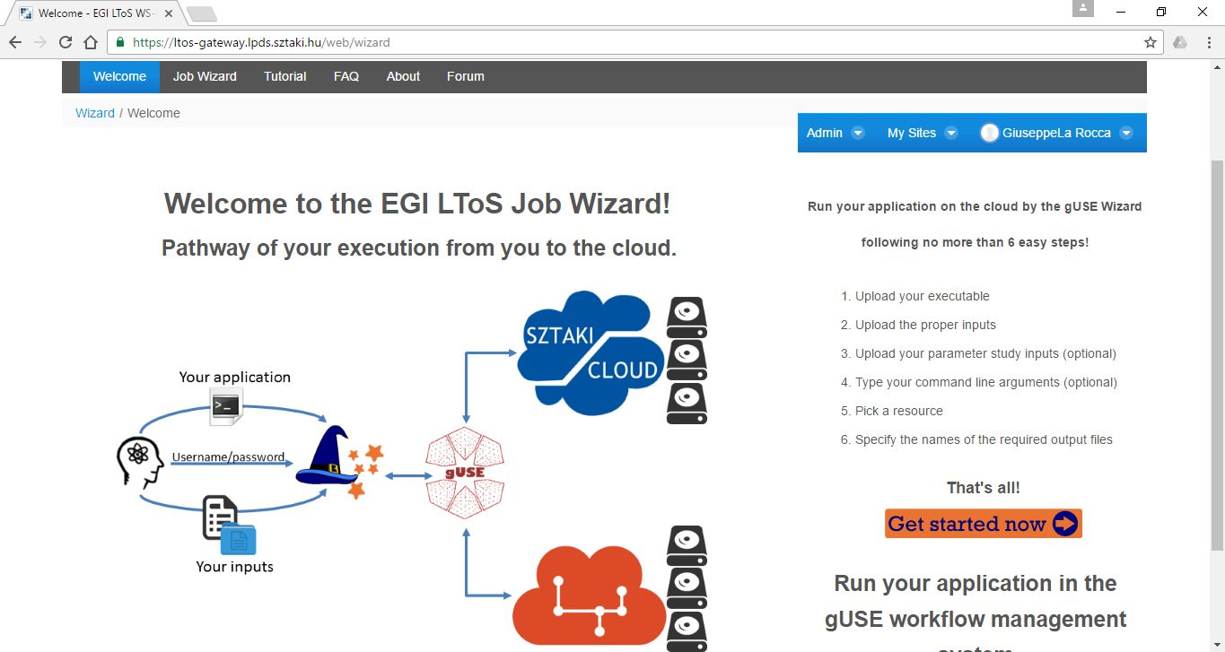
Science Gateway/WS-PGRADE
The WS-PGRADE Science Gateway offers a workflow-oriented Science Gateway framework with different customization methodologies.
Developed by MTA-SZTAKI and released under the Apache 2.0 license

Slide 12
Usage statistics

Slide 13
Statistics about the service since October 2017
Most asked for Chipster, 2nd for Galaxy

Slide 14
Publications
By users:
Evaluation of a data-based interface for heterogeneous systems (Master Thesis)
Changes of dimension of EEG/ECoG nonlinear dynamics predict epileptogenesis and therapy outcomes
Neurobiology of Disease, Volume 124, April 2019, 373-378
https://doi.org/10.1016/j.nbd.2018.12.014
Molecular modeling and biological studies show that some μ-opioid receptor agonists might elicit analgesia acting as MMP-9 inhibitors
Future Medical Chemistry, April 2019
DOI: 10.4155/fmc-2018-0535
About the service:
The EGI Applications on Demand service
Proceeding of the IWSG2017, Pozan
https://documents.egi.eu/document/3132

Slide 15
Links
EGI Applications on Demand
https://www.egi.eu/services/applications-on-demand/
https://wiki.egi.eu/wiki/AoD
EGI Marktplace
https://marketplace.egi.eu/ (Click on Applications)
EGI Service Operation Level Agreements (OLAs):
https://documents.egi.eu/document/2782
EGI VO Operation Level Agreements (OLAs):
https://documents.egi.eu/document/2773

Slide 16
Final thoughts
The EGI AoD service is open for anyone (users, NGIs)
How to increase the visibility of the service in your country ?
What application would you like to be present ?
Please provide your comments/feedback for improving the service.

