Slide 1
Draft document: PID core services in the European Open Science Cloud
www.project-freya.eu
twitter: @freya_eu

Slide 2
Pre-meeting in Prague
Action 4: Collaborate to write a white paper on our joint vision of European (or global) PID federated services. How do the FREYA core PID services relate to the EOSC services? This relates to the EC milestone on the EOSC federated core: which components of PID infrastructure should be core EOSC (and therefore funded by the EC) services? ACTION => use part of the planned workshop to start working on this.

Slide 3
Approach

Slide 4
Paper outline
Introduction
PID Services
The Value of PIDs
PID Services in the European Open Science Cloud
Recommendations

Slide 5
PID Policy in the EOSC
What constitutes a PID
Characteristics
PID Provider
Minimum Requirements for a trusted provider
Core PID Services
Core PID Types

Slide 6
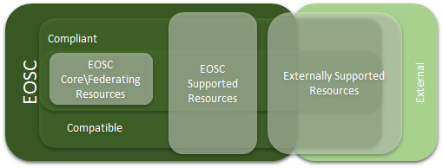
PID Services in the European Open Science Cloud

Slide 7
PID Services in the European Open Science Cloud
Core PID Services offer compliance to policy
PID Policy
Enabler of FAIR Data
Thus should considered as Federating and Enabling
Also Domain Specific PID Services
Shared or Added Value
Added Value
Resource
Shared Resources
Federating and enabling services
Compliance

Slide 8
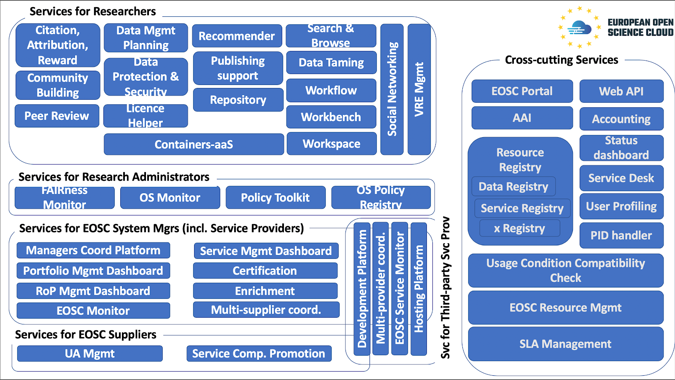
PID Handler Service

Slide 9
PID Handler Function
PID Service Function | Description | User
PID creation : | creating new PIDs conformant to a PID Scheme, | Resource Creator/Owner
PID assignment: | assignment of PIDs from a PID Scheme to a resource and the association of metadata on the resource | Resource Creator/Owner
PID resolution: | the direction to the associated resource from a PID under a PID Scheme, either directly or to a digital proxy. | Resource Seeker
PID description:. | the delivery of the metadata associated with a PID under a PID Scheme to allow the user to assess the associated resource | Resource Seeker
PID search: | the PID collection should be searchable via its metadata to discover resources. | Resource Seeker

Slide 10
PID Types in the EOSC
EOSC Resources include services, datasets, software, support, training, consultancy or any other asset
But core PID Types need to be
Generic: apply across all subject domains and disciplines; and
Mature: have stable and trusted Schemes with established PID supporting organisations
“Mature” - needs to be defined under PID Policy recommendations
Initial Core PID types, supported in Federating Enabling services
Data
Published Documents
People
Candidate Core PID Types
Organisations
Instruments
Software:
Funders and Grants

Slide 11
Compliant and Compatible PID Services
Other PID services are more domain specific and should be considered as contributing to the EOSC for a specific community. Thus these are not appropriate as core services, but depending on their usage and maturity, they might be Compatible or Compliant services.
Examples would include identifiers for data used in particular domains (e.g. identifiers for samples (e.g. International Geo Sample Number (IGSN)),
schemes for classifying entities within a domain (e.g. InCHI or SMILES used to identify chemical compounds, LSIDs in Life sciences).

Slide 12
Rules of Participation
Emphasis on openness, transparency and inclusiveness
Main rule: EOSC services shall be registered in an EOSC compliant or compatible service catalogue visible to the global EOSC gateway
7 additional specific requirements for information, functionality or characteristics which services should provide or possess
Machine-readable metadata, service PID - Needs to be defined
Service terms of use and policies - including adherence to PID Policy
Description of how accessibility and interoperability are ensured by the service Including use of PIDs for access
Enable portability of data and services where possible - PIDs provide invariance and redirection
Information about user charges/fees
Adherence to a minimal set of quality guidelines (e.g. TRL, CoreTrustSeal) – being defined in EOSC projects
Information about data management mechanisms for storing, processing and publishing content, including whether FAIR principles are applied to data; whether sustainability, openness and reproducibility of data are provided; data privacy and security practices; documentation, support and training materials and contact channels
Stricter rules for EOSC Core Resources’ service provision (SLAs) and interoperability

Slide 13
PID Graph Services
Enabling trusted connections between systems through Persistent Identifiers would allow EOSC to link the “crown jewels” of EU data infrastructures. Thus to support the PID Graph, we need to define a set of supporting services. For example:
Linking PIDs: cross-referencing PIDs (from different schemes).
PID Graph construction: building PID Graphs from components,
Query onto the PID graph - returning results of a GraphQL query onto a PID Graph.
Displaying (sections of the) PID Graph
These should be included as candidate core services within the EOSC.

Slide 14
Recommendations
PIDs are the key building blocks of a federated, FAIR research infrastructure and should form the building blocks of the European Open Science Cloud.
PIDs are needed to monitor, identify, and report on the progress of EOSC and should be used for this purpose.
There should be 5 PID core service components that are covered within EOSC: PID creation, PID assignment, PID resolution, PID description and PID search.
EOSC should support as core PID resource types generic and mature PID Schemes for at least : publications, data, and people
EOSC should consider as additional candidate Core PID Resource Types: Organisations, Grants and Funding, Instruments and Equipment, and Software
The services underlying PID graph functionality should also be considered candidate core services.
The services that provide PIDs should be trustworthy, sustainable and have a strong governance model.
The PID services registry should be integrated into the overall EOSC services offering and maintained beyond FREYA.

