Slide 1
FREYA/EOSC-hub workshop Amsterdam, 8–9 July 2019 Introduction to FREYA
Simon Lambert (UKRI-STFC)
FREYA Project Coordinator

Slide 2
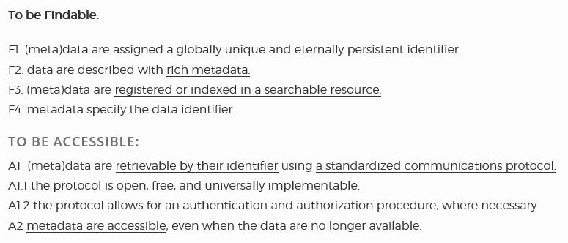
PIDs and e-infrastructure
Persistent identifiers are well established in the research lifecycle
PIDs are an essential component of FAIR
The THOR project (predecessor of FREYA) introduced new PID services and enhanced interoperability
There is potential for going much further
New types of entity with PIDs
Richer connections between PIDs (data discovery, provenance, CRIS, …)
Governance of the PID infrastructure

Slide 3
The FREYA partners

Slide 4
The three pillars of FREYA
PID Graph
A vision of linking together a wide range of entities with PIDs to allow complex queries
Enabling technologies to make the vision a reality
Applications showing the vision in reality in diverse domains
PID Forum
Stakeholder community brought together by FREYA
pidforum.org
PID Commons
Governance model and structures for sustainability of the PID infrastructure

Slide 5
The approach of FREYA
WP1 Project management
WP2 PID core services | IMPROVING WHAT WE HAVE
WP3 New PID types | BUILDING WHAT WE DON’T HAVE
WP4 Integrating the PID Graph | PUTTING IT TOGETHER in PRACTICE
WP5 Iterative Engagement | SHARING IT
WP6 Sustainability | MAKING IT LAST

Slide 6
FREYA and EOSC
FREYA operates in the context of the European Open Science Cloud and is expected to help build the EOSC
Intrinsic motivation (the PID Graph vision) and extrinsic motivation (the vision of EOSC)
FREYA must work with other projects and mechanisms in the rapidly developing EOSC

Slide 7
FREYA and EOSC: milestones
From the Commission Staff Working Document “Implementation Roadmap for the EOSC”
FREYA and RDA Europe 4.0
“Define a Persistent Unique Identifier policy for FAIR data” (Q4 2019)
FREYA and EOSC-hub and OpenAIRE-Advance
“Develop initial EOSC federating core including the EOSC shared resources” (Q4 2019)

Slide 8
FREYA’s achievements in first 18 months
A rich variety of PID Graph user stories has been developed
The vision of the PID Graph has been clarified and its enabling technologies established
Pilot applications show the potential of the PID Graph
Thorough assessment of potential new PID types
High profile in key events and communities
Creation of the PID Forum
Strong international connections (beyond Europe)
Work with EOSC partners

Slide 9
The outlook for the remainder of the project—some highlights
Focus on GraphQL as means of connecting the PID Graph
PID Services Registry (and relationship with EOSC catalogue)
Prototypes with new PID services
Establishment of RDA Interest Group
Intensive work towards PID Commons
Work with EOSC partners on policies, services, architecture, training

