Slide 1
EOSC-Hub Service Portfolio

Slide 2
EOSC-hub Service Categories
Discover and Reuse
Processing & Analysis
Data Management, Curation & Preservation
Access, Deposition & Sharing
Federation services
EOSC-hub Service Catalogue: https://wiki.eosc-hub.eu/display/EOSC/EOSC-hub+service+catalogue

Slide 4
Services for the Research Data Lifecycle
4
Access, Deposition & Sharing
Application DB (software & VM)
B2DROP (data)
B2Note (data)
B2SHARE (data)
DataHub
3
1
Data Management, Curation & Preservation
Federation Services
Discover & Reuse
B2HANDLE
B2SAFE
European Certified Trusted Repository
Federated AAI. monitoring, accounting
SLA and order Management
Security incident response and policies
Technical support & Training
B2FIND (data)
Marketplace (Services)
2
Processing & Analysis
Applications on Demand
Federated HTC & Cloud Compute IaaS & PaaS
Processing of sensitive data
Jupyter Notebook
Thematic data analytics
Scientific Workflow Management, Orchestration (DIRAC, PaaS Orchestrator)

Slide 5
EOSC-hub Service Provisioning Model
Shared Services offered in multi-tenant mode
EOSC-hub funded: Management, access provisioning and technical support
Community funded: Service enabling and integration, customization
Services requiring the operations of dedicated instances and/or allocated capacity
EOSC-hub funded:
Service capacity for piloting activities (depending on complexity)
Brokering (liaison with service suppliers matching RI requirements)
Technical support during testing phase
Community funded:
Service customization to the RI’s needs and enabling
Service capacity for large-scale piloting (testing phase) and/or full service scale provisioning (production phase)
Operational costs (e.g. different funding options possible: subcontracting, in-kind contributions provided by third parties against payment, person months)

Slide 6
Engagement levels for service providers
Governance
Participation to service portfolio management and the definition of its policies
Operational
Provisioning of services and resources through the EOSC-hub Marketplace as delivery channel
Participation to coordinated operations of the services provided to the service catalogue
Technical
Enabling of access to services and resources through the Hub: AAI integration

Slide 7
FAIR Data
Findable
Accessible
Interoperable
Reusable
Data has rich metadata, specifies data identifiers, has a globally unique persistent identifier and is registered and/or indexed in searchable resources
Data is retrievable via their identifier, via standard protocols, protocols are open, free and universally implementable, allows authentication and authorization where necessary and metadata are kept accessible when data is no longer available
Data has formal, accessible, shared and broadly applicable knowledge representation, use vocabularies that flow FAIR principles and include qualified references to other (meta)data
Data has plurality of accurate and relevant attributes, is released with clear and accessible data usage license, has associated provenance and meets domain-relevant community standards

Slide 8
EOSC-hub Support to FAIR
Findable
Discovering scientific products, services and resources
Accessible
Enabling access to scientific resources and services
Interoperable
Integrating and maintaining relevant services according to a defined standards roadmap
Reusable
Managing and preserving data (raw data, metadata, software, scientific products, annotation)

Slide 9
Discover and Reuse
Enhance discovery and reuse of scientific products across communities
B2Find
Marketplace

Slide 10
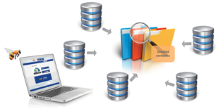
B2FIND
Making Open Science findable
(http://b2find.eudat.eu/)
Provided through EOSC-hub
Cross-disciplinary metadata and discovery service (B2FIND) allowing RI to make their data findable and discoverable in a central catalogue
Metadata can be harvested via OAI-PMH. Possibility to use also APIs as JSON-API’s and CSW2.0 to collect the metadata from the communities.
The project provides support to integrate community data catalogue
To be funded by the community
Elicitation & mapping of metadata schemas in use within the community
Definition of FAIR implementation guidelines (input to EOSC-hub)

Slide 11
EOSC-hub Marketplace
Provided through EOSC-hub:
Marketplace: multi-tenant user-facing platform for service providers to publish their EOSC services and EOSC-compliant data repositories, and collect service orders
Mature services and curated data
The RI retains control and accountability for the services and data published and participate in the management of the Hub service portfolio
Support to usage of common service templates
To be funded by the community:
Service design to set-up a cluster-wide or RI-specific service portfolio
Advice on ISO-compliant service portfolio management process, auditing
Operation of a dedicated customized marketplace (if necessary)

Slide 12
(2) Processing and Analysis
Scale out your computing environment and process & analyse data in a federated environment
Applications on Demand
Federated High Throughput Computing
Federated Cloud Compute IaaS and PaaS
Processing of sensitive data
Jupyter
Scientific Workflow Management, Orchestration (DIRAC, PaaS Orchestration)
Discipline-specific data analytics tools

Slide 13
Applications on Demand
Online scientific applications and application-hosting frameworks with computing and storage for compute-intensive data analysis (https://marketplace.egi.eu/42-applications-on-demand-beta).
Provided through EOSC-hub:
Hosting platform, compute and storage, extendible with new applications, application-hosting frameworks, and HTC or cloud resources: custom applications can be executed on EGI Cloud Compute and High-Throughput Compute services and offered as scalable, online services to researchers worldwide
Application porting support
To be funded by the community:
Porting of applications and support to end-users

Slide 14
Federated High Throughput Computing (HTC)
Run computational jobs at scale on the EGI infrastructure. It allows you to analyse large datasets and execute thousands of parallel computing tasks. HTC is provided by a distributed network of computing centres, accessible via a standard interface and membership of a virtual organisation (https://marketplace.egi.eu/32-high-throughput-compute)
Provided through EOSC-hub:
Technical support
Capacity via brokering to national HTC providers
Services to federate community-owned HTC clusters
To be funded by the community:
Capacity for compute-intensive applications
Service enabling via porting of community applications

Slide 15
Federated Computing IaaS and PaaS
Execute compute- and data-intensive workloads (both batch and interactive)
Host long-running services (e.g. web servers, databases or applications servers)
Create disposable testing and development environments on virtual machines and scale your infrastructure needs (https://marketplace.egi.eu/31-cloud-compute).
Provided through EOSC-Hub:
Multi-cloud IaaS with Single Sign-On (EGI Federated Cloud)
Run Docker containers (deploy and scale Docker containers on-demand)
Appliance Library to share and automatically distribute applications Orchestration to easily move applications across providers.
Unified web dashboard to interact with all providers.
Services to federate community-owned cloud resources
Technical support
To be funded by the community:
Capacity for compute-intensive applications
Service enabling via porting of community applications

Slide 16
Processing of sensitive data
Provided through EOSC-Hub:
If access to data is restricted by National or European regulations or by other confidentiality policies, the sensitive data services provide:
A secure IT platform to store, process, analyse and share data in a secured environment
Provide secure, separated and private environments enforced via strong access rules
Provide consultation and technical support to make use of the Sensitive Data Service
To be funded by the community:
Service provisioning and capacity on the Sensitive Data Services

Slide 17
Jupyter Notebook
Share documents with live code, equations, visualisations and explanatory text.
Provided through EOSC-hub:
Jupyter Notebook service with
AoD integration
Persistent storage
Customized notebook environments
Access to other EOSC services from the notebooks
To be funded by the community:
Community customisation & specific services instances.

Slide 18
Scientific Workflow Management and Orchestration
DIRAC4EGI: Workload management service to distribute jobs and manage centrally thousands of computational tasks on cloud and HTC
TOSCA-based deployment orchestration on multiple IaaS
Provided through EOSC-hub:
Operations of of workflow management system and orchestrator
Technical Support
Compute infrastructure, brokering to national compute providers
To be funded by the community:
Community customisation & specific instances.

Slide 19
Discipline-specific data analytics 1/3
Who | Service
WeNMR. A worldwide e-Infrastructure for NMR spectroscopy and Structural biology | Amber is a suite of programs that allow users to perform molecular dynamics simulations on biological systems HADDOCK is an information-driven flexible docking approach for the modelling of biomolecular complexes. The CS-ROSETTA web server generates 3D models of proteins. DISVIS allows visualising and quantifying the information content of distance restraints between macromolecular complexes. FANTEN is a user-friendly web tool for the determination of the anisotropy tensors and residual dipolar couplings. The GROMACS web server is an entry point for molecular dynamics on the grid. POWERFIT performs a full-exhaustive 6-dimensional cross-correlation search between the atomic structure and the density. The UNIO web server is an entry point for molecular dynamics on the grid. Besides the application software, the services also provide automated pre- and post-processing, the compute, storage and job scheduling and monitoring for running the application.
ENES. Services for Climate Modeling in Europe | The ENES Climate Analytics Service (ECAS) will enable scientific end-users to perform data analysis experiments on large volumes of climate data, by exploiting a PID-enabled, server-side, and parallel approach
Compact Muon Solenoid (CMS) | Dynamic On Demand Analysis Service (DODAS) provides dynamic generation of scalable, monitored HTCondor-based batch system clusters and Spark/Hadoop-based Big Data clusters instantiated on-demand over IaaS clouds

Slide 20
Discipline-specific data analytics 2/3
Who | Service
CLARIN (European Research Infrastructure for Language Resources and Technology) | The Component MetaData Infrastructure provides a framework to describe and reuse existing metadata blueprints
INCD (Portuguese National Infrastructure for Distributed Computation that provides scientific computing services for science) | On-demand Operational Coastal Circulation Forecast Service (OPENCoastS) builds on-demand circulation forecast systems for selected sections of the Portuguese coast
Earth Observation Data and Adding Value Services | MEA is a geospatial data analysis tool empowered with OGC standard interfaces. EPOSAR allows for a systematic generation of ground displacement maps and time series. Sentinel Playground - provide access to complete archive of Sentinel-2 data and ESA Archive of Landsat 5,7 and 8. Datacube Data Analytics Service proposes a multi-sensor, -scale and -purpose datacube approach. Geohazards Exploitation Platform is focused on the integration of Ground Segment capabilities and ICT technologies to maximise the exploitation of EO data. OSS-X Sentinel Service is a web based system designed to provide EO data users with Search - Cataloguing - Order and Dissemination capabilities for the Sentinel products. EO Cloud is a cloud processing platform based on open source OpenStack technology. EODC SDIP provides cloud, high performance computing and data storage facilities.

Slide 21
Discipline-specific data analytics 3/3
Who | Service
DARIAH (pan-European infrastructure for arts and humanities) | DARIAH Science Gateway offers cloud-based services and applications to the humanities research communities
IFREMER (operator of tools for observing and monitoring oceanographic databases) | The INFRAMER platform provides users with marine data collections from state-of-the art integrators in the world. Data collections provided on the platform are public but might require specific license or citation agreement from the users.
EISCAT (next generation incoherent scatter radar system) | The EISCAT_3D portal provides services for data cataloguing, discovery and pre-defined analysis

Slide 22
(3) Data Management, Curation and Preservation
Manage, preserve and curate data according to domain specific policies and provide access to HTC, HPC and Cloud for the processing and analysis of data
B2HANDLE
B2SAFE
European Trusted Digital Repositories

Slide 23
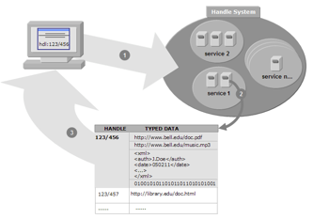
B2HANDLE
Making science referenceable (https://www.eudat.eu/services/userdoc/b2handle)
Provided through EOSC-Hub
Distributed service for storing, managing and accessing persistent references (PIDs) to scientific products
Unified technical interface for minting PIDs and PID namespaces (prefixes)
Replicated PIDs for high availability and resolution, including reserve lookups
Easy integratable and client-side application support through a Python library
To be funded by the community:
Provisioning of community dedicated PID prefixes
Provisioning of B2HANDLE service for minting PIDs

Slide 24
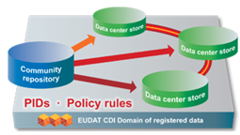
B2SAFE
Supporting data Management Policies (https://www.eudat.eu/b2safe)
Provided through EOSC-Hub:
Service to implement data management policies in a distributed and federated data infrastructure
Enabling access to large scale storage and archiving facilities
Replication, persistent identifier and data curation policies to secure data for long term preservation according to domain specific policies;
Staging of data to HTC/HPC resources (EGI FedCloud, PRACE HPC, etc.)
Technical support on data management policies
To be funded by the community:
Procurement of large pledges of storage infrastructure to be federated in EOSC

Slide 25
European Trusted Digital Repositories
Provided through EOSC-hub:
European Trusted Digital Repositories (ETDR) allowing RIs to publish and manage data in:
Deposit data in repositories which are certified according to a requirements for trusted digital repositories (e.g. CoreTrustSeal, Data Seal of Approval, Nestor Seal or ISO16363)
Ensure reliability and durability, manage, share and curate data in a FAIR way
Consultancy to become an ETDR
To be funded by the community:
Technical support to ingest data in ETDR
Service provisioning and resources in an ETDR

Slide 26
(4) Access, Deposition, Sharing
Make digital objects (data, software and applications) identifiable and share them with other researchers
Application Database
B2DROP
B2NOTE
B2SHARE
DataHub

Slide 27
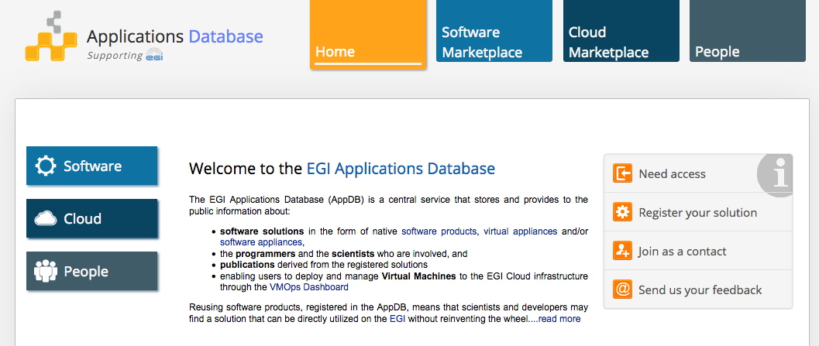
Application Database
Share/Discover and Use of community-specific scientific software, applications and cloud virtual appliances (https://appdb.egi.eu/)
EOSC-hub funded:
Application Database platform operations
Use to the service, including dashboard for managing VAs
Technical support
Support to packaging virtual appliances following security best practices

Slide 28
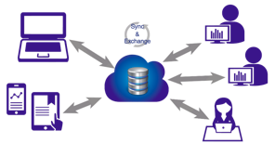
B2DROP
Sync and share research data (https://www.eudat.eu/services/b2drop)
Provided through EOSC-hub:
Store and share data with colleagues and team members, including research data not finalised for publishing
Cloud storage to share data with fine-grained access controls
Synchronise multiple versions of data across different devices, including workflow and computing environments
Publish data via B2SHARE
To be funded by the community:
Provisioning and operation of a dedicated customized B2DROP instance (if required)

Slide 29
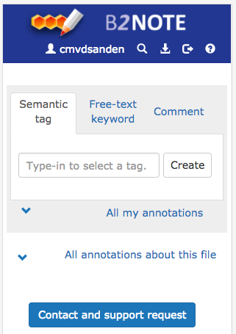
B2NOTE
Use annotations to structure your data (https://b2note.eudat.eu/)
Provided through EOSC-hub:
Manage and share annotations on data with colleagues and team members
Annotations are keywords or commentaries attached to a object, that explains or classifies it.
B2NOTE annotation service is integrated with the B2SHARE service and technology
B2NOTE can be easily integrated with other community data repository services
Provide training on semantic annotations
To be funded by the community:
Technical support on the integration of B2NOTE annotation service into community services

Slide 30
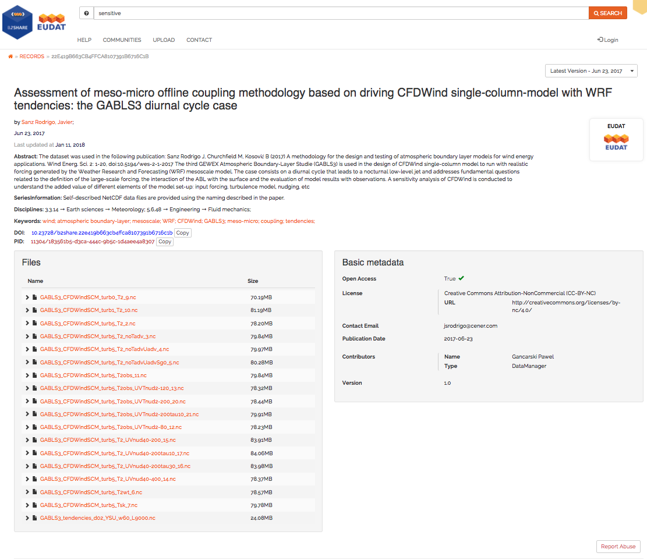
B2SHARE
Store and publish data (https://b2share.eudat.eu/)
Provided through EOSC-hub:
Data repository & publishing service (B2SHARE) allowing RIs to publish and manage data in a persistent way
Use of DataCite DOIs & EPIC PID
Domain specific metadata extensions
Manage the publish life cycle with version control
Community defined authorisation rules
Annotations via defined ontologies
To be funded by the community:
Customization and provisioning of a (dedicated) B2SHARE instance
Definition of FAIR implementation guidelines (input to EOSC-hub)

Slide 31
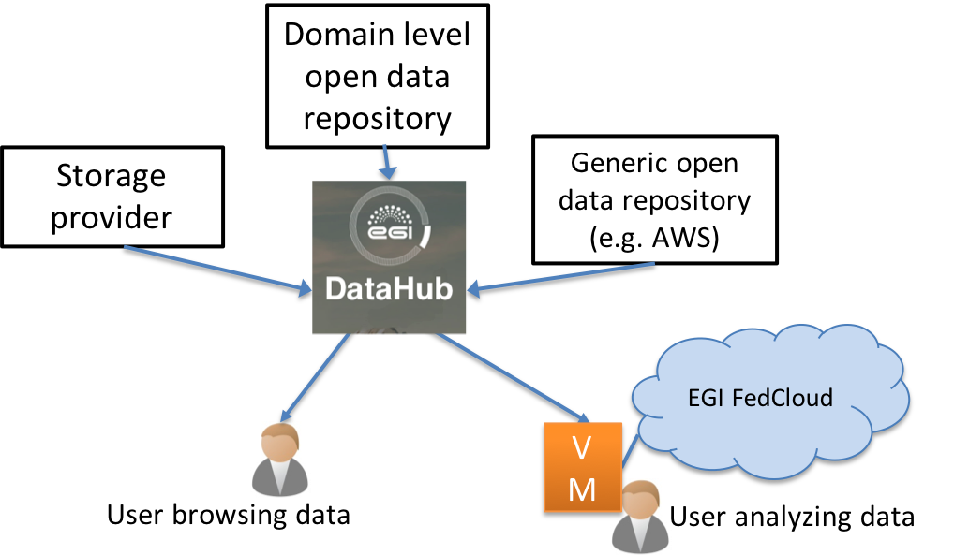
DataHub
Discovery, access and usage of reference open datasets and user data
Federates existing data sources and data storage providers into one name space
Brings data to the multiple hybrid clouds and HTC
Increased accessibility of data to users → Bring data to computing
Scalable federation of distributed data providers
Publishing/DOIs
Use of eduGAIN and federated AAI
Provided through EOSC-Hub:
Technology and its support
Test infrastructure
To be funded by the community:
Storage capacity to scale up data infrastructure
Dedicated support and service customization

Slide 32
EOSC-hub service catalogue mapping to FAIR
Findable
Accessible
Interoperable
Reusable
Service | F | A | I | R
B2Handle | X | X |  | X
B2Find | X |  | X | X
Marketplace | X | X |  | X
Application Database |  |  |  | X
B2SHARE | X | X | X | X
B2DROP |  | X
DataHub | X | X | X | X
European Trusted Digital Repositories | X | X | X | X
Service | F | A | I | R
Federated AAI |  | X
B2SAFE |  | X
B2NOTE |  |  | X | X
Federated Cloud/HTC
Jupyter Notebook
Applications on Demand
Workflow Management and orchestration
Sensitive Data Services

Slide 33
Federation services
Federated AAI
Monitoring and accounting
SLA and order management
Security incident response and security policies
Technical support and training

Slide 34
EOSC-hub AAI
Services for Trust and Identity
Provided through EOSC-hub:
Multi-tenant service for federated authentication and authorization supporting all main standards
Only one account needed for federated access to multiple heterogeneous (web and non-web) service providers using different technologies (SAML, OpenID Connect, OAuth 2.0, X509)
Use of federated IdPs in eduGAIN
Identity linking enables access to resources using different login credentials (institutional/social)
Aggregation and harmonisation of authorisation information from multiple sources
To be funded by the community:
Dedicated support
Service customization
Operations of a dedicated AAI infrastructure (if required)

Slide 35
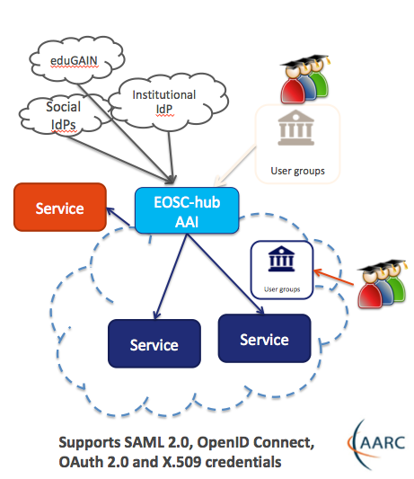
EOSC-hub AAI Architecture
Secure: operates under strict security policies
Simple: hides the complexity
Low overhead: Easy integration of multiple IdPs and AAs
Interoperable: AARC blueprint, eduGAIN
REFEDS R&S and Sirtfi policies

Slide 36
Capabilities
Only one account needed for federated access to multiple heterogeneous (web and non-web) service providers using different technologies (SAML, OpenID Connect, OAuth 2.0, X509)
Identity linking enables access to resources using different login credentials (institutional/social)
Aggregation and harmonisation of authorisation information from multiple sources
AAI is offered in two configurations
As a service: EOSC-hub AAI catch-all instance
Dedicated instance

Slide 37
Federated service management
Management of shared services of the Hub and related processes
Federated authentication and authentication
Marketplace (discovery, order management, SLA management)
Helpdesk for incident and problem management
can be offered and branded as front desk of RI users
IT Security Management (e.g. coordinated incident response, security forensics/monitoring)
Service quality assurance (auditing)
accounting and monitoring infrastructure
Service portfolio management
Maintenance of the EOSC-hub corpus of policies
data policies ← input from INFRAEOSC-04
security policies ← input from INFRAEOSC-04
standards roadmap ← input from INFRAEOSC-04
FAIR implementation guidelines ← input from INFRAEOSC-04

Slide 38
INFRAEOSC-04 input to EOSC-hub 1/2
Data and services to be published in the EOSC-hub marketplace
Terms of use of contributed data and services are defined by the RIs
Definition/Maintenance of
FAIR implementation guidelines
Community-specific data policies for compliance to applicable laws and technical interoperability
Input to EOSC-hub Principles of Engagement (PoE) and standards roadmap

Slide 39
INFRAEOSC-04 input to EOSC-hub 2/2
Participation to EOSC-Hub service portfolio management for all cluster services contributed to the Hub
Definition and maintenance of cluster service descriptions
Self-certification of compliance of cluster data and services to the Hub
Participation as service provider to the governance of the Hub (definition and maintenance of the overall Hub Service Management policies and processes) together with other providers e.g.
Definition/Maintenance of service level targets and performance reporting
Development of accounting probes and publishing of accounting records
Definition of policy and security requirements
IT security management concerning RI services

Slide 40
Examples of use cases - Competence Centres
 | Challenges | Relevant EOSC-hub services
ELIXIR CC | Establish a federation of cloud providers to replicate ELIXIR Core Datasets and Applications Bring these cloud-data providers into EOSC Enable federated AAI across life science and EOSC services | Federated Cloud AAI Operational policies Experience with Virtual Access Code of Conduct for sensitive data
Fusion CC (ITER) | Port fusion workflows to federated compute environment Federate and enable access to distributed datasets Application and data provenance | AAI Data and compute federation (containers) Workflow management Monitoring, helpdesk, PIDs, ...
Marine CC (Ifremer, Euro-Argo) | Cloud-based data subscription and data delivery service (from EMSO, Argo, SeaDataNet, etc.) Enabling users’ simulations to run within custom environments on ‘subscribed data’ Operate the setup as an EOSC service | Storage and compute clusters Data discovery and staging (B2Find, B2Stage) Jupyter service (24/7) FitSM (IT service management)
EISCAT_3D CC | Make EISCAT data accessible via a ‘data webshop’ Enable online data analytics for researchers (based on community and custom applications) Operate the data-compute portal as an EOSC service | B2Share (metadata schema management) DIRAC file catalogue and application manager for researchers Federated compute sites (cloud) User authentication, authorisation (VOMS, Perun) FitSM (IT service management)

Slide 41
Examples of use cases - Competence Centres (cont)
 | Challenges | Relevant EOSC-hub services
EPOS - ORFEUS CC | Effective transfer and staging of big data Harmonised data management policies at seismic observatories Enable researchers to analyse data, create and publish ‘user-defined data products’ | AAI Data staging and transfer services Federated compute services Jupyter (data access and analytics environment) Data Management good practices
Radio Astronomy CC (LOFAR→ SKA) | Enable researchers to find, access and process data from the LOFAR Telescope Support application developers in deploying workflows for researchers Support research users in data analytics on federation of compute clusters | B2Find - B2Share B2Stage B2Safe B2Handle (PIDs) Jupyter Federated compute and storage resources
ICOS-eLTER CC | Enable researchers to find, access and process data from ICOS and eLTER Integrate ICOS Portal and analysis tools with large-scale storage and compute resources Support research users in data analytics on federation of compute clusters | B2Safe B2Find B2Stage Federated cloud
Disaster Mitigation Plus CC | Setup simulation web portals for simulation of natural hazards (storm surge, dust transportation, forest fire, flood) Federate environmental data from agencies in Asia-Pacific region | Federated compute resources (HTC and cloud) Operational tools FitSM

