Slide 1
EOSC-Hub Technology Area description
Data Discovery and Metadata Management
Dissemination level: Public/Confidential If confidential, please define:
Disclosing Party: (those disclosing confidential information)
Recipient Party: (to whom this information is disclosed, default: project consortium)

Slide 2
2. Metadata Catalogue building block
Definition of a Metadata Catalogue Service
A Metadata (MD) Catalogue Service is a mechanism for storing and accessing descriptive metadata and allows users to query for […] digital objects (DO) based on desired attribute, […]. MD in catalogues can be queried and presented for evaluation and further processing by both humans and software. Catalogue services are required to support the discovery, binding and linkage to published […] research data.
Taken from :
http://www.coastalwiki.org/wiki/Metadata_and_metadata_catalogues
https://www.sciencedirect.com/topics/computer-science/catalog-metadata

Slide 3
2.a. Data Discovery and Access
Description : Possibility for end-users to search for and re-use research data
Architecture :
Technical integration of a transparent user interface (Data Discovery and Access Layer)
Implementation of comprehensive Metadata and Discovery service
Central data indexer based on a FAIR MD catalogue with rich MD (+ identifiers to referenced DO)
MD Index covering entire research landscape (resources within EOSC-hub and beyond)
Simple to use search GUI with facetted filtering and optimized precision and recall (SOLR index + search engine)
Standards :
MD schemas and FAIR controlled vocabularies
Search APIs : Elasticsearch, CKAN-API, … + SOLR Index
For data access and re-use : PIDs + Handle services , Provenence MD and Usage and Access Licences
Guidelines for re-searchers : Follow Search guides ; Feedback on usability and quality/correctness of MD is very appreciated => leads to iterative improvement of discovery and MD on service and provider site !

Slide 4
2.b. Metadata cataloguing and indexing
Description : Ability for data providers to publish metadata in central metadata aggregator
Architecture
Technical implementation of a low barrier method to add ‘harvesting endpoints’ and to adopt mapping according specific data provider/community standards
Implementation of Metadata Ingestion Workflow
Synchronous and incremental harvesting
Adoptable and interactive MD mapping (+validation, curation and FAIRisation)
Automated/interactive upload+indexing in MD catalog
Standards :
Harvesting : OAI-PMH, resourceSync, JSON-API, CWS, SparQL and other
Search and access : ElasticSearch, CKAN-API, … ; PIDs (for data + MD), handle (reslover) services
MD standards : Community specific and common MD schemas and controlled vocabularies
Interoperability Guidelines for data Providers (see e.g. for OpenAire, DataCite or EUDAT-B2FIND)

Slide 5
2.c. Annotation service
Description : Possibility for end-users to annotate data sets with ‘concepts’, e.g. comments or sematic tags (keywords from ontologies), to structure their data
Architecture :
Technical integration of annotation service and ‘semantic search’
Implementation of a
Searchable and linkable database of annotations and ontologies
GUI allowing to create, search and manage annotations on research data
Standards : JSON-LD, W3C Web Annotation data model
Guidelines : Policies and manual for re-searchers, how to annotate

Slide 6
Services offering the macro features
MD catalogues and indexer for cross-domain research data
Google data search : crawls mainly schema.org , but no (meta)data curation and validation and don’t care on open data access (‘dark data’, not really FAIR)
DataCite : actually just an agency for registering DOIs, but (by chance and success) as well a metadata aggregator with search portal, DataCite4.1. MD schema is a quasi standard (e.g. OpenAire and B2FIND )
EUDAT-B2FIND : Interdisciplinary Metadata and Discovery Service for research data,
in EOSC-hub common service portfolio (WP6)
integrated with B2SHARE data repository and other EOSC storage services (EGI-datahub, B2SAFE)
harvests MD directly from community repositories
full MD ingestion workflow + additional services (e.g. OpenAire deduplication (in progress) , B2HANDLE lib) + customised MD mapping, curation and validation and FAIRisation
OpenAire : focussed on scholary open data and providing services like deduplication services, more discovery of other open repositories/catalogues – not focussed on search for DOs
Do you know/use others ? What do you recommend to a re-searcher who wants to find open research data on a cross-domain level in a FAIR manner ?
Annotating services
EUDAT-B2NOTE : integrated in B2SHARE, + B2FIND is work in progress within EOSC-OpenAire cooperation
Many other services and tools for annatating and ‘semantic discovery’

Slide 7
Metadata Catalog building block
Maschine
Human
Data Discovery & Access
Metadata Annotating
External MD aggregator and Indexer
API
OAI-PMH
JSON-LD
Metadata Descriptions
Metadata Dissemination
Community MD catalogues
Metadata Ingestion
Meta Data
Catalog
SOLR Index
Search GUI
MD PID
Metadata PID Generation
MD Schema
Controlled Vocabs
Metadata Validation and Curation
Data Repositories

Slide 8
Macro-features of area Data in the EOSC Architecture
Human
Maschine and Processing Workflow
Human
Macro feature
End User /
Re-Searcher
User Interface / Ingestion Workflow
2.a. Data Discovery and Access
1.a. Data Publishing
MD PID
Discovery Portal
Data Portal
3.MD Dissemination, Curation and Validation
FAIRisation
Enrich MD
Linkage
Depuplication
Brockering
Checks, …
User Request
Metadata Catalog
Open Data Repository
010101
(Meta)Data Transfer
2.b.MD Cataloging
010101
PID
1.b.Data Preservation
010101
DOI
Linkage
Metadata Ingestion
Data Ingestion
Data Provider /
Research IS /
Communities
Domain Specific
MD Catalogue
Community/Research IS
Data Repositories

Slide 9
Macro-features of area Data in the EOSC Architecture
End User /
Re-Searcher
Macro feature
User Interface / Ingestion Workflow
2.a. Data Discovery and Access
1.a. Data Publishing
Discovery Portal
Data Portal
Metadata Catalog
Open Data Repository
Technical Implementation
010101
2.b.MD Cataloging
010101
1.b.Data Preservation
010101
Metadata Ingestion
Data Ingestion
Macro feature
Data Provider /
Communities
Community Metadata Catalogues
Community Repositories

Slide 10
Metadata Descriptions
Many communities defined their own community-specific metadata schema’s
There are some initiatives to define or at least harmonise minimum metadata which is required for publishing or harvesting
DataCite (https://schema.datacite.org/)
OpenAIRE guidelines for Data Archives (https://guidelines.openaire.eu/en/latest/data/index.html)
EUDAT-B2FIND (http://b2find.eudat.eu/guidelines/index.html)
EOSC pilot ‘Interoperability’ defined EDMI (https://eosc-edmi.github.io/)
Schema.org (
The best practices and guidelines on minimum metadata for harvesting and discoverability should be defined in accordance with the Open Data Repository macro feature and Open data and FAIR initiatives (e.g. with OpenAire, RDA, GO-FAIR ‘Discovery IN’ etc.)
Notes:
Taken/moved ? From Mark and references in last bullit changed … !!!

Slide 11
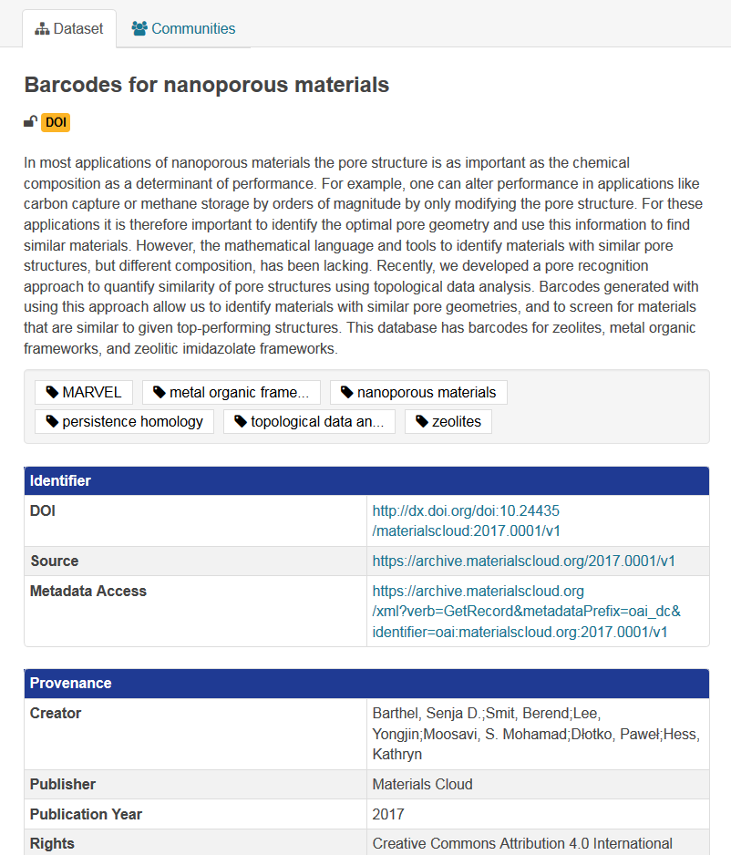
Metadata Example
Notes:
HEW : will add a slide ‘MetaData Curation …’ focussing on the aspects w.r.t. Metadata-management (Structure and granularity of MD, iterative improvement of quality of metadata during uptake process, …, sustainability of MD (and their catalogues), …

Slide 12
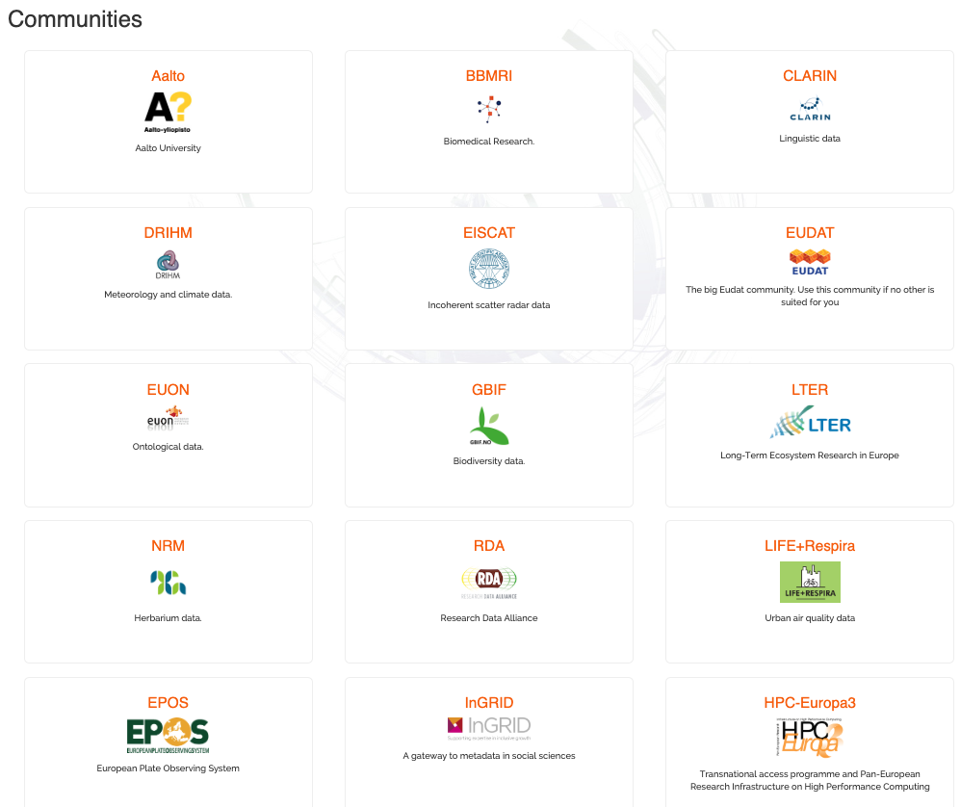
Example : Communities joining EUDAT-B2FIND :
20 Indexed in productive B2FIND with N records
~20 In the pipe (implementation of MD uptake and adoption of the mapping in progress)
~20 communities interested, but not yet added
Notes:
Taken from Mark ?

Slide 13
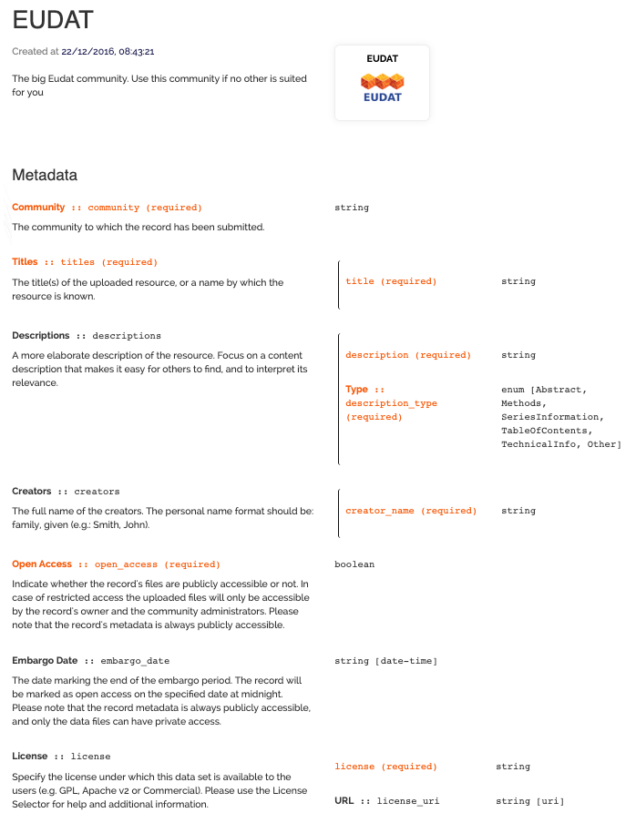
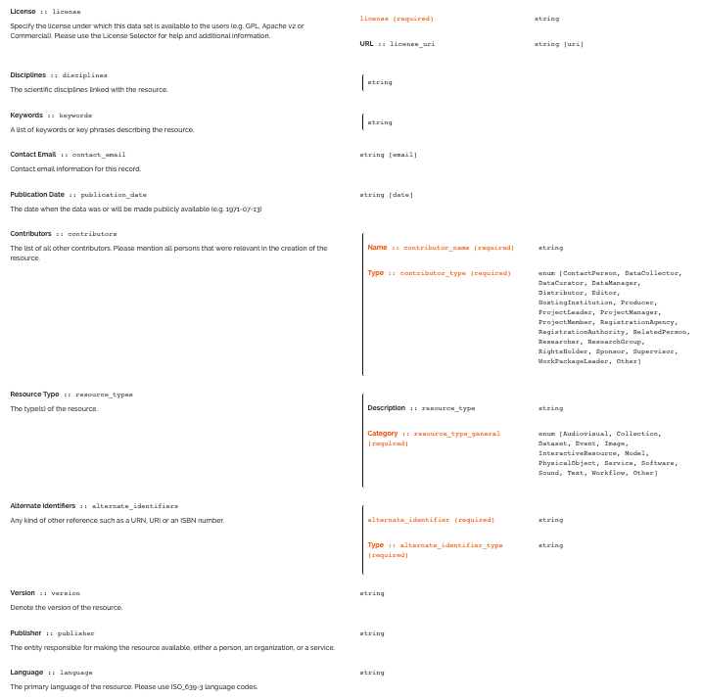
Notes:
Copied this slide from Mark, and could explain how MD schemas between B2SHARE and B2FIND are synchronized

Slide 14
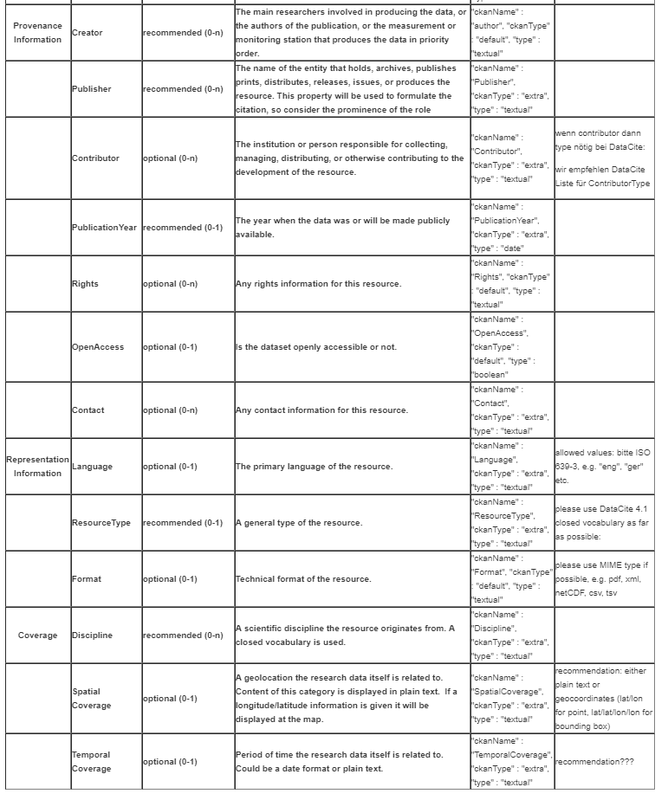
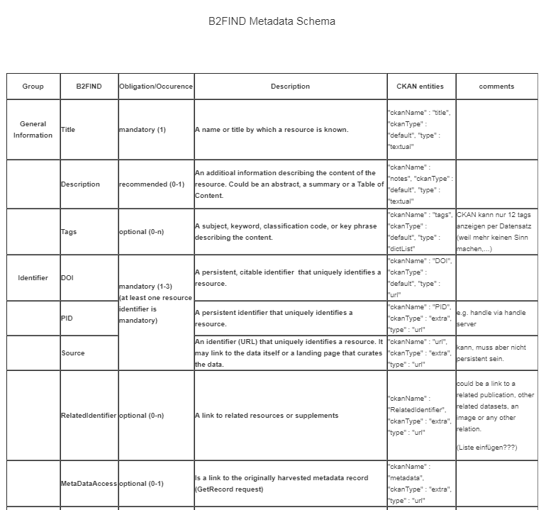
Generic cross-domain MD schema, e.g B2FIND based on DataCite4.1 →
https://cryptpad.fr/pad/#/1/edit/96rZFwOslkhalSt1t8312Q/04m-+XxHLO-iL5TZQsznCGIG/
Notes:
Copied this slide from Mark, and could explain how MD schemas between B2SHARE and B2FIND are synchronized

Slide 15
Controlled Vocabularies
Vocabularies are often very community and domain-specific
Controlled vocabularies should be used
Clear and transparent specification of vocabularies, e.g.
which vocabulary is being used for which property/facet
Optimally references by a PID or better a citable DOI is assigned to (standardized) vocabularies
Examples for generic, cross-domain vocabularies
EUDAT-B2FIND’s research disciplines https://cryptpad.fr/pad/#/1/edit/KDecbjauKCtZclOmZAbbWg/L4aEiGrzJlSbRSXrFutOb0Cd/
ISO 369 codes for Languages
Examples for a community specific vocabulary
http://vocabs.lter-europe.net
Notes:
Taken from Mark → adopt more B2FIND/OpenAire (Paolo?) specific

Slide 16
Metadata Harvesting
To enlarge the discoverable and findability of scientific artificers, scientific repositories should enable the harvesting of metadata.
Standardized Methods
OAI-PMH (https://www.openarchives.org/pmh/)
ResourceSync (http://www.openarchives.org/rs/toc)
Technology and/or protocol specific
JSON-API (https://json-ld.org/)
Community-specific
OGC/CSW (https://www.opengeospatial.org/standards/cat)
And others (SparQL, schema.org, …)
Notes:
To be moved from Mark ?!

Slide 17
Metadata Curation
Metadata curation involves the annotation, publication and presentation of the data such that the (added) value of the data is maintained over time, and the data remains available for reuse and preservation.
MetaData curation includes "all the processes needed for principled and controlled metadata creation, maintenance, and management, together with the capacity to add value to data”
Care on granularity and structure of provided (meta)data
The level of curation can differ from repository to repository and from community to community
The level of curation should be made clear to the users of a data repository → metadata catalogue
Defining the level of curation is commonly part of a improving metadata quality during iterative metadata ingestion/mapping process
Minimum requirements can be set (e.g. B2FIND’s low barrier approach requires only two metadata fields (title and identifier), a known metadata format and a harvest endpoint )
Notes:
HEW : will add a slide ‘MetaData Curation …’ focussing on the aspects w.r.t. Metadata-management (Structure and granularity of MD, iterative improvement of quality of metadata during uptake process, …, sustainability of MD (and their catalogues), …

Slide 18
FAIR Data Management of Open Data
Input
Results
Results
Interchange data
Processing
Platforms
Common D & A
Interoperability Layer
3
1
Find data
01AB
2
Access data
4
Reuse data
Data
Layer
1010
010101010101010
010101010101010
010101010101010
010101010101010
010101010101010
ABBA
010101010101010

Slide 19
Challenges and Future activities
Granularity of data and scalability w.r.t. # of indexed records and ‘level of indexing’ is crucial
Adopting, enhancing and automasation of MD mapping and validation
Enhance coverage to comprehensive catalogue over entire research landscape
Add sub and helper services to enable automated workflows in EOSC-hub
Example : If DOs are ingested in EOSC-hub repos automatically basic metadata are extracted/geenrated, data collections will built and indexed in the MD catalogue
Generalize and foster guidelines and best practice recommendations
Single-sign on UI (EOSC portal) for users to submit (combined) discovery, access [ and processing ] requests
I.e. Complex user request (for data, storage and computing resources, and processing …) is translated to technical workflow steps, which are triggered and excecuted step by step up to providng results to the user)
Foster and enhance result-oriented cooperation with other open data and FAIR initiatives
Do you miss macro-features interesting in this context, but not mentioned yet ???

Slide 20
Heinrich Widmann
widmann@dkrz.de

Slide 21
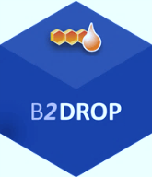
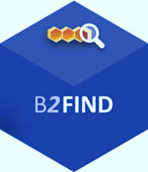
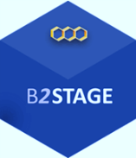
FAIR Discovery and Re-use of Open Data– the user view
Input
Results
Results
Interchange data
Processing
Platforms
Common D & A
Interoperability Layer
3
1
Find data
01AB
2
Access data
4
Reuse data
Data
Layer
1010
010101010101010
010101010101010
010101010101010
010101010101010
010101010101010
ABBA
010101010101010

Slide 22
Data Discovery and Access – the architecture
Used standards, protocols and API :
CKAN-API
SOLR Index
OAI-PMH
Guidelines for data providers
B2find…/guidelines
Compatible with OpenAire
Services offering the feature
EUDAT-B2FIND
EUDAT-B2SHARE
….

Slide 23
Macro-features already identified
Data publishing and open data (Mark)
Data Discovery and Metadata Management (Heinrich)
Data Discovery and Access
MD cataloguing/indexing
!+ Annotation service (Yann)
OpenAire services + ??? … (→ Paolo)
From Paolo’s list …
Notes:
@Paolo : If we know what you will present in the OpenAire session, Mark and I can refer to your session !?

Slide 24
Macro-features 1
One-two slide for each macro-feature describing:
a) description + architecture
b) standard, protocols and api
c) interoperability guidelines
d) samples of services offering the feature
both internal to EOSC-Hub and eventually outside the project to prove that the proposed APIs/protocols are widely used also outside EOSC-hub

Slide 25
FAIR Data Management of Open Data
– the user view
Input
Results
Results
Interchange data
Processing
Platforms
Common D & A
Interoperability Layer
3
1
Find data
01AB
2
Access data
4
Reuse data
Data
Layer
1010
010101010101010
010101010101010
010101010101010
010101010101010
010101010101010
ABBA
010101010101010

Slide 26
Metadata Catalogue for

