Slide 1
EOSC-Hub Technology Area description
Data Publishing and Open Access
Dissemination level: Public/Confidential If confidential, please define:
Disclosing Party: (those disclosing confidential information)
Recipient Party: (to whom this information is disclosed, default: project consortium)

Slide 2
Data Repository building block
RDA Definition of a Repository
A digital repository is an infrastructure component that is able to store, manage and curate Digital Objects and return their bitstreams when a request is being issued. A digital object (DO) is represented by a bitstream, is referenced and identified by a persistent identifier and has properties that are described by metadata.
Term definition reference document:
http://hdl.handle.net/11304/5d760a3e-991d-11e5-9bb4-2b0aad496318

Slide 3
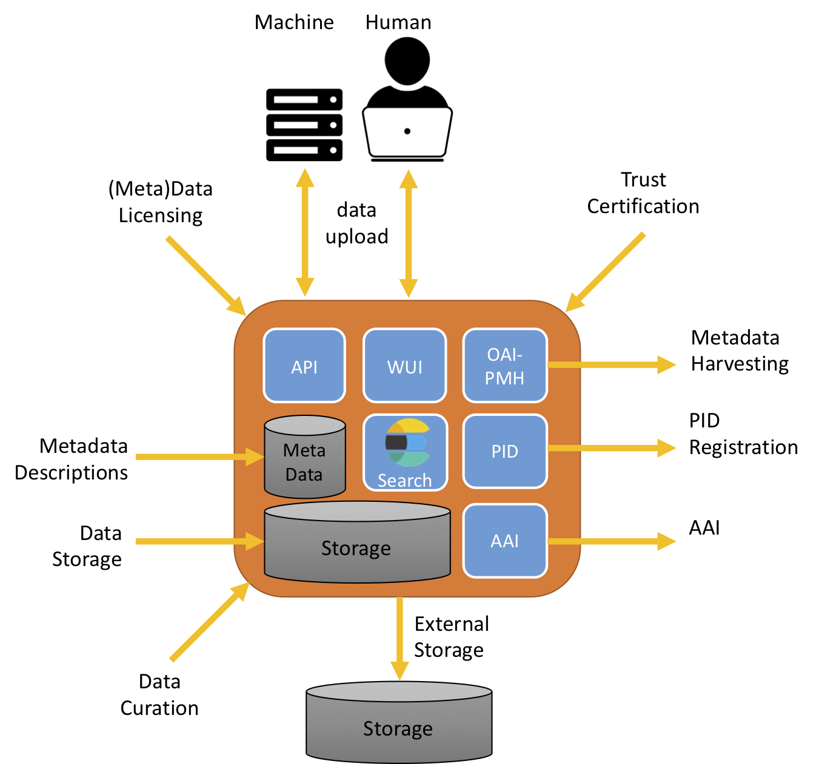
Data Repository building block

Slide 4
API for Upload/Download Digital Objects
Upload/download of DO:
SWORD v1,2,3 (http://swordapp.org/),
DOIP (Digital Object Interface Protocol, https://www.dona.net/sites/default/files/2018-11/DOIPv2Spec_1.pdf), being discussed and piloted within RDA
Many technology and service-specific APIs:
Fedora Commons (https://wiki.duraspace.org/display/FEDORA38/REST+API, https://wiki.duraspace.org/display/FEDORA475/RESTful+HTTP+API)
DSpace (https://wiki.duraspace.org/display/DSDOC6x/REST+API)
B2SHARE API (https://b2share.eudat.eu/help/api)
Zenodo (http://developers.zenodo.org/#rest-api)

Slide 5
Metadata Descriptions
Many communities defined their own community-specific metadata schema’s
There are some initiatives to define or at least harmonise minimum metadata which is required for publishing or harvesting
DataCite (https://schema.datacite.org/)
OpenAIRE guidelines for Data Archives (https://guidelines.openaire.eu/en/latest/data/index.html)
B2FIND (http://b2find.eudat.eu/guidelines/index.html)
EOSC pilot defined EDMI (https://eosc-edmi.github.io/)
The best practices and guidelines on minimum metadata for harvesting and discoverability should be defined in collaboration with the Data Discovery building block

Slide 6
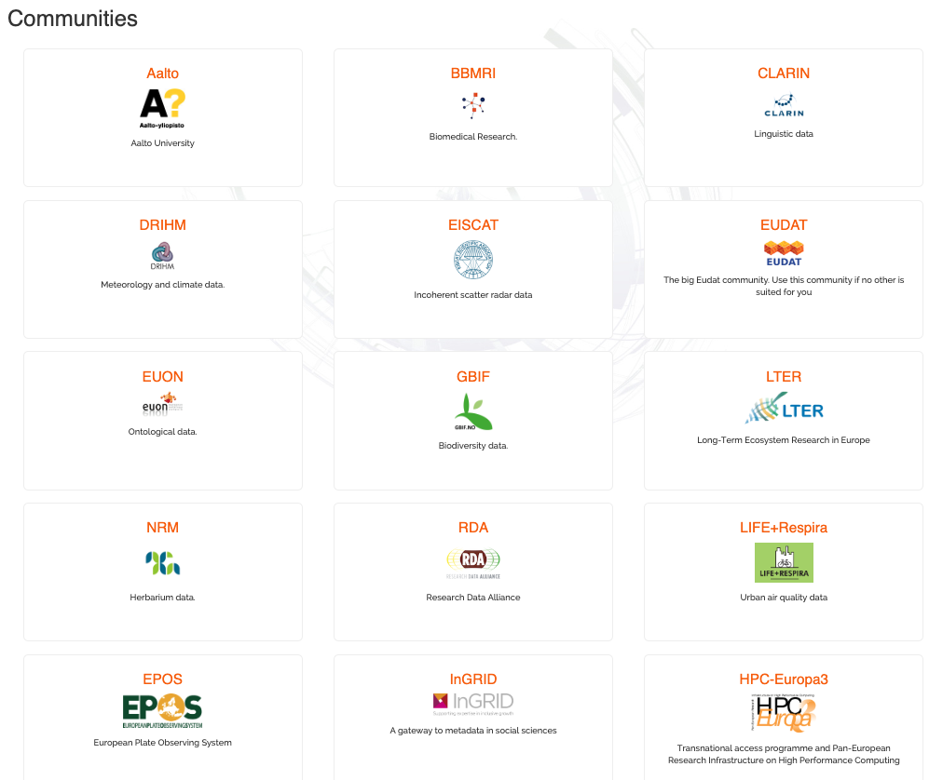

Slide 7
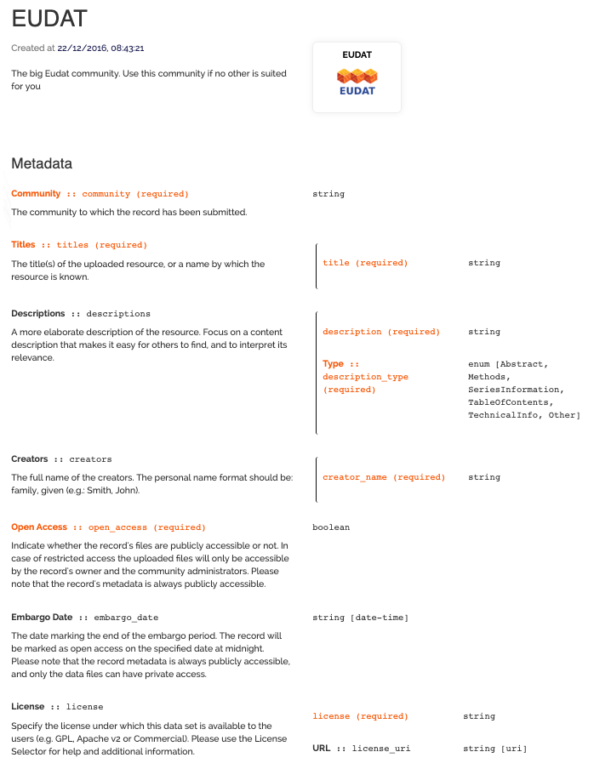
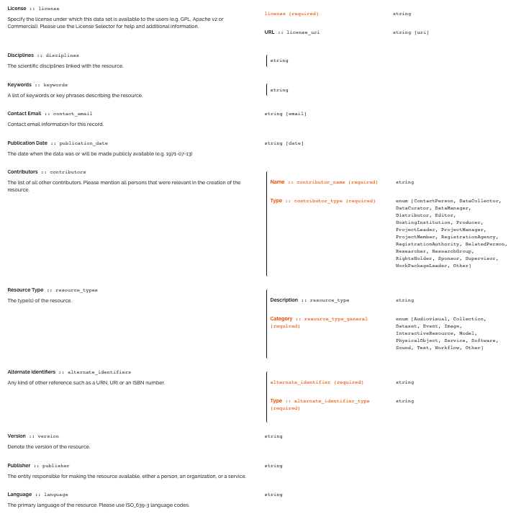

Slide 8
Vocabularies
Vocabularies are very community and domain-specific
an important aspect is that controlled vocabularies are used
,it is clear which vocabulary is being used,
Optimally references by a PID
Example from a community
http://vocabs.lter-europe.net

Slide 9
Metadata Harvesting
To enlarge the discoverable and findability of scientific artificers, scientific repositories should enable the harvesting of metadata.
Standardized Methods
OAI-PMH (https://www.openarchives.org/pmh/)
ResourceSync (http://www.openarchives.org/rs/toc)
Technology and/or protocol specific
JSON-API (https://json-ld.org/)
Community-specific
OGC/CSW (https://www.opengeospatial.org/standards/cat)
And probably many more

Slide 10
Persistent Identifiers
A persistent identifier is a long-lasting ID represented by a string that uniquely identifies a DO and that is intended to be persistently resolved to meaningful state information about the identified DO.
From an architectural point of view:
The minimum requirement is to assign PIDs to DO
The best practices for assigning PIDs are to be defined within the PID building block, data repositories are clients of PIDs.
For different purposes different PIDs are in use:
DOI (https://www.doi.org/) for publications, refers to a landing page of a dataset, is based on Handles and globally resolvable
ARK (Archival Resource Key) (https://n2t.net/e/ark_ids.html)
PURL (Persistent URL) http://www.purlz.org/
ORCID for Researchers
ISNI for all kind of contributors (researchers, inventors, writers, publishers, ….)
and more

Slide 11
Licensing
The best practice is to use a license to publish and make data (re-)usable
License is one of the main aspects for Open Access
Data: commonly Creative Commons used (https://creativecommons.org/licenses/?lang=en)
Software: many OpenSource licenses available
To guide users in selecting a license EUDAT developed a license selector tool which can be easily implemented in repository services, it support licenses for data and software (https://www.eudat.eu/services/userdoc/license-selector, https://github.com/ufal/public-license-selector)

Slide 12
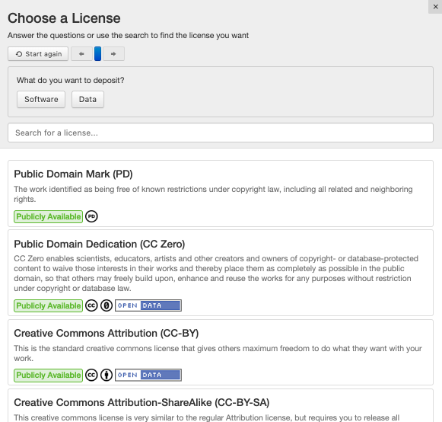
Licensing
Licenses for Data and Software
Uploader can select out of 22 different type of licenses
Licenses for Open Access are clearly marked
License selector can be easily integrated within repository services

Slide 13
AAI
In general, to get access to digital repository services to publish scientific artefacts users must register themselves to get a personal account to upload and publish data sets.
Federated identities are preferred, for example via eduGAIN, via services as EGI Check-In, EUDAT B2ACCESS
In general, the minimum metadata standards require that the person who has created the publication is identified (see field CreatorName), this aspect should be addressed in the ToU, Data Privacy statements and according to the GDPR.

Slide 14
Open Access
In Open Access platforms, metadata and data become open accessible available, an embargo period can be applied.
Not all data can be openly accessible, sensitive data can have restrictions, according to the EC Guidelines on FAIR Data Management Guidelines (http://ec.europa.eu/research/participants/data/ref/h2020/grants_manual/hi/oa_pilot/h2020-hi-oa-data-mgt_en.pdf) the following policy applies "as open as possible, as closed as necessary". Sensitive data can go beyond personal information, data can be for different reasons marked as sensitive.

Slide 15
Data Curation
Data curation involves the annotation, publication and presentation of the data such that the value of the data is maintained over time, and the data remains available for reuse and preservation.
Data curation includes "all the processes needed for principled and controlled data creation, maintenance, and management, together with the capacity to add value to data”
The level of curation can differ from repository to repository and from community to community
The level of curation should be made clear to the users of a data repository
Defining the level of curation is commonly part of a certification process
Minimum requirements can be set

Slide 16
Certification
https://www.icsu-wds.org/community/wds-members-forum/data-repositories-day-2018/2018-presentations/11_CTS_certification

Slide 17
Data Repository for

