Slide 1
EOSC Architecture WG
Dissemination level: Public/Confidential If confidential, please define:
Disclosing Party: (those disclosing confidential information)
Recipient Party: (to whom this information is disclosed, default: project consortium)

Slide 2
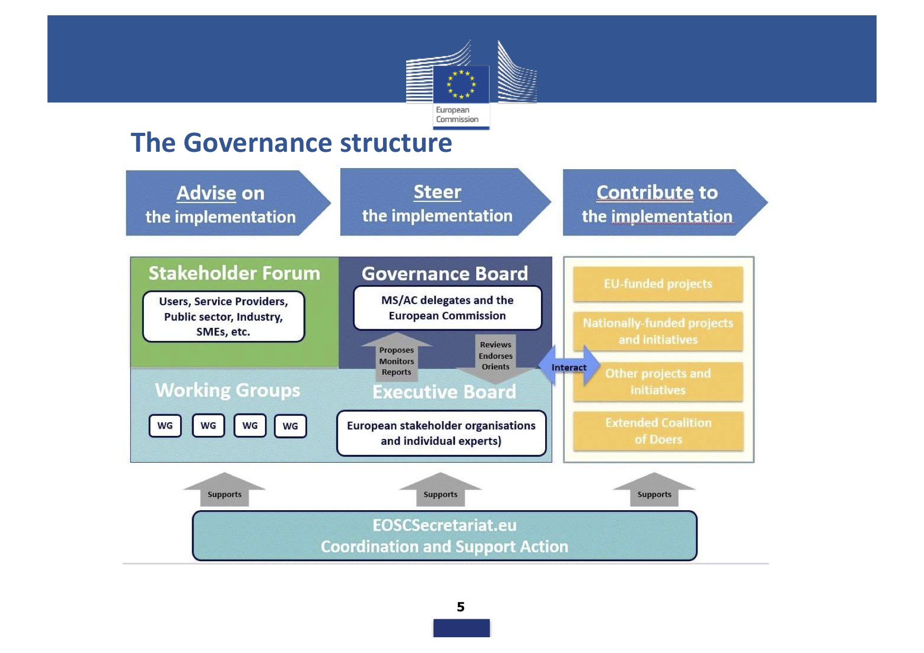
https://www.slideshare.net/TheEOSChubproject/eosc-status-and-perspectives

Slide 3
https://www.slideshare.net/sjDCC/building-local-thinking-global-eosc-150468783

Slide 4
https://www.slideshare.net/sjDCC/building-local-thinking-global-eosc-150468783

Slide 5
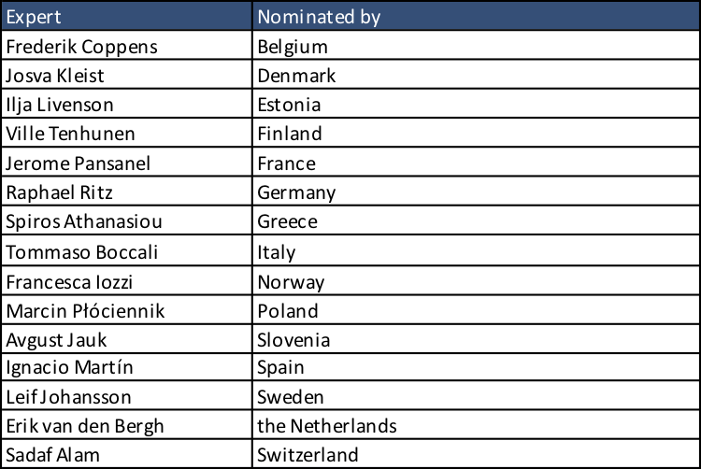
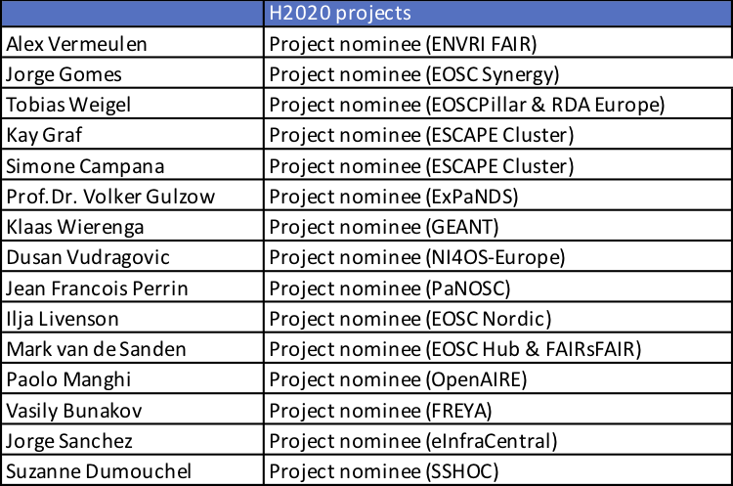
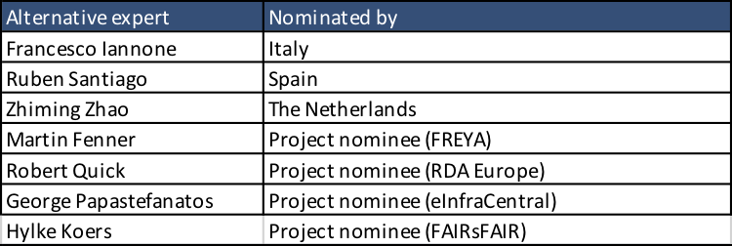
EOSC Architecture WG members

Slide 6
EOSC Architecture WG 2019 Goals
For the remaining of the 2019 year, we would like to achieve the three following goals:
Build a team
  Members of the group come from very different origins.
  Each of us has a different perspective on the EOSC technical architecture.
  We need to be able to share and understand each other priorities.
Share the current technical landscape
  Work has been underway to build EOSC for a number of years now.
  Our mandate is to federate the numerous initiatives that are making EOSC a reality.
  We need to share and understand the technical choices that have already been made.
Identify uses cases
  EOSC will have an impact if it serves scientists in the first place and ultimately the whole society.
  In order to achieve its mission, EOSC will use an iterative approach and provide operational solutions to a wide range of problems.
  We need to identify the uses cases that EOSC will serve in order to schedule the technical developments that will allow to deliver the value to EOSC end users.

Slide 7
Proposed Architecture Working Group process
Once we have made sufficient progress in sharing the technical landscape and identifying use cases, we will prioritize the technical efforts we need to undertake.
The following steps are planned:
Agree on charters for specific technical efforts (e.g. designing or contributing to a standard, developing best practices, exposing APIs, …)
Build open task forces to develop the desired artefact(s)
Ensure consistency between the various task forces
Build and promote evolving EOSC technical architecture documents

Slide 8
First steps
In order to address the first goal (Build a team), we would like each member to introduce her/himself with an email providing the following information
Personal introduction
Organisation introduction
User requirements
Technical achievements
Technical ongoing projects
Technical challenges
Openness policy
We understand that some issues may not be relevant for some people.
The list is voluntarily long in order for each member to be able to emphasize the issues that are relevant for her/his activities, roles and responsibilities.

Slide 9
EOSC-hub Contribution to EOSC WG
Contribute to the landscape scoping
Contribute to the use cases, for example from:
  Thematic Service
  Competence Centers and
  Digital Innovation Hub
Define the level of the EOSC Architecture
Propose an approach to define an the Technical Architecture
Identify building blocks and macro-features
Contribute to documentation

