Slide 1
Insitute of Information Science and Technologies
National Research Council
Pisa, Italy
Paolo Manghi
Scholarly communication services
OpenAIRE’s perspective

Slide 2
What’s the best focus?
Service Compositionality
Service Design
Functionality signature
Functionality architecture
Service consumers
Actors, discipline
Service focus
Resources managed
Mandatory
Optional
Community-specific
Community- agnostic
?
?

Slide 3
Open Science: establishing infrastructure
Research Infrastructures
Scholarly Communication Infrastructure
Literature
Repository/Publisher
Research literature:
Articles, docs, white papers
Data
Repository
Research
data
01101010
01100001
11010010
e-infra Tools &
Services
Research
data
01101010
01100001
11010010
Scientific product data sources
01101010
01100001
11010010
Software
Repository
Research
Software
“Experiment”
Repository
Scientific process
01101010
01100001
11010010
01101010
01100001
11010010

Slide 4
Open Science: establishing infrastructure
Research infrastructures
Scholarly Communication Infrastructure
Anonymization
Brokering
Science Monitor
Overlay platforms:
Peer-review
Annotation
Amnesia
Research literature:
Articles, docs, white papers
Digital preservation
Metadata Aggregators
Scientific product Catalogues
Metadata Validation
Usage Statistics
Research
data
e-infra Tools &
Services
01101010
01100001
11010010
Research
data
01101010
01100001
11010010
DMP tools
Research
Software
Scientific process
DMPTool
Scientific product data sources
Entity Registries
Virtual Research Environments
App
DB

Slide 5
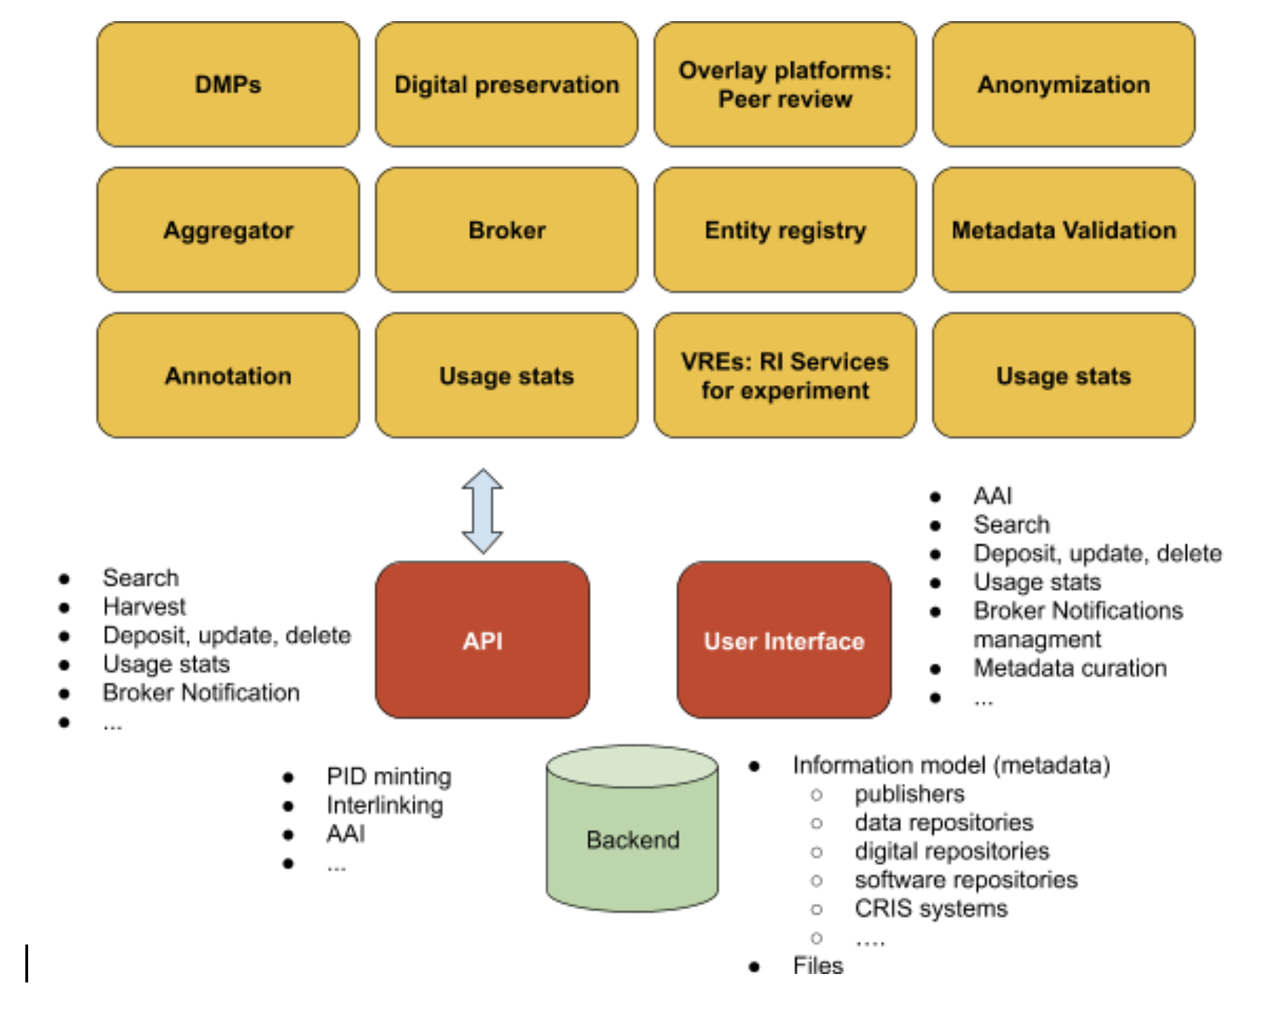
Scientific Product Data Source

Slide 6
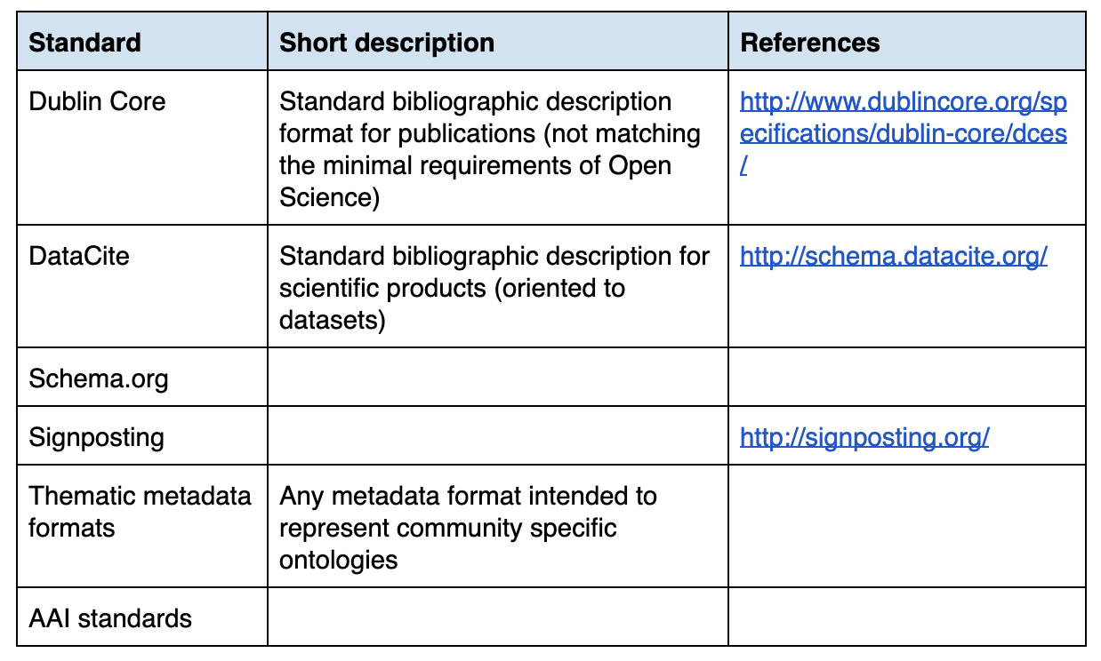
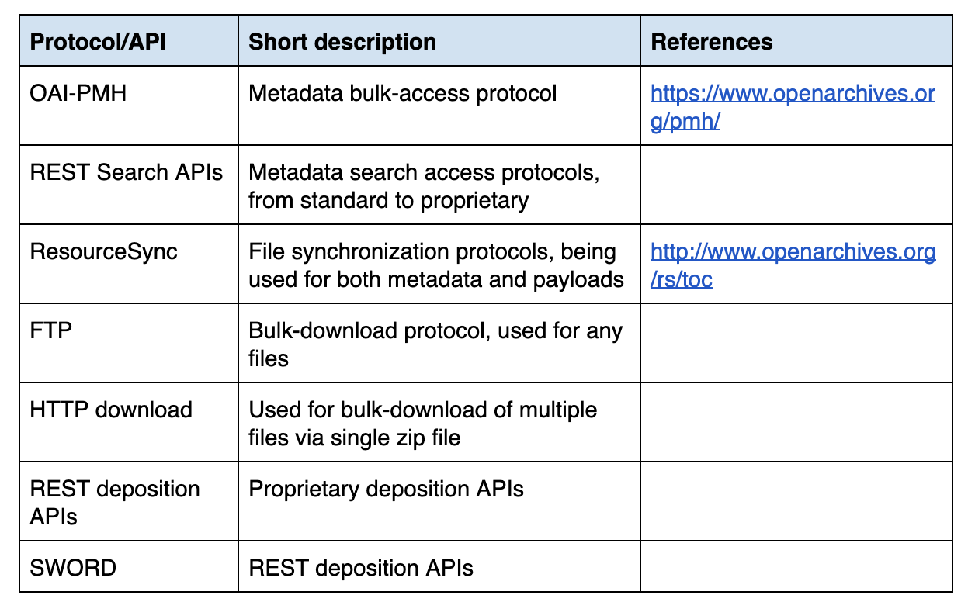
Scientific Product Data Source
COAR Next Generation Repositories Working Group

Slide 7
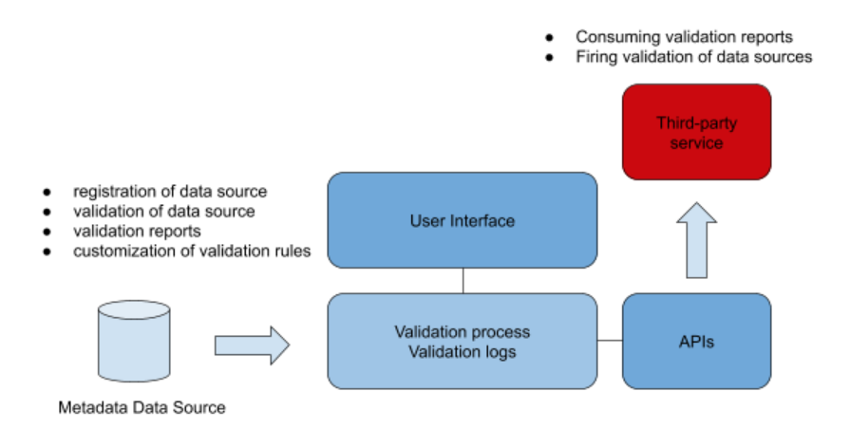
Metadata Validation

Slide 8
Scientific product catalogues
Thematic (serving a research community) Vs cross-community
Product-specific Vs Cross-product
Functionalities
Full-text mining/ML for semantic enrichment (open to third-party)
Semantic search (UIs and APIs)
Deduplication
Feedback and validation
…

Slide 9
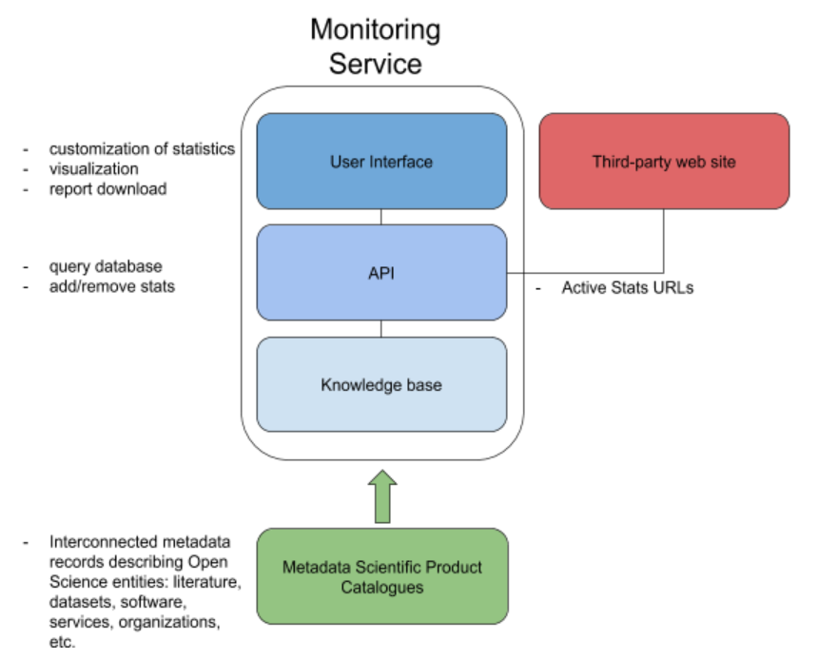
Science Monitoring

Slide 10
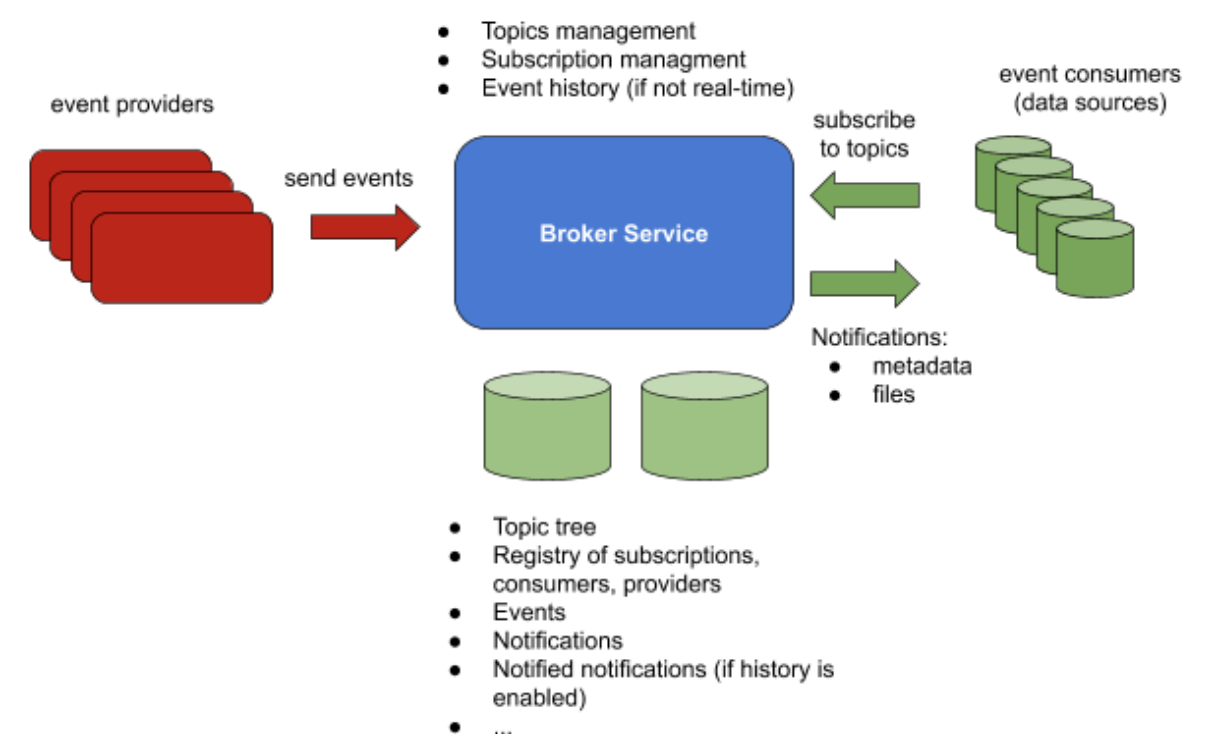
Brokering

Slide 11
Paolo Manghi
paolo.manghi@isti.cnr.it

