Slide 1
Training Marketplace
Claire Devereux
STFC, UK
claire.devereux@stfc.ac.uk

Slide 2
History
End of January 2011
Edinburgh withdraw from EGI with immediate effect
February: UK JRU meets, parties bid for hosting Training Technical Services (TTS)
Early March – STFC awarded TTS
End of March – end of transition, services moved to STFC

Slide 3
Training Services
Technical Training Services
Training events calendar
Database of trainers
Repository of training related materials (Digital library)

Slide 4
Training Marketplace
The vision:
One-stop shop for training needs
Integration of different services
Two-way dialogue: requests, feedback
Customized views, e.g. by NGI

Slide 5
Training Marketplace
The plan:
End of March – mirror Edinburgh’s web pages at STFC
Phase 1 – investigate new technology to integrate services
Phase 2 – implement these and develop interface

Slide 6
V1: Training Marketplace
Reality:
Challenges in receiving images of existing services from Edinburgh
STFC had to develop new technology and interface by end of March
Prioritized getting events calendar functioning

Slide 7
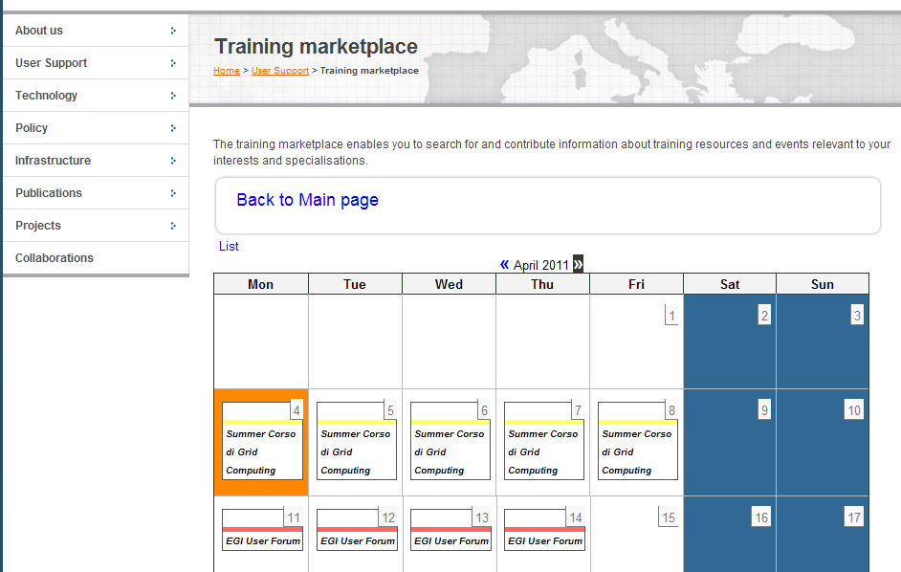
V1: Training Marketplace
V1 interface

Slide 8
V1: Training Marketplace
Current live site
Events calendar
List/calendar view
Increased functionality
Rate the event
Leave comments
Import into calendar

Slide 9
V2: Training Marketplace
V2: in development
Technology:
For integration of events calendar and training materials repository
Drupal technology for frontend website
Fedora as the backend repository
Apache Solr for improved search functionality
Possibility of Drupal module as repository

Slide 10
V2: Training Marketplace
Interface:

Slide 11
V2: Training Marketplace
Search box
Brings together all items :-
events, trainers, training materials
Will add in filters in advanced search
e.g, search only events, only training materials

Slide 12
V2: Training Marketplace
Map view
Hover over country will pop up
forthcoming events
local contacts for training
a link to further information, such as past events
Other views
Calendar and list view of events

Slide 13
V2: Training Marketplace

Slide 14
V2: Training Marketplace

Slide 15
V3: Training Marketplace
Longer term plans:
Using RT queue for feature requests
Advertising different resources such as training courses, training infrastructures
Linking into other resources, e.g. the AppDB, when performing a search

Slide 16
Timelines
V1 – Live – by End of March 2011
V2 – aim to go live by end of June 2011
V3 – longer term plans, integration with AppDB – around the time of EGI TF 2011

Slide 17
Feedback during USAG
Feedback from USAG 3/5/11:
Prioritize:
Advertising different resources such as degree courses, training infrastructures
NGI Views
For inclusion in V2

