Slide 1
TCOM Phone conference – 20 May 2019
Giacinto DONVITO -- TC – WP10 Leader
INFN

Slide 2
Status report
The Tech WS agenda is in the final stage:
https://indico.egi.eu/indico/event/4675/timetable/#all
Comments still possible with minor changes
Please register yourself and cross check that the people you have invited are already registered:
we have to be sure that we have the needed people there

Slide 3
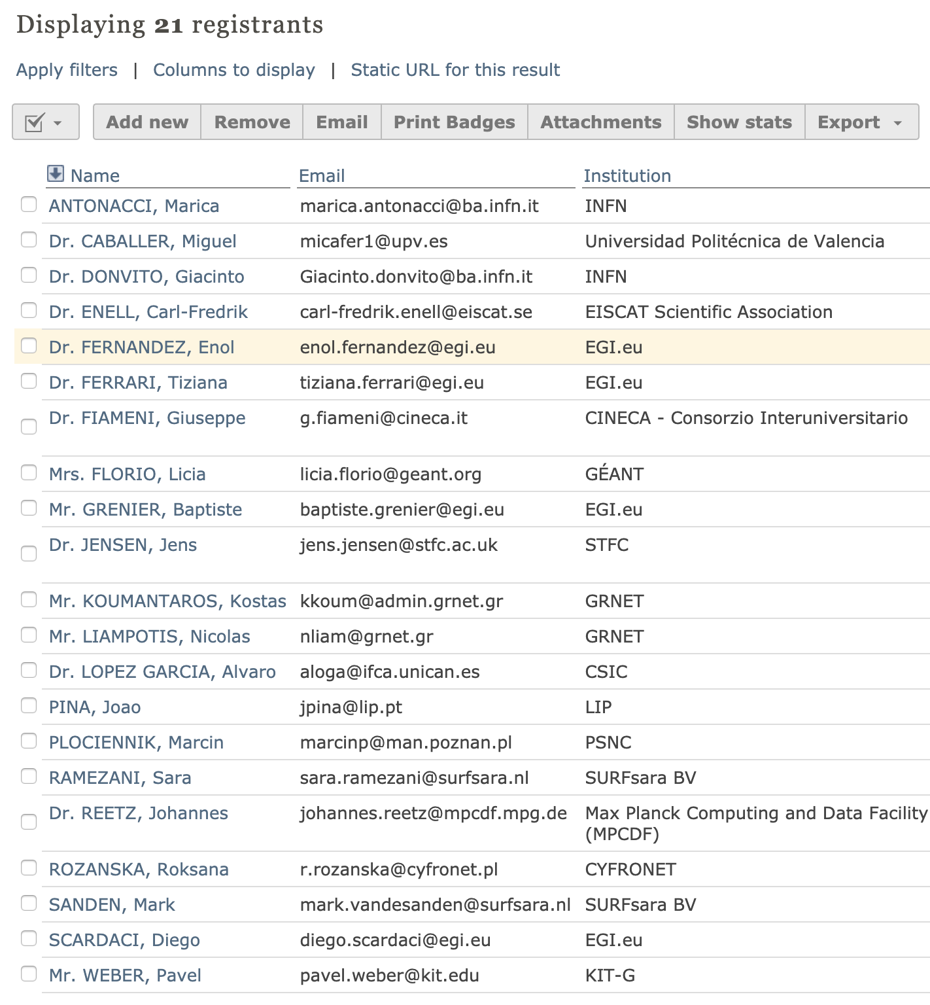
WS registrants

Slide 4
EOSC Technical Specification
Diego and me, have prepared a template for Technical Specification of the EOSC Core services:
https://docs.google.com/document/d/1mTv4RR7SczmeX7aOzUqmMhQZSaoKhjdTZIerc40oC-M/edit#
Here you will find the documents already asked:
https://drive.google.com/drive/u/0/folders/1_C-r7LSa8epZwfMUv05s9VDibXjIjz0Z
Please fill free to propose comments/suggestion to improve it
This could be useful also in preparation of the Tech WS.
For each of the tech area you could ask to fill similar template for each “macro-features”

Slide 5
Pending actions
Each TCOM Member should present the report about the status of each Tech Area in terms of “macro-features” highlighted and the level of details reached in the description
I suggest we use a common template for this presentation
Do we all agree?
I will start one and ask for comment/suggestion to improve it
We will have also the participation of GEANT/OCRE for cloud computing services
They will be mostly in the “role of observer, to capture input during the conference”
G. Fiameni also asked us

Slide 6
Pending actions
We will have also the participation of GEANT/OCRE for cloud computing services
They will be mostly in the “role of observer, to capture input during the conference”
Also OpenAIRE will be represented (most probably with Paolo Manghi)
Most probably we could include this contribution in the “Data” Session
“guidelines for data archives, scientific products and software, guidelines for the measurement and exchange of usage and data statistics, open repository, etc.”
Any suggestion on this?
G. Fiameni also asked us to report about the Fenix (https://fenix-ri.eu/)
I agree this could be useful: any comments?
Where this could fit better?

