Slide 1
Overview and Key Exploitable Results
Tiziana Ferrari, Project Coordinator
Dissemination level: Public

Slide 2
Outline
Project mission and structure
Project objectives, Key Exploitable Results and Work Packages
Main achievements
Response to the recommendations
Overview and Key Exploitable Results

Slide 3
Project Overview
EOSC-hub: Integrating and managing services for the European Open Science Cloud
Grant Agreement ID 777536
Tot budget: €33,287,542 100 Partners, 76 beneficiaries
EU Budget 3830 PMs, 106 FTEs
€ 30 000 000 +150 staff involved
Coordinator
STICHTING EGI
Consortium
100 partners 53 countries
36 Months Jan 2018 – Dec 2020
20 digital research infrastructures,
EGI, EUDAT CDI and INDIGO-DataCloud
jointly offering
services, software and data
for advanced, data-driven research & innovation

Slide 4
Mission
The EOSC-hub project mobilises providers of pan-European relevance offering services, software and data for advanced data-driven research and innovation.
These resources are offered via the Hub – the integration and management system of the European Open Science Cloud, acting as
a European-level entry point for all stakeholders.
EGI Federation
EUDAT
INDIGO-DataCloud
Research Infrastructures

Slide 5
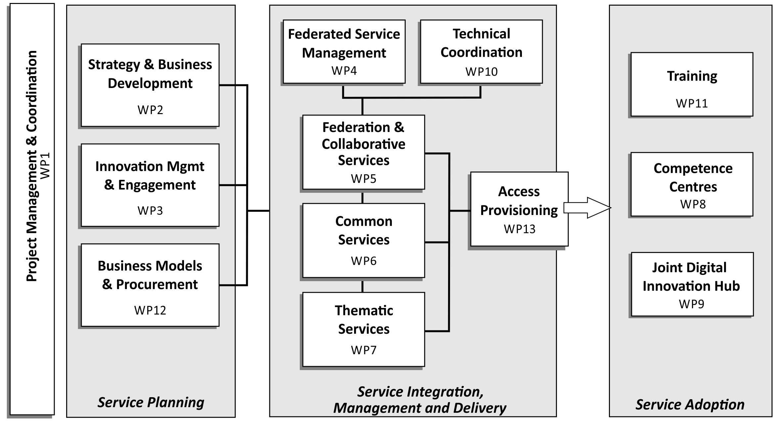
Work Package Structure
Overview and Key Exploitable Results

Slide 6
EOSC-hub response ECI objectives
OBJECTIVE Increase the ability to exploit research data across scientific disciplines and between the public & private sector | EOSC-hub RESPONSE > Publish, discover, access services and resources for all scientific disciplines > Open to national, regional, pan-European providers, and supports different exploitation models (e.g. free at point of use, commercial)
OBJECTIVE Increase interoperability, interconnect the existing and the new research digital infrastructures across Europe | EOSC-hub RESPONSE > Provide thematic services integrated with European compute/data platforms for data exploitation > Single sign on, integrated access and order management
OBJECTIVE Support open science | EOSC-hub RESPONSE > Services to share and discover research artefacts (publications, datasets, software, workflows etc.), research artefacts data sources (publication repositories, publishers, data archives, software archives, etc.)
Overview and Key Exploitable Results

Slide 7
Project KERs and Innovation Roles
Key Exploitable Results (KER)
9 Outputs which can be taken up, exploited and reused to support the future mature EOSC
Innovation
Roles
5 EOSC stakeholders taking up and benefiting from the KER
Overview and Key Exploitable Results

Slide 8
Key Exploitable Results and Innovation Roles
Services in the EOSC service portfolio
EOSC Portal and Marketplace
Training Courses and Materials
Interoperability & Integration Guidelines
Business and Sustainability Models
Rules of Participation
Service Management System
Internal Services in the Hub Portfolio
Digital Innovation Hub
Service Providers
Researchers and Research Communities
Education Training & Support
EOSC Hub Operators
Enterprise

Slide 9
Objective 1. Simplify and Integrate
Simplify access to a broad portfolio of products, resources and service provided by the major pan-European and international organizations through an open and integrated service catalogue
Services in the EOSC Service Portfolio
Support for federated service ecosystem: service discovery and access to market
Value proposition
The service providers will see increased interest in their services with user requirements that better match the specific offering
Researchers can compare solutions and reuse their credentials and knowledge related to EOSC service access with different providers
The Enterprise can lower the marketing and transaction costs considerably compared to targeting individual research institutes or researchers.
WP6 Common Services
WP7 Thematic Services
Overview and Key Exploitable Results
Notes:
EOSC Service Portfolio
Business models

Slide 10
Proposed Federating Core and Service Portfolio
EOSC SERVICE PORTFOLIO
Added-Value Services
SHARED RESOURCES
Generic data processing services, public good data, etc.
Arts and Humanities
Medical and Health Sciences
Physical Sciences Earth Sciences
Biological Sciences
Data Lifecycle Management, Compute,
Scientific Applications
HUB PORTFOLIO Key Access- and Federation-Enabling Services
COMPLIANCE FRAMEWORK
Rules of Participation, Service Management System, policies
Overview and Key Exploitable Results
Notes:
Hub Portfolio:
Access- and federation-enabling services
Compliance Framework:
Regulatory framework – policies and processes to operate the FC
drives composition of FC and Service Portfolio
Shared resources:
Resources (services and scientific products) of pan-European relevance developed by a given discipline but used more broadly by additional disciplines
Service developers could develop new services based on shared resources
Service portfolio:
Provides additional value-added services
Exploit FC
Discoverable through EOSC portal

Slide 11
Support to the Research Data Lifecycle
4
Access, Deposition & Sharing
Application DB (software & VM)
B2DROP (data)
B2Note (data)
B2SHARE (data)
DataHub
1
Data Management, Curation & Preservation
Access enabling Services
Discover & Reuse
B2HANDLE
B2SAFE
European Certified Trusted Repository
Federated AAI. monitoring, accounting
SLA and order Management
Security incident response and policies
Technical support & Training
B2FIND (data)
Marketplace (Services)
3
Processing & Analysis
2
Applications on Demand
Federated HTC & Cloud Compute IaaS & PaaS
Processing of sensitive data
Jupyter Notebook
Thematic data analytics
Scientific Workflow Management, Orchestration (DIRAC, PaaS Orchestrator)

Slide 12
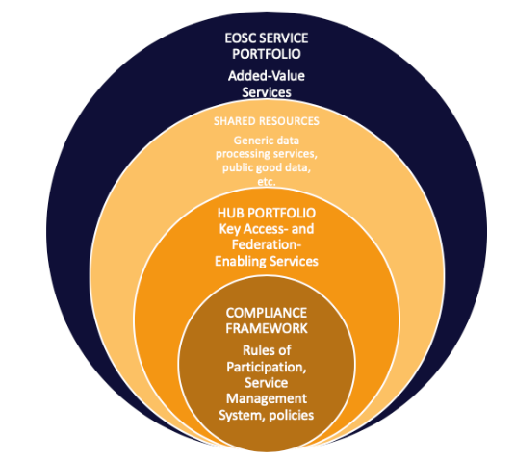
Objective 2. Remove Fragmentation 1/2
Remove fragmentation of service provisioning and access to high-quality digital services in Europe and beyond through the technical integration and adoption of standards for interoperability of compute, storage, data and software platforms
A concise and easily adopted set of technical guidelines allowing technical integration of solutions to EOSC system
Value proposition
Minimising the technical design and development effort needed to access to EOSC services market
Integration & Interoperability Guidelines
WP10 Technical Coordination
Overview and Key Exploitable Results
Notes:
EOSC Service Portfolio
Business models

Slide 13
Objective 2. Remove Fragmentation 2/2
Rules of Participation
Comprehensive and coherent set of rules for the services provides to onboard services into and make them discoverable and accessible through the EOSC Service Catalogue and Marketplace
WP2 Strategy & Business Development
WP4 Federated Service Mgmt
WP10 Technical Coordination
Value proposition
Bring new service providers into the EOSC ecosystem while ensuring the quality and conformance of the overall services and maintaining the trust of the user communities
Harmonized security policies & Data policy recommendations

Slide 14
Objective 3. Consolidate 1/3
Consolidate e-Infrastructures by expanding capacity and capabilities and improving service quality
Service Management System
Comprehensive, coherent and standards-based set of procedures and processes to manage the complete life cycle of services in a complex environment
Value proposition
Ensure robust and resilient service delivery in a federated infrastructure with different types of many-to-many relationships between users, providers and clients
Validation of providers
Incident Management
SLA negotiation
Customer Relationship Management
Capacity Management
…
WP4 Federated Service Mgmt
WP5 Federation & Collaborative Services
WP6 Common Services
Overview and Key Exploitable Results
Notes:
EOSC Service Portfolio
Business models

Slide 15
Objective 3. Consolidate 2/3
Consolidate e-Infrastructures by expanding capacity and capabilities and improving service quality
Internal Services provided in the Hub portfolio
Set of service interfaces providing basic enabling services for EOSC access
Value proposition
This KER provides a common toolset for integrating services to EOSC ecosystem. This is a prerequisite for the function of the hub as a federating core.
For the service providers, the KER provides tools to access several user communities through the hub by integrating their services to a single service API (instead of several community-specific ones)
Federated AAI
Order Management
Monitoring and Accounting
Helpdesk etc.
WP4 Federated Service Mgmt
WP5 Federation & Collaborative Services
WP13 Access Provisioning
Overview and Key Exploitable Results
Notes:
EOSC Service Portfolio
Business models

Slide 16
Objective 3. Consolidate 3/3
Achieving compatibility of business and sustainability models of traditional and emerging EOSC stakeholder groups in an intuitive and transparent manner
Value proposition
Demand estimation and prediction
Reduction of procurement costs through demand aggregation and centralised compliance monitoring (economies of scale)
Cross-border and -sectoral VAT compliance
➔ Collaboration with the OCRE project
Business and sustainability models for services and the Hub
WP2 Strategy & Business Development
WP12 Business Models & Procurement
Overview and Key Exploitable Results
Notes:
EOSC Service Portfolio
Business models

Slide 17
Objective 4. Widen demand side 1/3
Widen the access to services to all user groups including researchers, high-education, business organizations and expand the user base
WP2 Service Portfolio Mgm, WP4 Federated Service Mgmt
WP5 Federation & Collaborative Services, WP13 Access Mgmt
WP3 Innovation Management and Engagement
WP8 Competence Centres, WP9 Digital Innovation Hub
Support for federated service ecosystem: service discovery and access to market
Value proposition
The service providers will see increased interest in their services
Researchers can compare solutions and reuse their credentials and knowledge
The Enterprise can lower the marketing and transaction costs considerably compared to targeting individual research institutes or researchers.
EOSC Portal and Marketplace
Co-design
Requirements and Gap Analysis
Piloting and pre-production service provisioning
Technical development and service deployment
Overview and Key Exploitable Results
Notes:
EOSC Service Portfolio
Business models

Slide 18
Competence Centres 2/3
ESFRI landmark
T8.1 ELIXIR
T8.8 Disaster mitigation
T8.2 Fusion
ESFRI landmark
Competence Centres
T8.7 Carbon cycle
T8.3 Marine
ESFRI landmark
ESFRI project
T8.6 Radio astronomy
T8.4 Ionosphere studies
T8.5 EPOS-ORFEUS
ESFRI landmark
ESFRI landmark
ESFRI landmark
Overview and Key Exploitable Results

Slide 19
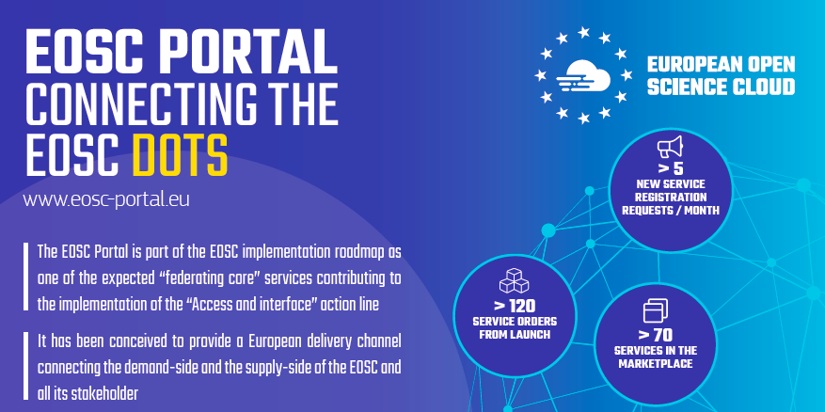
Early Adopters, Users, Portal and Marketplace 3/3
Users
Credit allocation & exploit
Support
Improve with feedback
Use
Early adopters
Pilot
Use
Co-develop
EOSC Portal
and Marketplace
Overview and Key Exploitable Results

Slide 20
Objective 5. Human Capacity
Provide a knowledge hub
Tools, consulting models and material that make it possible to provide training services tailored to optimally fit the needs of the diverse audience EOSC needs to reach.
Value proposition
Smooth integration into EOSC ecosystem, maximising the benefits
Innovation Management
Service Management
IT Security
Data management
EOSC services
Cross-project / cross-community synergies
Requirements analysis and technical development
Training Courses and Materials
WP8 Competence Centres
WP11 Training
WP9 Digital Innovation Hub
Overview and Key Exploitable Results
Notes:
EOSC Service Portfolio
Business models

Slide 21
Objective 6. Innovation Capacity 1/2
Increase innovation capacity of Research e-Infrastructures
Digital Innovation Hub
WP10 Technical Support
WP9 DIH
Digital Innovation Hub. Platform for industrial collaborations
Value proposition
Lowers initial investment (time and effort) for identifying/accessing services and developing/testing new products and services as well as increasing visibility and networking opportunities on a European level
Overview and Key Exploitable Results
Notes:
EOSC Service Portfolio
Business models

Slide 22
Role of Industry in the EOSC 2/2
Customer
Making use of existing EOSC services
Provider
Offering services to EOSC
Partner
Co-development
Procurement
Participate in the procurement framework (see WP12)
Overview and Key Exploitable Results

Slide 23
Results
An overview of the main achievements M01 – M18

Slide 24
Highlights – Service Provider Engagement
“The project developed and operates key components of the EOSC Federating Core”
Organizational Model
Shared Resources Tier: Compute and data management integration, piloting
Service Portfolio Management
Regulatory Tier: Harmonized policies, technical architecture and interoperability guidelines
Federating Tier: Federation tools, Portal and Marketplace; order management system, accounting, monitoring and helpdesk; AAI; Service Management System
Overview and Key Exploitable Results

Slide 25
Highlights – Service Provider Engagement
“The project engages with Service Providers daily and provides integration and service aggregation tools”
Daily operations of the EGI Federation and EUDAT CDI
Onboarding procedure and 42 new service registration requests, the Service Description Template
SP integration model based on packages of access enabling and federation services
Service Provider Forum
Service Management System with 13 processes
Creation and promotion of harmonized policies for EOSC (data sharing policies, AUP, security policies)
Overview and Key Exploitable Results

Slide 26
Highlights – Engagement with Research Communities and Projects
“The project engages and supports users on a daily basis with a dedicated enabling programme, order management and training”
Unified EOSC-hub helpdesk
> 60 training events, > 1500 people trained
65 unique user orders
Early Adopter Programme and selection procedures, 12 applicants
Digital Innovation hub and Competence Centres, with some integrated services already brought to the Marketplace
Market analysis to understand the need for / level of demand for digital services
Overview and Key Exploitable Results

Slide 27
Highlights – Strategy & Sustainability
“With OpenAIRE-Advance we contribute to the definition of the EOSC business plan and and Sustainability”
EOSC-hub exploitation plans and strategic actions
Briefing Paper on EOSC Federating Core
EOSC-hub & OpenAIRE Common vision, service provision and role in the EOSC Governance
Procurement requirements and EOSC demand assessment
1st Data sharing policy & contribution to the adoption of FAIR principles
Overview and Key Exploitable Results

Slide 28
Response to Recommendations
From January review report…

Slide 29
Recommendation 1 Progress with work plan
Engaging communities, expanding the catalogue of services and enlarging the user basis. While progressing with the work, the project implementers need to be aware that other changes will be needed
More support the demand side and allocation of budget reserve to implement the Early Adopter Programme
Streamlined activities involved in a service joining the EOSC-hub service portfolio
86 registered services in both portfolios, of which 10 in the Hub Portfolio
These services come from both project partners (EGI, EUDAT, INDIGO-DataCloud and research communities working on WP7 and WP8) and external actors
21 new services were onboarded and 24 are in verification
Public consultations through the EOSC liaison platform and Webinars:
Technical architecture and interoperability guidelines
Federating Core decomposition and sustainability
Service Management System
EOSC Portal Concept 2.0
Overview and Key Exploitable Results

Slide 30
Recommendation 2. Cross-project cooperation
EOSC-Hub needs to reinforce the interaction with other projects and the new governance structures. In particular, EOSC-Hub should engage in more active collaboration with FREYA
Four Collaboration Agreements and MoUs
FAIRsFAIR and FREYA planned in Q4 (virtual and f2f meetings in PY1)
Input to EOSC working groups
Participation to WG ARCH
Contributions to WG RoP
PMB reporting structure in place to align with WGs activities on a monthly basis
Contribution to EOSC Symposium 2019
Overview and Key Exploitable Results

Slide 31
Recommendation 3. Make EOSC a concrete result
Take a stronger steering role in future EOSC development
Engagement and consultation with external stakeholders on key results
Strategy alignment with ESFRI cluster projects and PRACE through the Strategy Board
For user communities
(EOSC branded) Early Adopter Programme
(EOSC branded) Digital Innovation Hub
For service providers
Onboarding procedures
EOSC Portal and Marketplace
Overview and Key Exploitable Results

Slide 32
Recommendation 7. Joint Activity Plan
The projects should continue, both individually and jointly, to increase the involvement and interaction with a larger spectrum of research communities and infrastructures
Cross-project strategic board has to be established
Activity reports gathered regularly
Joint interaction with the EOSC demand side through the Early Adopter Programme
Cross-project strategic board involvement in EOSC-hub and OpenAIRE-Advance White Paper “Common Vision, Service Provision, and Role in the EOSC Governance” ➔ WP2 Report
Planned: Milestone JAM3.4 “Aligned roadmap(s) for service positioning and sustainability within EOSC”
Overview and Key Exploitable Results

Slide 33
Recommendation 8.1 Revise Collaboration Agreement
The Collaboration Agreement should include specific technical activities related to the portal, along with related milestones
EOSC Portal Collaboration Agreement
April – December 2019
EOSC-hub, OpenAIRE-Advance, eInfraCentral (till June 2019), and other technical partners from the eInfraCentral consortium from July 2019
Overview and Key Exploitable Results

Slide 34
Recommendation 8.2 Roles and Responsibilities
Expand role of cross-project strategic board as far as the roles and responsibilities are concerned
Definition of IPR and exploitation
Definition of jointly owned results
The cross-project strategic board responsibilities were updated to clarify the role in providing coordinated input to the EOSC governance boards and working groups:
[NEW] Align input and messages addressed to the EOSC Board, Executive Board and Working Groups
Overview and Key Exploitable Results

Slide 35
Recommendation 9 Single Open Repository
A single open repository should be created to assemble all the specifications of the system (past, present and future) that support and define the EOSC federated architecture
A common EOSC-branded work space setup to host interoperability specifications and share them with the EOSC community for public comments.
https://wiki.eoschub.eu/display/EOSCDOC/EOSC+Documentation+Home
Consultation with the EC on use of EOSC brand and process for community endorsement
Overview and Key Exploitable Results

Slide 36
Recommendation 10. EOSC-hub and eInfraCentral Cooperation
Cooperation on unified service description template and categories, AAI, onboarding process, helpdesk, improved usability
Joint Activity 1. The daily operation and maintenance of the EOSC Portal
Joint Activity 2. Interoperability framework and glossary
Joint Activity 3. Technical integration including optimization of the service provider onboarding and the user experience ➔ Revised EOSC Portal architecture
Joint Activity 4. Content provisioning and promotion of the portal
Overview and Key Exploitable Results

Slide 37
Recommendation 1:1 EOSC Portal position paper
Produce a position paper where they agree to work together in a specific direction, shared terminology, common description of the main components of the EOSC portal (such as the catalogue and Marketplace)
EOSC Portal Concept 2.0 issued in March 2019
Revised common glossary
Activity will continue as a task force of WG ARCH
Overview and Key Exploitable Results

Slide 38
Recommendation 12. eInfraCentral successor
A specific and crucial decision that the three projects should take is who will inherit the eInfraCentral catalogue at the end of the eInfraCentral project (June 2019).
Committeemen to continuity through the EOSC Portal Collaboration Agreement
eInfraCentral consortium partners: namely EFIS, JNP and University of Athens.
Joint Results, ownership and milestones defined in the EOSC Portal Collaboration Agreement
Overview and Key Exploitable Results

Slide 39
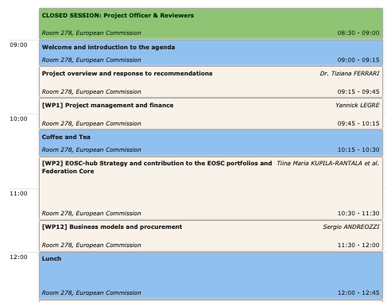
Agenda
Day 1 AM

Slide 40
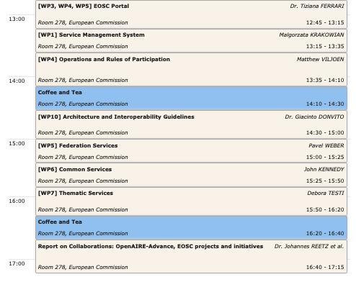
Agenda
Day 1 PM

Slide 41
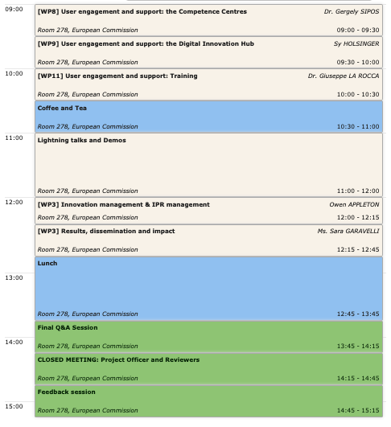
Agenda
Day 2

