Slide 1
EOSC Portal
Tiziana Ferrari/EOSC-hub Project Coordinator
EAB Meeting, 25 Nov 2019

Slide 2
Outline
Status and report of activities
EOSC Portal Collaboration Agreement and joint activity plan
Usage statistics
Considerations

Slide 3
Status and Report of Activities
EOSC Portal, EOSC-hub Review, 8-9 October 2019

Slide 4
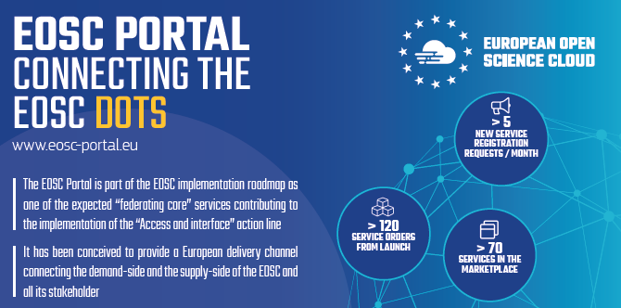
EOSC Portal, EOSC-hub Review, 8-9 October 2019

Slide 5
EOSC architecture as a federated system of resources and services from European digital infrastructures and national providers federated
EOSC is based on a “federating core” service contributing to the implementation of the “Access and interface” action line
of the EOSC roadmap
March 2018
Concept 1.0 and Design
November 2018
Launch and start of operations
March 2019
Concept 2.0 paper & Collaboration Agreement draft
April 2019
Feedback gathering from ESFRI cluster projects, Enhance-EOSC project submitted
June 2019
Revised Architecture

Slide 6
A delivery channel connecting the demand-side and the supply-side which showcases the potential of integrated and coordinated access to European services, data and other scientific outputs
https://eosc-portal.eu/
EOSC Portal, EOSC-hub Review, 8-9 October 2019

Slide 7
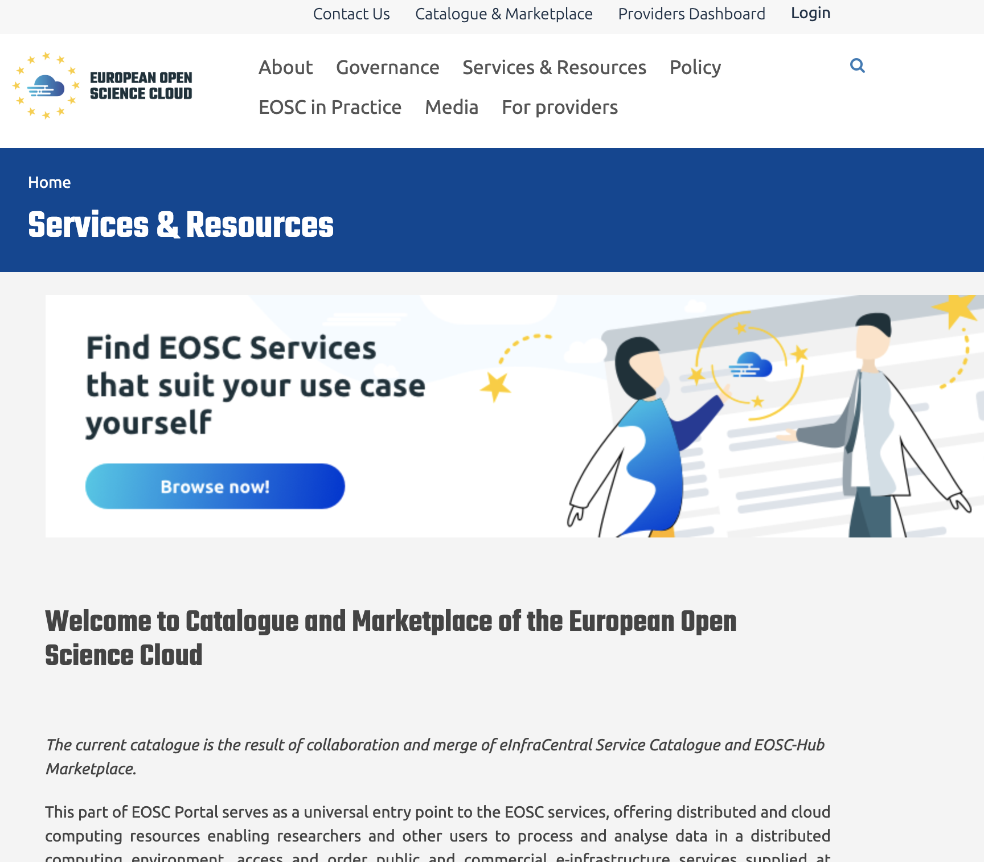
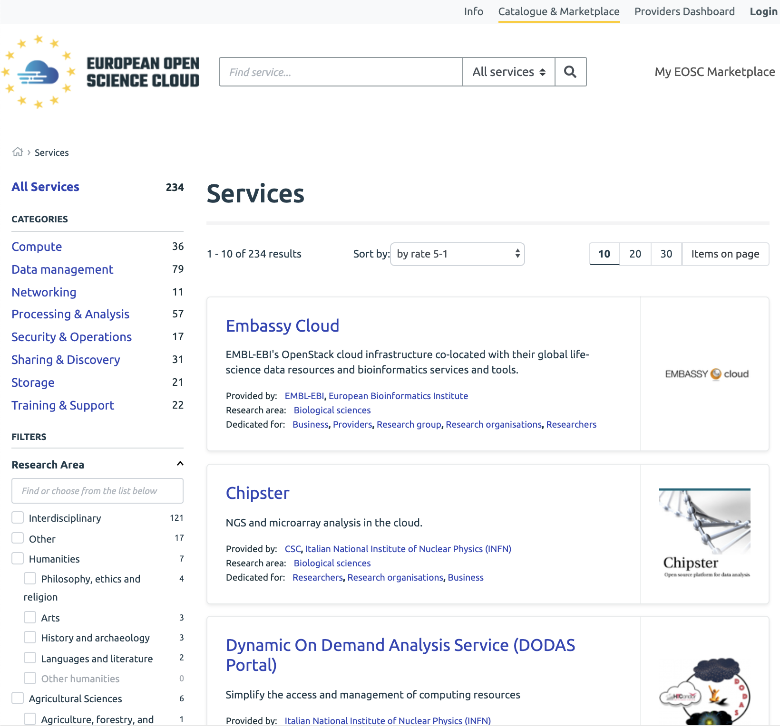
https://eosc-portal.eu/
EOSC Portal, EOSC-hub Review, 8-9 October 2019
Notes:
Clearer navigation between portal modules
Services and Resource section change to direct to unified catalogue&marketplace
Catalogue has now 234 services onboarded either by eosc-hub or EIC

Slide 8
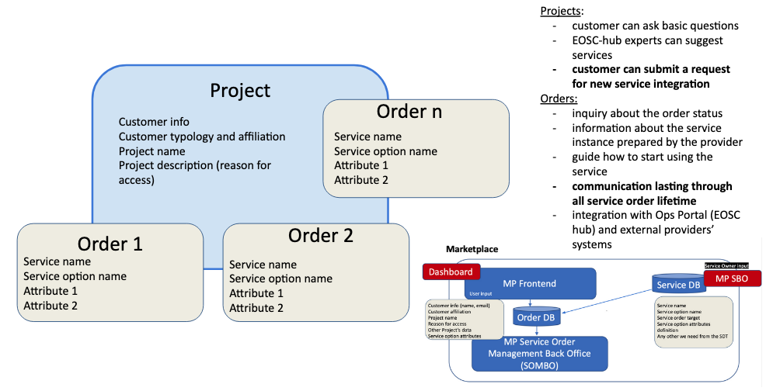
Marketplace: Projects and Orders
EOSC Portal, EOSC-hub Review, 8-9 October 2019

Slide 9
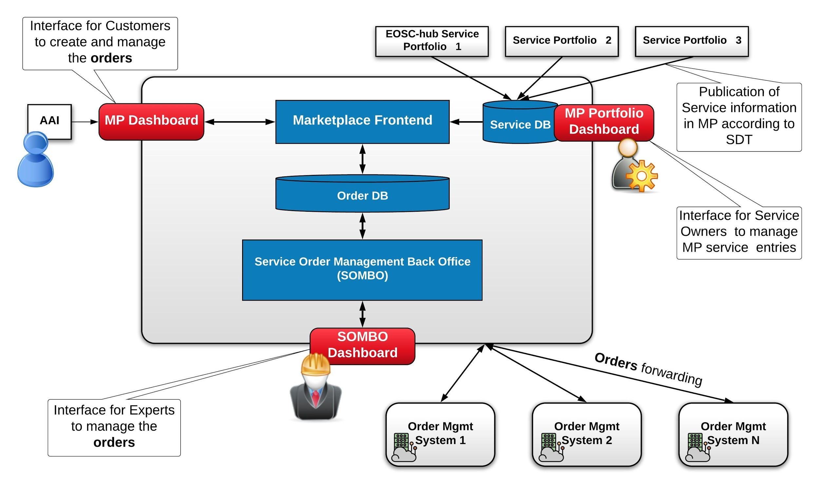
Marketplace Architecture
EOSC Portal, EOSC-hub Review, 8-9 October 2019

Slide 10
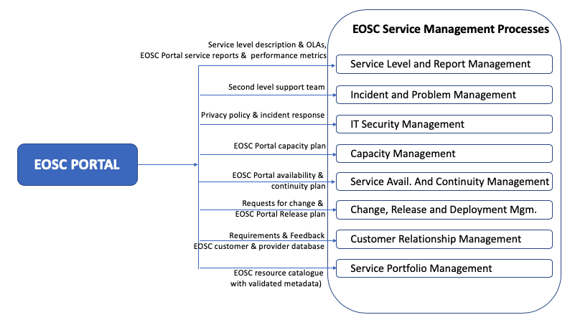
EOSC Portal backoffice Processes
EOSC Portal, EOSC-hub Review, 8-9 October 2019

Slide 11

Collaboration Agreement and
Joint Activity Plan
EOSC Portal, EOSC-hub Review, 8-9 October 2019

Slide 12
Activities and
Operations
Interoperability
Technical integration
Content provisioning
EOSC Portal, EOSC-hub Review, 8-9 October 2019

Slide 13
Joint Activity Plan (Apr-Dec 2019)
Operations
Coord: EOSC-hub WP4, EGI Foundation
  Running of the portal technical platform
  Integration and rolling to production
  First level and expert support
  GDPR compliant privacy policy, OLAs
  Monitoring, metrics
  Order management and customer relationship management
  Provider onboarding, data & service registration
  Validation
  APIs for automatic publishing and metadata updates
Interoperability Framework Coord: JNP
  Service Description Template, glossary
  APIs
  Accounting, monitoring, support and order management
  EOSC scientific product catalogue framework concept paper for inclusion of data repositories, software repositories etc.
EOSC Portal, EOSC-hub Review, 8-9 October 2019

Slide 14
Joint Activity Plan (Apr-Dec 2019) (cont)
Technical Integration
Coord: EOSC-hub WP5.2, CYFRONET
  New EOSC Portal architecture
  Single portal UI and entry point for service providers
  Define and develop single service database and data APIs
  Interconnection between the service database and the portal user interface
  Improvement of user experience and integration of UI of Porta/Service Catalogue/Marketplace
Content Provisioning
Coord: EOSC-hub WP3, TRUST-IT
  Editorial board participation for content creation
  Communication campaign to attract new service providers and users
  Creation of use cases on the EOSC services from participating projects
EOSC Portal, EOSC-hub Review, 8-9 October 2019

Slide 15
Background and Protection
Background
  Software and infrastructure
  API specifications
  Portal domain name, web site content
  EOSC logo
  Service Description Template and service classification scheme
  eInfraCentral and Marketplace service metadata
  Service Management System
  Helpdesk
  1st and 2nd level support team
  Monitoring & Accounting infrastructure
Protections
  Software: OSI compliant license
  Metadata: Possible copyright protection and potential sui generis database right
  Specifications and Service Management System: Creative Commons Attribution 4.0
EOSC Portal, EOSC-hub Review, 8-9 October 2019

Slide 16
Joint Results and Protection
EOSC Portal interoperability guidelines, documentation, glossary and architecture ➔ Create Commons with Attribution 4.0
EOSC portal Website design, portal brand, content and service metadata ➔ Copyright for visual identity of website and possible trademark for the EOSC acronym and EOSC name and logo
Domain name eosc-portal.eu ➔ Contract with register
EOSC Portal software ➔ OSI compliant license
EOSC Portal, EOSC-hub Review, 8-9 October 2019

Slide 17
Collaboration Agreement – Report of Activities
EOSC Portal, EOSC-hub Review, 8-9 October 2019

Slide 18
Operations
Running of the EOSC Portal and Marketplace platform
Testing and software updates: continuous availability of the platform, necessary security updates and updates connected to platform’s integrations (JIRA, SPMT)
First level support: handled incidents reported by the users, user support runs on a daily basis
Expert support to users and providers: 2 technical incidents reported by the users resolved
EOSC Portal, EOSC-hub Review, 8-9 October 2019

Slide 19
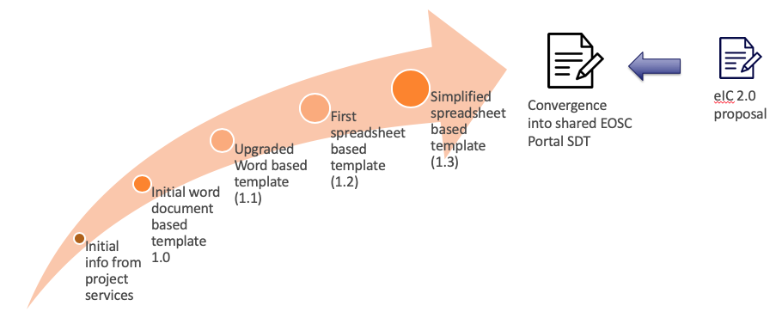
Service Description Template Evolution
EOSC Portal, EOSC-hub Review, 8-9 October 2019

Slide 20
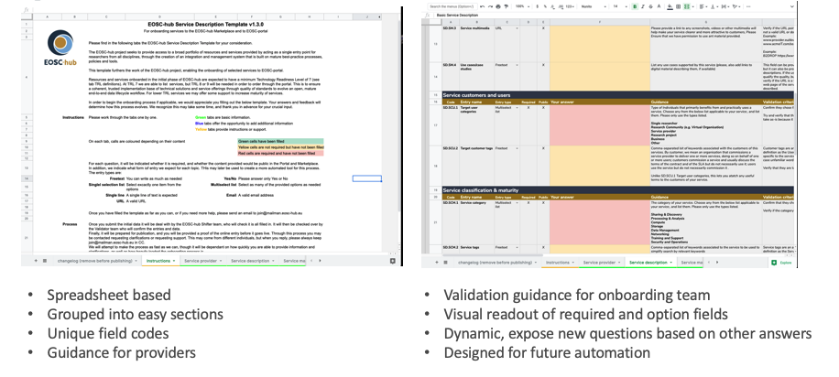
Current Service Description Template (SDT)
(http://bit.ly/eosc-hub-sdt)
EOSC Portal, EOSC-hub Review, 8-9 October 2019

Slide 21
SDT Convergence Process
Data model (SDT templates)
  Partial convergence in last round of templates
  Possible to map fields, importing from eIC to Marketplace possible with some minor intervention
  Discussions on shared data model and agreement for common categories etc happening now. Currently manually mapped.
Shared architecture agreed
  eInfraCentral based portfolio with database of SDT data
  EOSC-hub based catalogue using Marketplace as researcher facing interface
EOSC Portal, EOSC-hub Review, 8-9 October 2019

Slide 22
Nov 2019 Milestone
Objective: integrated, single list of services
Assumptions:
  All service from current catalogue and the EOSC-hub marketplace (EOSC-hub MP) will be available in single “Catalogue & Marketplace”
  The user interface will be based on technology from EOSC-hub MP
  The provider interface will be based on technology from eInfraCentral and service updates will be automatically populated into the user interface
The EOSC Portal backoffice, including service provider onboarding and order management, will be operated by EOSC-hub teams
Status:
  [DONE] Synchronization mechanism in the Marketplace with duplication solving
  [DONE] GUI improvements for better user experience - Plan
  [DONE] Aligned description and consistency checking
  [DONE] Deployment of new EOSC Portal version (Nov release)
EOSC Portal, EOSC-hub Review, 8-9 October 2019

Slide 23
Editorial Board
Establishment of an EOSC Portal Editorial Board
  Representatives of EOSC-hub, OpenAIRE, EOSC Pilot, eInfraCentral and EOSC Secretariat projects.
  Meetings every 3 weeks to discuss the portal updates and the communication actions
From EOSC launch: communication campaign to attract new service providers and users has started
  For providers “onboarding page”
  Promotion of funding opportunities, Early Adopters Programme, etc. to stimulate user engagement
Gathering of use cases using multiple EOSC services and Open Call
  A specific call for use case will be also issued for the EOSC Symposium
Preparation of the EOSC portal promotional material
  Roll-up banner, booklet and flier, and presentation/demo of the EOSC portal at different events (e.g. EC booth at the ICT Proposers Day 2019)
EOSC Portal, EOSC-hub Review, 8-9 October 2019

Slide 24
Analysis of usage and trends Dec 2018-Sep 2019
EOSC Portal, EOSC-hub Review, 8-9 October 2019

Slide 25
EOSC-hub Marketplace (Sep 2019):
Orders and related back office activities
144 Total orders
76 Served Orders
Common Services (79)
Thematic Services (28)
37 orders for services external to EOSC-hub

Slide 26
Distribution of orders (*):
Common Services (SX) and Thematic Service (DX)
(*) 11-2018/08-2019
EOSC Portal, EOSC-hub Review, 8-9 October 2019

Slide 27
Distribution of Users
Scientific Discipline (SX) and Country (DX)
Distribution by region
EU: 54
Asia Pacific: 40
America: 3
EOSC Portal, EOSC-hub Review, 8-9 October 2019

Slide 28
Concluding Remarks
The EOSC Portal supports the (to be defined) EOSC business model
  EOSC Concept 2.0 provides examples of how through the Portal providers can choose different federation and integration approaches with EOSC
  B2B and B2U transactions required
  The outcomes of the EOSC WG on Sustainability have implications on the EOSC Portal functionality to be delivered
Data discoverability and access
  The Portal needs a generally accepted approach to data discovery and access ➔ Enhance EOSC
Objective for EOSC-hub PY2
  Upgrade in 2019 to harmonize interfaces to users and providers ➔ New Marketplace development plan
  Consolidate EOSC portal back-office
  Collaboration agreement with Enhance EOSC needed from Jan 2020
EOSC Portal, EOSC-hub Review, 8-9 October 2019

