Slide 1
Hub and EOSC portfolios
Rules of Participation
Diego Scardaci (EGI), AMB Co-Chair
Budapest, 25 November 2019

Slide 2
Outline
EOSC-hub contribution to EOSC portfolios and Federating Core
Rules of Participation

Slide 3
The landscape
EOSC-hub project
Service
Service
Service
Service
Research domain
Service
Service
Service
Service
Service
Service
Service
Service
Service
Service
Service
Service
Provider domain
Service
Service
Service
Service
EOSC ‘Hub’

Slide 4
Two portfolios
(Full) EOSC Service Portfolio
EOSC Service Portfolio
Regional Hub
Thematic project
Other groups
External facing portfolio
Direct benefit to researchers: common and thematic services
Indirect benefit via Service providers: offer them additional capabilities for their services
Enable excellent research
EOSC-hub contribution to larger EOSC service portfolio
The Hub Portfolio
Internal: serve hub operators & service providers
Enable EOSC operation
Integrate with services from providers

Slide 5
The Hub Portfolio
The Hub Portfolio
EOSC hub AAI
Functions & central services
EOSC hub AAI
EOSC hub accounting
EOSC hub CMDB
EOSC hub collaboration software
EOSC hub helpdesk
EOSC hub monitoring
EOSC hub operations portal
EOSC hub service portfolio management tool
EOSC Portal & Marketplace
Interoperability specifications
External services
EGI
Check-In
EUDAT B2Access
Indigo IAM
Technical component services
Technical component services
Technical component services
Example: Check-In
Part of EOSC hub AAI – help power the hub vis use of Hub portfolio services
Can be integrated with external services so they can work with EOSC-hub AAI via integration with Hub Portfolio services and components
Can be deployed separately from EOSC hub via external EOSC Service Portfolio

Slide 6
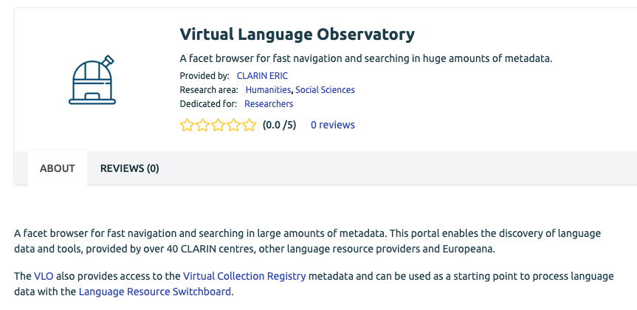
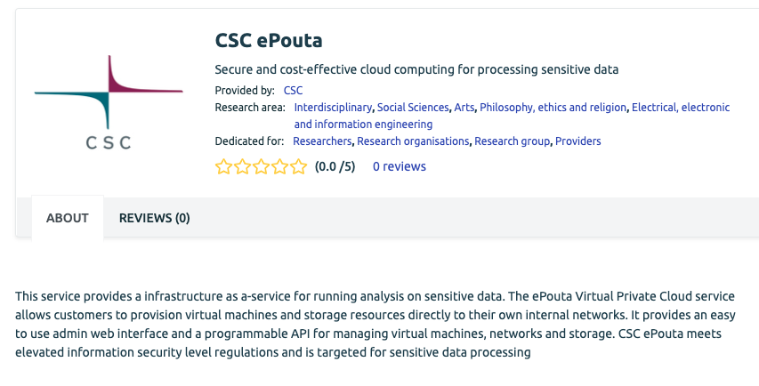
The EOSC Service Portfolio: EOSC-hub
EOSC (hub) Service Portfolio
Thematic Services
Address a specific research community
From ESFRIs, national projects, international initiatives
Task T7.1
CLARIN
Common Services
Provide generic functionalities that can apply to multiple domains
From technology providers, research projects, national groups
Includes services also seen as components in Hub Portfolio
Task T6.6
Sensitive data

Slide 7
The EOSC Service Portfolio: beyond the project
EOSC Portal
Service Catalogue & Marketplace
EOSC-hub Project
Wider EOSC community
EOSC (hub) Service Portfolio
Thematic Services
Service
Service
Service
Service
Service
Service
Service
Service
Service
Service
Service
Common Services
Service
Service
Service
Service
Service
Service
Service
Service
Service

Slide 8
EOSC Portal: 2020
Customers / Users
EOSC Portal
EOSC Enhance project
Service Catalogue - ‘EOSC-hub Marketplace’
Service Portfolio – eInfraCentral backend
EOSC-hub Project
EOSC (hub) Service Portfolio
Wider EOSC community
eInfraCentral listing
Archived from project, not onboarding
Thematic Services
Service
Regional Hubs
Thematic projects
National projects
Other groups
Service
Common Services
Service
Service

Slide 9
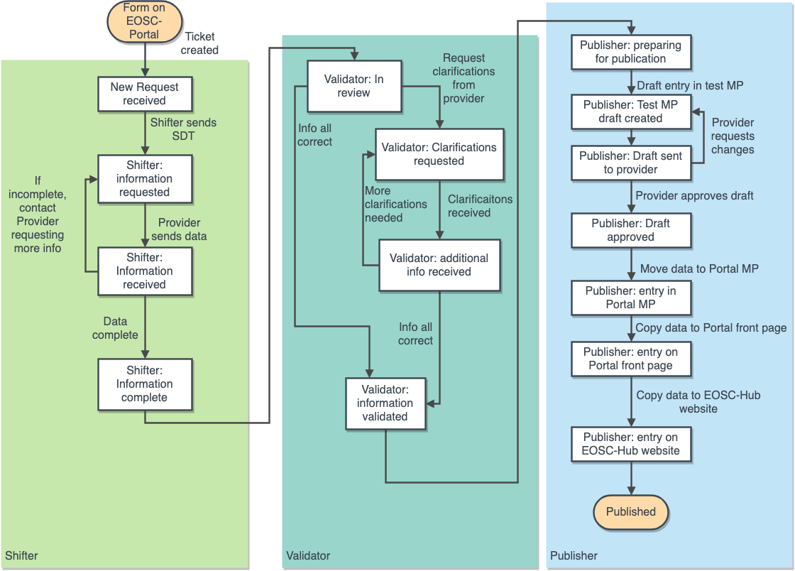
Onboarding Process: today

Slide 10
Onboarding Process: today
Submit the request for onboarding
Information gathering
Validation
Validation team examines filled template
Send an email to join@mailmain.eosc-hub.eu or fill the form available on the EOSC portal
Publication
Publish the service in the EOSC portal Marketplace
Receive support from EOSC-hub team in filling in the information
Receive a service description template to fill in
Fill the service description template
Ensures the services meets the Rules of Participation
Requests clarifications if required
Enters service in Service Portfolio
Transfer subset of data from the portfolio to the Marketplace on EOSC portal
Provide draft of entry to service provider

Slide 11
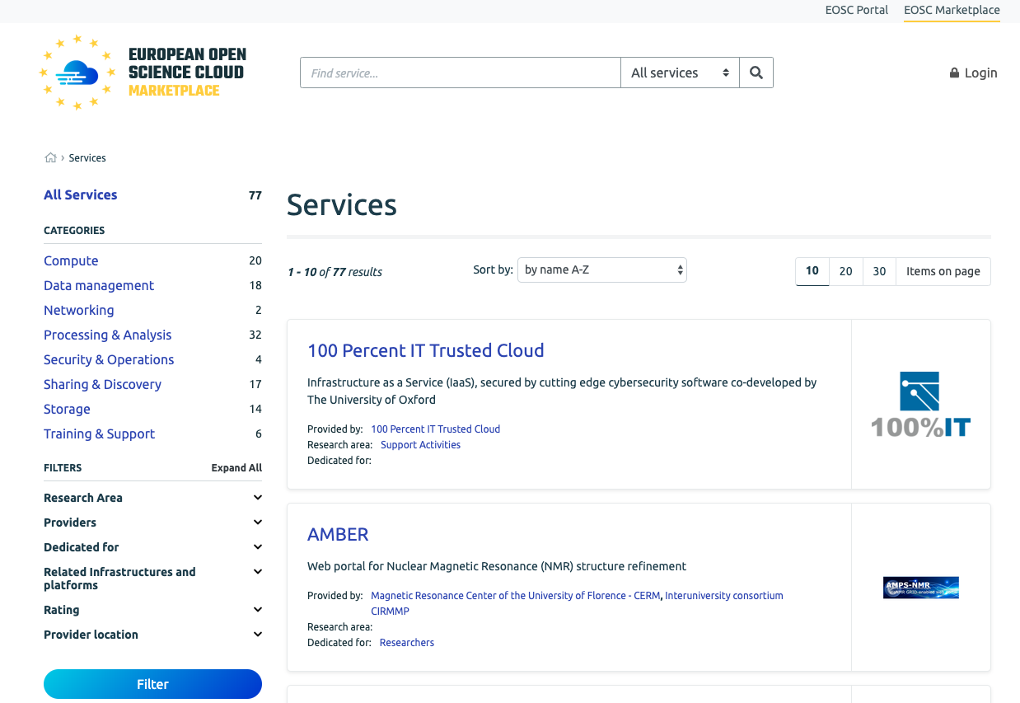
Onboarding Process: results
https://marketplace.eosc-portal.eu/

Slide 12
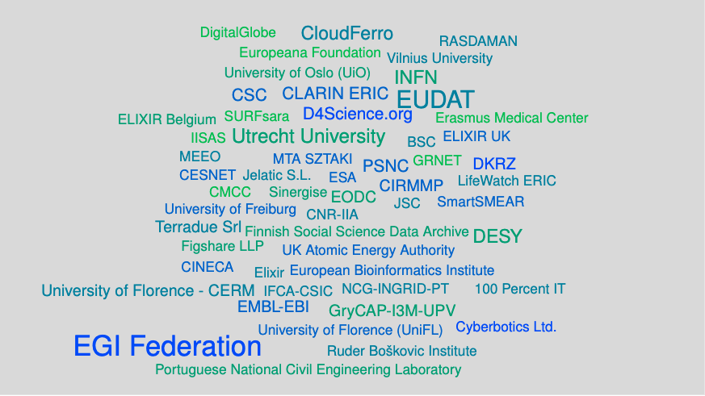
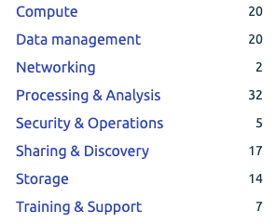
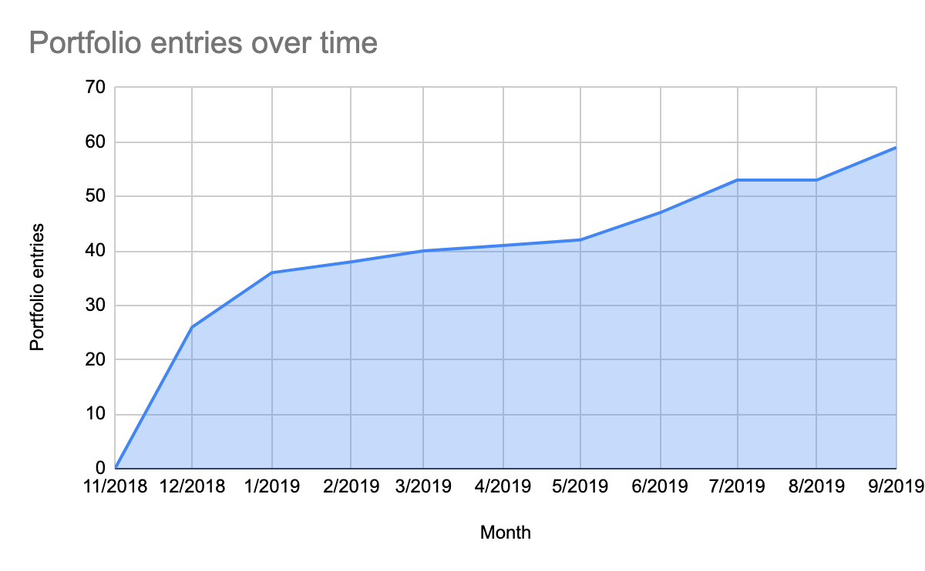
Onboarding to the Portal
Providers
Categories
Research disciplines

Slide 13
The ‘federating core’ and the wider EOSC
Thematic services:
e.g. RI services, thematic e-Infra services
Common services:
e.g. Data management, analytics, visualisation
Data :
e.g. ESFRI data sets, certified data sets, data catalogue listings
EOSC
Service
Portfolio
EOSC
Data
Portfolio
Shared resources:
Generic data processing services, public good data
EOSC
Federating
Core
EOSC
Federating
Core
Hub portfolio:
Key Access Enabling Services, e.g. AAI, Marketplace etc.
Compliance framework:
Rules of Participation,
Service Management System,
policies

Slide 14
The ‘federating core’ and the wider EOSC
Thematic services:
e.g. RI services, thematic e-Infra services
Common services:
e.g. Data management, analytics, visualisation
Data :
e.g. ESFRI data sets, certified data sets, data catalogue listings
EOSC
Service
Portfolio
EOSC
Data
Portfolio
Shared resources:
Generic data processing services, public good data
EOSC
Federating
Core
EOSC
Federating
Core
Hub portfolio:
Key Access Enabling Services, e.g. AAI, Marketplace etc.
Compliance framework:
Rules of Participation,
Service Management System,
policies

Slide 15
Outline
EOSC-hub contribution to EOSC portfolios and Federating Core
Rules of Participation

Slide 16
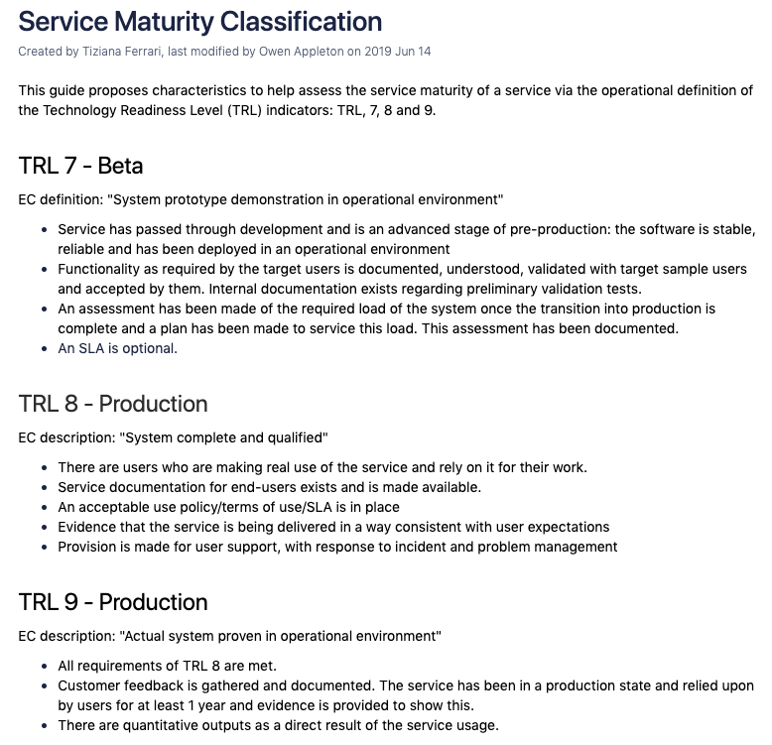
Rules of Participation
Cross-project taskforce (wp1-6,9,13) on criteria for participation
Areas of work
Service maturity classification (including harmonization across e-Infrastructures)
Service Description Template (SDT)
Providing guidance for security policy work
Classification, onboarding of services (next slides)
Provides input to EOSC RoP WG

Slide 17
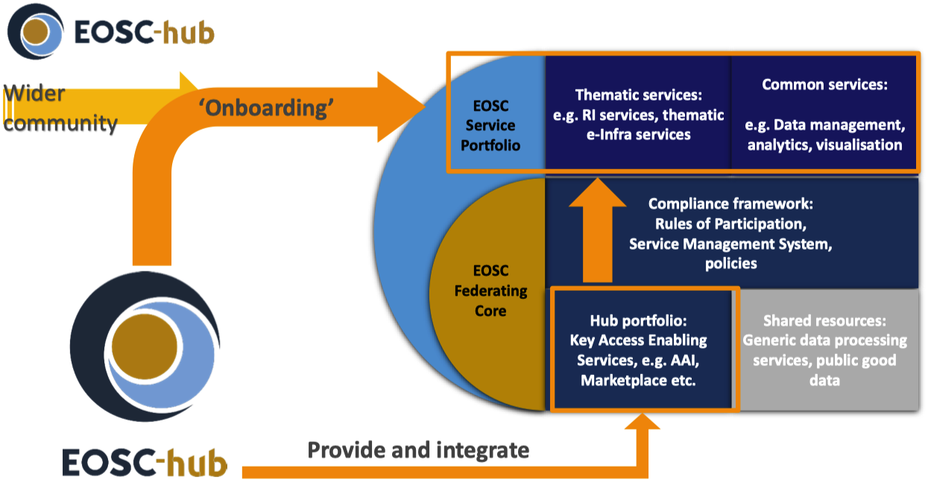
Onboarding procedure
RoP – Onboarding within EOSC-hub

Slide 18
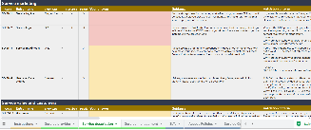
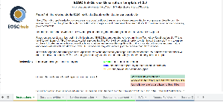
RoP – Onboarding Workflow
EOSC Service Portfolio
ACS:
A Chemistry
Service
Service Catalogue
Thematic
Services
EOSC Portal
EOSC Portal
Request onboarding
Fill SDT
Onboarding Shifter
Service Validator
Service in Portfolio
Published
8 people in
weekly rota
(T4.1)
5 people in
weekly rota
(T2.2)
1 person
(WP3)

Slide 19
RoP – General approach for onboarding EOSC Portfolio services
Original approach – 3 levels of integration
Level of provider’s SMS maturity
Based on which EOSC-hub SMS integration
HIGH-level required following EOSC-hub SMS
Too course-grained and rigid
New approach – package-based onboarding
Package: AAI, helpdesk etc.
Pragmatic – addresses provider needs from EOSC
Under active development
Onboarding requirements based on package(s) chosen
Details still under discussion
Possible packages & onboarding requirements
AAI
Trusted IdP
SIRFTI compliance
Helpdesk as a Service
2nd line support
SLAs defined
SLA
Marketplace for listing
§
Minimal SDT information
Completed OLA
Monitoring present
Capacity, continuity plans
Marketplace for ordering
Order management

