Slide 1
EGI Cloud Compute Service
Enol Fernández
enol.fernandez@egi.eu

Slide 2





The EGI Federated Cloud
Multi-cloud IaaS with Single Sign-On via Check-in
Run Virtual Machines on demand similar to AWS EC2/EBS or GCP Compute Engine
Technology agnostic:
OpenStack,
OpenNebula
Synnefo
Additional features
Single-Sign On via Check-in
Appliance Library
Resource discovery
Single GUI dashboard
Computation near data
Cloud compute
Cloud container compute
Online storage
AoD
Training infrastructure
Notes:
network with like-minded providers could be added to providers list

Slide 3
Cloud Compute
Deploy and scale virtual machines on-demand
Guaranteed computational resources in a secure and isolated environment with standard API access, without the overhead of managing physical servers.
Select pre-configured virtual appliances (e.g. CPU, memory, disk, operating system or software) from a catalogue replicated across all EGI cloud providers.
With Cloud Compute you can:
Execute compute- and data-intensive workloads (both batch and interactive)
Host long-running services (e.g. web servers, databases or applications servers)
Create disposable testing and development environments on virtual machines and scale your infrastructure needs
Select virtual machine configurations (CPU, memory, disk) and application environments to fit your requirements
Manage your Cloud Compute resources in a flexible way with integrated monitoring and accounting capabilities

Slide 4
Differences
Cloud Compute vs Cloud Container Compute vs HTC
 | Cloud Compute | Cloud Container Compute | High Throughput Compute
What is it? | Multi-cloud IaaS | Kubernetes on top of EGI Cloud Compute | The grid, a scalable batch system
What you run? | VMs | (Docker) Containers | Jobs
Typical workloads | Lift and shift existing applications Specific OS (kernel) requirements | Cloud-native containerised applications. | Execution of parallel computing tasks to analyse large datasets.
Pros / Cons | [+] Complete control on resources, run (almost) anything you’d like [-] Complex operation | [+] Industry standard [+] Hides complexity of Kubernetes setup [-] Kubernetes steep learning curve | [+] No management of resources, just submit jobs [-] Legacy interfaces [-] Porting of applications
Configurability
Abstraction

Slide 5





FedCloud Architecture
Research Communities
Platforms
Research Communities
Orchestration
Federation Services
IaaS
providers
Research Platforms
Operators
Check-in : Common AuthN and AuthZ across all layers

Slide 6
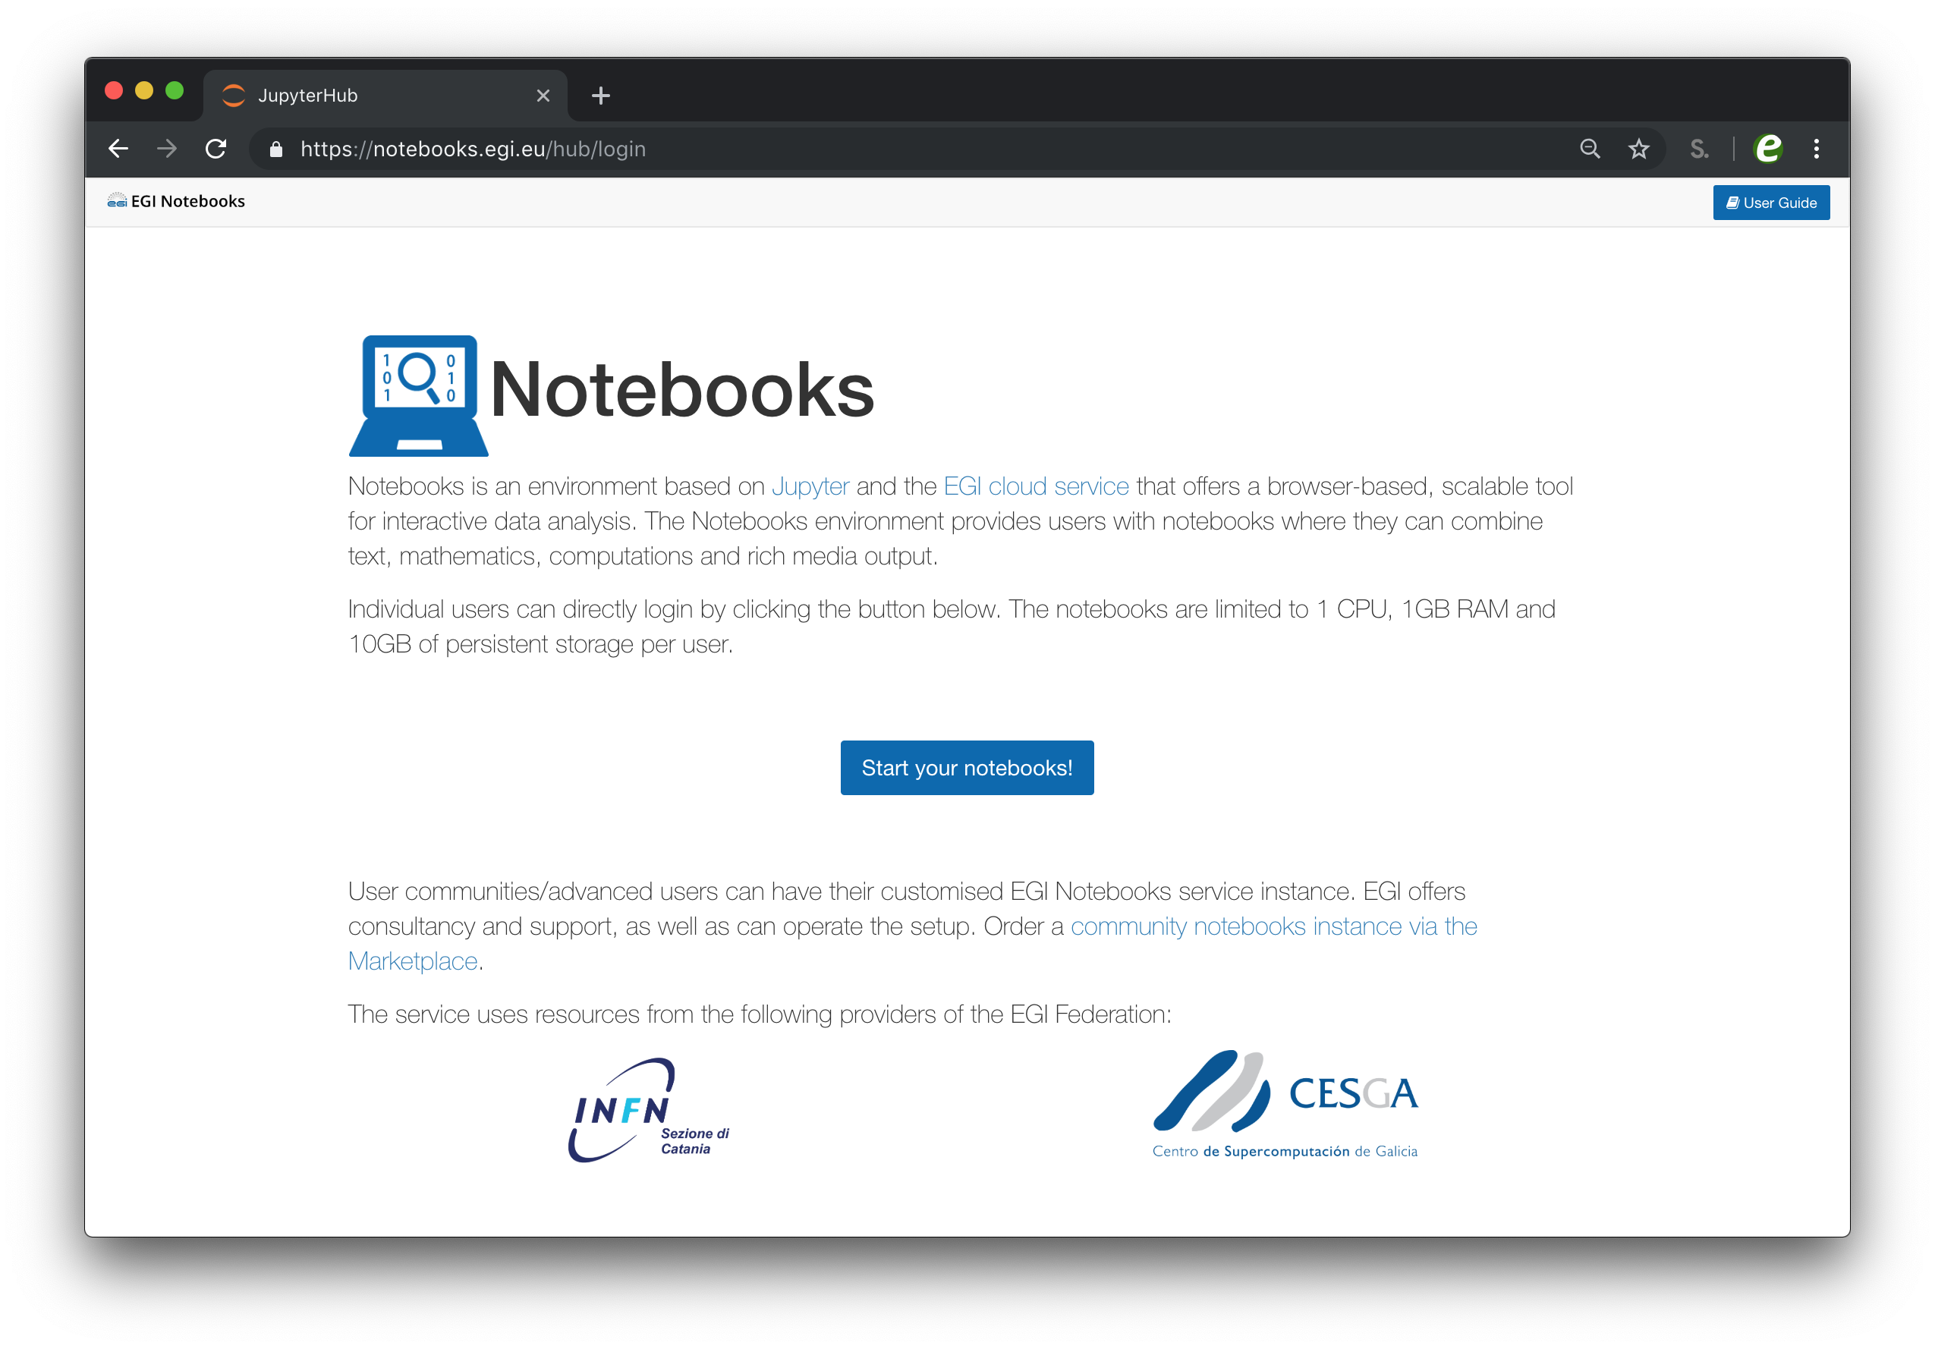
EGI Notebooks
One-click solution: login and start using
JupyterHub hosted in the EGI Cloud
  Offers Jupyter notebooks ‘as a Service’
Extra EGI Features:
  Login with the EGI AAI Check-In service
  Persistent storage for notebooks
  Use EGI computing and storage resources from your notebooks

Slide 7
NBIS
Scalable bioinformatics web-servers powered by cloud computing
Read more…
Clouds of the NBIS
Virtual Organisation
  A distributed Swedish research infrastructure
  providing bioinformatics support to life science researchers.
VM
Frontend
shared
storage
Query
VM
NBIS Servers powered by EGI:
Pcons.net
TOPCONS
SCAMPI2
ProQ3
PconsC2/PconsC3
BOCTOPUS2
VM
via web-page or API
Scalable handling of jobs using VMs from EGI Cloud Compute

Slide 8
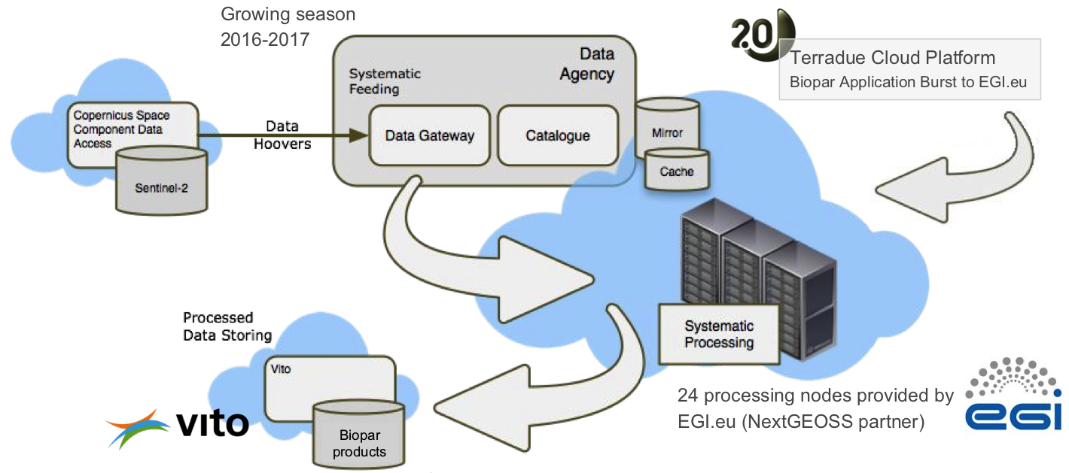
GeoHazards TEP
Read more…
  Cloud platform developed and operated by Terradue.
  It provides a rich set of ready to use EO Data processing services for geohazards analysis and monitoring.
  EGI Cloud Compute contributes resources to run near real-time processing of satellite data acquisitions.
Image taken from slides at https://indico.egi.eu/indico/event/3455/session/13/contribution/84

Slide 9

EGI Cloud: access layers
GUI Access
AppDB VMOps
AAI: Check-in
Federated
Access
IaaS Federated Access Tools
GUI Users
Developers/
Advanced users
Direct API
Access
IaaS API
IaaS API
Cloud Management Framework
Cloud Management Framework
EGI Federation features:
Accounting, Monitoring, Conf. DB, Info Discovery, AppDB
Notes:
User communities build either on top of orchestration tools that allow to deal with multiple providers in a homogeneous way or directly interact with the native APIs of the provides. Both cases they can use single sign-on thanks to Check-in.
A common GUI provided by AppDB VMOps brings a user-friendly dashboard to manage the resources at the distributed providers
The EGI federation services are integrated with the providers using their native APIs to deliver the extra features of EGI Cloud mentioned in previous slide
GUI access:
AppDB VMOps https://dashboard.appdb.egi.eu/vmops
API/CLI access:
Discovery: AppDB IS API (REST and GraphQL) https://wiki.egi.eu/wiki/Federated_Cloud_Discovery#AppDB
IaaS Federated Access Tools: https://wiki.egi.eu/wiki/Federated_Cloud_IaaS_Orchestration
Direct IaaS access, several APIs depending on the provider: https://wiki.egi.eu/wiki/Federated_Cloud_APIs_and_SDKs

Slide 10
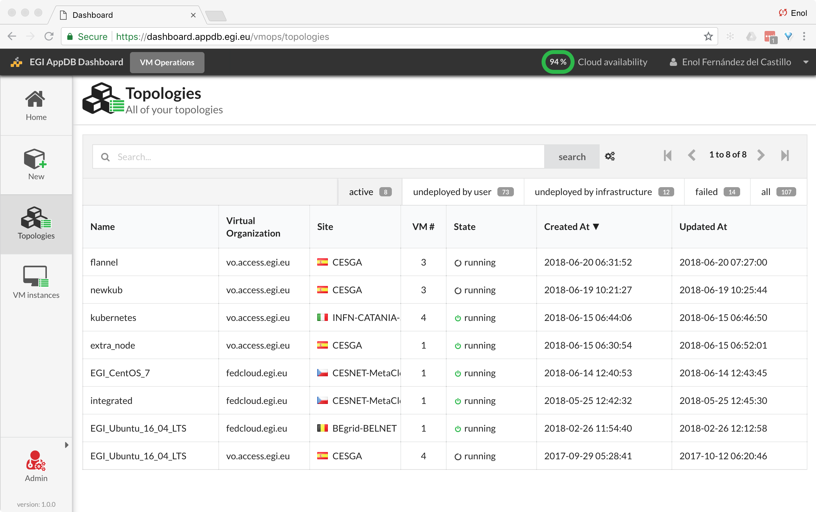
Manage VMs via AppDB VMOps Dashboard
Complete Check-in integration
Single dashboard for all providers
Wizard-like creation of VMs

Slide 11
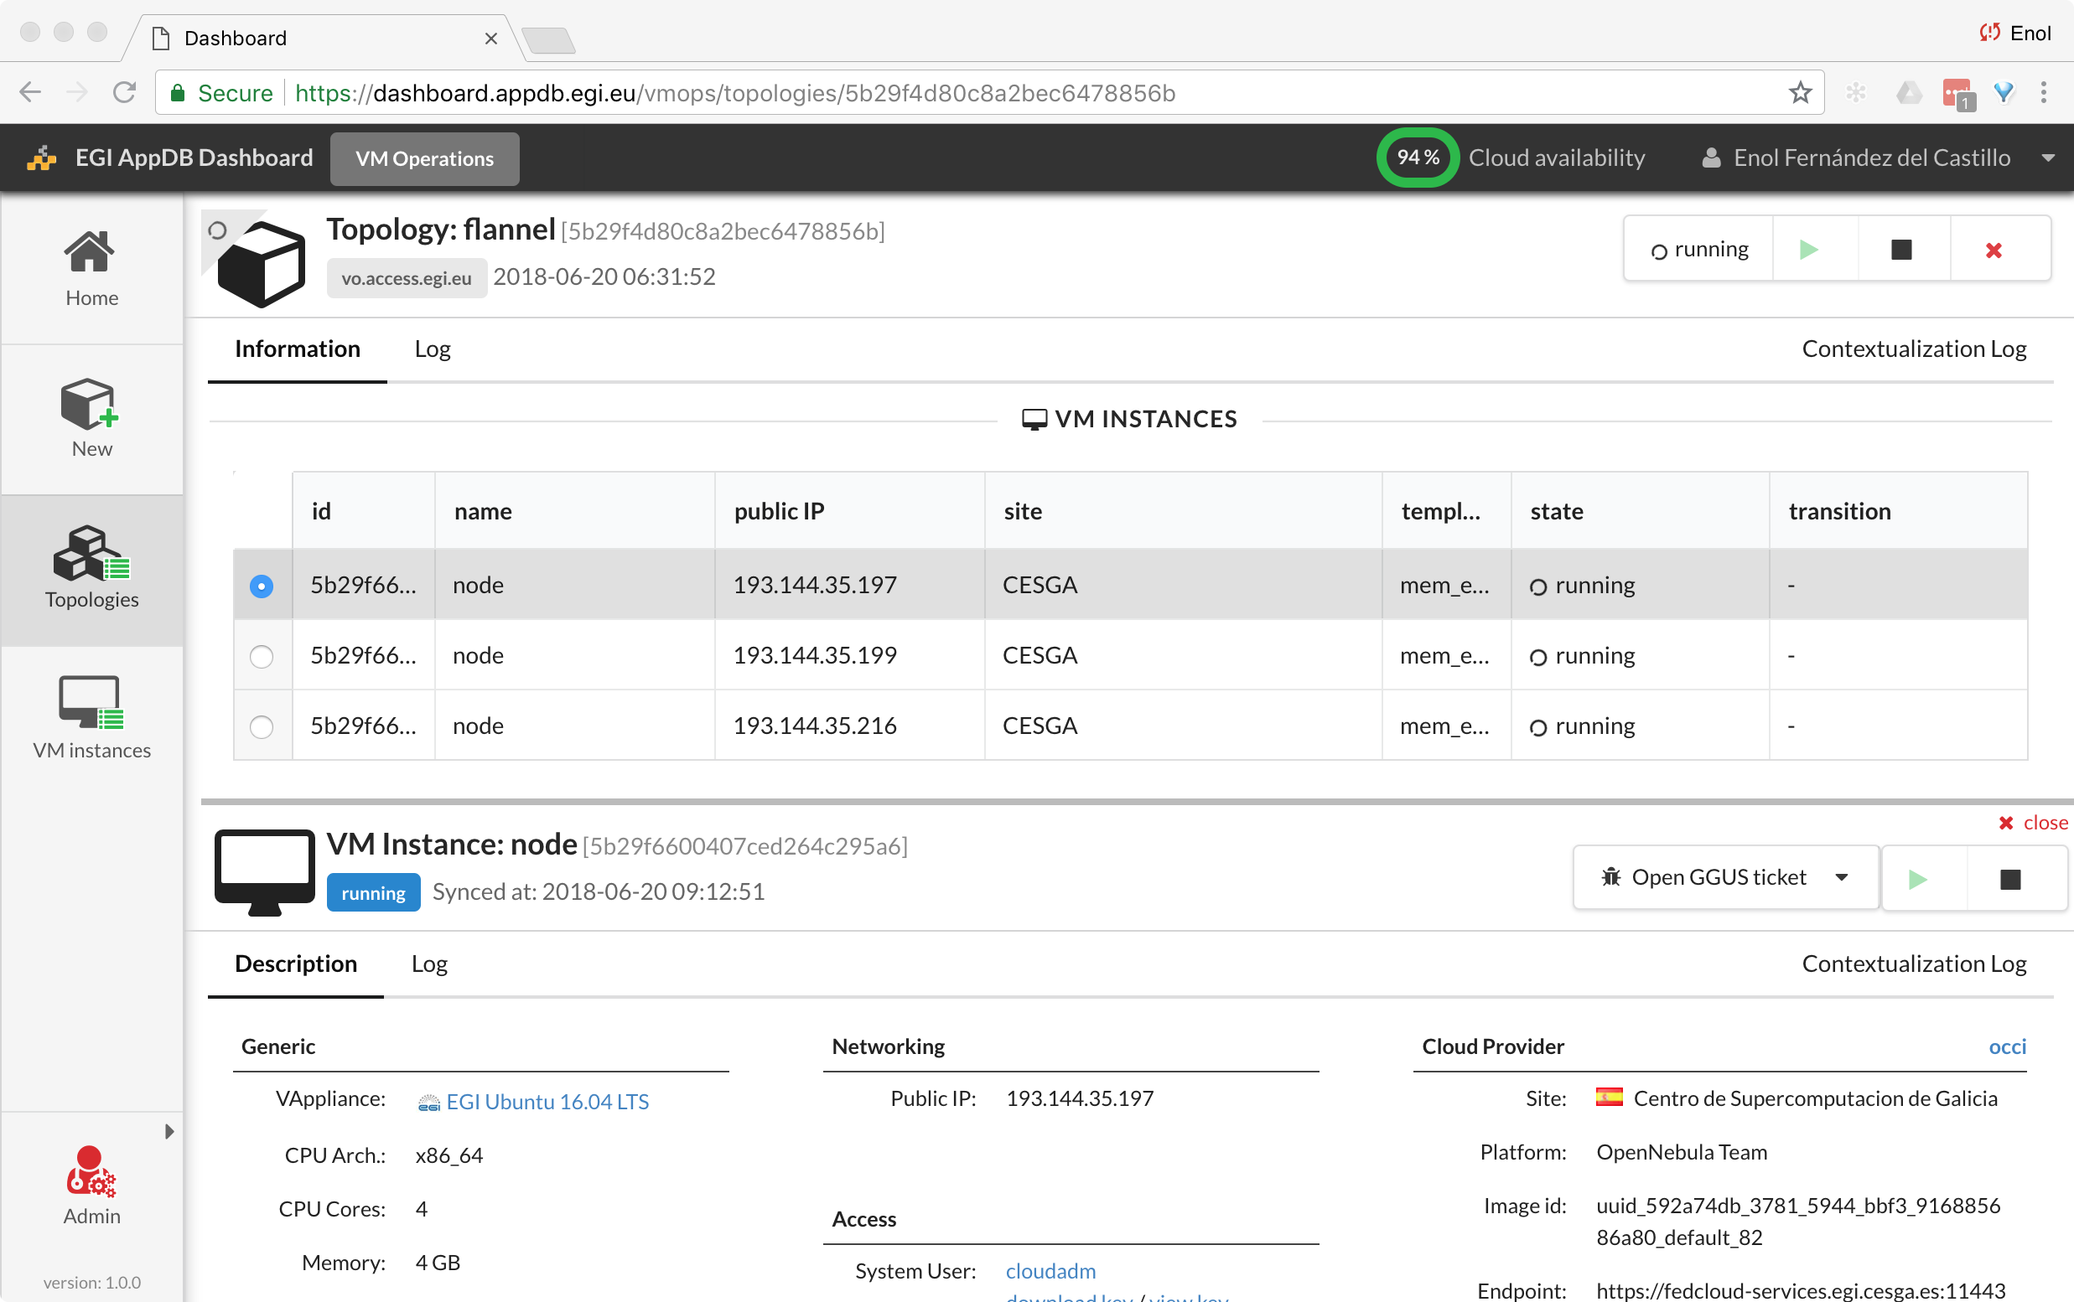
Manage VMs via AppDB VMOps
Global management of VMs
Topologies are a set of related VMs
GGUS integration
Individual management of VMs

Slide 12
Access and capacity allocation
“Free at a point of use”
Resource pool | fedcloud.egi.eu | access.egi.eu (AoD) | Community VOs
Membership requirements | X.509 certificate | Member of European research institutions (i.e. Check-in account) | Depends on VO (most still require X.509 certificate), new ones can be Check-in only
AppDB VMOps | ✅ | ✅ | Depends on VO
CLI/API access | ✅ | ❌ | ✅
Membership duration | 6 m, extensible up to 1 yr | 6 m, extensible up to 1 yr | 1 year renewable membership
Resource limits | Opportunistic, varying quota at providers. Limited lifetime per VMs may be applied | Opportunistic, varying quota at providers. Limited lifetime per VMs may be applied | Specified in the SLA: opportunistic, pledged, time based
Available providers | All providers | Providers of the Applications on Demand platform: INFN-Catania-Stack, CESGA, RECAS-Bari | As specified in the SLA

Slide 13
Use cases
Compute and data intensive workloads
  Batch and interactive (e.g. Jupyter notebooks) with scalable and customized environments
Service Hosting
  Long-running services (e.g. web server, database, application server)
Datasets repository
  Store and manage large datasets (in a storage volume)
Disposable and testing environments
  Host training environments, test applications

Slide 14



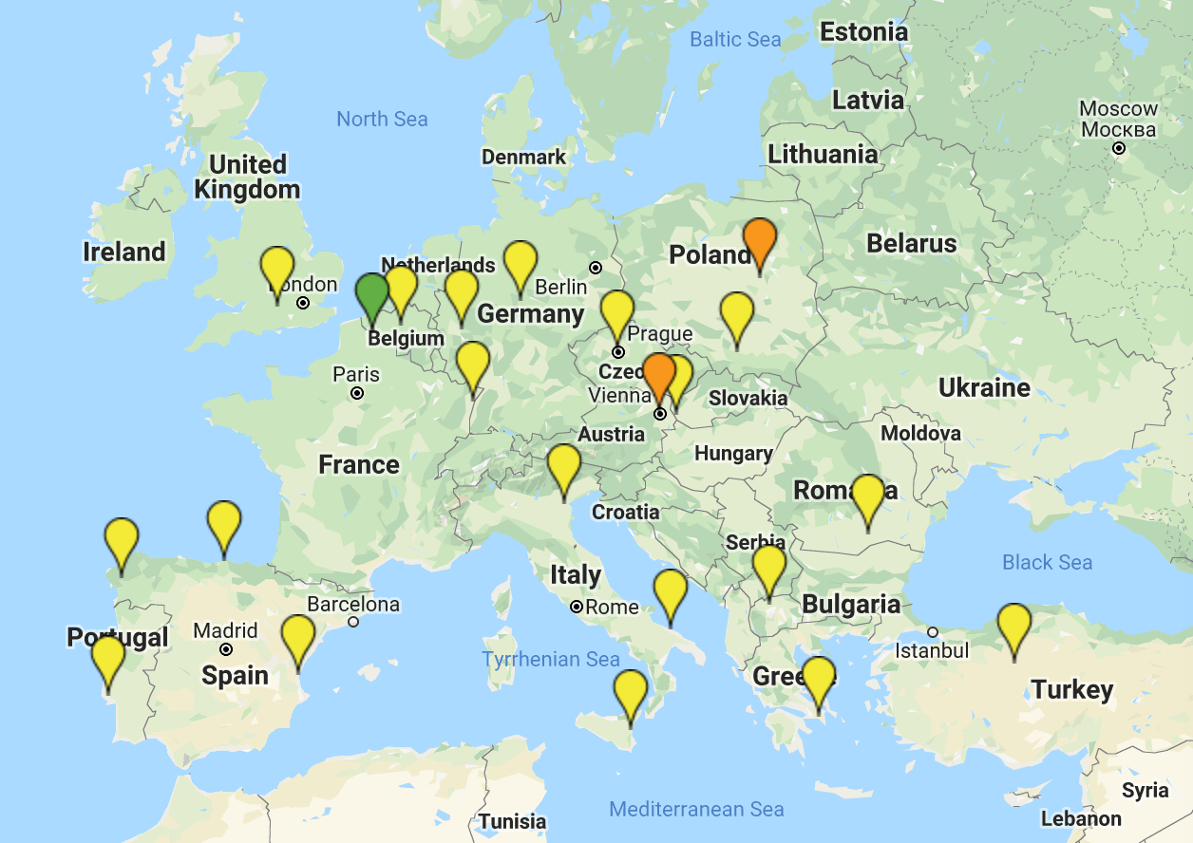














The infrastructure
New!
Finalising integration!
Notes:
IN2P3 highlighted just in case ☺

Slide 15
The FedCloud in action
Since 2015 1.9 million Virtual Machines consumed over 10,000 years of compute time

Slide 16
Summary
EGI Cloud brings together IaaS resources from NGIs to support (federated) research communities
Pilot and test with fedcloud.egi.eu or access.egi.eu VOs, production usage with community VOs with SLAs
Check-in enabled federation: access the service with your own credentials, both web and CLI/API
AppDB VMOps, a common dashboard for the federation

