Slide 1
E-ScienceTalk PMB
E-ScienceTalk PMB Meeting 4
11 May 2011
Telcon

Slide 2
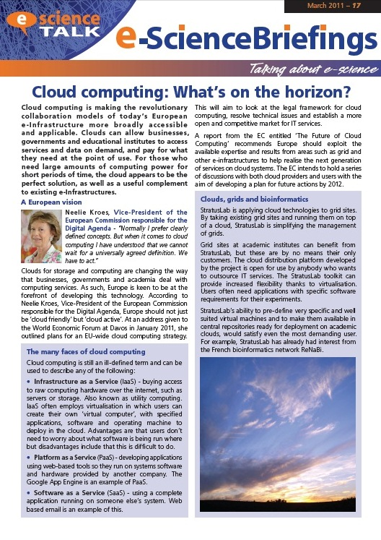
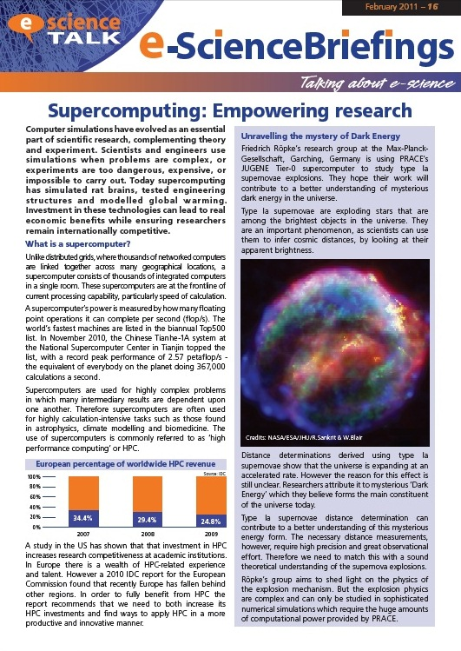
WP1: Grid policy outreach
Progress
New name and template released
e-ScienceBriefing ‘Supercomputing: Empowering Research’ released at the Cloudscape-III meeting and online
e-ScienceBriefing ‘Cloud computing: What’s on the horizon?’ released at the ISGC11 event and online
Policy advisory group feeding into the Briefings review process
Regular meetings established with e-IRGSP2/3, sharing news items and circulating materials
New e-ScienceBriefing page created with a new layout and html versions of the Briefings
GridCasts held at ISGC2011, Cloudscape-III, EGI User Forum, FET’11
Translation of cloud computing Briefing into Spanish
Recruitment to 0.5FTE post at QMUL, interviews 26 May

Slide 3
WP1: Grid policy outreach
Next steps
Grids and clouds in Asia mini-Briefing currently being prepared for end May
Identifying policy events for later in the year eg e-IRG in October Poznan, eChallenges, October in Florence
Next Briefing on desktop computing
e-Concertation will be on 22 September in Lyon (co-located with EGITF2011)
Future topic ideas
International dimension of grids
eGovernment
Impact indicators
Digital Agenda for Europe
Next Framework programme

Slide 4
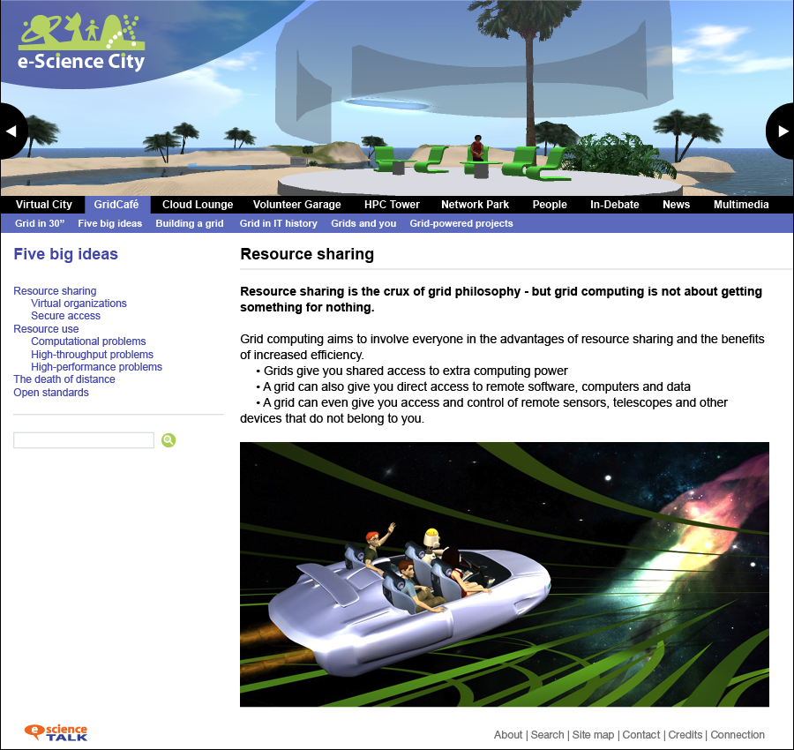
WP2: GridCafé, GridCast, GridGuide
Progress
e-ScienceTalk
Drupal upfront development time very high, proceeding with the e-ScienceCity based on html version for now.
GridCafé
French version of GridCafé receiving 8% of hits for the homepage
Russian translation 75% complete, problem with the encoding, separate site will be needed
Concept ideas for e-ScienceCity developing, along with the 3D GridCafe
GridCast
GridCast at ISGC2011, Taipei, 19-25 March (+ posters, 8 bloggers)
GridCast at EGI User Forum, Vilnius, 11-14 April (+ posters, 7 bloggers)
GridCast at FET’11, Budapest, 4-6 May (+ iSGTW poster, 3 bloggers)
GridGuide / RTM
Added PANDA layer to show the ATLAS jobs, more GridGuide sites added to RTM.
RTM displayed at EGI User Forum and FET’11.
Digital Library
iSGTW rss feed added to Digital Library home page
Working on a document upload page for the e-ScienceTalk site

Slide 5
WP2: GridCafé, GridCast, GridGuide
Next steps
e-ScienceTalk
New leaflet and promotional materials eg pens, banner
Copyright notices – apply by the end of the first period
GridCafé
New translations for the GridCafé eg Chinese – ASGC working on this
Volunteer computing contributions from Citizen CyberScience (and EDGI)
Build the new e-Science landing area
Build a test version of the 3D Café ready for the CloudScape III event in March
GridCast
Longer, more editorial posts – some of these have been tried out
Upcoming GridCasts at TNC11, Role of e-Infrastructures on Climate Change, TeraGrid
Experiment more with longer videos, a ‘day in the life’, a conference overview, vox pops
GridGuide / RTM
Work on the USP – who is it for? NGIs being encouraged to add sites. NRENs?
Should we also include projects as well as individual sites?
EGI SSO profile pages – use like LinkedIn pages

Slide 6
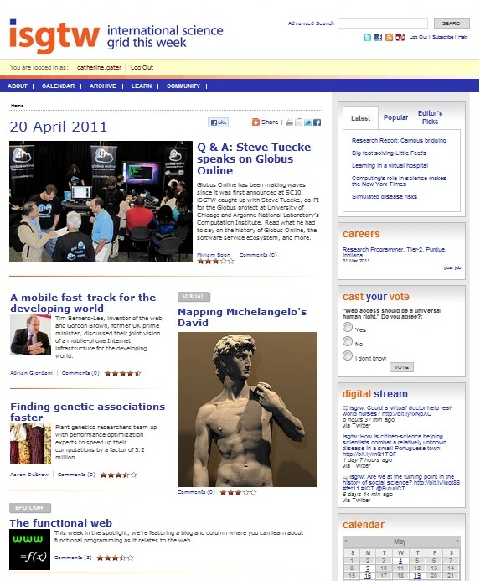
WP3: iSGTW
Progress
New editor started on 1 April 2011, successful handover with Dan Drollette
Publishing has continued with no further legal challenges, some high profile articles (Berners-Lee/Brown article picked up by Scidev.net)
Subscriptions hovering around 8000, some issues with spam addresses initially
Trademarking of iSGTW at Swiss Trademark Office underway with CERN IP support
First feedback issues resolved by Xenomedia and all invoices now received
US Editor dropping to 0.5FTE over the summer, recruitment of a 0.5FTE Asia-Pacific region editor discussed with ASGC and OSG
Proposal to change hosting of iSGTW site to CERN server
Chair role agreed for iSGTW Advisory Board, next meeting is 22 July at Fermilab

Slide 7
WP3: iSGTW
Next steps
Moving the ownership and hosting of the URL to Europe
Recruiting a new Asia Pacific editor and establishing a publishing schedule
Adding a member of ASGC to the iSGTW Board
Issues
Remaining development budget for changing to a new name
Funding a ‘due diligence’ check on a new name ($1-2000 per name)
Not clear when and if a new name will be found

Slide 8
WP4: Management
Progress
Project timesheets moved to EasyTS
Presentation planned at British Science Association Science Communication Conference, UK, 25 May
Costings for e-Concertation meetings now confirmed, working on an amendment to the DoW
Weekly meetings continuing with the project team, F2F held at CERN in March to discuss long term aims of iSGTW with new Editor
Paper prepared on copyright and trademark, ahead of the iSGTW Advisory Board meeting
Travel: invitations to CCLAR, Colima, Mexico, 5-9 September
MoUs with e-IRGSP2/3, EUIndiaGrid2, LINKSceem2, WeNMR, CHAIN and DEGISCO now signed
EMI MoU ready to sign, EGI-InSPIRE first draft in development
SAGrid and REUNA agreements need to be pursued

Slide 9
Q2 Effort
Overall effort achieved in Q2 in PMs: per work package
Work package | December | January | February | Total | Year plan | Linear Q plan | Q2 % achieved | Q1 % achieved
WP1 | 0.72 | 0.83 | 0.89 | 2.44 | 46.0 | 4.2 | 58% | 92%
WP2 | 1.47 | 1.67 | 1.72 | 4.86 | 64.0 | 5.8 | 84% | 75%
WP3 | 1.19 | 1.86 | 2.17 | 5.22 | 52.0 | 4.7 | 111% | 121%
WP4-M | 0.44 | 0.44 | 0.39 | 1.27 | 17.0 | 1.5 | 85% | 113%
WP2-UNF | 0.0 | 0.0 | 0.0 | 0.0 | 8.0 | 0.7 | 0% | 0%
WP4-UNF | 0.6 | 0.08 | 0.08 | 0.22 | 5.0 | 0.5 | 44% | 18%
Total | 3.88 | 4.88 | 5.25 | 14.01 | 192.0 | 17.5 | 80% | 90%
Overall effort achieved in Q2 in PMs: per partner
Partner | December | January | February | Total | Year plan | Linear Q plan | Q2 % achieved | Q1 % achieved
CERN | 1.19 | 1.72 | 2.16 | 5.07 | 67 | 6.1 | 83% | 90%
APO | 0.86 | 1.14 | 1.06 | 3.06 | 34 | 3.1 | 99% | 110%
QMUL | 0.89 | 1.06 | 1.11 | 3.06 | 47 | 4.3 | 71% | 80%
IMPERIAL | 0.5 | 0.5 | 0.5 | 1.5 | 26 | 2.4 | 63% | 80%
EGI.eu | 0.45 | 0.48 | 0.42 | 1.35 | 18 | 1.6 | 84% | 110%
Total | 3.89 | 4.90 | 5.25 | 14.04 | 192 | 17.5 | 80% | 90%

Slide 10
Expected spend profile
Partner | WP1 | WP2 | WP3 | WP4 | Total | 1st Year
EGI.eu |  |  |  | 187.694 | 187.694 | 68.252
QMUL | 223.513 | 56.858 | 40.627 |  | 320.998 | 116.727
APO | 28.088 | 154.882 | 28.088 |  | 211.057 | 76.748
Imperial |  | 114.181 |  |  | 114.181 | 41.520
CERN | 69.164 | 77.562 | 319.344 |  | 466.070 | 169.480
Total | 320.764 | 403.485 | 388.057 | 187.694 | 1.300.000 | 472.727
Overall EC contribution is 1.3million Euros

Slide 11
Estimated expenditure
Estimated personnel expenditure Q2 (in K euros)
Work package | Dec | Jan | Feb | Cumul Direct | Cumul Indirect | Cumul Eligible | Q2 Estimated Funding | Q1 Estimated Funding
WP1 | 3.535 | 4.134 | 4.480 | 12.149 | 2.430 | 14.578 | 12.999 | 20.829
WP2 | 8.091 | 8.934 | 9.281 | 26.306 | 5.261 | 31.568 | 28.148 | 25.341
WP3 | 7.073 | 11.250 | 13.133 | 31.457 | 6.291 | 37.748 | 33.658 | 36.815
WP4-M | 3.366 | 3.366 | 2.936 | 9.668 | 1.934 | 11.602 | 10.345 | 13.100
WP2-UNF | 0 | 0 | 0 | 0 | 0 | 0 | n/a | n/a
WP4-UNF | 426 | 612 | 612 | 1.649 | 330 | 1.979 | n/a | n/a
Total | 22.491 | 28.296 | 30.441 | 81.229 | 16.246 | 108.755 | 85.150 | 96.085

Slide 12
Deliverables and milestones tracking
Months | 1 | 2 | 3 | 4 | 5 | 6 | 7 | 8 | 9 | 10 | 11 | 12
WP1 Policy
T1.1 Policy |  | D1.2.1 | D1.1 |  | D1.2.2 |  |  | D1.2.3 |  |  | D1.2.4
T1.2 Impact |  |  |  |  |  |  |  |  |  |  | D1.3
T1.3 Events |  |  | MS1
WP2 GridCafé
T2.1 GridCafé
T2.2 GridGuide |  |  |  |  |  |  |  |  |  |  |  | D2.1
T2.3 GridCast |  | MS4 |  |  |  | MS4 |  |  |  | MS4
WP3 iSGTW
T3.1 Weekly | D3.1 cont. |  | D3.2 |  |  |  |  |  |  |  |  | D3.4.
T3.2 New media |  |  |  |  | MS7 |  |  |  | D3.3 |  | MS7
WP4 Mgmt
T4.1 | MS10 | D4.1 | D4.2 | MS10 |  | MS11 | MS10 |  |  | MS10 |  | D4.3 MS12
Complete
In preparation
Overdue

Slide 13
Project Issues
WP1-WP4
Ensure a good balance of information and contributions from collaborating projects for e-ScienceBriefings
Adding Russian, Chinese etc to the GridCafe
Consultation processes with the iSGTW Advisory Board and unresponsiveness
New name for iSGTW and movement of the site to CERN
High travel costs
Protection of current and future e-ScienceTalk product names

