Slide 1
Common Services
Dr John Alan Kennedy (MPCDF), WP6 leader
Luxembourg, 8-9 October 2019

Slide 2
Overview
WP6 Objectives
Introduce 6 Core service areas (goals and achievements)
1. Discovery and access, 2. Federated Compute
3. Processing and Orchestration, 4. Data and metadata management
5. Preservation, 6. Sensitive Data
Service evolution and integration activities
Conclusion and Outlook

Slide 3
WP6 Common Services: Integration & Maintenance
Objectives:
Maintain the high quality of the baseline and advanced common services from the evolving service catalogue according to a maintenance plan, ensure that these services are developing according to the requirements of users, thematic services and competence centers, and provide support and contribute to the documentation
Integrate the storage, compute and data services from different infrastructures and ensure their discoverability, accessibility, interoperability, reusability and integrity
Integrate the common services with federation and collaboration services as well as the integration with the thematic services and competence centres.
Number of Tasks: 6
Number of Participants: 26
Efforts planned RP1: 198.5PMs

Slide 4
Key Exploitable Results WP6
Researchers and
research communities:
Empower my research
Educate, inform and support my team and community
Services in the EOSC Service Portfolio
EOSC Portal
and
Marketplace
EOSC Hub Operators: Develop the EOSC landscape
Service Providers:
Provide services for
Researchers
Rules of Participation
Training courses and materials
Service Management System
Internal services in the Hub portfolio
Interoperability & Integration Guidelines
Business and sustainability models for services and the Hub
Digital Innovation Hub:
platform for industrial collaborations with EOSC
Enterprise: Develop, expose and grow my services

Slide 5
Core service areas:
Data Discover and Access
Federated Compute
Processing and Orchestration
Data and Metadata Management
Data Preservation
Sensitive Data Services

Slide 6
1. Data Discovery and Access
Goal: Common data discovery and access layer for EOSC-hub
Major Achievements:
Integration of B2FIND with EOSC data services
Harvest from EGI-Datahub
Harvest from B2SAFE (harbadrop)
Integration B2DROP-B2SHARE
Enable transparent cross infrastructure data transfers
[F]ind distributed data in EOSC-hub and beyond
[A]ccess distributed data resources wherever they are located
[I]nteroperate by sharing and publishing research output
[R]reuse, exchange and stagedata (depending on the use case)
Services: B2FIND, EGI Datahub, INDIGO IAM, B2STAGE, B2SAFE, B2DROP.

Slide 7
2. Federated Compute
Goal: Provide a Multi Purpose, Federated Compute environment
Major Achievements:
EOSC-hub AAI Integration (EGI Check-in)
Development of EGI Workload Manager
Data Service Integration (EGI-DataHub and B2DROP)
All services in monitoring and accounting
Multi Purpose Computing: Cloud Compute, Cloud Container Compute, High Throughput Compute, EGI Workload Management
Access to Data: EGI DataHub, EGI Online Storage, B2SAFE, CVMFS

Slide 8
3. Processing and Orchestration
Goal: Provide Orchestration services to provision and configure virtual infrastructures across multiple cloud sites
Major Achievements:
Infrastructure Manager added to EOSC Marketplace
Integration of EGI Cloud Compute into Orchestration Service
Started CMDB, AppDB information system alignment (central information source)

Slide 9
4. Data and Metadata Management
Goal: Integration and maintenance of data and metadata service
Major Achievements:
Integration of B2SHARE and EGI-DataHub
Integration of B2SAFE and B2SHARE
Integration of B2NOTE and B2SHARE
Advancing the B2SAFE Data Policy Manager (DPM)
Integration of FAIR data resources with seamless access from EOSC-hub computational resources

Slide 10
5. Data Preservation – Curation - Provenance
Goal: Integration of a Certified Trusted Digital Repository into EOSC-hub
Major Achievements:
Two ingest points (milestone 6.7)
Production ready CINES TDR
DANS-KNAW proof of concept
CINES TDR being added to EOSC marketplace
Two different technical solutions:
B2SAFE and B2SHARE as ingest points
Same quality constraints (CTS certification)
CINES eTDR:
DSA Certified TDR (CTS in progress)
B2SAFE as ingest
Findable data (B2FIND)
Being added to EOSC marketplace

Slide 11
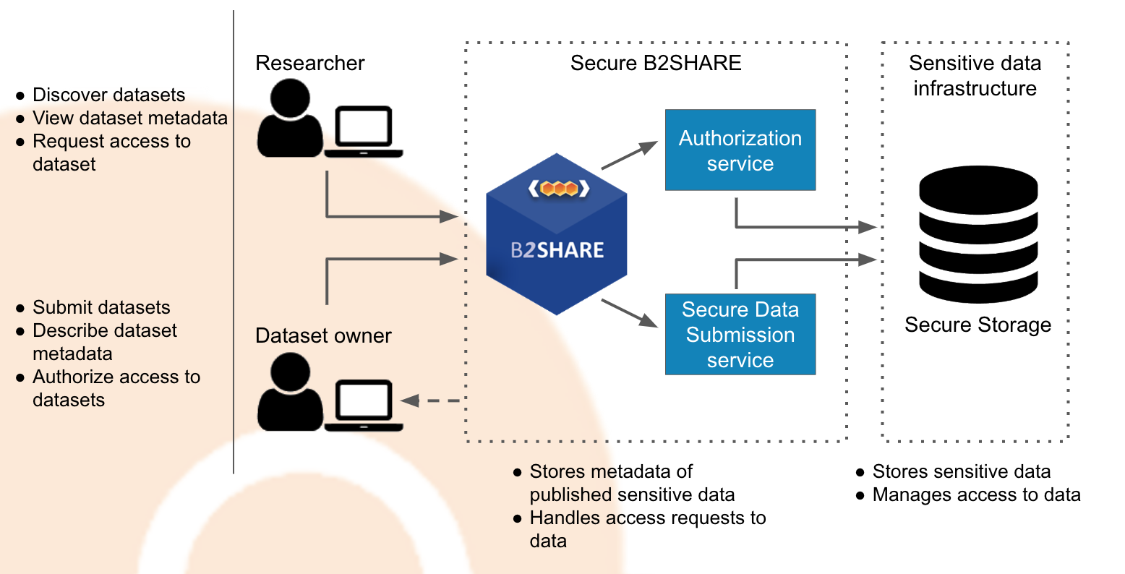
6. Sensitive Data Services
Goal: Integrate sensitive data services into EOSC-hub
Major Achievements:
Integration plan in place for two Sensitive data service (TSD, ePouta)
TSD and ePouta both in EOSC Marketplace
Secure B2SHARE development underway
Amnesia anonymization service from OpenAIRE is supported in TSD in production
Secure B2SHARE exposes metadata from secure data stores.
End users can harvest this and request access to this data

Slide 12
Cross ranging activities:
Data Discover and Access
Federated Compute
Processing and Orchestration
Data and Metadata Management
Data Preservation
Sensitive Data Services

Slide 13
Cross ranging activities:
Data Discover and Access
Federated Compute
Processing and Orchestration
Data and Metadata Management
Data Preservation
Sensitive Data Services
EOSC-hub AAI Enabled

Slide 14
Cross ranging activities:
Data Discover and Access
Federated Compute
Processing and Orchestration
Data and Metadata Management
Data Preservation
Sensitive Data Services
EOSC-hub AAI Enabled
Monitoring and Accounting

Slide 15
Cross ranging activities:
Data Discover and Access
Federated Compute
Processing and Orchestration
Data and Metadata Management
Data Preservation
Sensitive Data Services
EOSC-hub AAI Enabled
Monitoring and Accounting
Service Maintenance, Evolution and Integration

Slide 16
EOSC-hub AAI / Monitoring and Accounting
EOSC-hub AAI enabled:
Enable access to all common services via EOSC-hub Proxy IdPs
EGI Check-in, B2ACCESS
Lower the barrier for user access to service
Common infrastructure
Milestone 6.5
Monitoring and accounting:
Enable common monitoring and accounting across e-infrastructres
Guidelines for probe development defined
Probes for all common services deployed
Milestone 6.3

Slide 17
Service Evolution and Integration
Rolling Maintenance and Integration plans – underpin all activities
Maintain and evolve services to meet changing needs
Integrating common services to bring added value
Meeting requirements in close collaboration with:
WP7 (Thematic Services)
WP8 (Competence Centers)
WP10 (Technical Coordination)
Coordination of requirements – (WP10)
Integration - focus on Standards and APIs (in collaboration with WP10)*
TCOM maintain high level overview (Technical Roadmap)
* For more information - See Architecture and Interoperability Guidelines Presentation [WP10] by Giacinto Donvito

Slide 18
Integration example: Transparent data exchange
Goal: Transparent data exchange between e-infrastructures
(EGI<->EUDAT)
Real end-user driven activity
Core WP6 integration task
Milestone 6.6
Solution demonstrated
Dissemination material provided to WP11
The integration of the EGI-DataHub and B2STAGE/B2SAFE services for the purpose of transparent data transfer between these infrastructures included development of the following features:

Slide 19
Example of Services adopted by Thematic Services
Common Service | e-Infrastructure Provider | Service Type | Used by Thematic Services
EGI Cloud Compute | EGI | Compute | VLO (CLARIN), GEO DAB (GEOSS), OPENCoasts(LNEC), WeNMR(UoU), EO Pillar services, DH Science Gateway (DARIAH), Invenio(DARIAH), DODAS(CMS)
EGI Workload Manager | EGI | Compute | WeNMR(UoU), OPENCoasts(LNEC)
EGI HTC | EGI | Compute | WeNMR(UoU)
INDIGO IM | INDIGO | Compute | ECAS(ENES)
INDIGO Orchestrator | INDIGO | Compute | Invenio(DARIAH), DODAS(CMS), OPENCoasts(LNEC)
INDIGO udocker | INDIGO | Compute | WeNMR(UoU)
EGI Cloud Container | EGI | Compute | GEO DAB (GEOSS),
CVFMS | EGI | Compute | DODAS(CMS)
EGI DataHub | EGI | Data Management | DODAS(CMS), ECAS(ENES), WeNMR(UoU), EO Pillar services), OPENCoasts(LNEC)
B2DROP | EUDAT | Data Management | LRS (CLARIN), ECAS(ENES)
B2HANDLE | EUDAT | Data Management | ECAS(ENES)
B2SAFE | EUDAT | Data Management | OPENCoasts(LNEC),
B2SHARE | EUDAT | Data Management | VCR (CLARIN), ECAS(ENES), EO Pillar services
B2FIND | EUDAT | Data Management | VLO (CLARIN), VCR (CLARIN),
* For more information see – Thematic Services Presentation [WP7] by Debora Testi

Slide 20
Efforts Planned and Used
WP | Task No. | Task Name | P1 M1 - M18
 |  |  | Planned PM | Used PM | Used%
WP06 | T06.01 | Discovery and Access | 46 | 51.6 | 112%
 |  | Unfunded efforts | 7.5 | 0 | 0%
 | T06.02 | Federated Compute/Cloud | 52.5 | 51.5 | 98%
 |  | Unfunded efforts | 1.5 | 0 | 0%
 | T06.03 | Processing and Orchestration | 17 | 30.5 | 180%
 |  | Unfunded efforts | 4.5 | 3.3 | 74%
 | T06.04 | Data and Metadata Management | 52.5 | 63.3 | 121%
 | T06.05 | Preservation (data and software) | 12 | 11.4 | 95%
 | T06.06 | Sensitive Data | 5 | 3.4 | 68%
WP06 Total |  |  | 198.5 | 215 | 108%

Slide 21
Deviations
Milestone 6.8 – B2NOTE connect to a new data management system
Due: 01.05.2019
Amendment requested, re-scoped and Delayed

Slide 22
Key Results
Providing 20 common services [First release D6.1]
Rolling maintenance and integration plans [D6.2, M6.1, M6.2]
Strong uptake of services by thematic service providers
All common services accessible via EOSC-hub proxy IdPs (EGI Check-In or B2ACCESS) [M6.5]
Monitoring and Accounting probes for all services [M6.3]
Enabled managed data transfer across e-infrastructures [M6.6]
Ingest point for TDRs integrated with EOSC-hub data transfer services [M6.7]

Slide 23
Outlook
Continue maintenance and evolution of services
Focus even more on integration tasks and community needs
Based on gap analysis from Thematic Services and TCOM
Consolidation of Data Preservation and Sensitive Data services
Data Management Policies

