Slide 1
Federation Services
Pavel Weber (KIT), WP5 Lead
Luxembourg, 8-9 October 2019

Slide 2
Outline
Main objectives of WP5
Overview of the federation services
Integration of federation services
Status of activities and major achievements in WP5 main areas

Slide 3
WP5 Federation and Collaboration Services: Integration and Maintenance
Objectives:
Maintain the high-quality of the federation and collaboration services and tools according to a maintenance plan, and ensure that they evolve according to the developing requirements. Includes software maintenance (e.g. bug fixes) and perfective maintenance to improve their performance and maintainability
Integrate the federation and collaboration services and tools according to an integration plan and support the integration with common and thematic services
Identify requirements and opportunities for improvement
Number of Tasks: 6
Number of Participants: 17
Efforts planned RP1: 169PMs

Slide 4
Key Exploitable Results WP5
Researchers and
research communities:
Empower my research
Educate, inform and support my team and community
Services in the EOSC Service Portfolio
EOSC Portal
and
Marketplace
EOSC Hub Operators: Develop the EOSC landscape
Service Providers:
Provide services for
Researchers
Rules of Participation
Training courses and materials
Service Management System
Internal services in the Hub portfolio
Interoperability & Integration Guidelines
Business and sustainability models for services and the Hub
Digital Innovation Hub:
platform for industrial collaborations with EOSC
Enterprise: Develop, expose and grow my services

Slide 5
Federation Services of EOSC
Definition of Federation Services of EOSC
Core EOSC services, which guarantee the operation of the EOSC Hub and support the integration of generic, thematic services, as well as any new onboarded service in the EOSC ecosystem
Federation Services provide:
Interfaces for integration with common and thematic services and allow communities and users to exploit the EOSC-hub capabilities
Benefits ( discovery, access and support) for EOSC Providers in offering their services to the EOSC Users
Support for federated Service Management System and distributed operations

Slide 6
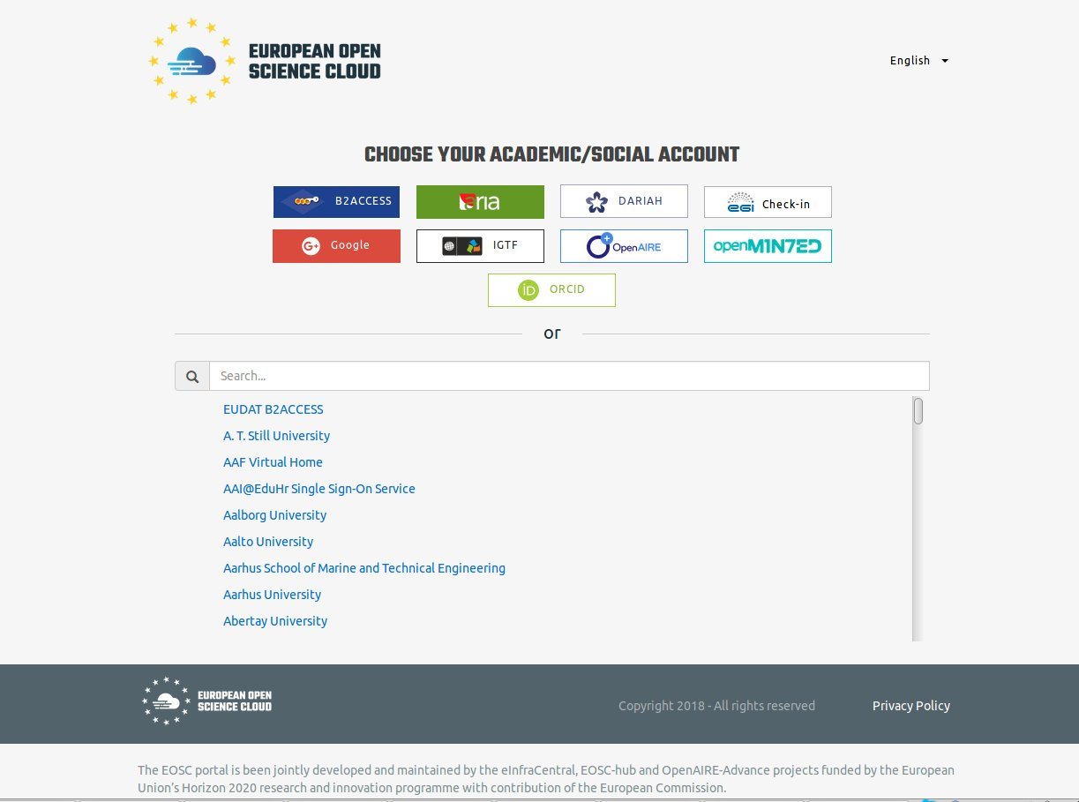
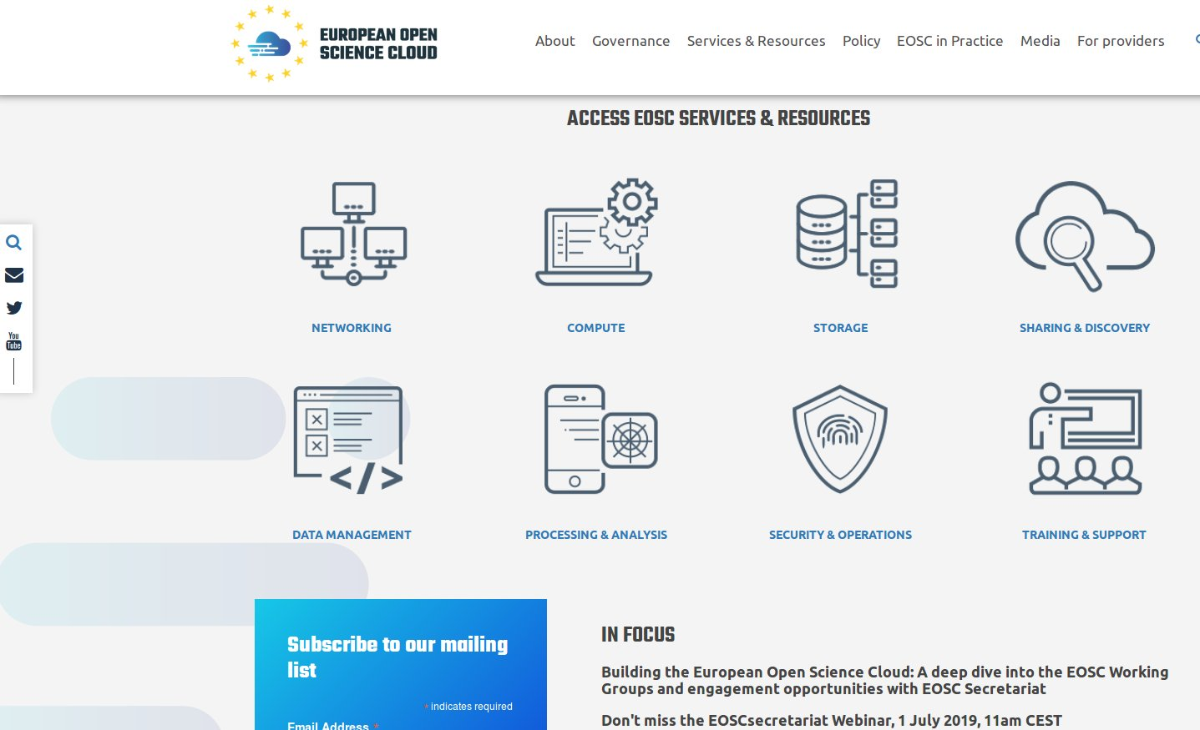
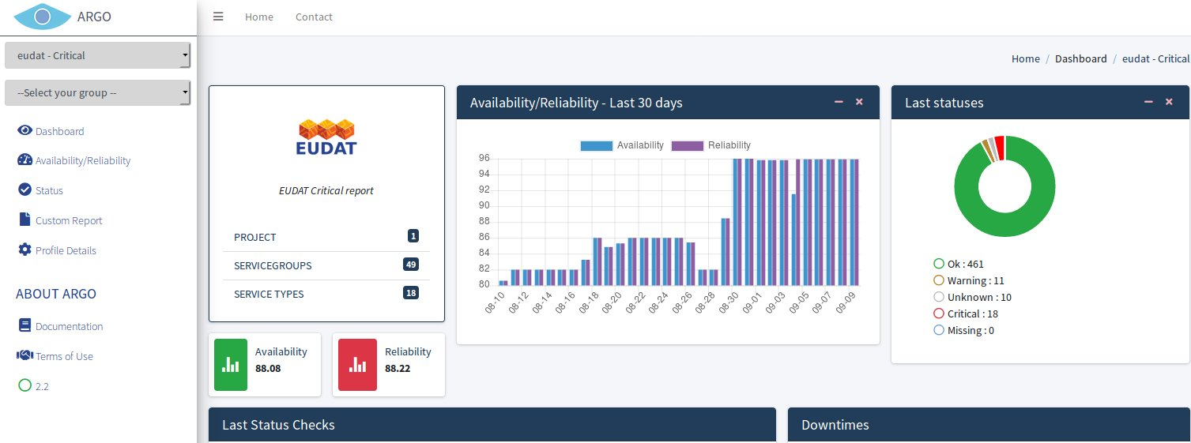
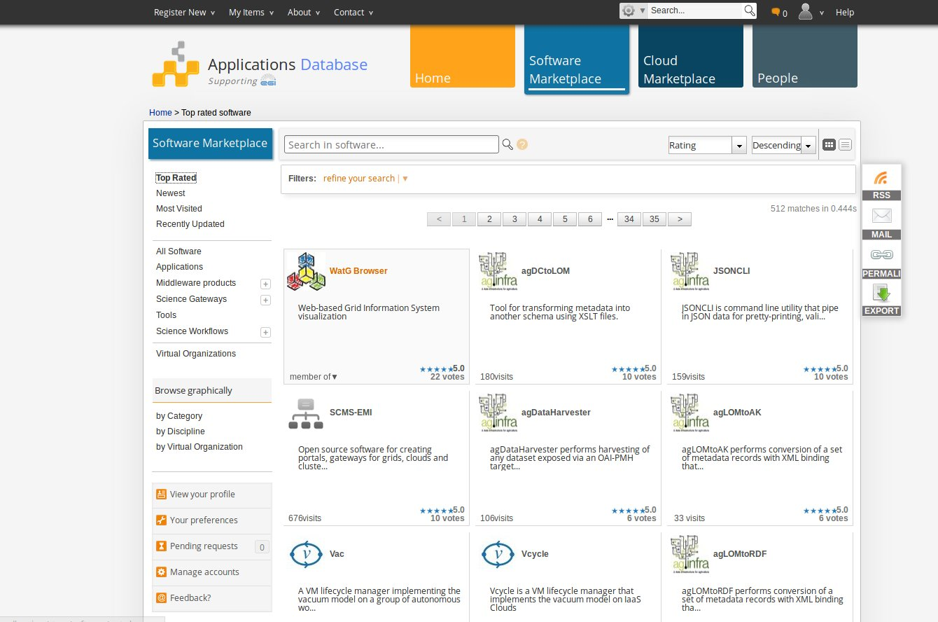
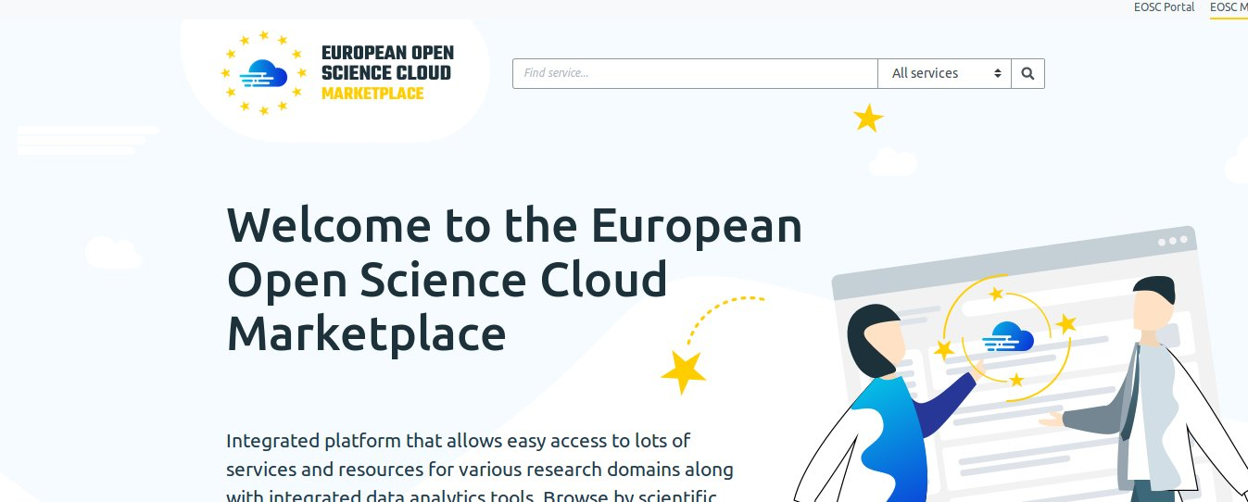
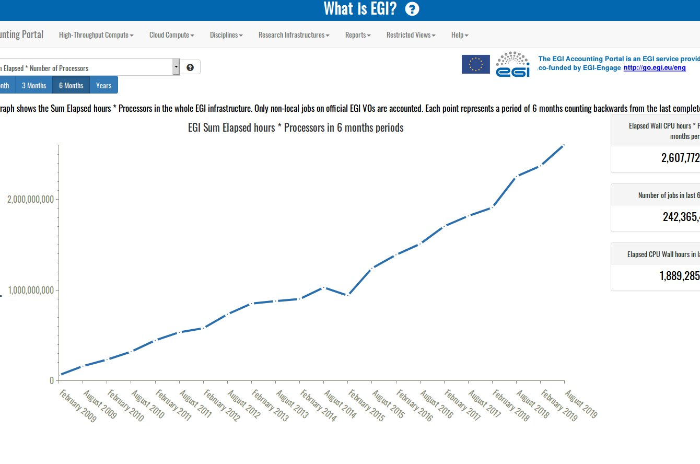
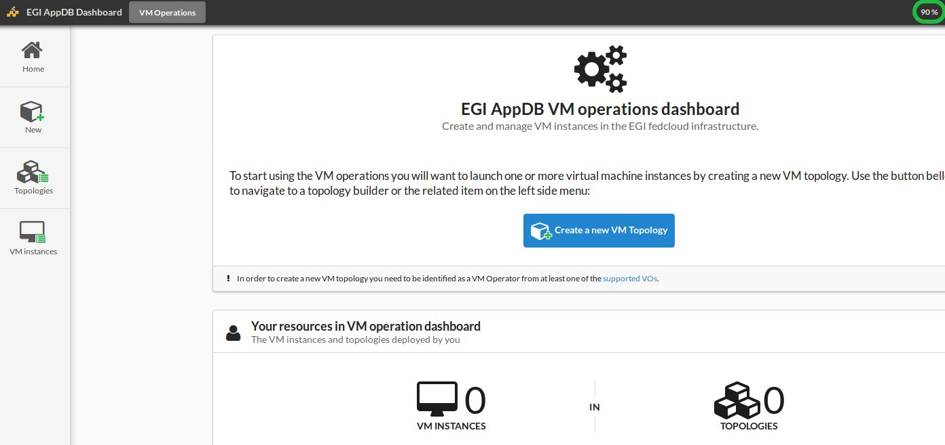
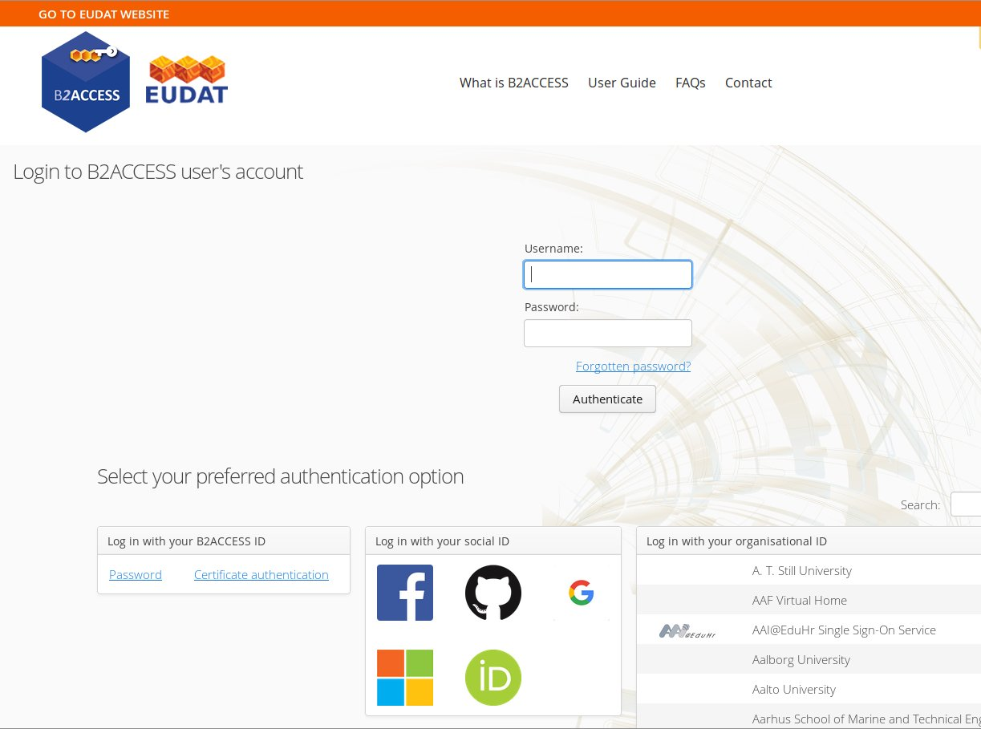
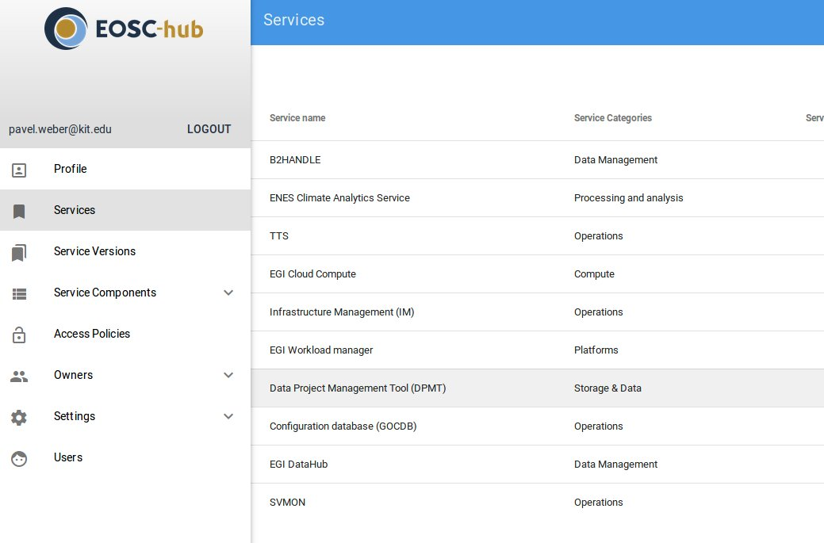
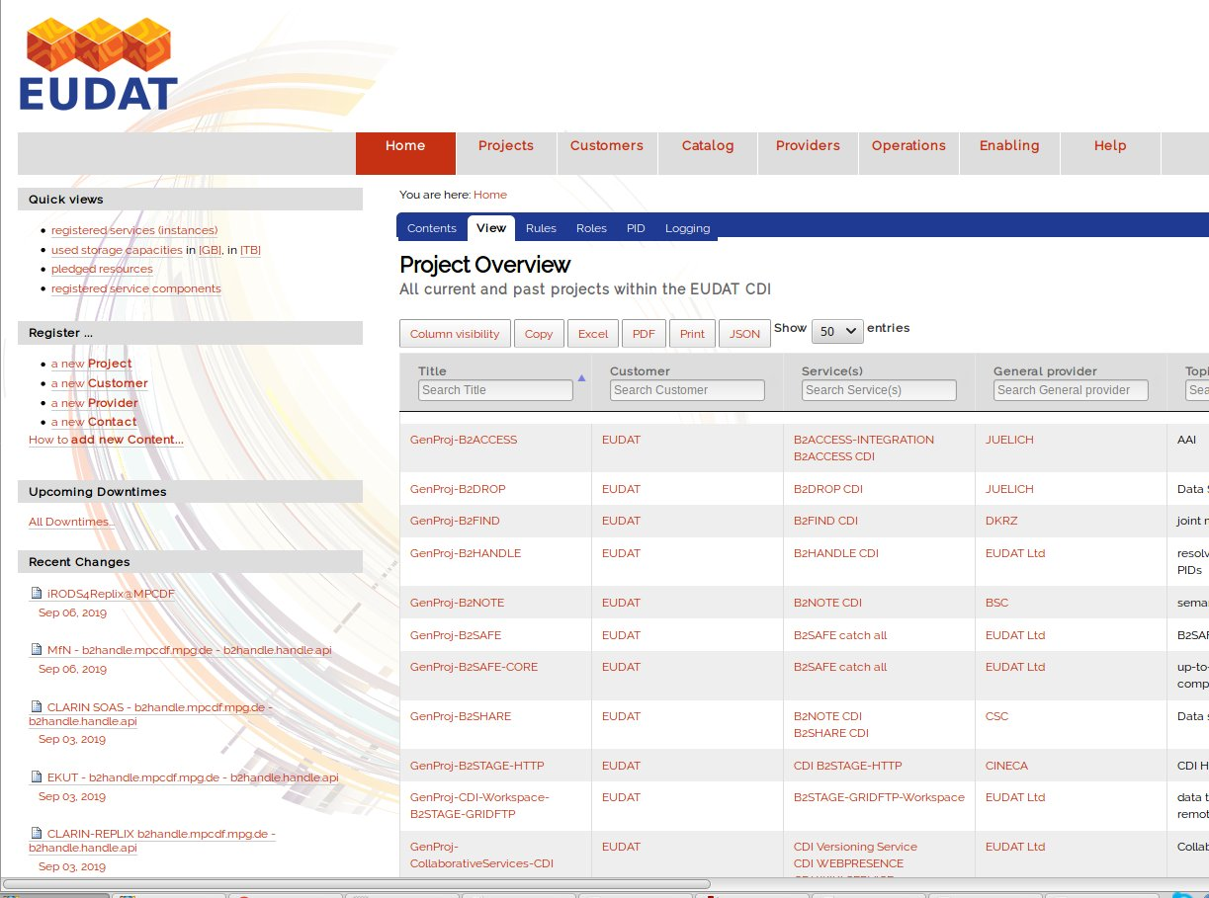
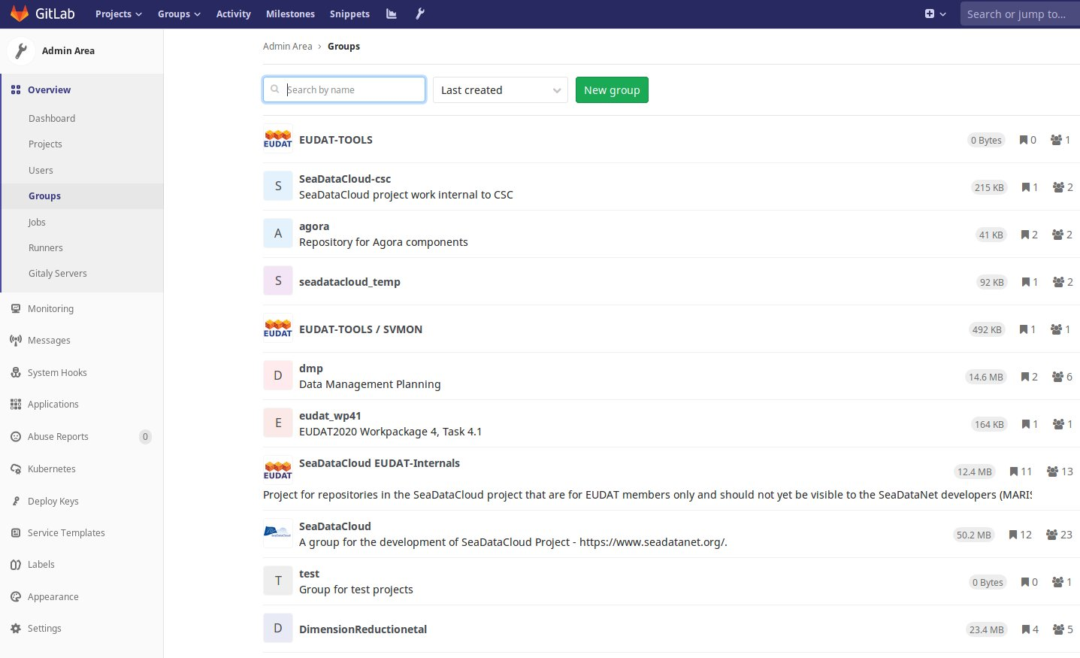
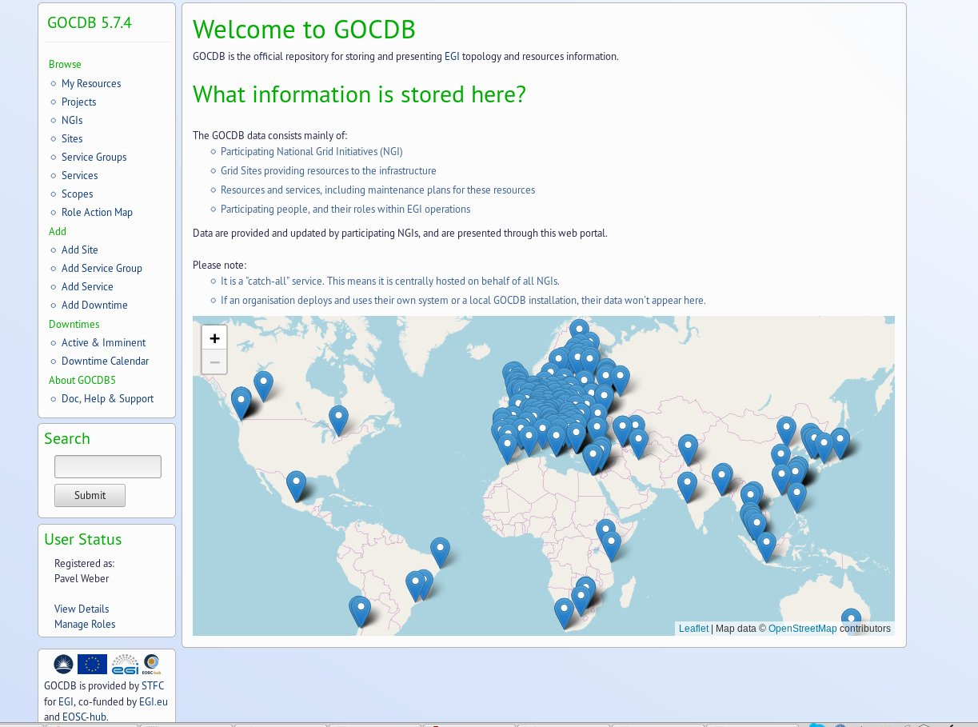
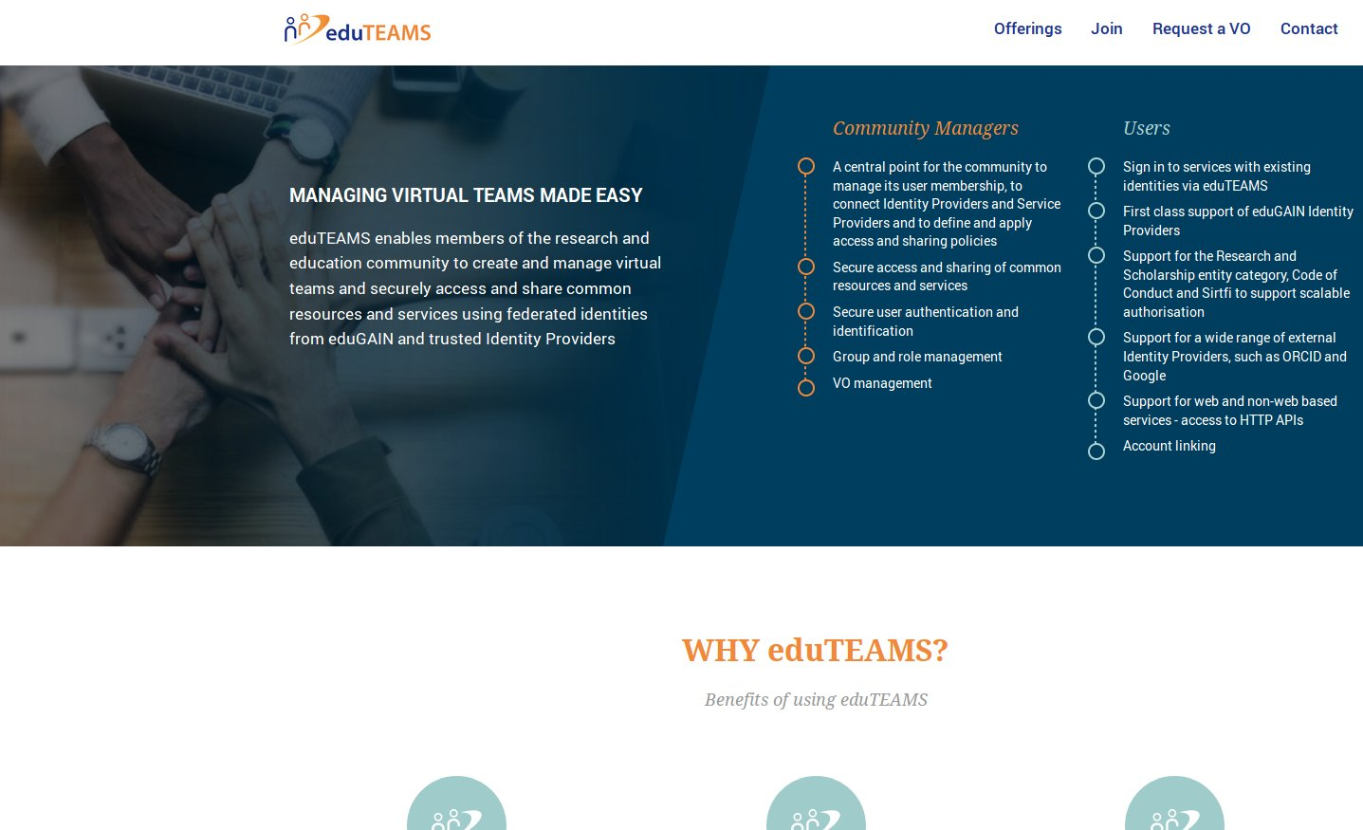
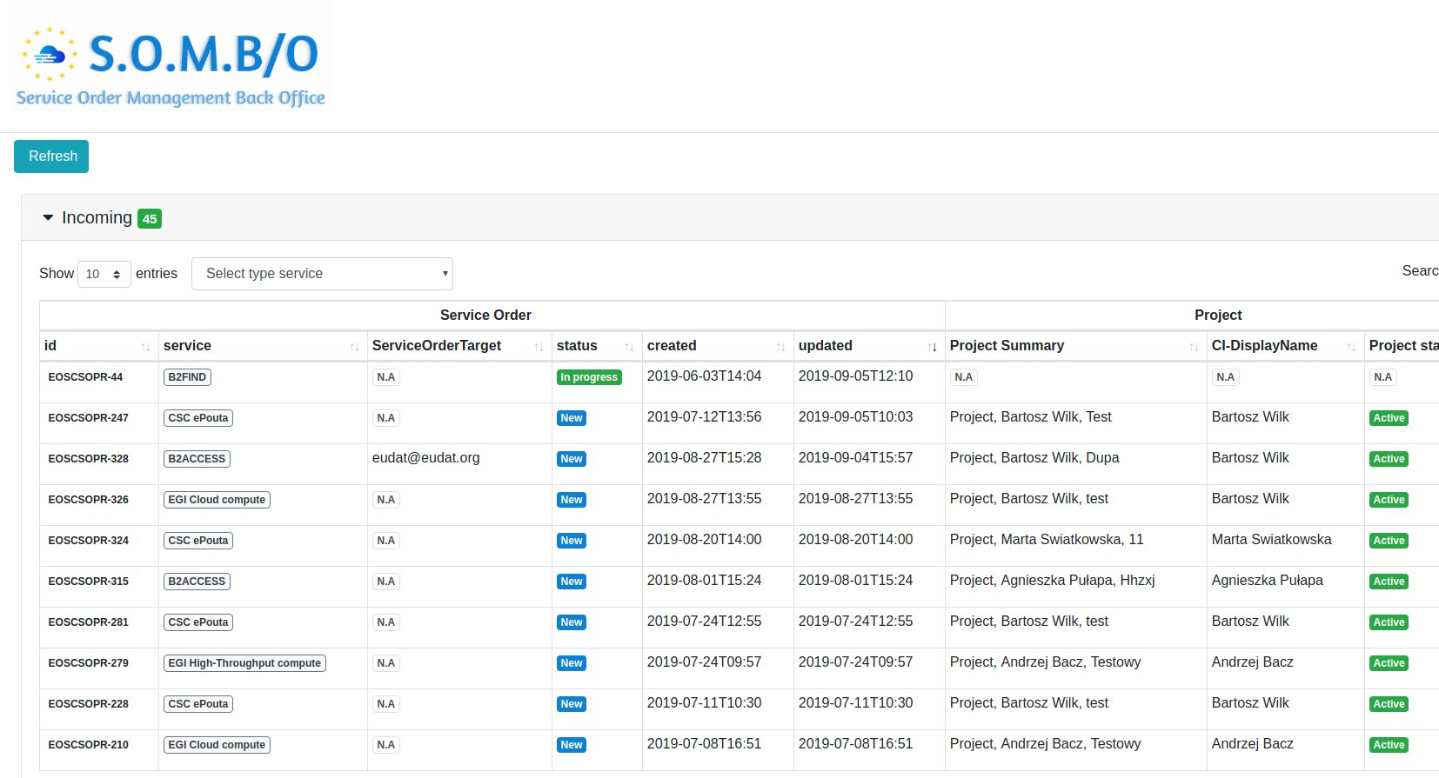
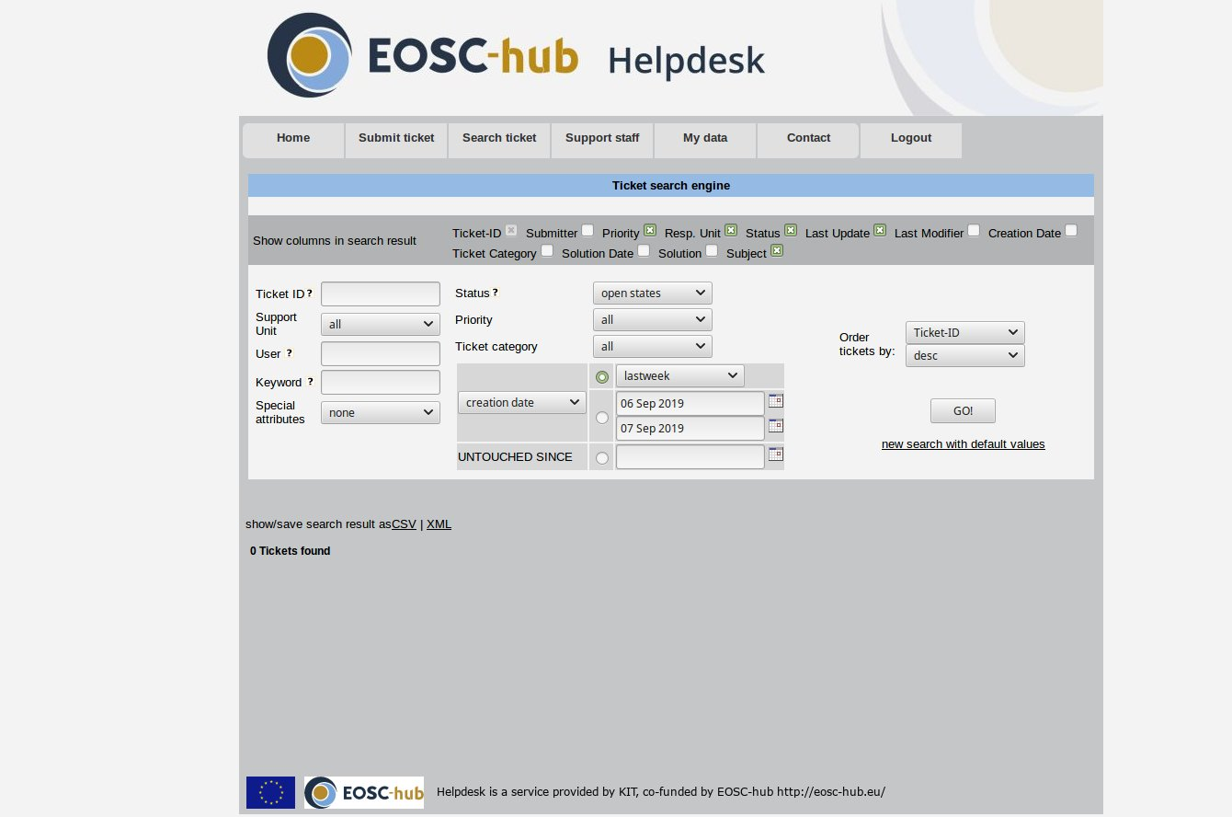
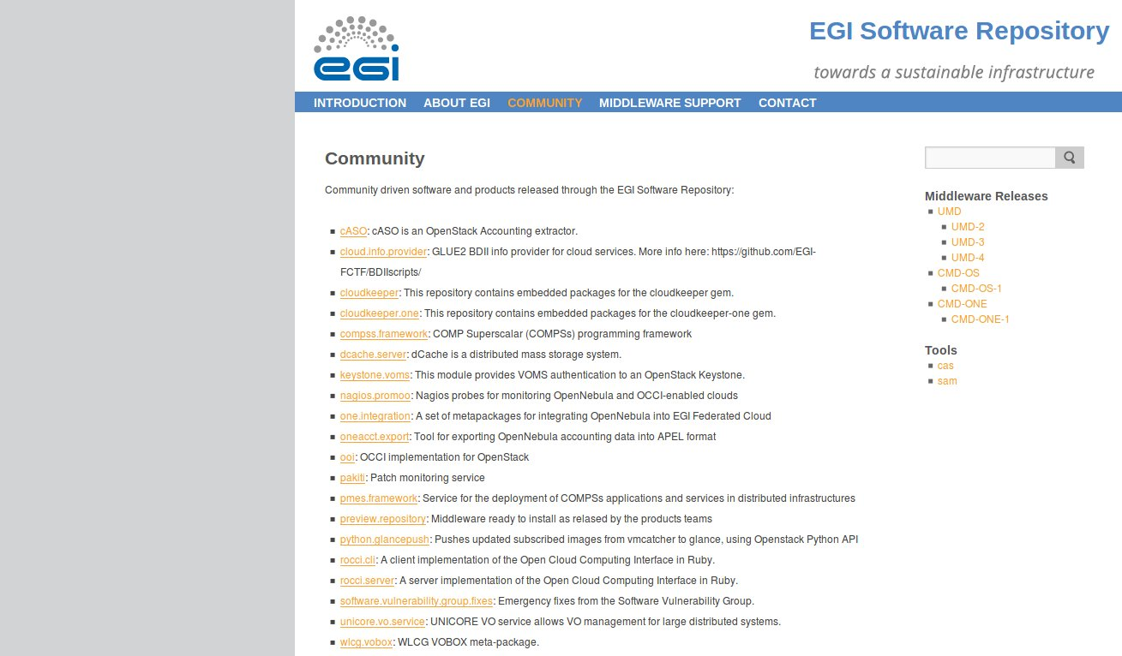
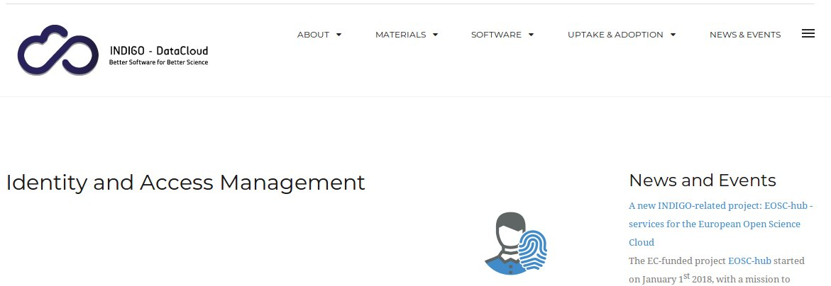
EOSC Federation Services ( functional roles)
T5.1
T5.2
T5.3,4,5
T5.6
Access
Service Discovery and Ordering
Operations Support
Software and App Repositories
Check-in
EOSC Portal /
Market
place
Monitoring
Accounting
AppDB
B2ACCESS
Service
Portfolio
Tool
Config.
Database
GitLab
eduTEAMs
IAM
SOMBO (Service Order Mgmt. System)
Helpdesk
EGI Software Repo

Slide 7
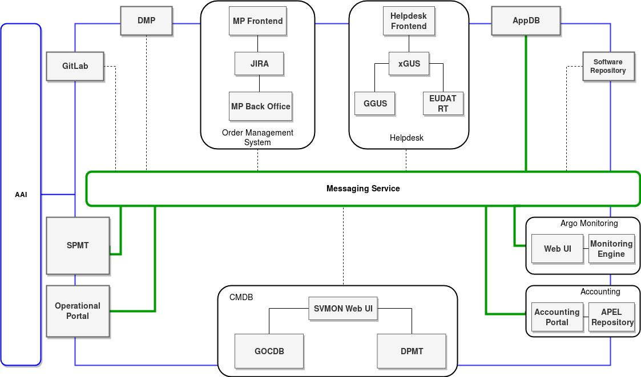
Architecture and integration of federation services
Initial approach:
point-to-point integration
Many issues due to evolvement of components
Current approach:
common transport layer “Messaging Service”
Rest APIs
Loose coupling
Green - already integrated
Dotted - work in progress
Integration of federation services

Slide 8
EOSC Federation Services
T5.1
T5.2
T5.3,4,5
T5.6
Access
Service Discovery and Ordering
Operations Support
Software and App Repositories
Check-in
EOSC Portal /
Market
place
Monitoring
Accounting
AppDB
B2ACCESS
Service
Portfolio
Tool
Config.
Database
GitLab
eduTEAMs
IAM
SOMBO (Service Order Mgmt. System)
Helpdesk
EGI Software Repo

Slide 9
Authentication & Authorization Infrastructure
Objective: AAI should enable seamless and uniform access to the EOSC services and resources, based on EGI, EUDAT and INDIGO-DataCloud the solutions (SP/IdP Proxies), their interoperability and integration
AAI working group activities:
Development of the EOSC-hub AAI architecture
Integration of EOSC-hub AAI services:
Alignment of user related attributes:
Authentication information
Authorization information
Alignment of Policies:
Privacy statements
Acceptable Use Policies
Technical support for integration of EOSC services with AAI

Slide 10
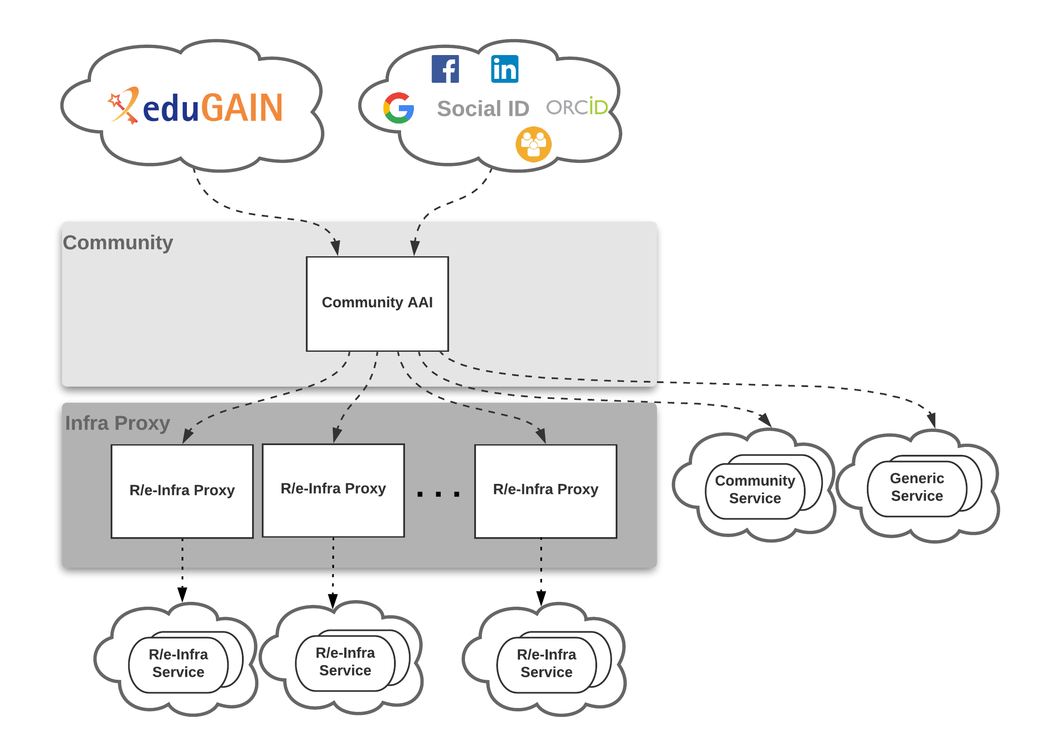
Authentication & Authorization Infrastructure
EOSC-hub AAI high-level architecture based on the “community-first” approach of the AARC Blueprint Architecture (BPA)
Community: Enables the use and management of community identities for access to EOSC resources
Infra Proxy: Enables access to resources offered by Service/Resource Providers connected to the R/e-Infrastructures
High-level AAI architecture for access to EOSC resources

Slide 11
Authentication & Authorization Infrastructure
Accomplished tasks:
Definition of the EOSC-hub high-level architecture
Definition of the EOSC AAI interoperability guidelines
Initial AAI services integration ( B2ACCESS, Check-In)
A white label AAI is provided to EOSC Portal
Integration with EOSC-hub services ( e.g. DODAS, ECAS, DARIAH Science Gateway, WeNMR suite, etc.)
Many technical enhancements of the AAI services
Check-in: Improvements of User and Service Provider interfaces
RCauth Online CA: preparation of software for distributed operations (HA)
IAM: Integration with RCAuth Online CA
eduTEAMS: improvement of Discovery Service
Alignment of user related attributes partially done (details in the backup)

Slide 12
Authentication & Authorization Infrastructure
Summary of accomplished and ongoing policy-related activities:
Activity | B2ACCESS | Check-in | eduTEAMS | INDIGO-IAM
Alignment of privacy statements | ✓ | M21 | ✓ | ✓
Alignment of operational security and incident response policies | ✓ | ✓ | ✓ | ✓
Alignment of Acceptable Use Policies (AUPs) | M24 | M24 | ✓ | ✓
Main challenges:
Multiple user registration: related to authentication and AUP alignment
OAuth2 token validation in multiple domains: no validation in OAuth2 Authorization Servers for tokens issued by different Authorisation Servers
Workaround: connect a given service to different proxies/ AS that issue tokens
Many dependencies on external partners, policy approval procedures

Slide 13
EOSC Federation Services
T5.1
T5.2
T5.3,4,5
T5.6
Access
Service Discovery and Ordering
Operations Support
Software and App Repositories
Check-in
EOSC Portal /
Market
place
Monitoring
Accounting
AppDB
B2ACCESS
Service
Portfolio
Tool
Config.
Database
GitLab
eduTEAMs
IAM
SOMBO (Service Order Mgmt. System)
Helpdesk
EGI Software Repo

Slide 14
Service Discovery and Ordering
Objective: Development and integration of the services and tools which support EOSC-hub Order Management System to facilitate discovery, access and ordering of services in the EOSC-hub Catalogue
Status of Service Order Management System:
Architecture is defined
First prototype is ready
Implementation is ongoing
Notes:
Add View Source button on editor
Added Style Clean up functionality on Editor.

Slide 15
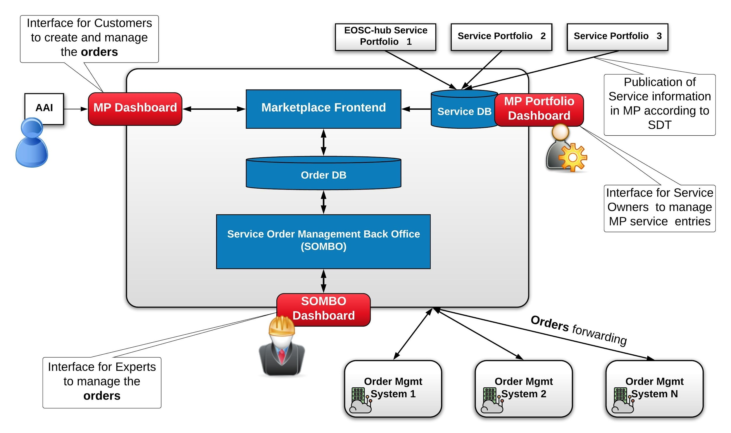
Service Discovery and Ordering
High-level architecture of EOSC-hub Service Order Management System
Notes:
Add View Source button on editor
Added Style Clean up functionality on Editor.

Slide 16
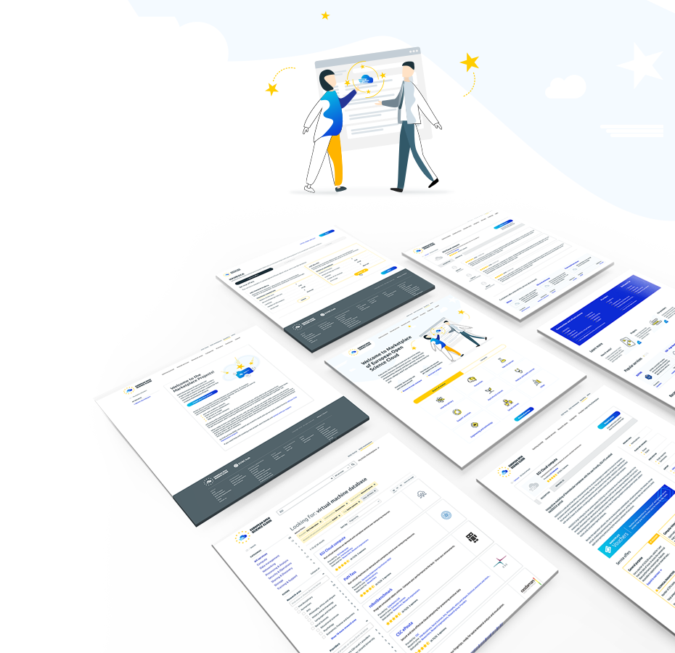
Marketplace
Accomplished tasks:
Integration with EOSC AAI
All baseline EOSC-hub services are orderable via MP
Enhancement of MP service and user experience, filtering, service model
Integration with EOSC-hub SOMBO to facilitate the
fulfillment of the orders
Implementation of features enabling voucher-based orders
Hierarchical structure of projects and service access requests
Integration with eInfra Central API
Ongoing activities
Development of EOSC Portal architecture concept and
tighter integration with eIC platform to deliver unified EOSC Portal
- activity in the scope of collaboration agreement
Integration with EOSC-hub Service Portfolio Management Tool
Refinement and adoption of Service Description Template

Slide 17
EOSC Federation Services
T5.1
T5.2
T5.3,4,5
T5.6
Access
Service Discovery and Ordering
Operations Support
Software and App Repositories
Check-in
EOSC Portal /
Market
place
Monitoring
Accounting
AppDB
B2ACCESS
Service
Portfolio
Tool
Config.
Database
GitLab
eduTEAMs
IAM
SOMBO (Service Order Mgmt. System)
Helpdesk
EGI Software Repo

Slide 18
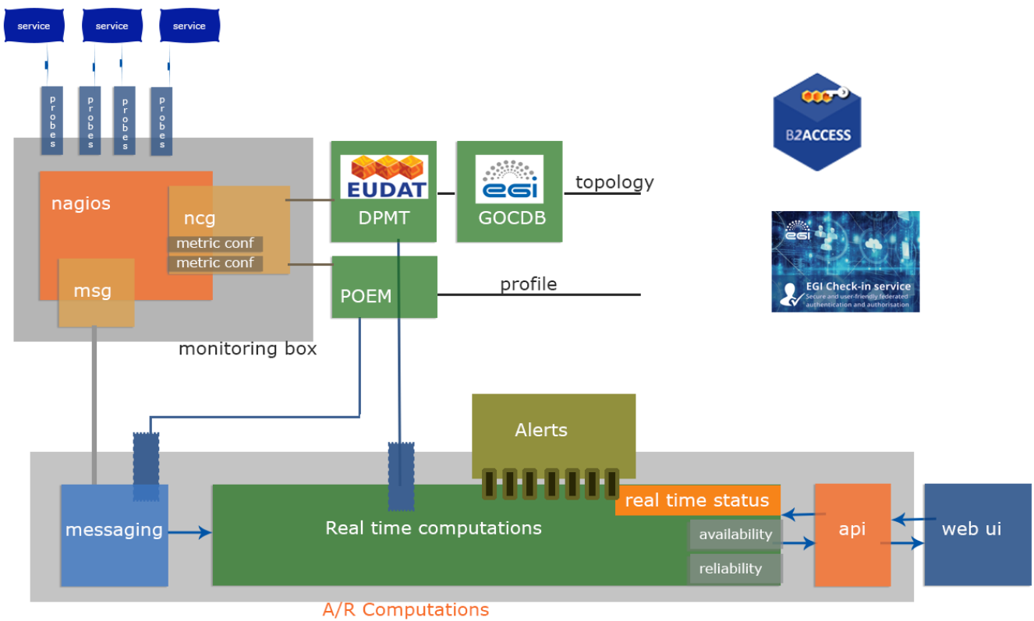
Monitoring System
Objective: Monitoring system should provide consistent monitoring of EOSC-hub services and support customers in management of their probes and services
The ARGO monitoring system:
monitors all EOSC-hub
services
sends incident alerts
reports on availability
and reliability
ARGO high-level architecture

Slide 19
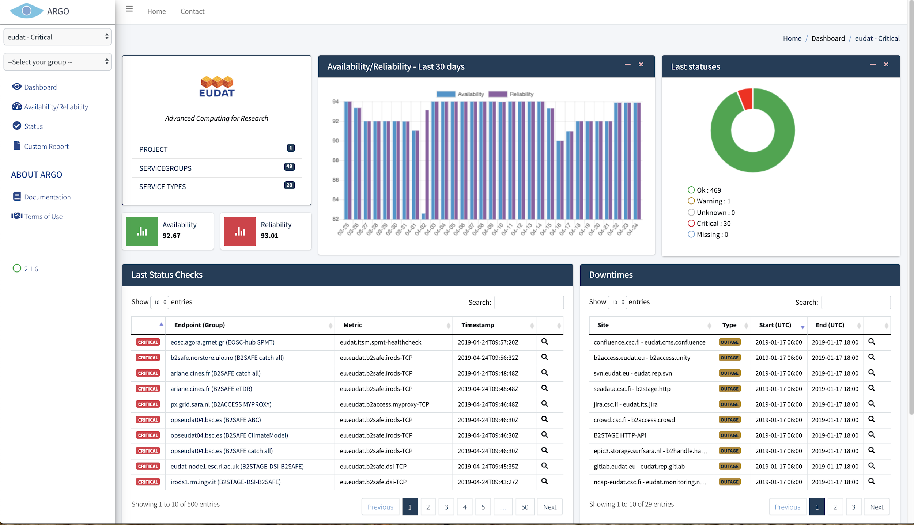
Monitoring System
Accomplished tasks:
Unified Web UI with EGI and EUDAT dashboards
Central management engine of customer thresholds with Profiles
Ongoing activities
Web UI to handle customer thresholds
Monitoring service management for customers ( VO and Infra managers) to manage profiles and probes
Unified ARGO Web User Interface

Slide 20
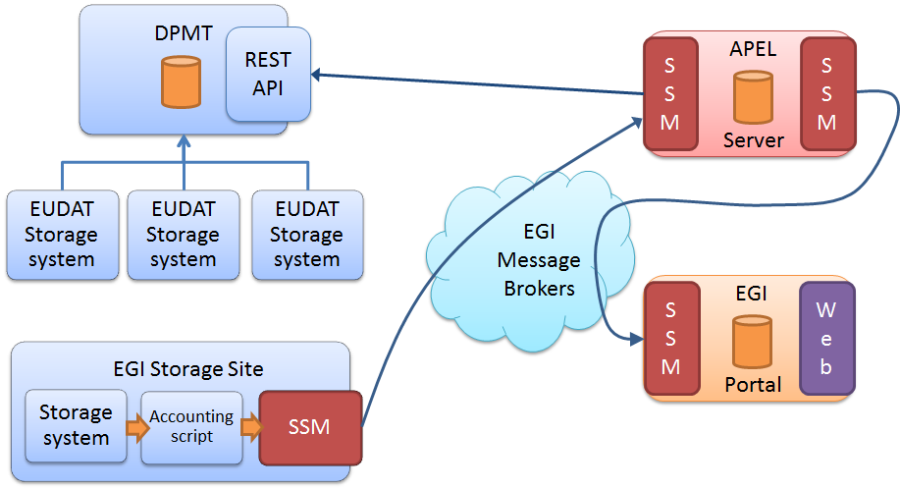
Accounting System
Objective: Accounting system should provide consistent accounting data from all EOSC-hub resources accessible from a single web portal
Accomplished tasks:
Integration of EGI and EUDAT accounting
services
Accounting system integrated with AMS.
Ongoing activities
Enhancement of accounting data
presentation in accounting portal
Customisation of accounting record related
to service order and customer
Integration of EUDAT and EGI accounting systems

Slide 21
Helpdesk
a)
b)
Initial objectives for EOSC Helpdesk:
To build unified helpdesk system which integrates EUDAT and EGI helpdesks.
Fulfill the requirements of ISRM process
Later requirements for EOSC Helpdesk:
To support 2 Use cases:
Service Provider has own Helpdesk
Technical integration of services
Service Provider would like to use EOSC
Support Unit: Helpdesk as a service
Service Provider A
Service Provider B
Helpdesk
RT, OTRS, JIRA..
EOSC Helpdesk
Support Unit B
CMDB
Known errors Database
High level EOSC Helpdesk Architecture

Slide 22
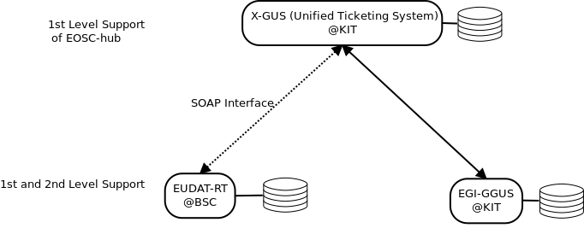
Helpdesk
Accomplished tasks:
Full integration between xGUS
and EUDAT and EGI Helpdesks
SOAP interface for integration
Tickets synchronization
Ticket owner, Status, body
1st Level Support is active
Use case b) is also supported
API for integration with web forms
Ongoing activities
Integration with B2ACCESS
UX design and Web Interface improvement
Integration with JIRA
Integration of EOSC-hub helpdesk with EUDAT-RT and EGI-GGUS

Slide 23
EOSC Federation Services
T5.1
T5.2
T5.3,4,5
T5.6
Access
Service Discovery and Ordering
Operations Support
Software and App Repositories
Check-in
EOSC Portal /
Market
place
Monitoring
Accounting
AppDB
B2ACCESS
Service
Portfolio
Tool
Config.
Database
GitLab
eduTEAMs
IAM
SOMBO (Service Order Mgmt. System)
Helpdesk
EGI Software Repo

Slide 24
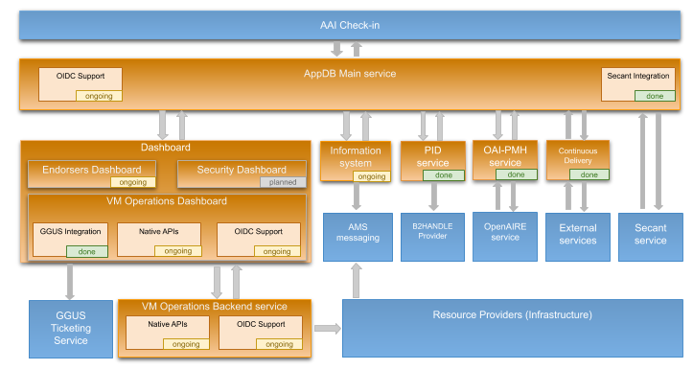
Software and App Repository: Application Database
Objective: Maintenance and development of Application and Software Repositories
Application Database:
maintains information about software, virtual appliances.
provides VMOps Dashboard to deploy and manage VMs for EGI Cloud Compute
AppDB service integration diagram

Slide 25
Software and App Repository: Application Database
Accomplished tasks:
AppDB VMOps integration with GGUS
AppDB integration with B2HANDLE for enriching registered digital objects with PIDs
AppDB integration with OpenAIRE - AppDB OAI-PMH endpoint has been deployed
AppDB VMOps has been extended and provides users more control on their VMs
Ongoing activities:
Implementation of a new Information System for cloud compute for fetching of information from the resource provider/site based on glue 2.1 schema
Support of OIDC
AppDB VMOps: Support of native CMF (OpenStack/OpenNebula) APIs instead of OCCI
AppDB Endorsers and VM image security dashboards

Slide 26
WP5: M1-M18 Efforts Planned & Used
WP | Task No. | Task Name | P1 M1 - M18
 |  |  | Planned PM | Used PM | Used%
WP05 | T05.01 | AAI and Identification | 18.8 | 16.8 | 90%
 |  | EGI CA-70% funded by EC | 21 | 21.6 | 103%
 | T05.02 | EGI CA Marketplace and Order Mgm -70% funded by EC | 24.5 | 36.7 | 150%
 | T05.03 | Integrated Business and Operation Systems | 16.5 | 14.9 | 90%
 |  | EGI CA-70% funded by EC | 14 | 10.1 | 72%
 | T05.04 | Monitoring Accounting Messaging Security Tools | 4.5 | 2.7 | 59%
 |  | EGI CA-70% funded by EC | 47.5 | 43.2 | 91%
 | T05.05 | Helpdesk | 4.5 | 5.7 | 126%
 |  | EGI CA-70% funded by EC | 2.5 | 3.1 | 122%
 | T05.06 | Application and SW Repositories and General Collaboration Services | 1.5 | 1.6 | 107%
 |  | EGI CA-70% funded by EC | 13.5 | 11.5 | 85%
WP05 Total |  |  | 168.8 | 167.6 | 99%

Slide 27
Deviations
Marketplace:
Delays in integration and development of tools contributing to Order Management due to unplanned significant amount of effort requested for preparation of the EOSC Portal in the second half of 2018. Milestone 5.6 “Order management system integrated with back-office management system” has been postponed

Slide 28
Main Results
Authorization & Authentication Infrastructure:
Definition of the EOSC-hub AAI high-level architecture
Initial integration of AAI [M5.1]
Service discovery and ordering:
Marketplace enhancement and ability to order all EOSC-hub services [M5.2]
Design and implementation of distributed order management system
Operations support:
Consistent monitoring of all EOSC-hub services [M5.5]
Integration of EUDAT and EGI accounting systems [M5.3]
Unified integrated Helpdesk system in place [M5.5]
Software and Applications repositories:
AppDB enhancement and its integration with OpenAIRE harvesting services

Slide 29
Outlook
Authorization & Authentication Infrastructure:
Finalization of integration and alignment activities
Finalization of new distributed architecture for RCauth Online CA
Service discovery and ordering:
Development and implementation of a new service access and ordering models
Contribution to the delivery of unified EOSC Portal
Operations support:
Further integration and enhancement of information services, work on common standards e.g. accounting record, to support service operations and service ordering procedures
Software and Applications repositories:
Maintenance and enhancement of repositories to facilitate development and provisioning of software products

Slide 30
Summary
Main focus in WP5 during the first project period was given for analysis of the initial requirements and use cases, design and development of integration scenarios for federation services in complex distributed EOSC environment
Significant enhancement for most of the federation services, adoption of standards, improvement of APIs
Work on high-level architecture and implementation of Service Management System requirements
More effort and focus is needed towards integration with EOSC Portal

Slide 32
Backup slides

Slide 33
Federation Services of EOSC - Full list
Service | Description | Main Components | Category | Service Owner(s) | Access
Perun | identity and access mngmt system (IAM) | Perun Core, … | Federation: AAI | EGI / CESNET
Check-in | AARC BP compliant EGI Identity and Access Management proxy solution | Comanage | Security&Operations | EGI / GRNET | VA
B2ACCESS | AARC BP compliant EUDAT Identity and Access Management proxy solution | Unity IDM | Security&Operations | EUDAT / JUELICH | VA
WaTTS | Token Translation Service (TTS), supporting IGTF compatible (IOTA) X.509 certificates. | Erlang OTP | Federation: AAI | INDIGO / KIT
RCauth.eu | TTS that can issue PKIX credentials on the fly and in real-time |  | Federation: AAI | EGI / Nikhef, GRNET, STFC | VA
Marketplace | user-facing platform to promote, discover, order and access | Ruby-on-rails App | Collaboration | EOSC-hub Cyfronet
SPMT | full list of services, to manage service according FitSM | Agora | Collaboration | EOSC-hub GRNET | VA
Ops Portal | VO management and operations support tool for the daily operations of EGI | Vapor App | Federation | EGI / CNRS | VA
DPMT | business and operations support tool to manage projects and services topologies. | Plone, python | Federation | EUDAT / MPCDF | VA
DMP Tool | Data Mngmt Planning tool for creating and updating data management plans. |  | Federation | EUDAT / SIGMA2
GOCDB | Registry to record information about the complete e-Infrastructure topology. |  | Federation | EGI / STFC | VA
SVMON | Information aggregator and provider on software versions installed. | Spring App | Federation | EUDAT / KIT | VA
Accounting Portal | framework for monitoring status, availability and reliability provided by infrastructures |  | Collaboration | EOSC-hub / CESGA | VA
ARGO Msg | messaging Service | ARGO | Federation | EOSC-hub GRNET / SRCE | VA
Pakiti, SECANT | monitors the patching status on Linux systems; security cloud assessment framework |  | Federation | EGI / CESNET | VA
ARGO monitoring | monitoring status, availability and reliability | ARGO | Federation | EOSC-hub / GRNET | VA
APEL accounting | collects, aggregates, stores, displays compute, storage, and cloud resource usage data | APEL | Federation | EOSC-hub / STFC | VA
EUDAT RT Helpdesk | EUDAT ticketing system based on Request Tracker | RT | Collaboration | EUDAT / BSC | VA
XGUS Helpdesk |  |  | Collaboration | EOSC-hub / BSC
GGUS Helpdesk |  |  | Collaboration | EGI / KIT
AppDB/UMD | Application data base, enabling EGI Cloud infrastructure |  | Collaboration | EGI / IASA | VA

Slide 34
Authentication & Authorization Infrastructure
Summary of accomplished and ongoing Alignment activities:
Activity | B2ACCESS | Check-in | eduTEAMS | INDIGO-IAM
Alignment of user attributes | ✓ | ✓ | ✓ | M24
Alignment of VO/group membership and role information | ✓ | ✓ | ✓ | M24
Alignment of resource capabilities information | ✓ | ✓ | ✓ | M24
Alignment of affiliation information | M24 | M24 | M24 | M24
Alignment of assurance information (including freshness of affiliation information) | PY3 | PY3 | PY3 | PY3
Oauth2 token validation across multiple domains (proof-of-concept implementation) | M24 | M24 | M24 | M24
Oauth2 token validation across multiple domains | PY3 | PY3 | PY3 | PY3

