Slide 1
Report on Collaborations: OpenAIRE-Advance, EOSC projects and initiatives
Johannes Reetz (MPCDF), Diego Scardaci (EGI Foundation)
EOSC-hub AMB co-chairs
Dissemination level: Public/Confidential If confidential, please define:
Disclosing Party: (those disclosing confidential information)
Recipient Party: (to whom this information is disclosed, default: project consortium)

Slide 2
Outline
e-Infrastructure collaborations
OpenAIRE-Advance: Joint Activity Plan and PY1 results
GEANT
Cross-project collaborations
EOSC for evidence-based policy making
EuroGEOSS
PolicyCloud
EOSC in the international landscape
African Open Science Platform

Slide 3
OpenAIRE-Advance
Collaboration Agreement
1st EOSC-hub Review, Luxembourg 8-9 Oct 2019
3

Slide 4
EOSC-hub – OpenAIRE Collaboration
The EOSC-hub / OpenAIRE-Advance Collaboration Agreement signed in April 2018
It defines a joint activity work plan aiming at ensuring service integration and a technical and policy alignment of the projects’ respective strategic plans.
Joint Activities in three areas:
Service Integration (JA1)
Communications, Engagement, Support and Training (JA2)
Governance and Strategy (JA3)
The collaboration produced a number of results, for instance
the adoption of OpenAIRE best practices for software, metadata schemas, open source software by the EOSC-hub/EGI Application Database service
the integration of the EOSC-hub/EGI Notebook with Zenodo for reproducibility of science via software sharing and MyBinder;
a jointly developed training programme,
the production of a joint White Paper highlighting a number of priorities to ensure an effective implementation of the EOSC vision.

Slide 5
Joint Activity Areas
JA1: Service Integration
JA2: Communication, Engagement, Support and Training
JA3: Governance and Strategy

Slide 6
JA1: Service Integration
JA1.1 Machine-consumable Data Management Plans
JA1.2 Interoperability across EOSC services for Open Science
JA1.3 Towards Open Science-oriented Scientific Impact
JA1.4 Enabling Services Integration in support of EOSC

Slide 7
JA1 Service Integration
Scholarly communication services
(sharing, evaluating, monitoring science)
Interoperability across EOSC services for Open Science
Towards Open Science-oriented Scientific Impact
JA1.2
JA1.3
Research infrastructure services
(performing science)
EOSC as Access facilitator
Machine-consumable Data Management Plans
Enabling Services Integration in support of EOSC
JA1.1
JA1.4
E-infrastructure
(enabling digital services for science)

Slide 8
Task Structure of the Activities
Define and promote common guidelines
JA1.2.A
Interoperability across EOSC services for Open Science
JA1.2
Facilitating publishing and exchanging information on scientific products in EOSC
JA1.2.B

Slide 9
Task Structure of the Activities (cont)
AAI Integration
JA1.4.A
Enabling Services Integration in support of EOSC
Annotation
JA1.4
JA1.4.B
Anonymization of sensitive data
JA1.4.C

Slide 10
JA2: Communication, Engagement, Support and Training
JA2.1 Communications
JA2.2 Common Support and Training
JA2.3 Events

Slide 11
JA3: Governance and Strategy
JA3.1 Cross-project Governance
JA3.2 Strategy

Slide 12
Recommendation 7. Joint Activity Plan
from the introductory presentation
The projects should continue, both individually and jointly, to increase the involvement and interaction with a larger spectrum of research communities and infrastructures;
Cross-project strategic board has to be established
White paper on ‘Common Vision for EOSC, service placement and role in upcoming EOSC governance
Activity reports gathered regularly
Joint interaction with the EOSC demand side through the Early Adopter Programme
Registration of OpenAIRE services into Marketplace
Cross-project strategic board involvement in EOSC-hub and OpenAIRE-Advance White Paper “Common Vision, Service Provision, and Role in the EOSC Governance” 🡺 WP2 Report
Planned: Milestone JAM3.4 “Aligned roadmap(s) for service positioning and sustainability within EOSC”

Slide 13
Status of Joint Activity Milestones until M18
Milestone | Activity | Due Date (month) | Status
JAM1.5 Report on OpenAIRE guidelines for Data Archives and Research Software Repositories | JA1.2 | M06 | DONE and active
JAM2.1 Communications plan | JA2.1 | M06 | DONE
JAM2.8 A common template and workflow for event organization | JA2.3 | M06 | DONE
AM3.1 Cross-project Strategic Board | JA3.1 | M06 | DONE
JAM2.5 Joint training schedule, including 3 joint training events delivered in PY1 | JA2.2 | M08 | DONE
JAM1.17 Use case documented for integrating the OpenAIRE AAI with the Federated AAI of EOSC-hub | JA1.4.A | M09 | IN PROGRESS
JAM2.2 Establishment of joint communications channel | JA2.1 | M09 | DONE
JAM2.9 Joint event programme - first issue (PM1 - PM18) | JA2.3 | M09 | DONE
JAM3.2 Review of Advisory Board Requirements and setup of advisory board(s) | JA3.1 | M09 | DONE
JAM1.23 Use case documented for piloting the OpenAIRE Amnesia service within the EUDAT Sensitive Data Services | JA1.4.C | M12 | DONE
JAM3.3 White paper outlining common vision for EOSC, service placement, and role in upcoming EOSC governance | JA3.2 | M12 → M15 | SUBMITTED

Slide 14
Status of Joint Activity Milestones until M18 (cont)
Milestone | Activity | Due Date (month) | Status
JAM1.18 Pilot the use case for AAI integration between OpenAIRE and EOSC-hub | JA1.4.A | M15 delayed
JAM1.1 Pilot DMP service with communities | JA1.1 | M18 | DONE
JAM1.6 New guidelines for specific classes other scientific products (e.g. services, protocols, workflows, virtual appliances) | JA1.2 | M18 | DONE (no case)
JAM1.9 B2FIND and B2SHARE adapted to support guidelines for Data Archives and enabling harvesting by OpenAIRE RCD | JA1.2.B | M18 delayed | IN PROGRESS
JAM1.10 EGI AppDB adapted to support OpenAIRE guidelines for software other scientific products and enabling harvesting by OpenAIRE RCD | JA1.2.B | M18 | DONE
JAM1.14 Definition of guidelines for measuring and the exchange of usage statistics (in collaboration with RDA and other standardization bodies as applicable) | JA1.3 | M18 | IN PROGRESS
JAM1.20 Feasibility study on the usability and integration of the B2NOTE service in OpenAIRE services (including considerations on policies, business model, operations costs) | JA1.4.B | M18 delayed | IN PROGRESS
JAM2.3 First report on communications activities & update of Communications Plan | JA2.1 | M18 | DONE
JAM2.6 First summary report of joint events | JA2.2 | M18 | DONE
JAM2.10 Joint event programme - second issue (PM19 - PM36) | JA2.3 | M18 | IN PROGRESS
JAM3.4 Aligned roadmap(s) for service positioning and sustainability within EOSC | JA3.2 | M18. postponed to M21 | IN PROGRESS

Slide 15
EOSC-hub GEANT: GNT4-2/GNT4-3 Collaboration Agreement
Extending cross-infrastructure collaborative efforts with GEANT
1st EOSC-hub Review, Luxembourg 8-9 Oct 2019
15

Slide 16
Activities and Results
Activity 1: Service Portfolio and Roadmap Alignment
Consultation on the EOSC-hub service portfolio management process and terminology (T2.2) and the federating core architecture (T2.3)
Contribution to the EOSC Portal Concept 2.0
Activity 2: Communication, Events, Training and Engagement
Promotion of the Early Adopter Programme and events like the EOSC-hub events and the TNC conference, collaboration for the definition of the EOSC Symposium programme
Activity 3: Federated Service Management
TRANSITS I course delivered aimed at new or potential computer security incident response team (CSIRT) personnel but also system administrators delivering services within EGI, EUDAT and EOSC who wish to gain a better understanding in the aspects of security related to incident response
Activity 4/5: AAI and Cloud Interoperability and Service Integration
Coordinated promotion of federated AAI solutions
(In progress) EGI-GEANT Collaboration agreement for federated AAI operations
Activity 6: Technical Coordination
Participation to TCOM coordination efforts, input to AAI & Cloud technical architecture and interoperability guidelines (WP10) & first cross-team technical coordination workshop (October 2019)

Slide 17
OCRE
Memorandum of Understanding (May 2019 - Dec 2020)
JA1 Organisation of cloud procurements
JA2 Stimulating cloud adoption
1st EOSC-hub Review, Luxembourg 8-9 Oct 2019
17

Slide 18
JA1 Organisation of cloud procurements
Q2 2019 - EOSC-hub input to tender on:
WP10: Cloud interoperability requirements and guidelines from
cloud integration use cases
technical architecture and standards roadmap
WP4: Security policy interoperability
WP12: Procurement and business models (D12.1)
Q3 2019 - EOSC-hub input incorporated in the OCRE Tender
Q1 2020 - EOSC-hub and OCRE will support selected cloud suppliers to join EOSC
Service onboarding in the EOSC Marketplace
Q4 2020 - EOSC-hub Buyer Group - : Analysis of requirements/opportunities
research entities to establish a group buyer role in the OCRE tender
aggregating demand and doing purchase in bulk.

Slide 19
JA2 Stimulating cloud adoption
EOSC-hub ‘Early adopter programme’ and OCRE Adoption track
EOSC-hub and OCRE coordinated efforts to support researchers participating to the EOSC-hub ‘Early adopter programme’ with funding for resources and with technical expertise
EOSC-hub will promote the usage of available services in EOSC-hub and OCRE cloud and Earth Observation services
EOSC-hub will help researchers to move services in production
EOSC-hub will explore cloud-bursting scenarios, where commercial clouds are brought into play, to deliver extra capacity on a temporary basis
OCRE will make available vouchers to participants in the EAP for a value of 100,000 Euro → to use cloud resources at commercial IaaS providers which are part of the GÉANT IaaS framework

Slide 20
JA2 Stimulating cloud adoption - Joint Communication
Cross links between EOSC-hub & OCRE websites and communication efforts
use cases, success stories and promotion towards users
EOSC-hub will incorporate OCRE in its communication
OCRE will provide EOSC-hub with
information about OCRE and the opportunities which OCRE provides to the EOSC-hub community
to give input to tender requirements
to participate in the tender

Slide 21
Cross-project collaborations
Aligning efforts for EOSC promotion and adoption
EOSCPilot
INFRAEOSC-04-2018 Cluster Projects
EaPConnect
Max Centre of Excellence
Virtual Brain Cloud
1st EOSC-hub Review, Luxembourg 8-9 Oct 2019
21

Slide 22
EOSCPilot (Jan 2017 - Mar 2019)
EOSCPilot supported the first phase of the EOSC develpoment - EOSC-hub leverages EOSCPilot main results
Evolution of EOSCPilot glossary to support the definition of the EOSC Portal concept 2.0
Adoption of EOSCPilot recommendations and scientific demonstrator outputs for the the definition of the federated core (briefing paper)
Analysis of EOSCPilot scientific demonstrators technical requirements to drive
Design of the EOSC Technical Architecture
Prioritise technical specification of ‘building blocks’ and related interoperability guidelines
Evolution of EOSC-hub technical services (WP5, WP6, WP7)
Bridging a few demonstrators from testing to production
PROMINENCE service in the Marketplace
LOFAR Competence Centre
Support to the TextCrowd
EOSC-hub Training registry architecture follows EOSCPilot recommendations

Slide 23
INFRAEOSC-04-2018 Cluster Projects
Strategic input to EOSC-hub outputs (EOSC Portal Concept 2.0, Federating Core, EOSC value proposition)
advise on strategy plan and implementation, including exploitation and service deployment plans
Gathering of EOSC use cases (ongoing)
Joint promotion to the Early Adopter Programme and Marketplace
PARTHENOS and SSHOC (Social Sciences and Humanities)
e.g. CESSDA data catalogue in Marketplace
EOSC-Life (Life Science)
e.g. (ELIXIR) European Galaxy Service in Marketplace
ESCAPE (Astroparticle Physics)
ENVRI-FAIR (Environmental Sciences)
PANOSC (Photon Neutron Science) - see next slide

Slide 24
EOSC-hub support to PaNOSC use cases
Main objectives
EOSC Integration → PaNOSC services published in the EOSC Marketplace (in progress)
Technical integration and reuse of existing solutions
3 pilots in progress
Facility users want to transfer datasets to their home PC/lab
Archiving uses case: host open data from a production RI to external cold storage for wider exploitation
Local download of open data to compute facilities for local exploitation

Slide 25
Technical collaboration with PaNOSC
Jupyter notebooks on cloud/EGI
Federated cloud provisioning/EGI
Data transfer/EGI
Data discovery and archiving/EUDAT
https://marketplace.eosc-portal.eu/services/egi-cloud-compute
https://marketplace.eosc-portal.eu/services/egi-notebooks
https://marketplace.eosc-portal.eu/services/b2find
https://marketplace.eosc-portal.eu/services/b2safe

Slide 26
EaPConnect Project
Objective: Promotion of the participation of Eastern Europe countries to EOSC via the Eastern Partnership Connect (EaPConnect) project
Decrease the digital divide and facilitate participation of local scientists, students and academics in global R&E collaborations and EOSC
Countries in scope: Armenia, Azerbaijan, Belarus, Georgia, Moldova and Ukraine
EOSC-hub / EaPConnect pilots
Federated Cloud and Cloud bursting, promotion of scientific applications on Cloud (e.g. Armenia Data Cube, ADC4SD project), federated data access in the Cloud (e.g. Copernicus)
Training of local scientists “Introduction to Jupyter on cloud and Open Science” @ EaPEC 2019

Slide 27
MaX Centre of Excellence
MaX - Materials design at the Exascale - is one of the 'European Centres of Excellence for HPC applications' (H2020-INFREADI-2018-1)
supports developers and end users of advanced applications in the field of materials (HPT & HTC)
enabling the exascale transition in the materials domain
developing advanced programming models, novel algorithms, domain-specific libraries, in-memory data management, etc

Slide 28
MaX Centre of Excellence & EOSC-hub
Open Science Platform: AiiDA + Materials Cloud
Open and FAIR data sharing: Archive, Discover, Explore
Discover (curated data) & Explore (raw data)
AiiDA lab: cloud data generation and analysis platform (AiiDA + Jupyter)
Collaboration with EOSC-hub and integration into EOSC:
AiiDa lab hosting in the EGI Federated Cloud
Kubernetes cluster (cloud containers)
Integration with B2ACCESS for AAI
B2SHARE under analysis
⇒ AiiDA lab will be published in the EOSC Marketplace

Slide 29
VirtualBrainCloud - EOSC for data analytics for health
VirtualBrainCloud bridging the gap between computational neuroscience and subcellular systems biology
Integration of research streams into a cloud-based brain simulation platform supporting personalized diagnostics and treatments for Alzheimer’s dementia
Coordinate efforts of The Virtual Brain large scale simulation platform (EU Flagship Human Brain Project) and IMI-EPAD initiative (European prevention of Alzheimer’s dementia consortium)
Develop and validate a decision support system that provides access to high quality multi-disciplinary data for clinical practice

Slide 30
VirtualBrainCloud - EOSC for data analytics for health
Technical objective: support the creation collaborative workbenches/VREs to search/integrate data, run pre-processing, store data, re-use already pre-processed data, etc
Technical requirements:
Data discovery: federated search and access of data (AAI)
Simulation capabilities: cloud/HTC infrastructure for data pipelines
Containerized data and analysis with Jupyter Notebooks
Tools to manage sensitive data
Collaboration with EOSC-hub
Notebook integrated on EGI Cloud, DataHub for federating data in cloud and access for processing, scaling up in EGI Cloud, adoption of EGI Cloud tools (VM image repository, Applications on demand), tools for sensitive data
Publish Virtual Brain Cloud services in EOSC marketplace

Slide 31
EOSC for evidence-based policy making
EOSC-hub support to EU-wide initiatives: EuroGEOSS and the PolicyCloud project
1st EOSC-hub Review, Luxembourg 8-9 Oct 2019
31

Slide 32
EuroGEOSS
EuroGEOSS is Europe's part of the Global Earth Observation System of Systems (GEOSS)
allow Europe to position itself as global force in Earth observation thanks to the vast knowledge gained through running the Copernicus programme and others.
GEOSS is a worldwide system which aims to use earth observation data to improve the lives of citizens and help governments make good, evidence-based decisions to support UN sustainable development goals
GEOSS is operated by the Group on Earth Observations (GEO)
partnership of more than 100 national governments, 100 participating organisations and the European Commission

Slide 33
EuroGEOSS pilots roles in EOSC
Service/Product providers
Contribute to the portfolio & Integrate
Promote, Train, Exploit
Manage the Hub
Early adopters
Pilot
Use
Co-develop
Integrate with federated AAI, computing and storage
Consumers
Credit allocation & exploit
Support
Improve with feedback
Use
1st EOSC-hub Review, Luxembourg 8-9 Oct 2019
33

Slide 34
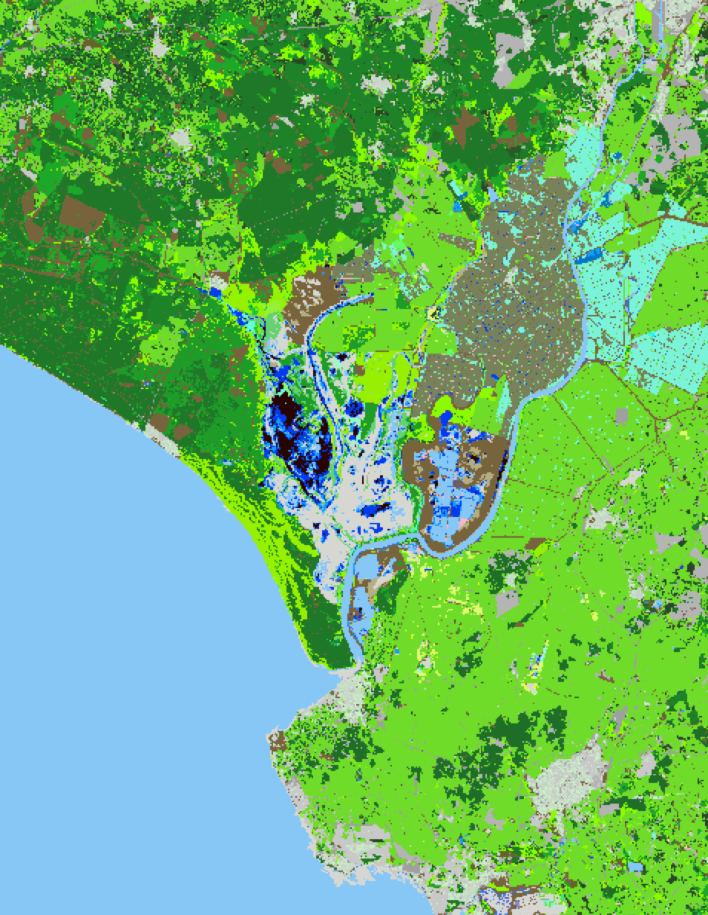
ECOPotential VLab: managing protected environments
Europe’s protected areas and surrounds are vulnerable to human-induced events and processes including those associated with climate change.
As an example, the biodiversity of Doñana National Park in Spain is affected by agricultural expansion, and urban development and climatic variability with all impacting on water supply.
Whilst large amounts of Earth Observation data are available, these are vastly underexploited for monitoring changes and implementing management actions aimed at nature conservation and sustainable and wise use.
Map showing combination of daily, between image observations and annual change in hydroperiod superimposed on the land cover classification
1st EOSC-hub Review, Luxembourg 8-9 Oct 2019
34

Slide 35
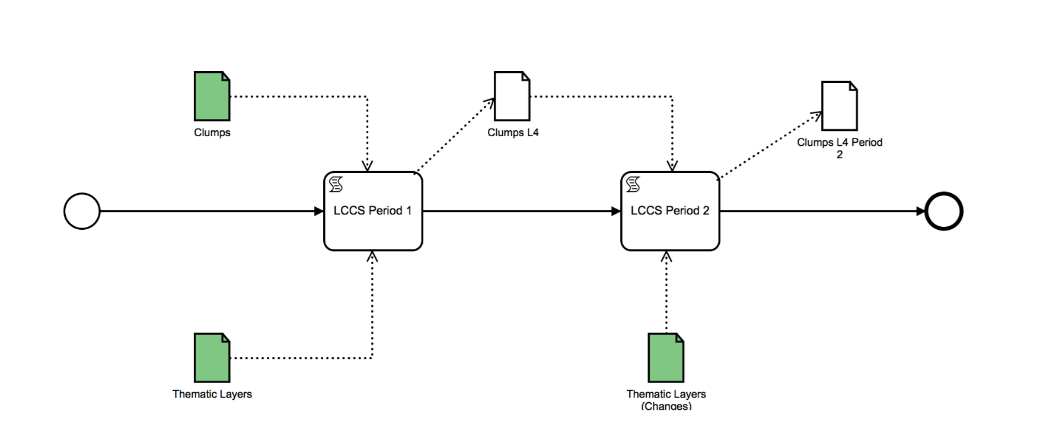
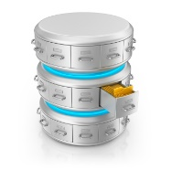
Architecture Overview
Knowledge bases
Discover the service through the EOSC Portal
Workflows
Identify available related workflows related to the issue of interest
VLAB
Long-term preservation
archives
Explore available data through GEOSS
VLab APIs
VLab
Portal and apps
Execute the workflow taking advantage of the EOSC infrastructure
Source code
Remote processing services
1st EOSC-hub Review, Luxembourg 8-9 Oct 2019
35

Slide 36
PolicyCloud (Jan 2020)
PolicyCLOUD aims at delivering an integrated cloud-based environment for data-driven policy management. The environment will provide decision support to public authorities for policy modelling, implementation and simulation through identified populations, enforcement and adaptation.
PolicyCLOUD addresses the full lifecycle of policy management: modelling, monitoring, enforcing, simulation, analysis and compliance.
Collaboration
Use of EOSC and e-Infrastructures as data hosting platform interoperable with the project data analytics platforms to be developed

Slide 37
EOSC-hub support to international initiatives
African Open Science Platform
1st EOSC-hub Review, Luxembourg 8-9 Oct 2019
37

Slide 38
African Open Science Platform
Promotion of EOSC and collaboration with the African Open Science Platform to support efforts to
develop “an open science and innovation platform that depends not only on the physical infrastructure for acquiring, curating and disseminating data and information, but also on protocols, policies and procedures in the science system that provide structure and support”
Interest in piloting a international cloud federation for the sharing and exploitation of open data (Copernicus and AfriGEOSS, bioinformatics, astronomy and astrophysics)

Slide 40
Annex 1:
on Collaboration with OpenAIRE Advance
1st EOSC-hub Review, Luxembourg 8-9 Oct 2019
40

Slide 41
JAM1.5 Report on OpenAIRE guidelines* for Data Archives and Research Software Repositories
M06
Document (public ongoing report)
Report on OpenAIRE guidelines for Data Archives* and Research Software Repositories+
Authors: Paolo Manghi, Hans van Piggelen, Heinrich Widmann, Marios Chatziangelou, William V. Karageorgos
https://docs.google.com/document/d/1zXcDrrS2Ud8XL2lDFJcj2b1CQjMzmHKp7USBBJkKvVc
Feedback on OpenAIRE Guidelines for Data archives (B2SHARE, B2FIND)
Feedback on OpenAIRE guidelines for Research Software Repositories (EGI AppDB - software repository)
Feedback on OpenAIRE guidelines for Other products Repositories (EGI AppDB - virtual appliance repository)
* OpenAIRE Guidelines for Data Archives: Use of DataCite
+ https://software-guidelines.readthedocs.io/en/latest/

Slide 42
JAM2.1 Communications plan
M06
Document:
Communications Plan EOSC-hub & OpenAIRE-Advance
Authors: EOSC-hub & OpenAIRE Advance communications teams
https://docs.google.com/document/d/1zXcDrrS2Ud8XL2lDFJcj2b1CQjMzmHKp7USBBJkKvVc

Slide 43
JAM2.8 A common template and workflow for event organization
M06
Document:
Common template and workflow for event organization
Authors: EOSC-hub & OpenAIRE Advance communications teams
This document includes guidelines for the organisation of Joint events, including webinars.
https://docs.google.com/spreadsheets/d/1fXsVcGOP2bfD7AoHJmfUTDYN6V5U_SnVZczPXTdsyj8

Slide 44
JAM3.1 Cross-project Strategic Board
M06
The EOSC-hub – OpenAIRE-Advance cross-project strategic board is in place
The EOSC-hub board participating in the cross-project Strategic Board is the PMB. Governance and strategy topics will be dwelt in collaboration with EOSC-hub WP2 and WP2.3 specifically for governance and sustainability
Decision: 12.12.2018

Slide 45
JAM2.5 Joint training schedule, including 3 joint training events delivered in PY1
M08
Document
EOSC-hub and OpenAIRE-Advance joint training schedule for PY1
https://docs.google.com/document/d/1JMCsNBjuxq6kpEiNZATlGgmtm0amTUQj9r6lW30FVaU
Content
Joint training events
The list of training events/webinars/workshops and technical talks events that have been jointly organised by EOSC-hub and OpenAIRE Advance projects during PY1 are presented. The list is structured according to the main common target audiences of EOSC-hub and OpenAIRE Advance projects.

Slide 46
JAM2.2 Establishment of joint communications channel
M09
Joint cross-project communications channels have been established.
For details, see https://wiki.eosc-hub.eu/display/EoscHubOpenAIRE/EOSC-hub+and+OpenAIRE+Collaboration+Home

Slide 47
JAM2.9 Joint event programme - first issue (PM1 - PM18)
M09
Document:
Joint event programme of EOSC-hub and OpenAIRE Advance until M18
Authors: Communications and Events Teams of EOSC-hub and OpenAIRE Advance
https://docs.google.com/spreadsheets/d/1fXsVcGOP2bfD7AoHJmfUTDYN6V5U_SnVZczPXTdsyj8
This document includes the list of events jointly organised by EOSC-hub and OpenAIRE in 2018 and the plan for future events.

Slide 48
JAM3.2 Review of Advisory Board Requirements and setup of advisory board(s)
M09
The EOSC-hub / OpenAIRE Advance cross-project strategic board meeting decided on the 12 Dec 2018 that EOSC-hub and OpenAIRE-Advance shall have independent External Advisory Boards, which will be consulted in a coordinated manner on topics of common interest. Topics may be like service provisioning, strategy within EOSC, collaboration, governance and sustainability.

Slide 49
JAM1.23 Use case documented for piloting the OpenAIRE Amnesia service within the EUDAT Sensitive Data Services
M12
The Amnesia has been installed in TSD and it is now part of the software portfolio for all the TSD users. The service is documented in the TSD user guide here: https://www.uio.no/english/services/it/research/sensitive-data/use-tsd/software/#toc6
The service is used out of the box by any users having structured data, i.e. whenever k-anonymisation is enough. This is the case for all the users that collect data throughout the web-based collection tool built in TSD, namely Nettskjema. More info about Nettskjema here:
https://www.uio.no/english/services/it/research/sensitive-data/use-tsd/datacollection/nettskjema/index.html
After importing data from Nettskjema, as JSON or Excel sheets, Amnesia can be used to anonymise the data prior to processing.
For more information: https://wiki.eosc-hub.eu/display/EoscHubOpenAIRE/JAM1.23+Use+case+documented+for+piloting+the+OpenAIRE+Amnesia+service+within+the+EUDAT+Sensitive+Data+Services

Slide 50
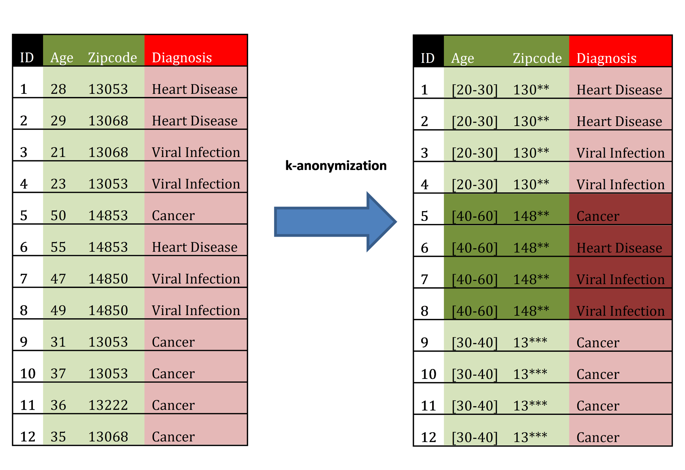
JAM1.23 Use case documented for piloting the OpenAIRE Amnesia service within the EUDAT Sensitive Data Services (cont)
M12
Schematic Data anonymization in TSD with Amnesia
Data anonymization tool, that allows to remove identifying information from data.

Slide 51
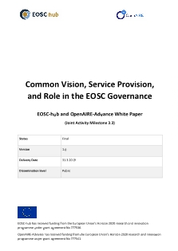
JAM3.3 White paper outlining common vision for EOSC, service placement, and role in upcoming EOSC governance
M12
Common Vision, Service Provision, and Role in the EOSC Governance*
EOSC-hub and OpenAIRE-Advance White Paper
This paper outlines a common vision for EOSC, service provision, and role in EOSC governance, as defined in the Joint Activity Plan of the two EC projects EOSC-Hub and OpenAIRE-Advance (April 2018). In the meantime, the EOSC landscape has evolved, notably with the establishment of the EOSC Governance and the enactment of the EOSC Implementation Roadmap (Commission Staff Working Document, March 2018). Authoritative structures are now in place and, accordingly, the primary addressee of this paper is now the EOSC Governance Board through the working instruments of the European Commission.
* https://eosc-hub.eu/sites/default/files/Common%20Vision%2C%20Service%20Placement%20and%20Role%20in%20EOSC%20Governance%20June2019.pdf

Slide 52
JAM1.1 Pilot DMP service with communities
M18
Document
Short Report on Pilot of Data Management Plan Tools*
Authors
Georges Kakaletris, Natalia Manola, Diamantis Tziotzios / University of Athens, Greece,
Adil Hasan, Francesca Iozzi, Hanne Moa / UNINETT Sigma2 AS, Norway
1 July 2019
* https://docs.google.com/document/d/1xB4u5dUGS4w4HFalj7y4OOutUQqutGadE2_U4R_Vh5I
The document is based on the feedback from the communities.

Slide 53
JAM1.6 New guidelines for specific classes other scientific products (e.g. services, protocols, workflows, virtual appliances)
M18
Studies revealed that no new guidelines are required for other classes of products, due to lack of critical mass.

Slide 54
JAM1.10 EGI AppDB adapted to support OpenAIRE guidelines for software other scientific products and enabling harvesting by OpenAIRE RCD
M18
Implementation of OpenAIRE guidelines for Research Software Repositories*: EGI AppDB - software repository
Implementation of OpenAIRE guidelines for Other products Repositories+: EGI AppDB - virtual appliance repository
* https://software-guidelines.readthedocs.io/en/latest/
+ https://guidelines-other-products.readthedocs.io/en/latest/
EGI AppDB: https://appdb.egi.eu/

Slide 55
JAM2.3 First report on communications activities & update of Communications Plan
M18
First report on communications activities & update of Communications Plan
The communications aspect of the collaboration has had a good first 18 months. The team has solidified its activities in a number of areas, namely 10 well-received joint articles, case studies and press releases. The main focus areas of the communications plan have been:
Authoring joint case studies and news items: one item per month has been published on different aspects of the collaboration, technical milestones, outreach activities and aspects of the portal.
Developing the EOSC portal, in particular the information and country pages and taking care of all communication aspects.
https://wiki.eosc-hub.eu/download/attachments/30738978/JAM2.3%20Communications%20v2.pdf

Slide 56
JAM2.6 First summary report of joint events
M18
First summary report of joint events
The document is a summary report of the joint training events for researchers communities, data and service providers, research support staff, NOADs and NILs that were conducted under the EOSC-hub/OpenAIRE-Advance Collaboration Agreement (CA) during the first year of the projects. The purpose of this summary report is to assess the effectiveness of the training activities carried out by the two projects in the context of this Collaboration Agreement.
https://wiki.eosc-hub.eu/download/attachments/30738980/JAM2.6%20-%20First%20Summary%20Report%20of%20joint%20events.pdf

