Slide 1
Thematic services
Debora Testi (CINECA), WP7 leader
Luxembourg, 8-9 October 2019
Dissemination level: Confidential

Slide 2
WP7 Thematic Services: Integration, maintenance and Exploitation
Objectives:
  Vertically integrate thematic services with common components
  Foster thematic services deployment and operation
  Enable users access to services
  Monitoring and accounting systems are part of this integration.
Number of Tasks: 9
Number of Participants: 26
Efforts planned RP1: 215PMs

Slide 3
Key Exploitable Results WP7
Researchers and
research communities:
Empower my research
Educate, inform and support my team and community
Services in the EOSC Service Portfolio
EOSC Portal
and
Marketplace
EOSC Hub Operators: Develop the EOSC landscape
Service Providers:
Provide services for
Researchers
Rules of Participation
Training courses and materials
Service Management System
Internal services in the Hub portfolio
Interoperability & Integration Guidelines
Business and sustainability models for services and the Hub
Digital Innovation Hub:
platform for industrial collaborations with EOSC
Enterprise: Develop, expose and grow my services

Slide 4
Outline
Thematic services
  What are they?
Thematic Services and the Hub
  Early adopter of the Hub services
  Offer in the Hub
  Offer in the EOSC Marketplace
Conclusion & Future plans

Slide 5
Thematic services - What are they?
User can search, find and access different type of services in the EOSC Marketplace
  Thematic services:
    scientific applications like those offered by the Research Infrastructures
    research data, advanced data brokering and analysis capabilities for specific research communities and multidisciplinary research

Slide 6
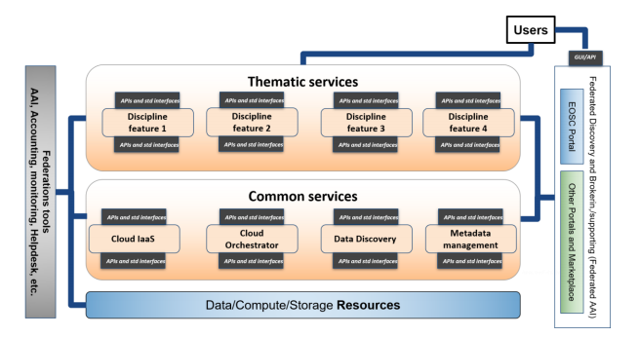
Early adopters of the EOSC-hub services

Slide 7
Enhance the Hub to better serve Thematic services
Research enabling services as source of requirements for EOSC-hub access enabling and common services
To drive the evolution of the other services
Thematic Services (WP7)
Technical Support
(WP10)
Service Developer
(WP5/WP6)
Use cases analysis
Tech requirements
Hub Services
New service releases
Service adoption

Slide 8
Thematic Services in EOSC-hub
T7.1
CLARIN
Humanities
Physical sciences
Earth sciences
Biological sciences
T7.9
LifeWatch
T7.2
DODAS
T7.8
DARIAH
Thematic services
T7.3
ECAS
T7.7
EO Pillar
T7.4
GEOSS
T7.6
WeNMR
T7.5
OpenCoastS
Notes:
WP8 Objectives:
Running proofs of concept to test the feasibility of use cases, based on specific scientific and technical requirements defined by high impact research communities.
Conducting pilots to define and test the architecture of solutions.
Preparing the production environments to make platforms available to users beyond the CC.
Defining business models to sustain the solutions within EOSC after the end of the project.

Slide 9
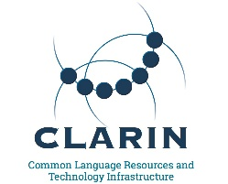
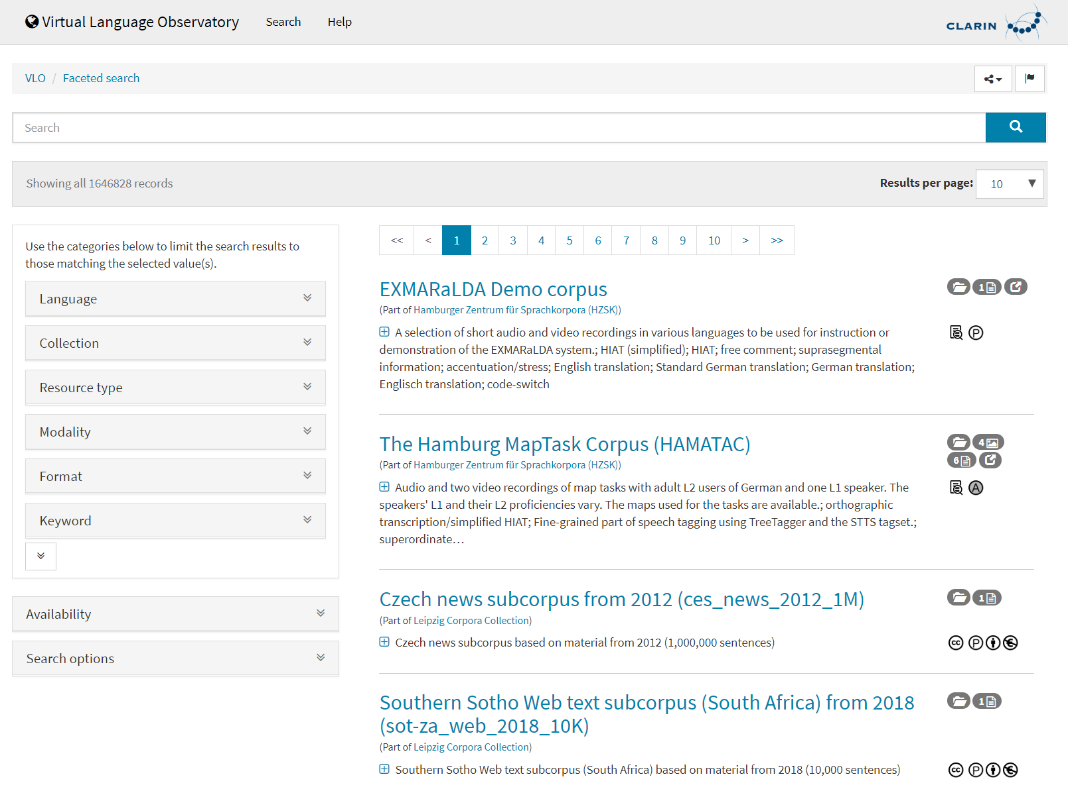
CLARIN - European Research Infrastructure for Language Resources and Technology
LRS - VA Metrics
Visits: 528/month
Harvested metadata records: 909’388
VCR - VA Metrics
# Collections: 7
VLO - VA Metrics
# Tools: 70
Virtual Language Observatory: uniform search and discovery functionality for language resources and tools
Virtual Collection Registry: a registry of collections pointing to digital objects, enabling easy citation
Language Resource Switchboard: find a matching tool for a given (language) dataset
New collaboration established with Europeana:
metadata (about 120k records) into the VLO.
«It is now possible to directly call a broad range
of processing applications via the Language Resource Switchboard. This
demonstrates literally how we are providing a Hub in EOSC(-Hub)»
Service | Integration with Hub
Virtual Language Observatory (VLO) | EGI Cloud Compute, B2FIND, B2SHARE
Virtual Collection Registry | B2FIND, B2SHARE
Language Resource Switchboard | B2DROP, B2SHARE

Slide 10
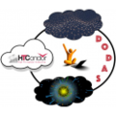
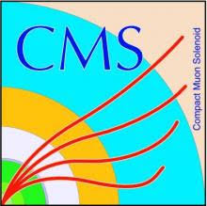
WLCG CMS Experiment - DODAS
Dynamic On Demand Analysis Service (DODAS) automates the process of provisioning, creating, managing and accessing a pool of heterogeneous computing and storage resources:
  HTCondor based batch system as a Service
  Big Data platform for Machine Learning as a Service
  a new CMS use case based on BigData processing is under integration
Use case:
Adopted by the Alpha Magnetic Spectrometer experiment
Under technical evaluation by 2 new scientific communities: Virgo and Fermi
DODAS Thematic Service is highly integrated with a wide range of EOSC-hub services and is provided through the EOSC Marketplace.
Born within CMS experiment computing environment, since 2018 is integrating within data analysis workflow of 4 communities within HEP, Astroparticle and Gravitational wave (AMS, Fermi and Virgo).
Service | Integration with Hub
DODAS | EGI DataHub CVFMS EGI Check-in INDIGO IAM XrootD data Cache EGIFedCloud Orchestrator Accounting Monitoring
DODAS - VA Metrics
Jobs: 1.1M (500K CMS + 600K AMS)
Clusters deployed: 1084

Slide 11


ENES European Network for Earth System Modelling - ECAS
ECAS Climate Analytics Service (ECAS) enables scientific end-users to perform data analysis experiments on large volumes of multidimensional data:
  PID-enabled, server-side, and parallel approach
  Focus on data intensive analysis, provenance management, and server-side approaches
  Ophidia Big Data Analytics framework
  Also integrated with Earth System Grid Federation (ESGF), JupyterHub and the ECAS-Lab web portal
4 main use cases:
Users with no directly available computing or data analysis resources
Users from climate data communities
Climate data cross-model/large-scale ensemble analysis
Prototyping applications with datacube concept
ECAS has successfully integrated a wide range of services across
workflow stages and multiple EOSC service provider areas to provide a
unique working environment. Preliminary uptake has shown that the ECAS
environment can facilitate better data and workflow sharing close to the
user needs.
Service | Integration with Hub
ECAS | EGI DataHub INDIGO IAM B2ACCESS EGI Check-in B2SHARE, B2DROP, B2HANDLE INDIGO Infrastructure Manager

Slide 12


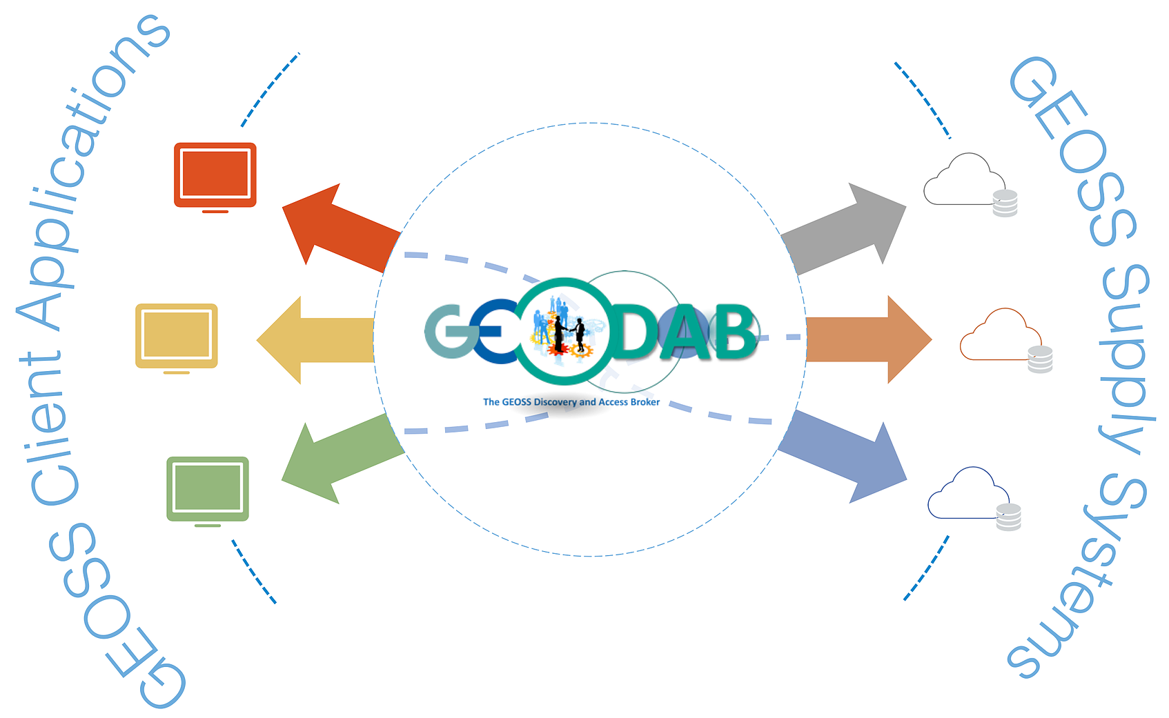
GEOSS - Global Earth Observation System of Systems
GEO Discovery and Access Broker (GEO DAB) transparently connects GEOSS User’s requests to the resources shared by the GEOSS Providers:
  brokering framework that interconnects hundreds of heterogeneous and autonomous supply systems (constituting the GEO metasystem)
  provides mediation, harmonization, transformation, and QoS capabilities
  simplify cross and multi-disciplinary discovery, access, and use (or reuse) of disparate data and information
Main use cases:
Discovery and Access of GEOSS datasets
Generation of new products utilising GEOSS datasets (discover) through the execution and orchestration of workflows
Demo of GEOSS was presented at the EOSC Launch in September 2018 and a new updated version will be presented at the next GEO Plenary, in the context of EuroGEOSS Sprint To Ministerial of the European Commission.
Service | Integration with Hub
GEO DAB | EGI Cloud Compute and Cloud Container AAI

Slide 13

OPENCoastS - Coastal circulation on-demand forecast
From national to European scope:
integration with European and global services for water levels and meteorological forcing (e.g. EMODNETPhysics, FES2014, MeteoFrance)
OPENCoastS service builds on-demand circulation forecast systems for user-selected sections of the North Atlantic coast:
  daily forecasts of water levels and 2D velocities over the spatial region of interest for periods of 48 hours
  forcing conditions at the boundaries and over the domain are defined by the user from global forecast databases
  automatic comparison with real-time in-situ sensor data can be provided for a number of user specified locations
OPENCoastS has grown from a national service to a worldwide platform with users on all 5 continents. Thanks to the service provided by EOSC-hub, we have over 50 international deployment and users in 23 countries. Three international training events has spread the word on this service and on the advantage of using e-infrastructures and their core services to support user oriented engineering platforms to address coastal research and management needs.
Main use cases:
Forecast systems to anticipate hazardous events and prepare emergency response
Support planning activities, from daily tasks to strategic interventions
Studies of coastal processes, of the climate change and anthropogenic impacts in the coastal zone
Facilitate the access to circulation forecasts
OPENCoasts - VA Metrics
International deployments: 50
Countries reached: 23 (Angola, Australia, Belgium, Brazil, Cape Verde, China, Colombia, Finland, France, Germany, India, Indonesia, Italy, Mozambique Netherlands, New Zealand, Portugal, Russia, Spain, Taiwan, Timor-Leste Ukraine, USA)
Service | Integration with Hub
OPENCoasts | EGI Cloud Compute, EGI HTC, EGI Workload Manager , EGI DataHub, EGI Check-in, B2STAGE, B2SAFE, Accounting, Orchestrator

Slide 14

WeNMR - A Worldwide e-infrastructure for NMR and structural biology
The WeNMR suite is composed of seven individual platforms:
AMPS-NMR: a web portal for Nuclear Magnetic Resonance (NMR) structures
CS-ROSETTA: to model the 3D structure of proteins
DISVIS: to visualise and quantify the accessible interaction space in macromolecular complexes
FANTEN: for multiple alignment of nucleic acid and protein sequences
HADDOCK: to model complexes of proteins and other biomolecules
POWERFIT: for rigid body fitting of atomic structures into cryo-EM density maps
SPOTON: to identify and classify interfacial residues as Hot-Spots (HS) in protein-protein complexes
Main use cases:
Disease-causing mutations
Engineer better molecules for material, health or food applications
Obtain a starting point for drug design to combat disease
HADDOCK is an EOSC-hub Thematic Service for structural biologists provided through the EOSC Marketplace.
In the past year: +30% users, +126% simulations submitted.
WeNMR suite - VA Metrics
New users: 3844
Number of user runs submitted: 24702
Job submitted: 10’343’738 | CPU time: 20’705’927 hours
Reached countries: 108
Service | Integration with Hub
WeNMR suite | EGI HTC, EGI Cloud Compute, EGI Workload Manager, EGI Check-in INDIGO udocker OneData

Slide 15
EO Pillar
EO Pillar - VA Metrics
EODC EO DATA available: > 3 PB
OSS-X Sentinel: Number of published products
CloudFerro: EO data available: > 9 PB
CloudFerro: Number of users: 200
CloudFerro: EOBrowser Collections: 9
The EO-Pillar service provides access to different services in the field of Earth Observation (EO).
Data Access and Computing services
Terradue, an EO private company, provides the engineering and operational support for the Geohazards Exploitation Platform (GEP), which offers a rich set of ready to use EO data processing services for the analysis and monitoring of earthquake, volcanoes and landslides.
GEP is integrated with the EGI Federated Cloud and is now part of the Hub offering.
In numbers: 1.4 Million Cloud Compute hours and +108% increase of use of Terradue services.
EO Data Exploitation services
EO general user services
EODC Data Catalogue Service
EODC JupyterHub for global Copernicus data
OSX-Sentinel
CloudFerro Data Collections Catalog
CloudFerro Infrastructure
CloudFerro EO Finder
CloudFerro EO Browser
Geohazards Exploitation Platform (GEP)
MEA Platform
Rasdaman EO Datacube
Sentinel Hub
EPOSAR Service
Service | Integration with Hub
All services except MEA Platform and EPOSAR | EGI Check-in EGI Cloud Compute EGI DataHub B2SHARE Monitoring Accounting
MEA and EPOSAR

Slide 16

DARIAH - Digital RI for the Arts and Humanities
Main use cases:
Publication of collections of research data from the Arts & Humanities with integrated meta-data handling and search
Service | Integration with Hub
DARIAH Science Gateway | EGI Cloud Compute EOSC-hub AAI Accounting Monitoring
Invenio repo | INDIGO IAM INDIGO Orchestrator EGI Cloud Compute
DARIAH repo | EOSC Federation Services
DARIAH Science Gateway: provides a set of generic and customized services and tools
  Semantic Search Engine (SSE): allows users to search in Open Access Document Repositories and Data Repositories and to discover new correlations about document and data
  Parallel Semantic Search Engine (PSSE): enabling users to semantically correlate contents in geographically distributed digital repositories
  Simple Cloud Access: workflow creation and execution
  DBO@Cloud: Cloud repository of Bavarian dialects
Invenio-based repository in the cloud:
  enables users to easily create, deploy and configure their own Invenio-based repository instance in the cloud
DARIAH repository: storing and searching objects in research projects
DARIAH Repository becomes target data repository for an increasing number of projects and initiatives (Discuss Data (DE), Text+ (DE), SSHOC, and more under discussion)
DARIAH - VA Metrics
Number of supported applications: 5
Country reached: 10

Slide 17




LIFEWATCH
Remote Monitoring and smart sensing
  Web services for the entire process required to work with Sentinel data products
  Interface to search, find and download Copernicus Sentinel satellite products easily
Plant Classification
  Large-scale plant classification algorithm based on the ResNet convolutional neural network architecture
  Open API that allows users to create their own versions of the service
Glacier Lagoons of Sierra Nevada
  Citizen Science portal for research
  Photographs of lagoons, historical and current, that helps to understand how these sentinels of global change respond to growing pressure and environmental degradation
GBIF Spain
  Data access under biogeographic context with advanced facets
  Support natural history collections, institutions, and relevant biodiversity projects in order to gain their participation
Main use cases:
Geospatial integration
Land Analysis
Great opportunity of knowing other institutions and their respective activities.
Some service providers have been in contact to be integrated into the EOSC-hub Marketplace in order to gain visibility and get other extra benefits from being at this European platform.
This is the case for example of ‘Glacier Lagoons of Sierra Nevada’, from the University of Granada, Spain.
Main use case:
Automatic classification of plant images
Main use case:
Image Viewing
Main use case:
Data access
Service | Integration with Hub
Remote Monitoring and smart sensing | Ongoing
Plant Classification | Integrated
Glacier Lagoons of Sierra Nevada | Ongoing
GBIF Spain | Ongoing

Slide 18
Thematic Services – Service adoption
Integration status for the Hub different services

Slide 19
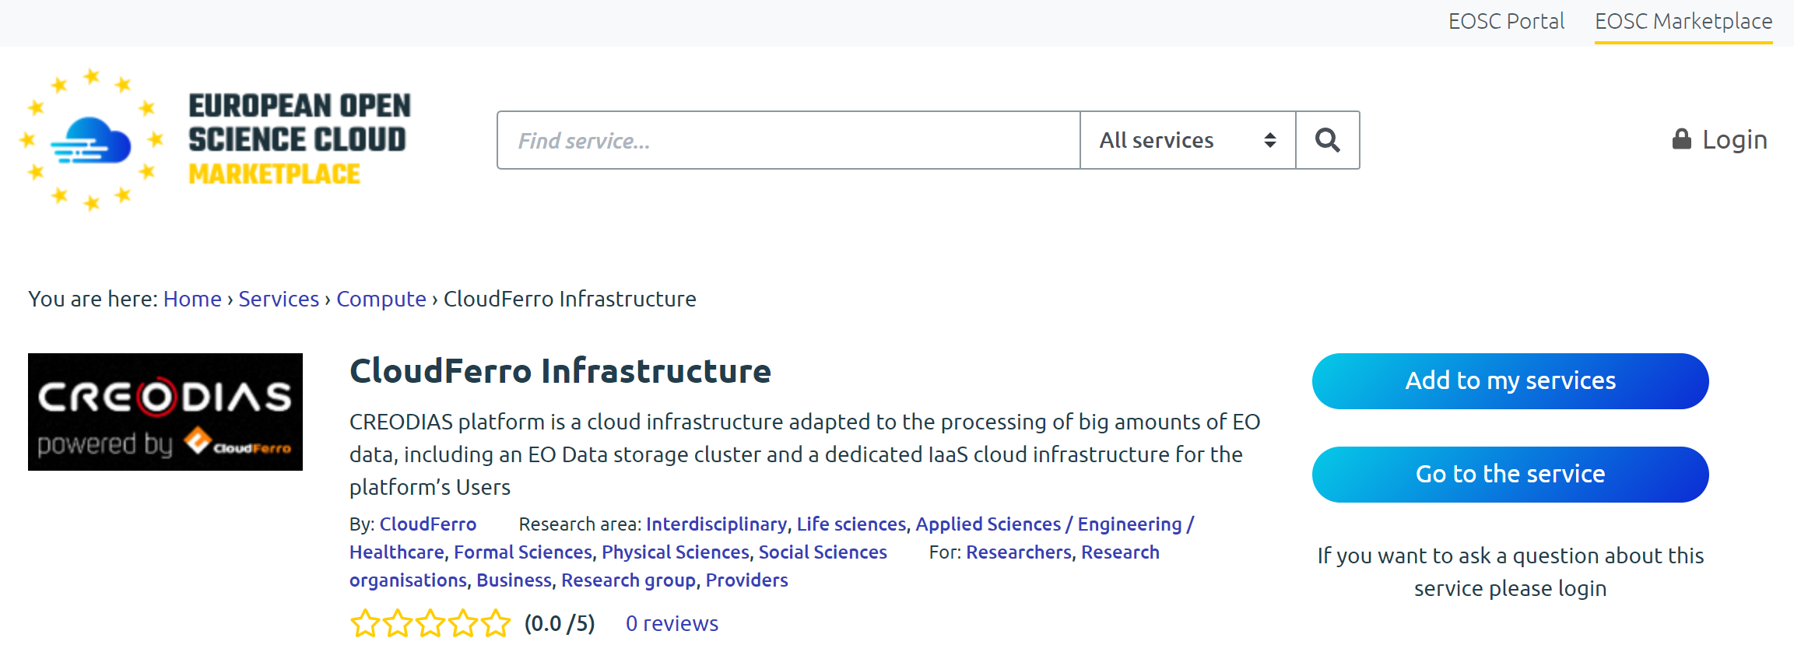
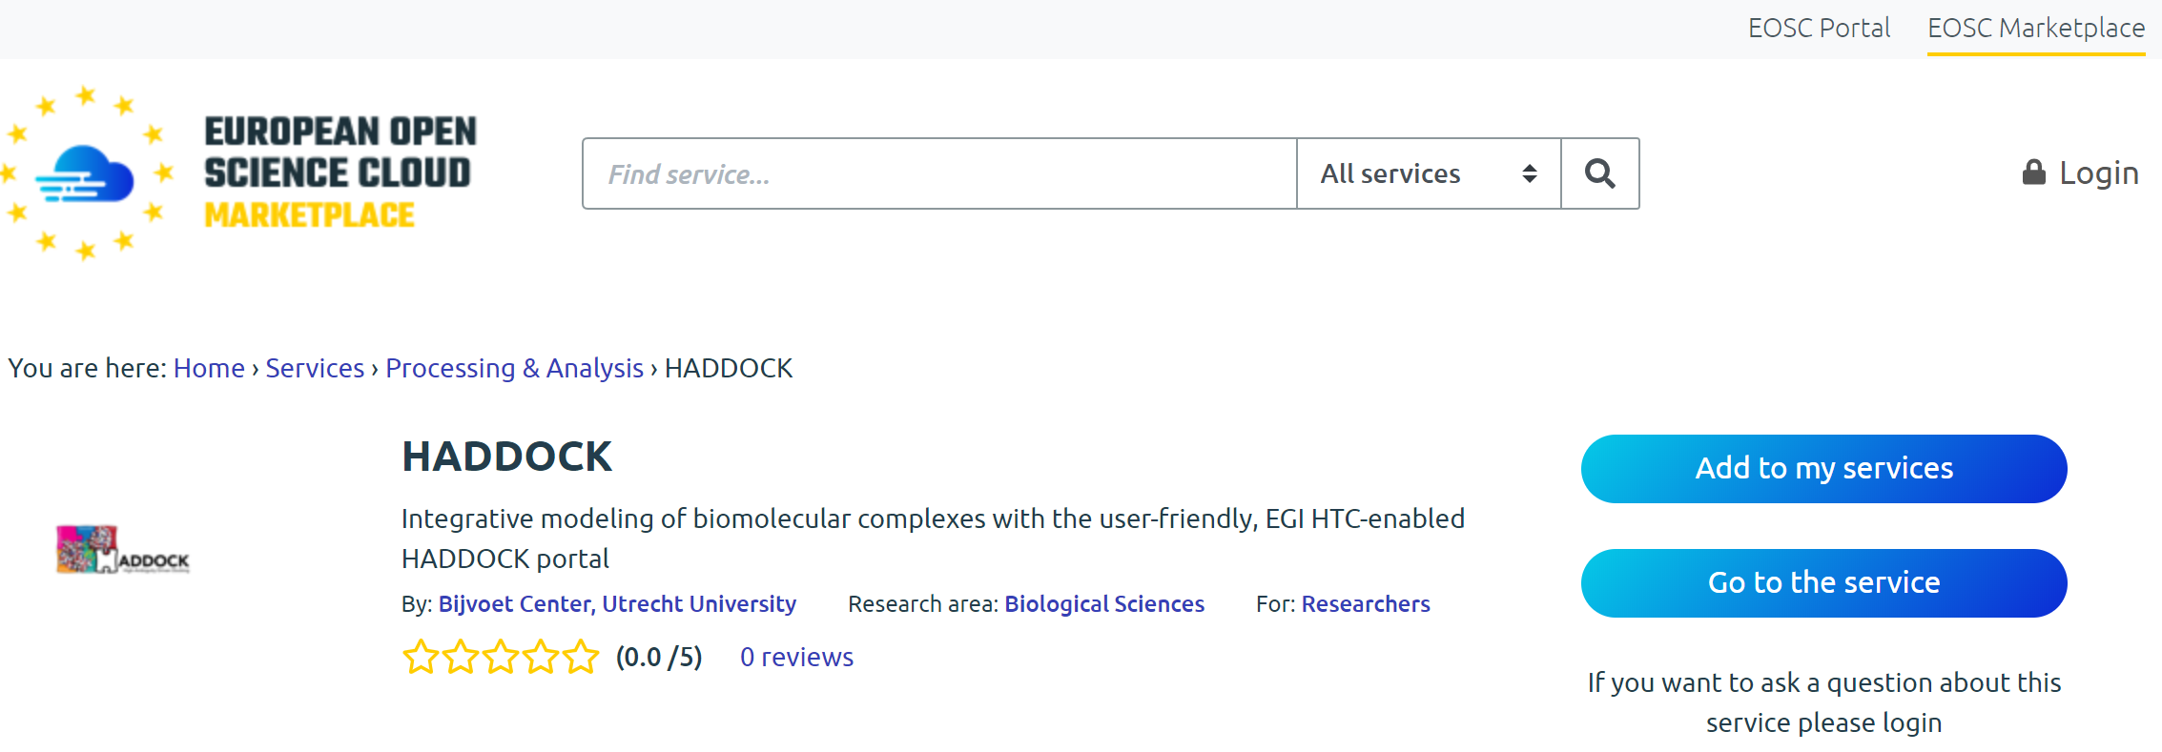
Thematic services in the EOSC Marketplace
All Tasks have already published at least on Thematic services in the EOSC Marketplace and are accessible via the EOSC Portal
  Requests to access are accounted via the SOCRM process

Slide 20
WP7: M1-M18 Efforts Planned & Used
WP | Task No. | Task Name (*end month extended in AN3) | P1 M1 - M18
 |  |  | Planned PM | Used PM | Used%
WP07 | T07.01 | CLARIN (M01-M30) | 19,5 | 29.6 | 152%
 | T07.02 | On Demand Analysis Service - CMS (M01-M30) | 17.4 | 23.3 | 134%
 | T07.03 | ENES Climate Analytics Service (M01-M22)* | 29.5 | 29.1 | 99%
 | T07.04 | GEOSS (M01 - M36) | 14.7 | 19.3 | 132%
 | T07.05 | OpencoastS LNEC (M01-M23)* | 23.5 | 29.9 | 127%
 | T07.06 | WeNMR (M01-M18) | 22 | 23 | 105%
 | T07.07 | EO Pillar (M01-M15) | 48 | 53.2 | 111%
 |  | Unfunded efforts | 2 | 1.9 | 97%
 | T07.08 | DARIAH (M01-M30)* | 7 | 9.2 | 131%
 | T07.09 | LifeWatch (M16-M24)* | 6.3 | 5.3 | 84%
WP07 Total |  |  | 189,8 | 223.9 | 118%

Slide 21
Deviations
No major deviations from plans
Some tasks have or are requesting extension to complete or add integration activities
Lifewatch activities, for which we reported some issues in the past, are now proceeding

Slide 22
Main results
Thematic services are being offered via the Hub
  From various scientific disciplines and large research infrastructures
TSs are early adopter of the Hub services
  Service integration/composition is ongoing
  Sources of requirements to improve the Hub service offer
Thematic services accessible via the EOSC Portal and the EOSC Marketplace

Slide 23
Future plans
Increase the integration of the TSs with the Hub
  More Hub services adopted
Advertise the TSs offer in the Hub to widen their usage
  Marketplace, training events, participation to conference, etc.

