Slide 1
WP9 - EOSC Digital Innovation Hub (EOSC DIH)
Bringing Industry into the European Open Science Cloud
Sy Holsinger (EGI Foundation), WP9 Manager
Luxembourg, 8-9 October 2019
Dissemination level: Public

Slide 2
Content Outline
Background to Digital Innovation Hubs (DIH)
EOSC DIH Intro and WP9 Structure
WP9 Activities and Results
Strategy, Communication and Dissemination
Business Pilots
Commercialization support
Use of Resources
Deviations and Lessons Learned
Future Plans and Conclusions
09/10/2019
WP9 EOSC DIH - 1st EOSC-hub Review, Luxembourg 8-9 Oct 2019
2

Slide 3
EC Digital Innovation Hub Initiative
Background and landscape
09/10/2019
WP9 EOSC DIH - 1st EOSC-hub Review, Luxembourg 8-9 Oct 2019
3

Slide 4
Digital Innovation Hub
EC definition
What is a Digital Innovation Hub?
An ecosystem of start-ups, SMEs, large industries, researchers, accelerators and investors that fosters the creation of partnerships to stimulate innovation.
09/10/2019
WP9 EOSC DIH - 1st EOSC-hub Review, Luxembourg 8-9 Oct 2019
4

Slide 5
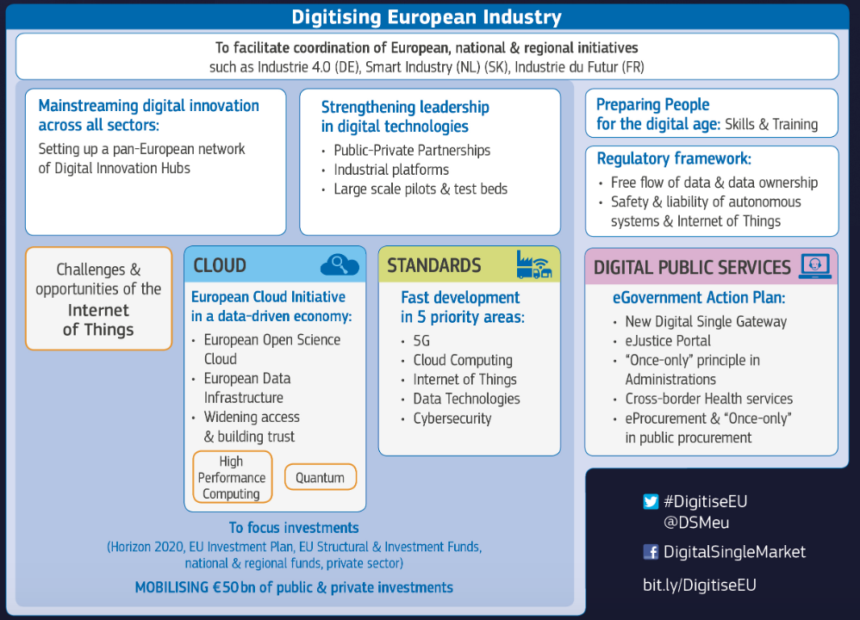
Created the EOSC DIH
EOSC identified as a key component
09/10/2019
WP9 EOSC DIH - 1st EOSC-hub Review, Luxembourg 8-9 Oct 2019
5

Slide 6
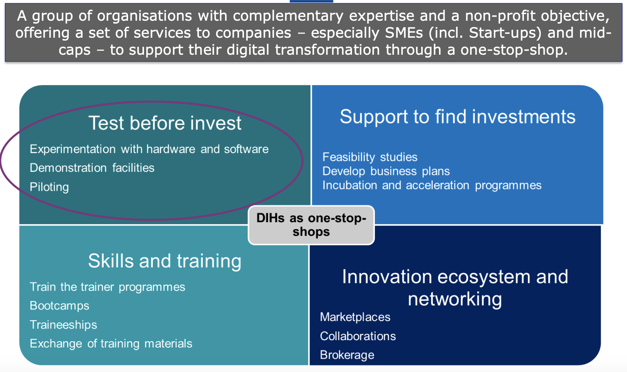
DIH Service Needs
*Andrea Halmos, European Commission, DG CONNECT, Unit A2, Technologies & Systems for Digitising Industry
09/10/2019
WP9 EOSC DIH - 1st EOSC-hub Review, Luxembourg 8-9 Oct 2019
6

Slide 7
European Landscape of DIHs
Agile, and demand-driven, Digital Innovation Hubs in Europe are sustainable innovation ecosystems, not just a gateway to services.
22 innovation hubs all over the European continent, soon expanding worldwide
Digital Innovation Hubs in H2020: The EC is focusing EUR 300M in H2020 (2018-2020) – short time from idea to hands-on experimentation and development.
€110m of funding has been invested in I4MS since 2013; - 11 large projects funded by FP7 and H2020, 70 competence centres;
09/10/2019
WP9 EOSC DIH - 1st EOSC-hub Review, Luxembourg 8-9 Oct 2019
7

Slide 8
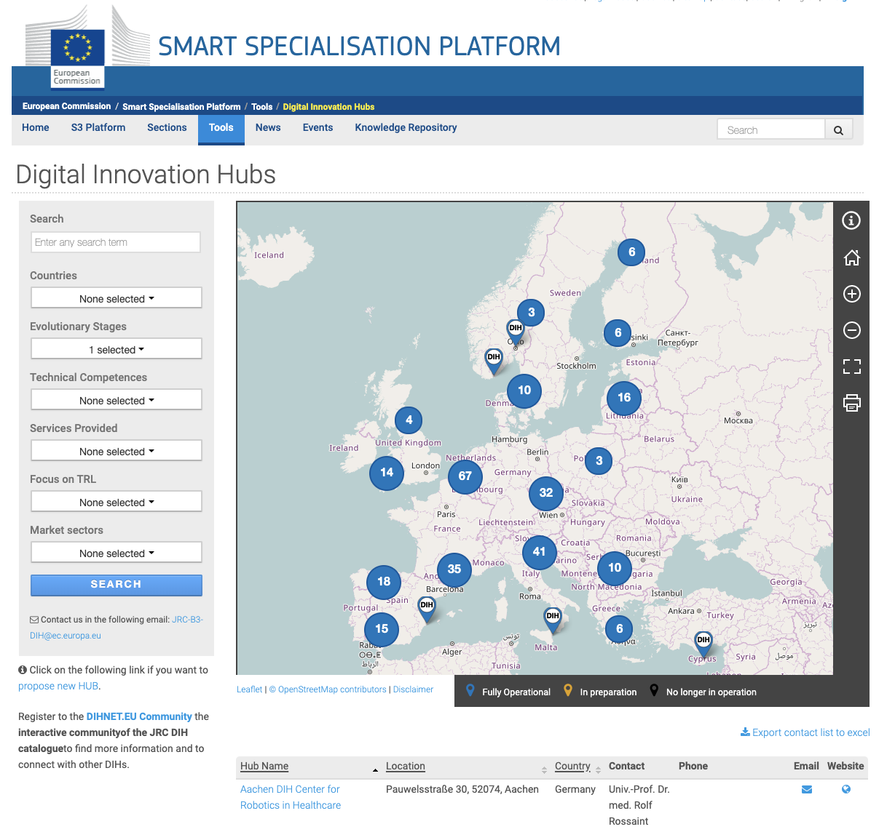
Digital Innovation Hubs Catalogue
First version available:
Fact-sheets with profile, contact data, service examples for regional, national, and EU- supported DIHs
Map-based search tool by technical competences, market sector, services
http://s3platform.jrc.ec.europa.eu/digital-innovation-hubs-tool
09/10/2019
WP9 EOSC DIH - 1st EOSC-hub Review, Luxembourg 8-9 Oct 2019
8

Slide 9
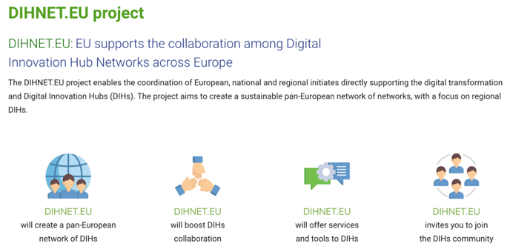
EC DIH Support
Derive recommendations to the High-Level Governance; Build DIH Community
3 Working Groups
DIHnet Project
WG on Digital Innovation Hubs
2. Joint WG of DEI and Multi Stakeholder Platform (MSP) on standardization activities of Digital Industrial Platforms
3. WG on Future Partnerships
09/10/2019
WP9 EOSC DIH - 1st EOSC-hub Review, Luxembourg 8-9 Oct 2019
9

Slide 10
Role of Industry in the EOSC
Customer
Making use of existing EOSC services
Provider
Offering services to EOSC
Partner
Co-development
Procurement
Participate in the procurement framework (see WP12)
09/10/2019
WP9 EOSC DIH - 1st EOSC-hub Review, Luxembourg 8-9 Oct 2019
10

Slide 11
EOSC Digital Innovation Hub
WP9 structure
09/10/2019
WP9 EOSC DIH - 1st EOSC-hub Review, Luxembourg 8-9 Oct 2019
11

Slide 12
Key Exploitable Results WP9
Researchers and
research communities:
Empower my research
Educate, inform and support my team and community
Services in the EOSC Service Portfolio
EOSC Portal
and
Marketplace
EOSC Hub Operators: Develop the EOSC landscape
Service Providers:
Provide services for
Researchers
Rules of Participation
Training courses and materials
Service Management System
Internal services in the Hub portfolio
Interoperability & Integration Guidelines
Business and sustainability models for services and the Hub
Digital Innovation Hub:
platform for industrial collaborations with EOSC
Enterprise: Develop, expose and grow my services
09/10/2019
WP9 EOSC DIH - 1st EOSC-hub Review, Luxembourg 8-9 Oct 2019
12

Slide 13
Builds on the EC initiative to onboard industrial partnerships within the EOSC
Joint effort from years of individual e-Infrastructure industry engagement programs
Focused on (not limited to) start-ups and SMEs
Starts with 6 business pilots selected during project preparation; open for many more
To persist beyond the life of any support project (e.g. EOSC-hub project – www.eosc-hub.eu)
Driven by
09/10/2019
WP9 EOSC DIH - 1st EOSC-hub Review, Luxembourg 8-9 Oct 2019
13

Slide 14
EOSC DIH: Objectives
Offer access to e-Infrastructure resources to support pilots, prototyping, scaling-up, design, performance verification, testing, demonstration, etc.
Facilitate partnerships with SMEs/industry, innovation clusters, accelerators and investors that stimulate innovation
Increase visibility on a European/International level
Provide business coaching and training to “accelerate” market uptake and exploitation results
Support access to funding/grants
Develop long-term business relationships
09/10/2019
WP9 EOSC DIH - 1st EOSC-hub Review, Luxembourg 8-9 Oct 2019
14

Slide 15
EOSC DIH: Services
Piloting and co-design
Technical access
Pilots/proofs of concepts
Service/Product design
PaaS/SaaS Integration
Performance verification
Testing
Compute (HTC, HPC, Cloud)
Storage (Online/Archive)
Data management
Research data
Tools & applications
Training & Support
Visibility
Technical consultancy
Service management
Commercialization and business coaching
Brokerage to funding and opportunities
Media Exposure
Participation to events
Promotional print material
Inclusion in marketplace
Networking
09/10/2019
WP9 EOSC DIH - 1st EOSC-hub Review, Luxembourg 8-9 Oct 2019
15

Slide 16
EOSC DIH: WP9 Task, Activities and KPIs
T9.1 | Joint DIH ecosystem (Lead: EGI Foundation) | Establish and evolve the DIH Communicate and disseminate the DIH Collaborate with other DIHs Manage the DIH platform/tool
T9.2 | Business Pilots (Lead: PSNC) | Coordinate pilots (6 initially selected in open call) Ensure access to services and tech support Assess and validate results Identify additional pilots
T9.3 | Commercialization Support (Lead: F6S) | Identify business opportunities from the pilots Support technology transfer process models Mentor pilots and competence centres Define pre-commercial agreements
KPI# | Name | Area | BT | ST
KPI03 | Services/technologies increased in TRL via the DIH | T | 7 | 10
KPI04 | Published business pilot success stories | SE | 5 | 8
KPI05 | Signed (pre-)commercial agreements for EOSC-hub services from DIH | SE | 3 | 6
09/10/2019
WP9 EOSC DIH - 1st EOSC-hub Review, Luxembourg 8-9 Oct 2019
16

Slide 17
EOSC DIH: WP9 Timelines
PM1
PM6
PM12
M18
PM24
PM30
PM36
T9.1
Joint DIH
T9.2
Business Pilots
T9.3
Commercialization Support
PM3
PM21
PM6
PM24
PM36
D9.1
1st Business Pilot Work plans
D9.3
Business Pilot Results
D9.2
Joint DIH Strategy
M9.1
Publication of Business Pilot Success Stories
D9.4
Joint DIH Final Results
Delivered
09/10/2019
WP9 EOSC DIH - 1st EOSC-hub Review, Luxembourg 8-9 Oct 2019
17

Slide 18
WP9 Activities and Results
Strategy, Communication and Dissemination
09/10/2019
WP9 EOSC DIH - 1st EOSC-hub Review, Luxembourg 8-9 Oct 2019
18

Slide 19
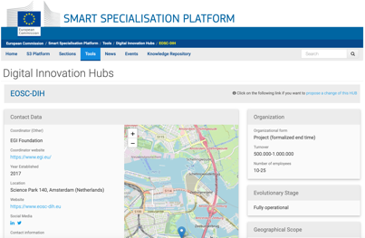
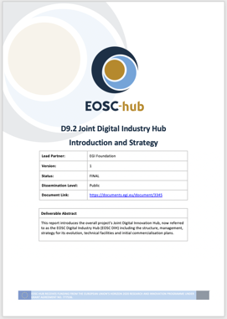
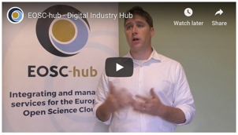
Strategy and Promotion
Strategy
“EOSC DIH”, as the mechanism for industry to engage the EOSC; live beyond the life of the project
D9.2 "Joint Digital Innovation Hub Intro and Strategy" (M6 – Jun)
Official DIH registered in EC Catalogue
Promotional Material
Dedicated DIH logos and URL
EOSC-hub website: Dedicated DIH page content
Video interviews: DIH intro + ICT 2018 promo video
EOSC-hub Magazine: DIH article (issue 1)
Usable slide decks, brochure, poster, banner
Twitter account = 90+ tweets; 300+ followers
09/10/2019
WP9 EOSC DIH - 1st EOSC-hub Review, Luxembourg 8-9 Oct 2019
19

Slide 20
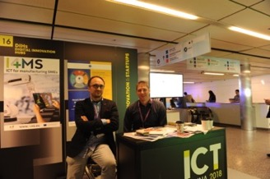
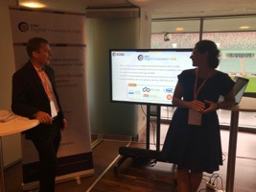
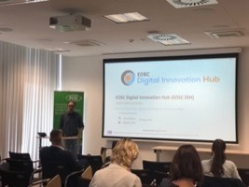
Events Organized and Attended
Organized
DI4R 2018 (Lisbon – Oct’18): “DIHs for Industry Engagement” Session
ICT 2018 (Vienna – Dec’18): Networking session; Joint DIH Booth participation
CompBioMed Webinar (May ‘19): “Open data services for biomedicine business”
EOSC-hub Week (Prague – Apr’19): “SME/industry engagement within EOSC”
7th IT Future Expo (Warsaw – Sept’19): Exhibition Booth (3000+ attendees)
Presented
ICTFOOTPRINT.eu Workshop “Green ICT” (Amsterdam – Mar’18)
ELIXIR Innovation and SME Forum (Frankfurt – Oct’18)
EC DIH Working Group Meetings (Brussels - Apr,’19)
SmartAgriHubs North East Europe Workshop (Poznan – May’19)
BDVA PPP Summit (Riga – Jun ’19)
EC JRC / Net Service F2F (Bologna – Jul’19)
Attended
EC DIH Working Group Meetings (Feb, May, Jul ‘18; Brussels - Apr, Jul’19)
BDVA Group Meetings (Brussels - Mar, Apr, Jun, Sep’18) + Meetup (Sofia – May ‘18)
EC DIH Annual Event (Warsaw – Nov’18)
Several local industry events in Poland (May, Jun’19)
20
09/10/2019
WP9 EOSC DIH - 1st EOSC-hub Review, Luxembourg 8-9 Oct 2019

Slide 21
Industry Collaborations
Various Stages of Development
Finalizing Pilot
Under Discussion
Projects
Networks & DIHs
Partners & Providers
Other
09/10/2019
WP9 EOSC DIH - 1st EOSC-hub Review, Luxembourg 8-9 Oct 2019
21

Slide 22
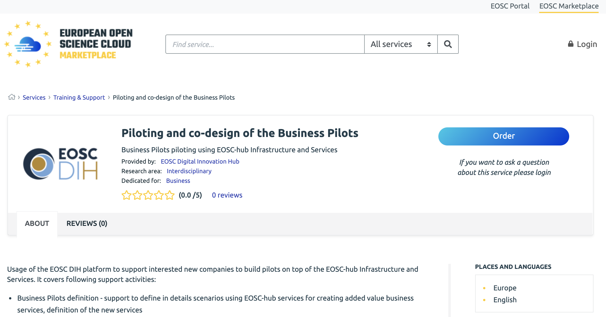
Vouchers, Marketplace, Platform
Vouchers
*additional options based on use case
EOSC Marketplace
Collaboration Platform
*prototype based on
09/10/2019
WP9 EOSC DIH - 1st EOSC-hub Review, Luxembourg 8-9 Oct 2019
22

Slide 23
WP9 Activities and Results
Initial 6 pre-selected business pilots + additional ones onboarded
09/10/2019
WP9 EOSC DIH - 1st EOSC-hub Review, Luxembourg 8-9 Oct 2019
23

Slide 24
Our Initial 6 Business Pilots
ACTION Seaport
Space Weather Data for the DRACO Observatory
CyberHAB
Bot Mitigation Engine
Sport Smart Video Analysis
Furniture Enterprise Analytics Datafurn
24
09/10/2019
WP9 EOSC DIH - 1st EOSC-hub Review, Luxembourg 8-9 Oct 2019
24

Slide 25
Our Initial 6 Business Pilots
Improving safety and operational performance of seaports
A Cloud Framework for State-of-the-art Space Weather
Using data cloud services to manage harmful algae blooms
ACTION Seaport
Space Weather Data for the DRACO Observatory
CyberHAB
Solutions to secure online services from Botnets Attacks
Analyzing Sport Performance through a Cloud-hosted platform
Platform-as-a-Service Data Analytics for the Furniture Industry
Bot Mitigation Engine
Sport Smart Video Analysis
Furniture Enterprise Analytics Datafurn
09/10/2019
WP9 EOSC DIH - 1st EOSC-hub Review, Luxembourg 8-9 Oct 2019
25

Slide 26
Our Initial 6 Business Pilots
Acquired
TRL 7->8
TRL 4->7
TRL 5->7
ACTION Seaport
Space Weather Data for the DRACO Observatory
CyberHAB
TRL 2->7
TRL 4->7
TRL 5->8
SME->Large Enterprise
Bot Mitigation Engine
Sport Smart Video Analysis
Furniture Enterprise Analytics Datafurn
09/10/2019
WP9 EOSC DIH - 1st EOSC-hub Review, Luxembourg 8-9 Oct 2019
26

Slide 27
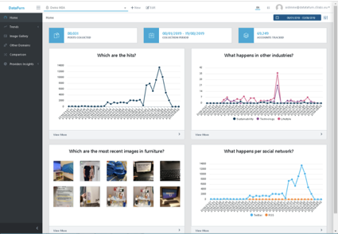
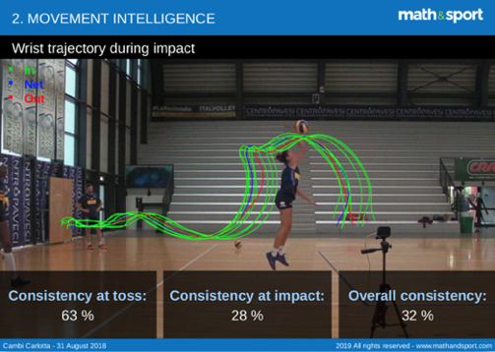
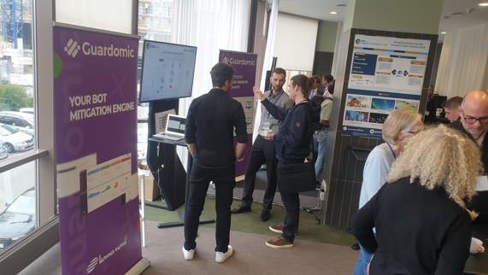
Business Pilots Support
Deliverables / Milestones
D9.1 and D9.3 provided on time
Success stories publication (anticipated from PM24)
Pilots implementation
Each pilot followed detailed implementation plan (D9.1):
Plans, design, architecture, early demonstrators, release for early adopters, final pilot release, dissemination and exploitation
Direct support
Status meetings: 3-weekly meetings
Technical one-to-one meetings with pilots
Arranged meetings with experts for given tech
Analysis of business pilots from different perspectives
Communication between pilots and WP1, WP3, WP10
Important Events
DI4R 2018 (Lisbon – Oct’18): Preparations and presentation of 2 demos
EOSC Week in Prague: Preparation and presentation of 4 remaining ones (best demo prize for one of the pilot among 14 competitors)
09/10/2019
WP9 EOSC DIH - 1st EOSC-hub Review, Luxembourg 8-9 Oct 2019
27

Slide 28
Business Pilots: Services/Resources Used
# | Pilot | Type of infrastructure | EOSC sites | EOSC services used | TRL increased
1 | CyberHAB | Cloud infrastructure (OpenStack) VM has: 20CPUs, 256GB of memory, 50GB of disk and a 500GB volume, 50GB in OneData | IFCA (ES) | Jupyter Notebook, Cloud Compute; Onedata (EGI DataHub); INDIGO IAM | 5 -> 7
2 | Sports Smart Video Analysis | Cloud infrastructure (OpenStack) VM: 4 cores 16GB RAM (frontend) + instance g3.large 12 vCPU, 22GB RAM, 1x 1080Ti (computing) + 100GB storage | IFCA (ES) | Cloud Compute | 4 -> 7
3 | ACTION Seaport | OpenStack 20 CPU, 40 GB ram, 1080 GB data | PSNC (PL) | Cloud Compute | 7 -> 8
4 | Guardomic | OpenStack 18 CPU, 34 GB RAM, 1670 GB data | PSNC (PL) | Cloud Compute | 2 -> 7
5 | DRACO Observatory | Virtual machine with 2 virtual CPUs and 16GB of RAM. Root storage of 8GB | CESGA (ES) | Cloud Compute | 4 -> 6
6 | Furniture Enterprise Analytics | Cloud Compute (80 vCPUs and 160 GBs RAM) | INFN-Bari (IT) | Cloud Compute | 5 -> 8
09/10/2019
WP9 EOSC DIH - 1st EOSC-hub Review, Luxembourg 8-9 Oct 2019
28

Slide 29
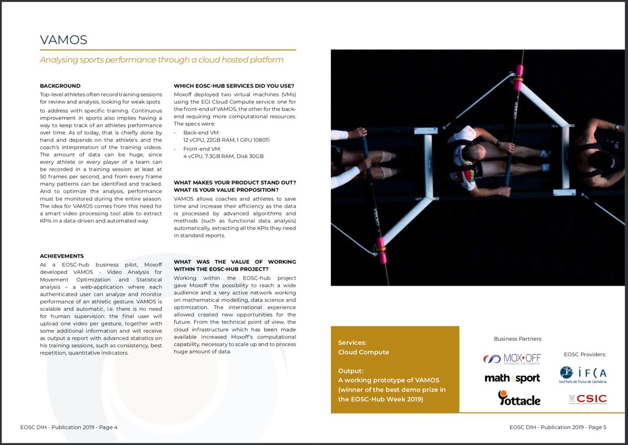
EOSC DIH: Success Stories Publication
09/10/2019
WP9 EOSC DIH - 1st EOSC-hub Review, Luxembourg 8-9 Oct 2019
29

Slide 30
2 New Business Pilots Onboarded
“Coming soon”
Artificial Intelligence for rare disease diagnosis
Blockchain for university certificates
Video coding and compression
09/10/2019
WP9 EOSC DIH - 1st EOSC-hub Review, Luxembourg 8-9 Oct 2019
30

Slide 31
Commercialization Support
Webinars and pilot consultancy
09/10/2019
WP9 EOSC DIH - 1st EOSC-hub Review, Luxembourg 8-9 Oct 2019
31

Slide 32
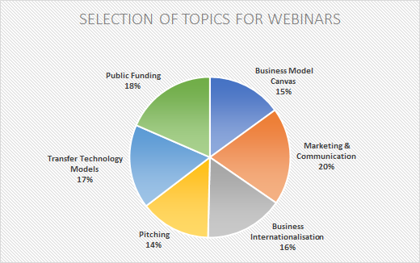
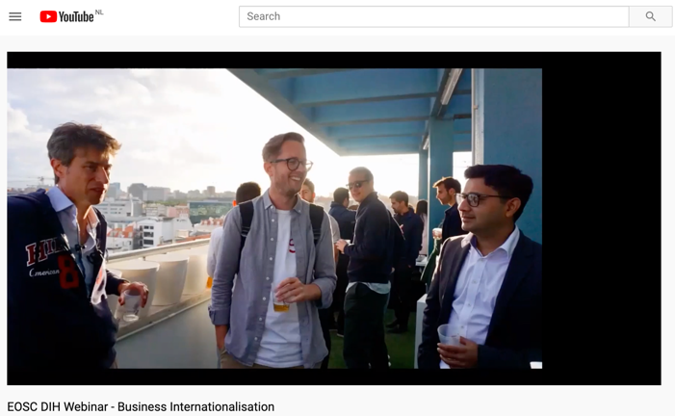
Commercialization Support
Planning
Contributions to D9.1, D3.1 and D9.3
Webinars/Events
DI4R 2018 (Lisbon – Oct’18): Presented Commercialization support service offer
Survey ran to find the topics of most interest
“How to Pitch” webinar via ESIL project (Nov’18)
“Business internationalization” Webinar ran (Jun’19)
Direct support
Business Pilots: Attendance of regular meetings
WP7: task leader meeting attendance
Analysis of business pilot final report to start defining pre-commercial agreements (3 of 6).
Most activities will take place in 2nd half of project (by design)
09/10/2019
WP9 EOSC DIH - 1st EOSC-hub Review, Luxembourg 8-9 Oct 2019
32

Slide 33
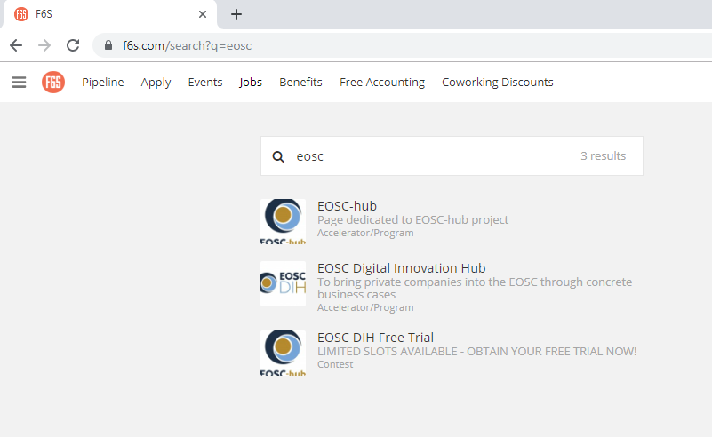
Commercialization Support
Connecting to related European DIH’s
Trinity DIH: foster EU competitiveness through digitization https://projects.tuni.fi/trinity/
Diatomic Project: a network of digital innovation hubs in Advanced Robotics https://diatomic.eu/
F6S Platform
Set up pages for EOSC DIH for the startup community
Main page: https://www.f6s.com/eosc-hub
EOSC DIH: https://www.f6s.com/eoscdigitalinnovationhub
EOSC Free trial: https://www.f6s.com/eoscdihfreetrial.
Most activities will take place in 2nd half of project (by design)
09/10/2019
WP9 EOSC DIH - 1st EOSC-hub Review, Luxembourg 8-9 Oct 2019
33

Slide 34
Use of Resources
Project effort and technical support
09/10/2019
WP9 EOSC DIH - 1st EOSC-hub Review, Luxembourg 8-9 Oct 2019
34

Slide 35
WP9: PM Plan and Consumption
WP | Task No. | Task Name | P1 M1 - M18
 |  |  | Planned PM | Used PM | Used%
WP09 | T09.01 | Joint DIH Ecosystem | 17.5 | 15.8 | 90%
 | T09.02 | Business Pilots | 152.4 | 133.3 | 87%
 |  | Unfunded effort | 6.3 | 7.4 | 118%
 | T09.03 | Commercialization Support | 13.8 | 5.3 | 39%
WP09 Total |  |  | 190 | 161.8 | 85%
Overall effort consumed in line with project activities and plans (no major impact)
T9.3 to ramp in second half of project by design
09/10/2019
WP9 EOSC DIH - 1st EOSC-hub Review, Luxembourg 8-9 Oct 2019

Slide 36
WP9: Budget for Technical Resources
€100,000 allocated to WP9 for supporting pilots with additional resources as needed and to support the onboarding of new pilots
No cascade funding mechanism available
PMs available only to project consortium members
Total budget for Infrastructure | €100,000
Budget Allocated | €30,050
Budget Remaining | €69,950
Avg. cost per use case to date | €5,510
Est. Use Cases Remaining | 12
09/10/2019
WP9 EOSC DIH - 1st EOSC-hub Review, Luxembourg 8-9 Oct 2019

Slide 37
Deviations / Lessons Learned
WP Admin
Change of business pilot partner: Action Modulers -> Bentley
Was managed, but took quite a bit of time/effort
Some staffing issues within project partners
UCL: plans to ramp effort within 2nd half of project
CINECA: EGI supported one pilot not foreseen; discussing shift of leadership of onboarding new pilots to PSNC
Only for personnel effort, technical resources to support pilots is still foreseen
Allocated budget of €100k during project
Positive, but the need had to be defined then managed
Business Pilots
Communication between pilots and project members
Terminology around project related aspects was new and not always understood
Many things needed to be repeated several times or clarified
Need to streamline and improve onboarding process
Some availability/reliability issues with resources, but has pushed to improve the way services are delivered
09/10/2019
WP9 EOSC DIH - 1st EOSC-hub Review, Luxembourg 8-9 Oct 2019
37

Slide 38
Future plans
Joint DIH Ecosystem
Continue the momentum generated in first half of project; DIHs are now becoming known
Extend the EOSC DIH service offer and refine promotional material
Need to add EOSC DIH information to the EOSC Portal
Disseminate and communicate through event organisation and participation as well as social media
Finalize collaborations and reach out to new contacts including other DIHs around Europe; Many requests coming in
Further develop online platform to coalesce a community of industry participants, experts, innovators, and funding bodies
Investigate sustainability models post-project (i.e. multi-partner legal entities or collaborations)
Business Pilots
Provide support to ensure intended results are achieved and potential long-term agreements analyzed
Onboard new pilots, which is not only a project KPI, but an important activity for the long-term viability of the EOSC DIH
Expand the industry voucher programme to continuously entice new industry customers
Commercialisation Support
Support the business pilots and establish pre-commercial agreements
Ramp up webinars and one-to-one consultancy sessions with pilots, competence centers and thematic service providers
Connect with accelerators and funders
09/10/2019
WP9 EOSC DIH - 1st EOSC-hub Review, Luxembourg 8-9 Oct 2019
38

Slide 39
Summary
EOSC DIH in Numbers
8
Business Pilots
169
VMs Instantiated
6
Success Stories
18
Industry Events
4
Services in EOSC MP
€500k
Direct SME Support
319
Twitter Followers
442k
CPU
Hours
09/10/2019
WP9 EOSC DIH - 1st EOSC-hub Review, Luxembourg 8-9 Oct 2019
39

Slide 40
EOSC DIH Partners
EOSC DIH Team
Sy Holsinger (EGI)
Elisa Cauhe (EGI)
Marcin Plociennik (PSNC)
Agnieszka Rabenda-Tomczak (PSNC)
Konrad Leszczynski (PSNC)
Claudio Arlandini (CINECA)
Giuseppe Fiameni (CINECA)
Nuno Varandas (F6S)
Hugo Cantão (F6S)
Catherine O'Donoghue (F6S)
David Wright (UCL)

