Slide 1
Competence Centres (WP8)
Gergely Sipos (EGI Foundation), WP8 Leader
Luxembourg, 8-9 October 2019

Slide 2
Outline
Role of Competence Centres (CCs) in EOSC-hub
The CC approach
Work done so far in each CC
Status & use of resources
Future plans
Summary - key results

Slide 3
Competence Centres in EOSC-hub
Federation and common services
Thematic services (9)
WP5
WP6
WP5
WP7
Federation Services
AAI, Accounting, Monitoring, Operations, Security
Added value services
Compute, data, software management, curation & preservation
Open Collaboration Services
Application/software repository, Configuration management, Marketplace
integration
WP6
Basic infrastructure
Compute and storage
integration
Co-develop
WP10
Competence Centres (8)
WP11
Outreach and training
WP8

Slide 4
WP8 objectives
Running proofs of concept to test the feasibility of use cases, based on specific scientific and technical requirements defined by high impact research communities.
Conducting pilots to define and test the architecture of solutions.
Preparing the production environments to make platforms available to users beyond the CC.
Defining business models to sustain the solutions within EOSC after the end of the project.

Slide 5
Competence Centres
Number of Tasks: 8
Number of Participants: 36
Efforts planned RP1: 232PMs
ESFRI landmark
T8.1 ELIXIR
T8.8 Disaster mitigation
T8.2 Fusion
ESFRI landmark
Competence Centres
T8.7 Carbon cycle
T8.3 Marine
ESFRI landmark
ESFRI project
T8.6 Radio astronomy
T8.4 Ionosphere studies
T8.5 EPOS-ORFEUS
ESFRI landmark
ESFRI landmark
ESFRI landmark
Notes:
WP8 Objectives:
Running proofs of concept to test the feasibility of use cases, based on specific scientific and technical requirements defined by high impact research communities.
Conducting pilots to define and test the architecture of solutions.
Preparing the production environments to make platforms available to users beyond the CC.
Defining business models to sustain the solutions within EOSC after the end of the project.

Slide 6
Key Exploitable Results WP8
Researchers and
research communities:
Empower my research
Educate, inform and support my team and community
Services in the EOSC Service Portfolio
EOSC Portal
and
Marketplace
EOSC Hub Operators: Develop the EOSC landscape
Service Providers:
Provide services for
Researchers
Rules of Participation
Training courses and materials
Service Management System
Internal services in the Hub portfolio
Interoperability & Integration Guidelines
Business and sustainability models for services and the Hub
Digital Innovation Hub:
platform for industrial collaborations with EOSC
Enterprise: Develop, expose and grow my services

Slide 7
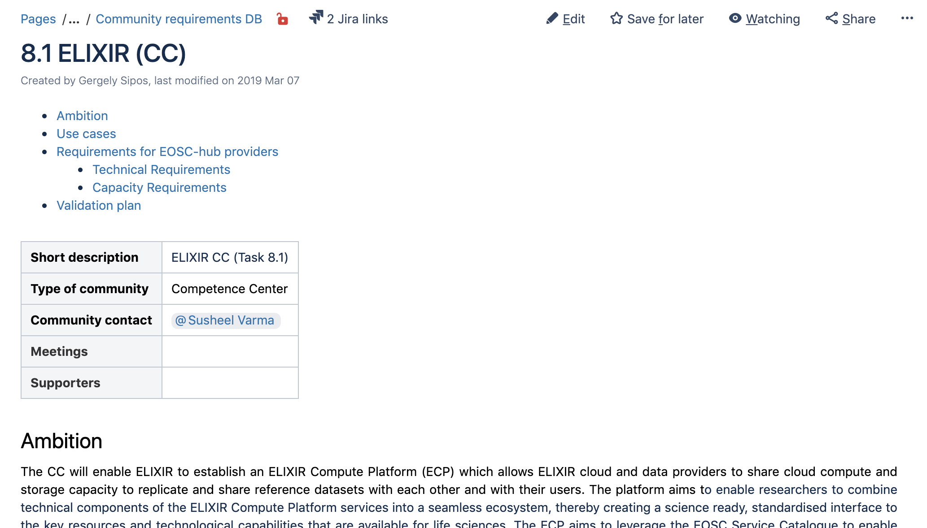
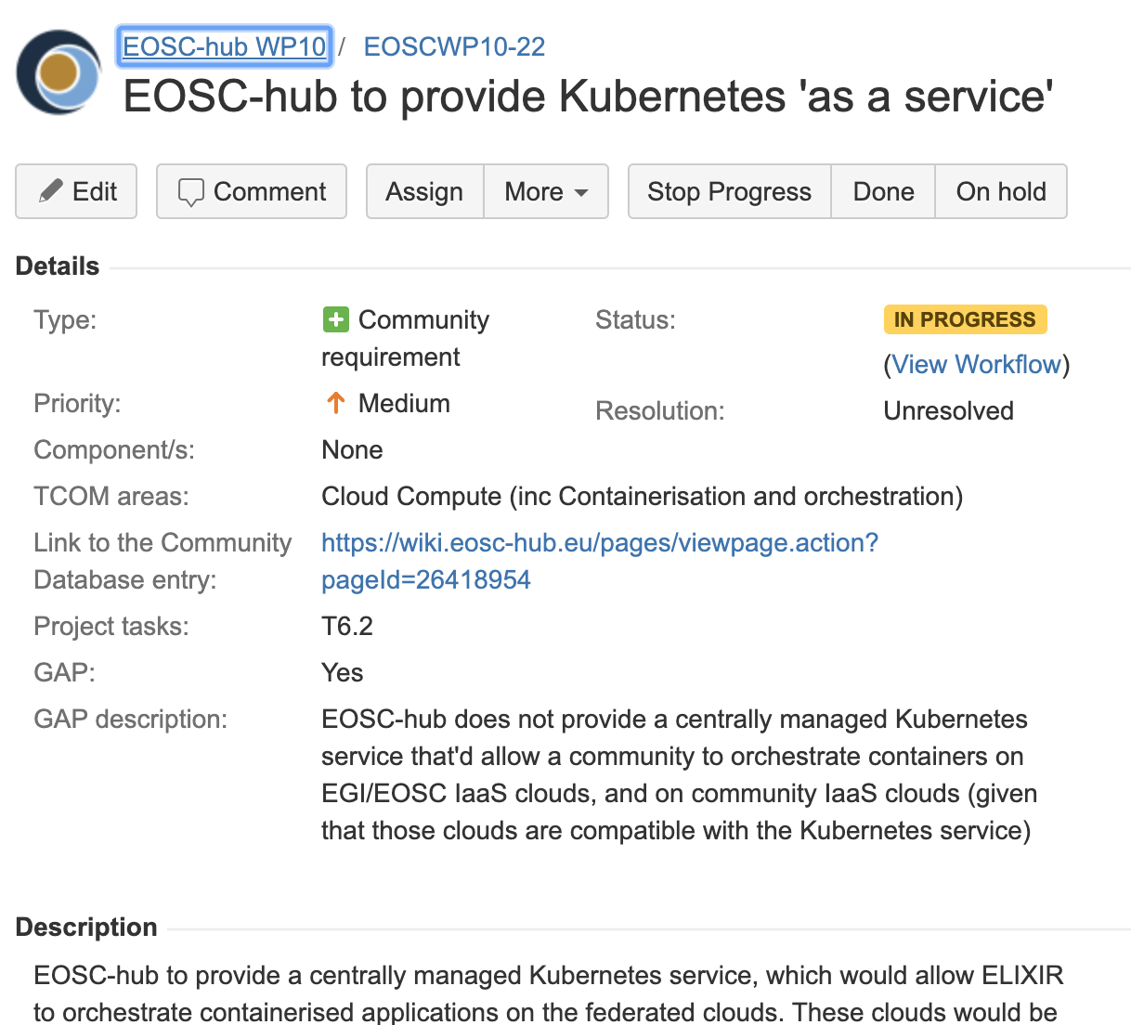
The ‘CC approach’
Community requirements Database & Jira
Who
Research community experts
Service providers (common services)
Technology providers
What
System planning & design → Teleconferences; 3 f2f meetings
Requirement collection → M8.1 in March 2019 (M12)
Setup proof-of-concepts → D8.1 in June 2019 (M18)
Dissemination and training → PY3
Service co-creation & bringing new services into the EOSC catalogue
EISCAT_3D (Portal); Marine (Argo); Disaster Mitigation (iCOMCOT)

Slide 8
T8.1 ELIXIR
Objectives
Establish a federation of cloud providers and replicate ELIXIR Core Datasets
Setup applications on the cloud federation
Enable federated AAI across these resources and EOSC
Progress
Reference Data Set Distribution Service (RDSDS) was setup with 1000Genomes and MMG datasets (Metabolights, Pride, ArrayExpress and ENA will be next)
ELIXIR AAI was made compatible with EOSC AAI; De.NBI and EMBL-EBI Clouds connected
Contribution from life sciences to D2.8 (First Data Policies Recommendations)
3 institutional clouds joint the EOSC Portal (CESNET, CSC, EMBL-EBI)
Open questions
File Transfer Service: Own instance or shared instance?
Business model for capacity allocation (EOSC-Life interaction)

Slide 9
T8.2 Fusion
Objectives
Port fusion workflows to federated compute environment
Federate and enable access to distributed datasets
Application and data provenance
Progress
Storage:
EGI DataHub: setup and tests run successfully at CEA and PSNC
B2SAFE: tested on a virtualised infrastructure; feature requests sent back to development team
Compute
DODAS assessed: Does not fit to the envisaged use case (yet?)
PROMINENCE on an EGI cloud resource pool, with SLA in place
Porting 3 workflows to containers (IMAS, MAST, JINTRAC)
Next step, open questions
Long-term, but opportunistic access to cloud resources
Running licensed software in data centres
Notes:
IMAS: ITER Modelling and Analysis System
MAST: Tokamak converting raw data to physical parameters
JINTRAC: coupled simulations of different plasma scenarios within a tokamak

Slide 10
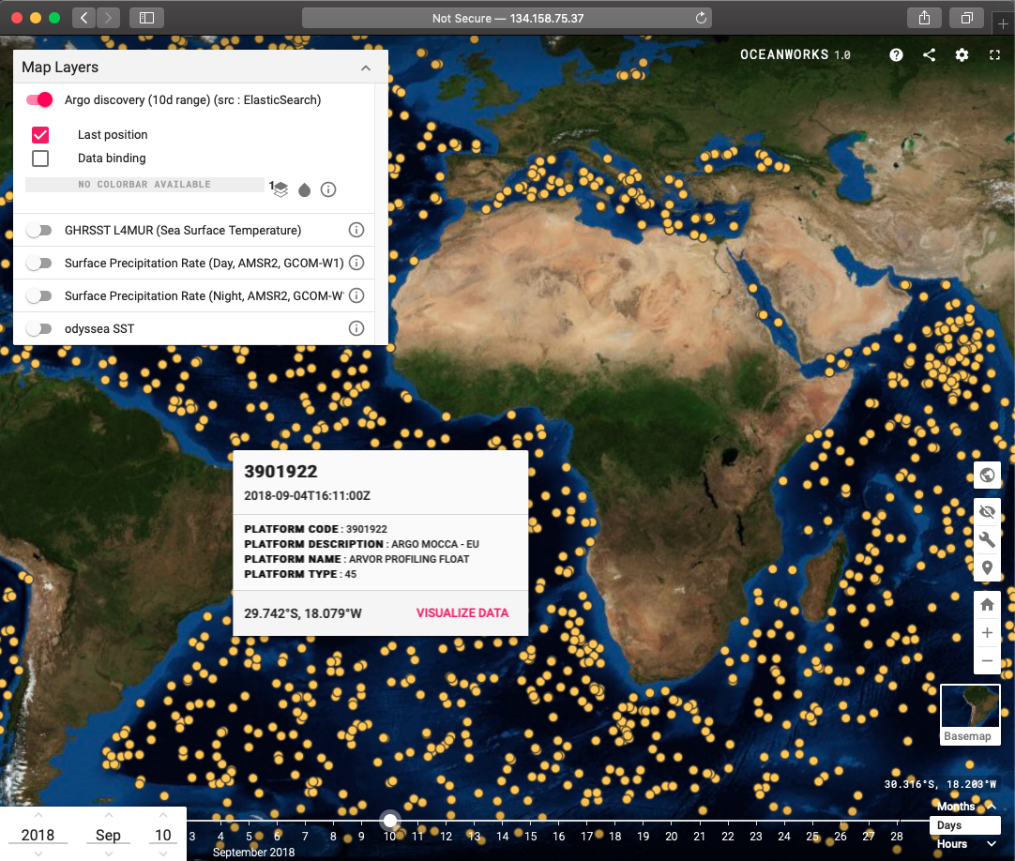
T8.3 Marine
Objectives
Data collection and delivery platform (Argo Discovery)
Federate and make accessible distributed data (SeaDataNet)
Progress
Argo
Discovery platform was developed with open big data tools (Hadoop-Spark-Cassandra-Elasticsearch)
Moving the setup to CSC and registering as TLR-7 in EOSC
SeaDataNet
OneData deployed at CINECA, CYFRONET, IN2P3, INFN-CNAF
Challenges and open questions
Data delivery platform is delayed due to staff turnover
SeaDataNet work was defined in PY2
Bridging with ‘Blue Cloud services’ and other relevant initiatives
Argo discovery service

Slide 11
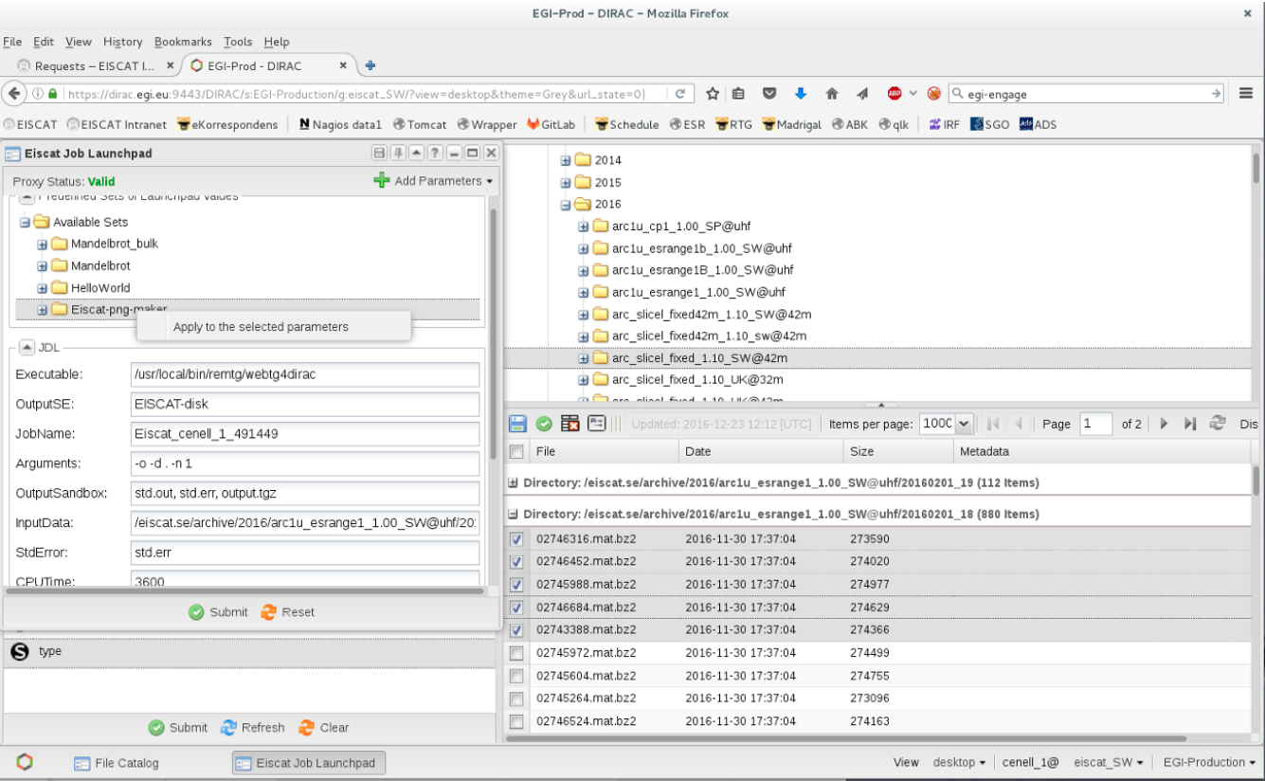
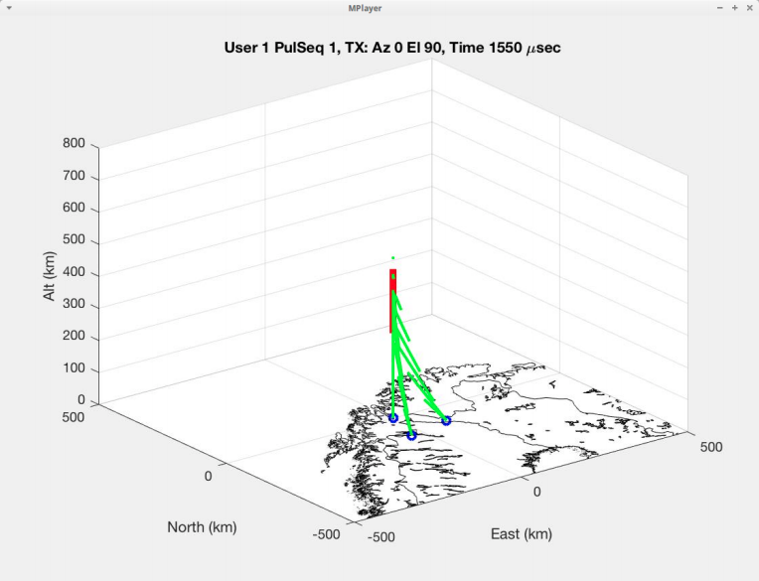
T8.4 EISCAT_3D
Objectives
Make EISCAT data accessible via a ‘data webshop’
Enable online data analytics for researchers
Progress
Portal from EGI-Engage was connected to EOSC AAI
Arranged cloud capacity for the project at CSC
Defined metadata structure; Initial implementation in the Portal
Connected EGI File Transfer Service into Portal
Open questions
Hierarchical metadata in DIRAC and B2Find:
Will EGI-EUDAT AAI work together?
Cloud procurement for beyond the project
EISCAT Portal
Manage compute jobs
Filter by meta-data
Browse data

Slide 12
T8.5 EPOS-ORFEUS
Objectives
Enable federated access to seismic data at ORFEUS centres, and replication of data across centres
Enable researchers to search for, access and analyse data for custom products
Progress
AAI integrated with 4 web services
Successful preliminary tests for data staging and replication with ‘RuleManager’
Jupyter Notebooks at GRNET and SURFSara are under testing
Next step
Putting the three areas together (AAI, data management, computing)

Slide 13
T8.6 Radio astronomy
Objectives
Enable researchers to find, access and process data from the LOFAR Telescope
Support application developers in deploying workflows for researchers
Support research users in data analytics on federation of compute clusters
Progress
AAI: Technologies identified suitable (Check-in with COmanage)
Data: Integration of dCache with B2SHARE and B2HANDLE PIDs started
Computing: Functional tests completed, scalability tests to follow
Challenge
Delay due to late allocation of people
Notes:
CWL: Common Workflow Language

Slide 14
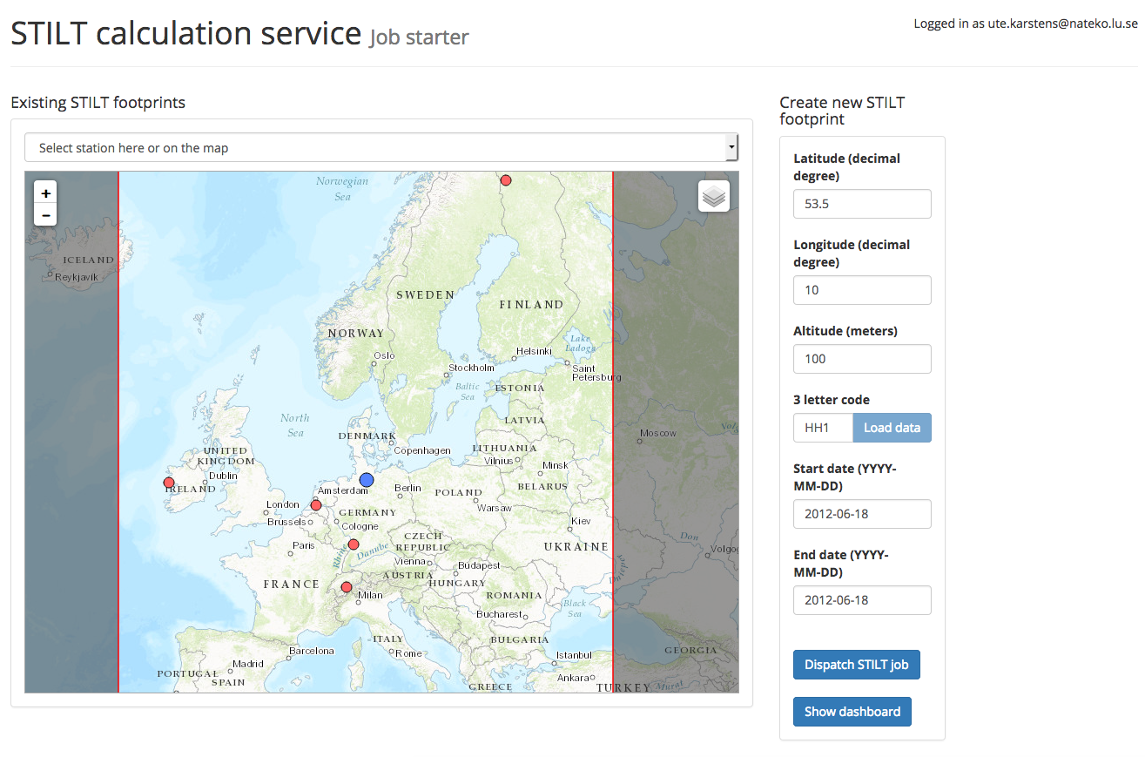
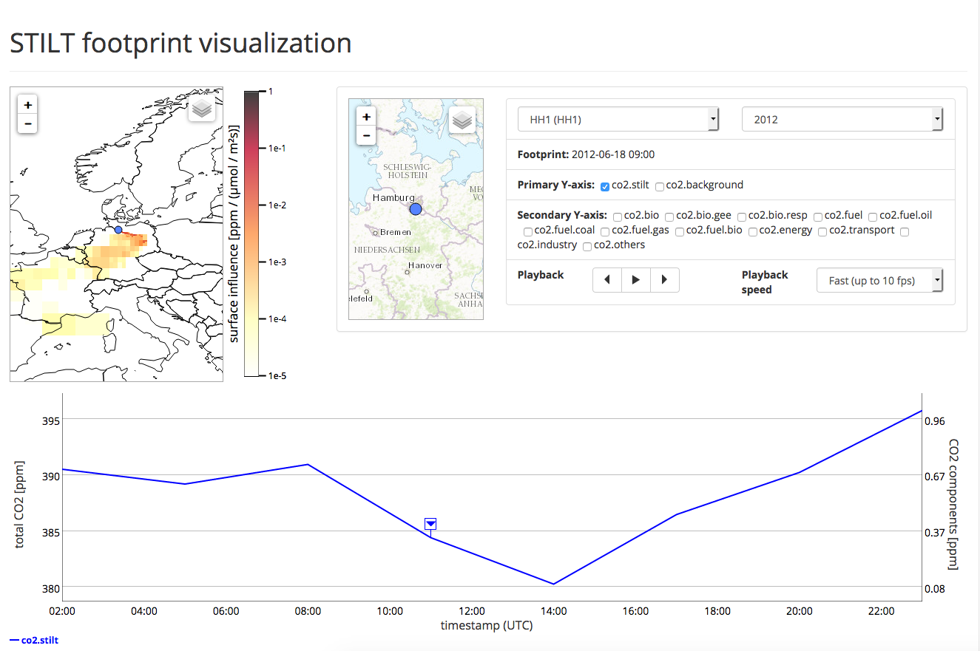
T8.7 ICOS - eLTER
Objectives
ICOS: Integrate ICOS Portal and its analysis tools with large-scale storage and compute resources
eLTER: Develop and share data analysis workflows through user friendly interfaces and scalable infrastructures
Progress
ICOS:
Data archival and processing pipeline is in place at CSC (Data product generation from 100 carbon stations in near real-time)
ICOS ERIC run a tender for long-term provisioning (EUDAT Ltd)
eLTER:
Testing of EGI Notebooks and IaaS Cloud resources are ongoing
Negotiations for long-term operation started with FZJ
Challenge
Delayed delivery: Request to extend the task until M36

Slide 15
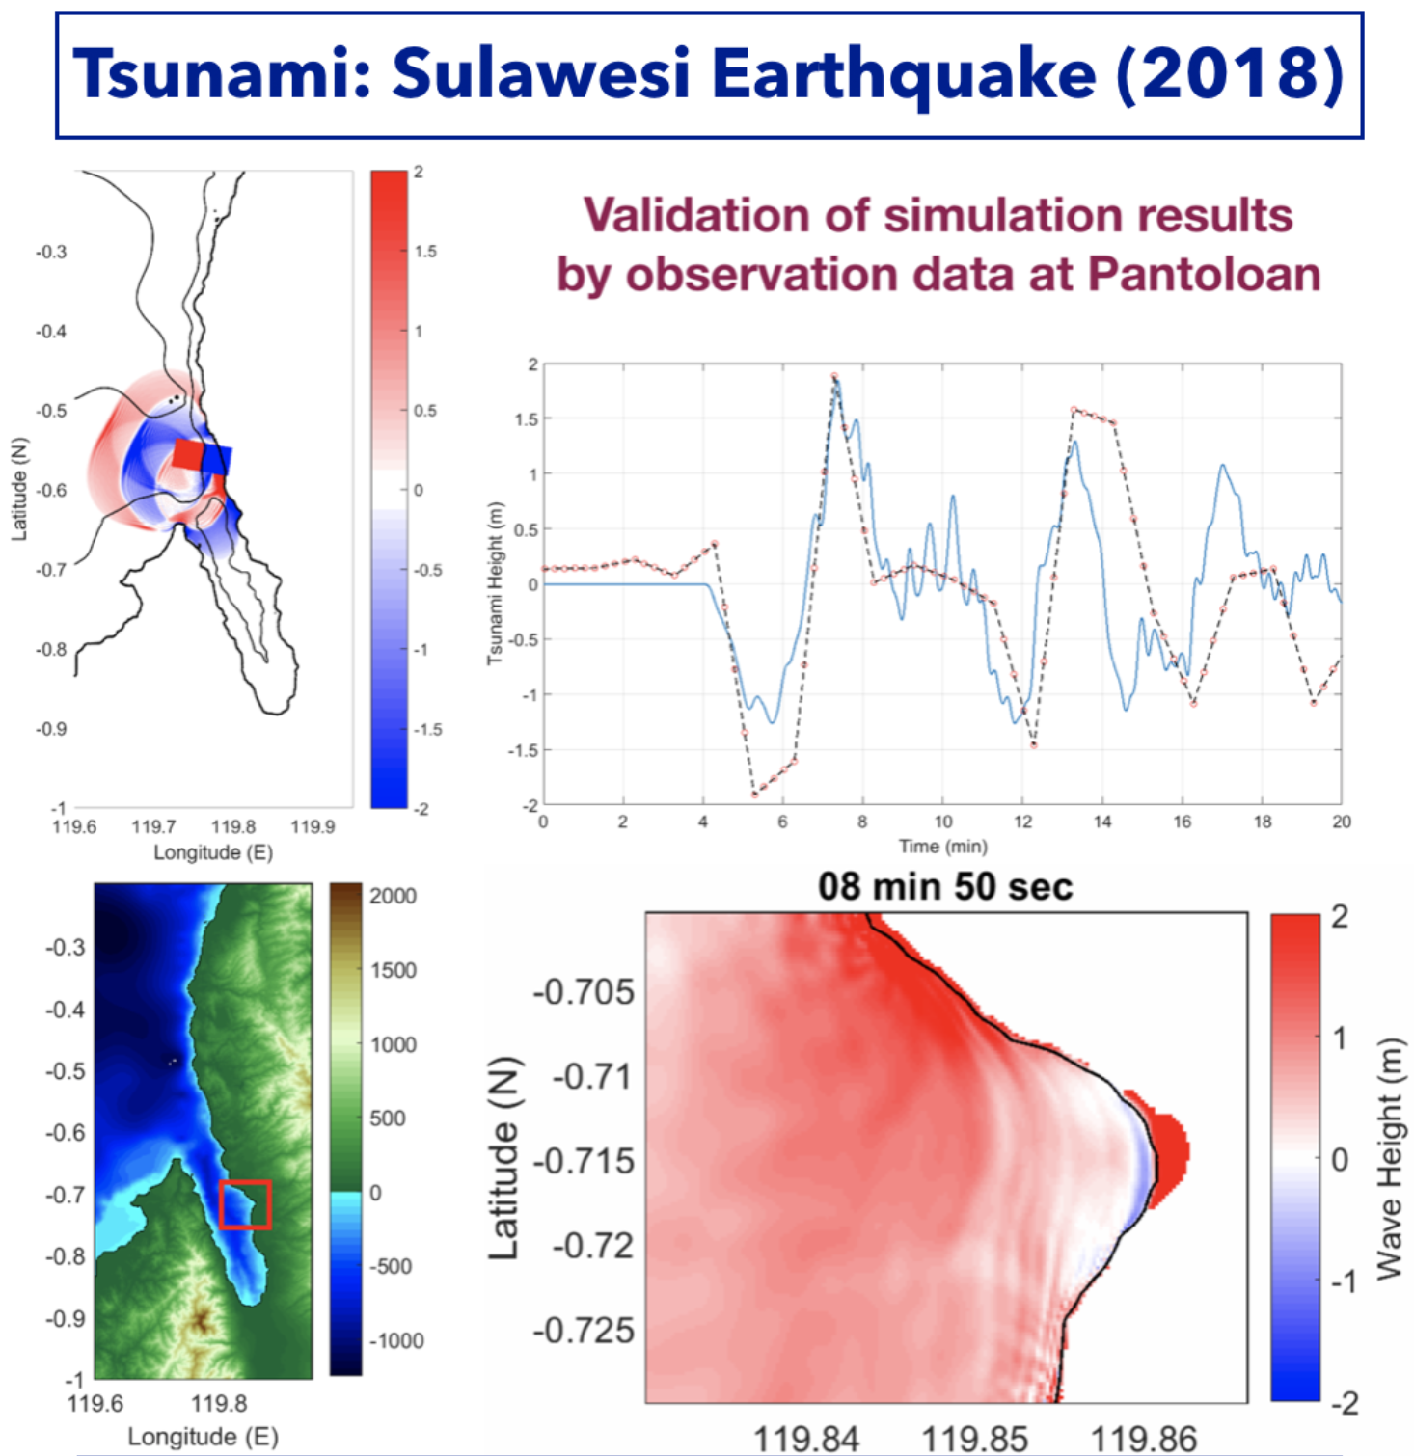
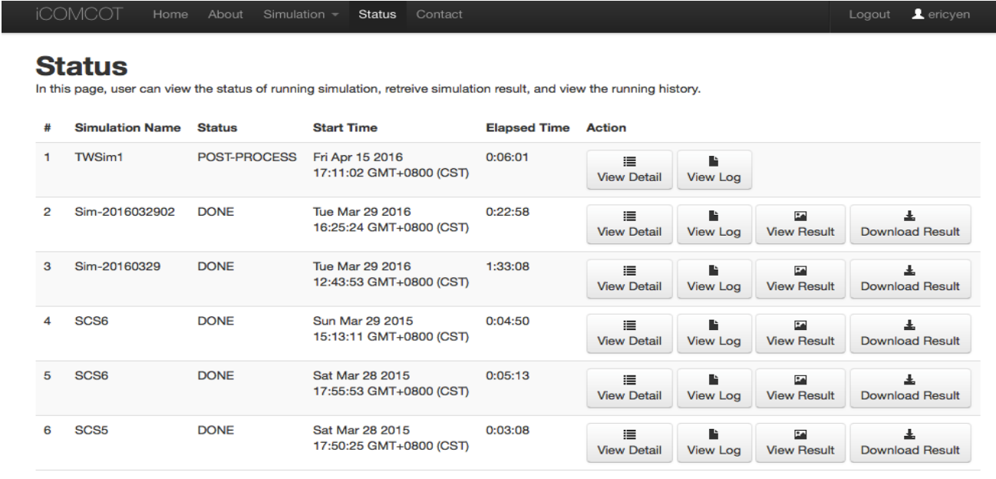
T8.8 Disaster mitigation
Objectives
Re-simulate past disaster events to increase our understanding of the causes of such events
Setup generic simulation portals for natural hazards
Progress
Tsunami simulation (Sulawesi Tsunami, Indonesia 2018)
Typhoon and storm surge (Typhoon Pabuk, Thailand 2019)
Flood (Malaysia 2017)
Dust transportation of biomass burning (IndoChina, 2018)
Analysis of additional use cases (tsunami early warning of Indian Ocean, lightening, forest fire monitoring and storm surge)
Cataloguing of iCOMCOT portal in EOSC started

Slide 16
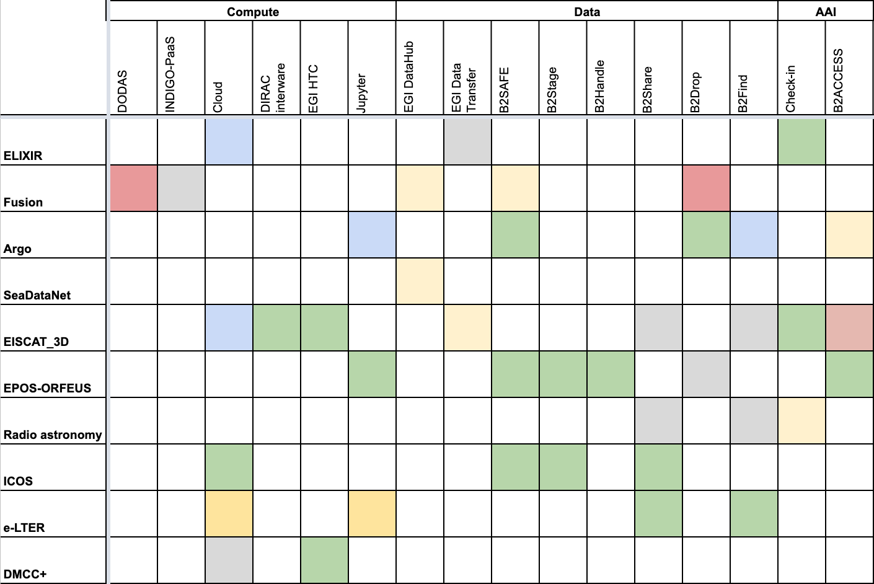
Service assessment status overview
GREY - considered for adoption, but the integration is yet to start
YELLOW - integration is ongoing
BLUE - technology is integrated and assessment is yet to finish
RED - technology does not fit into the use case
GREEN - technology is integrated and positively evaluated
Prominence platform
ARGO discovery portal
Successful integrations across AAI, Data Management, Computing
Access to federated data from Jupyter is an emerging use case (See demo later)
Cross-provider AAI interoperability was a critical requirement for WP5 – Still open
EISCAT Portal
Carbon portal
iCOMCOT Portal
Notes:
GREY - technology/service is considered for adoption, but the integration and assessment work is yet to start
YELLOW - integration is ongoing
RED - technology was assessed and does not fit into the use case
BLUE - technology is integrated and assessment is yet to finish
GREEN - technology is integrated and positively evaluated

Slide 17
Use of resources & deviations
WP | Task No. | Task Name (*end month extend in AN3) | P1 M1 - M18
 |  |  | Planned PM | Used PM | Used%
WP08 | T08.01 | ELIXIR | 24.5 | 13.8 | 56%
 | T08.02 | ITER | 30.5 | 33.2 | 109%
 |  | Unfunded efforts | 4.5 | 1.3 | 28%
 | T08.03 | Marine | 28 | 39.8 | 142%
 | T08.04 | EISCAT | 26.5 | 22 | 83%
 | T08.05 | EPOS | 35.9 | 43.5 | 121%
 | T08.06 | LOFAR | 29.5 | 17.8 | 60%
 | T08.07 | ICOS* | 10.5 | 8.9 | 85%
 |  | Unfunded efforts | 1 | 0 | 0%
 | T08.08 | Unfunded DMCC | 32 | 17.5 | 55%
WP08 Total |  |  | 222.5 | 197.8 | 89%
CESNET to be active in resource provisioning in PY3
Platform was developed and is put in place
Delay due to overlap with EOSCpilot (ASTRON science demonstrator)

Slide 18
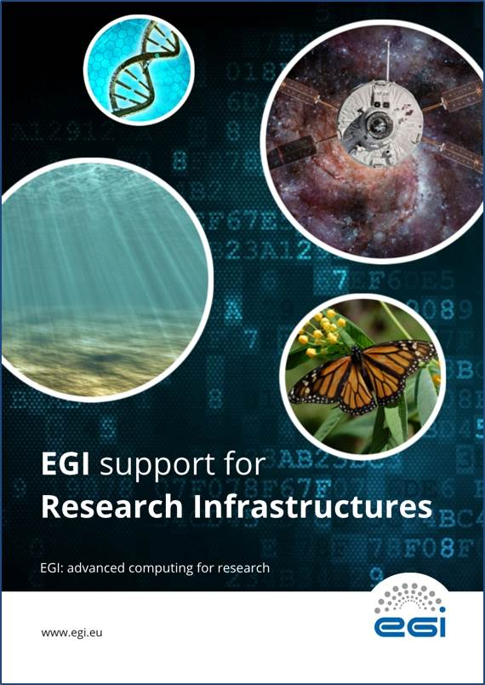
Future plans
Complete service assessments and integrations (See matrix previously)
Outreach and training
ELIXIR to demonstrate to ELIXIR Nodes
Fusion to demonstrate & disseminate to FAIR4FUSION (started in Sep’19)
Marine to do demo & knowledge transfer to SeaDataNet and Blue Cloud
EISCAT tutorial at EISCAT 3D User Meeting
Talk at EPOS-ORFEUS annual event
…
Handover
Operations – Negotiate with RIs; with Clusters; with Community projects
Good practices – Prepare a publication
EOSC

Slide 19
Summary – Key results
8 communities are progressing as planned, 2 with slight delays
3 thematic services & 3 clouds are operational in EOSC
Marine (Argo discovery); EISCAT_3D (EISCAT Portal); Disaster Mitigation (iCOMCOT)
ELIXIR clouds (CESNET, CSC, EMBL-EBI)
2 thematic service to become operational in early 2020
ICOS (Carbon portal)
Fusion (PROMINENCE)
These together rely on 6 common services

