Slide 1

OPENCoastS: An open-access service for on-demand coastal predictions
Anabela Oliveira, J. Rogeiro, J. Teixeira, A. Azevedo, A. B. Fortunato, M. Rodrigues, P. Lopes (LNEC)
J. Gomes, S. Bernardo, M. David, J. Pina, J.P. Martins (LIP)
X. Bertin, L. Lavaud (CNRS/LR)
S. Castanedo, F. Mendez (UC)

Slide 2
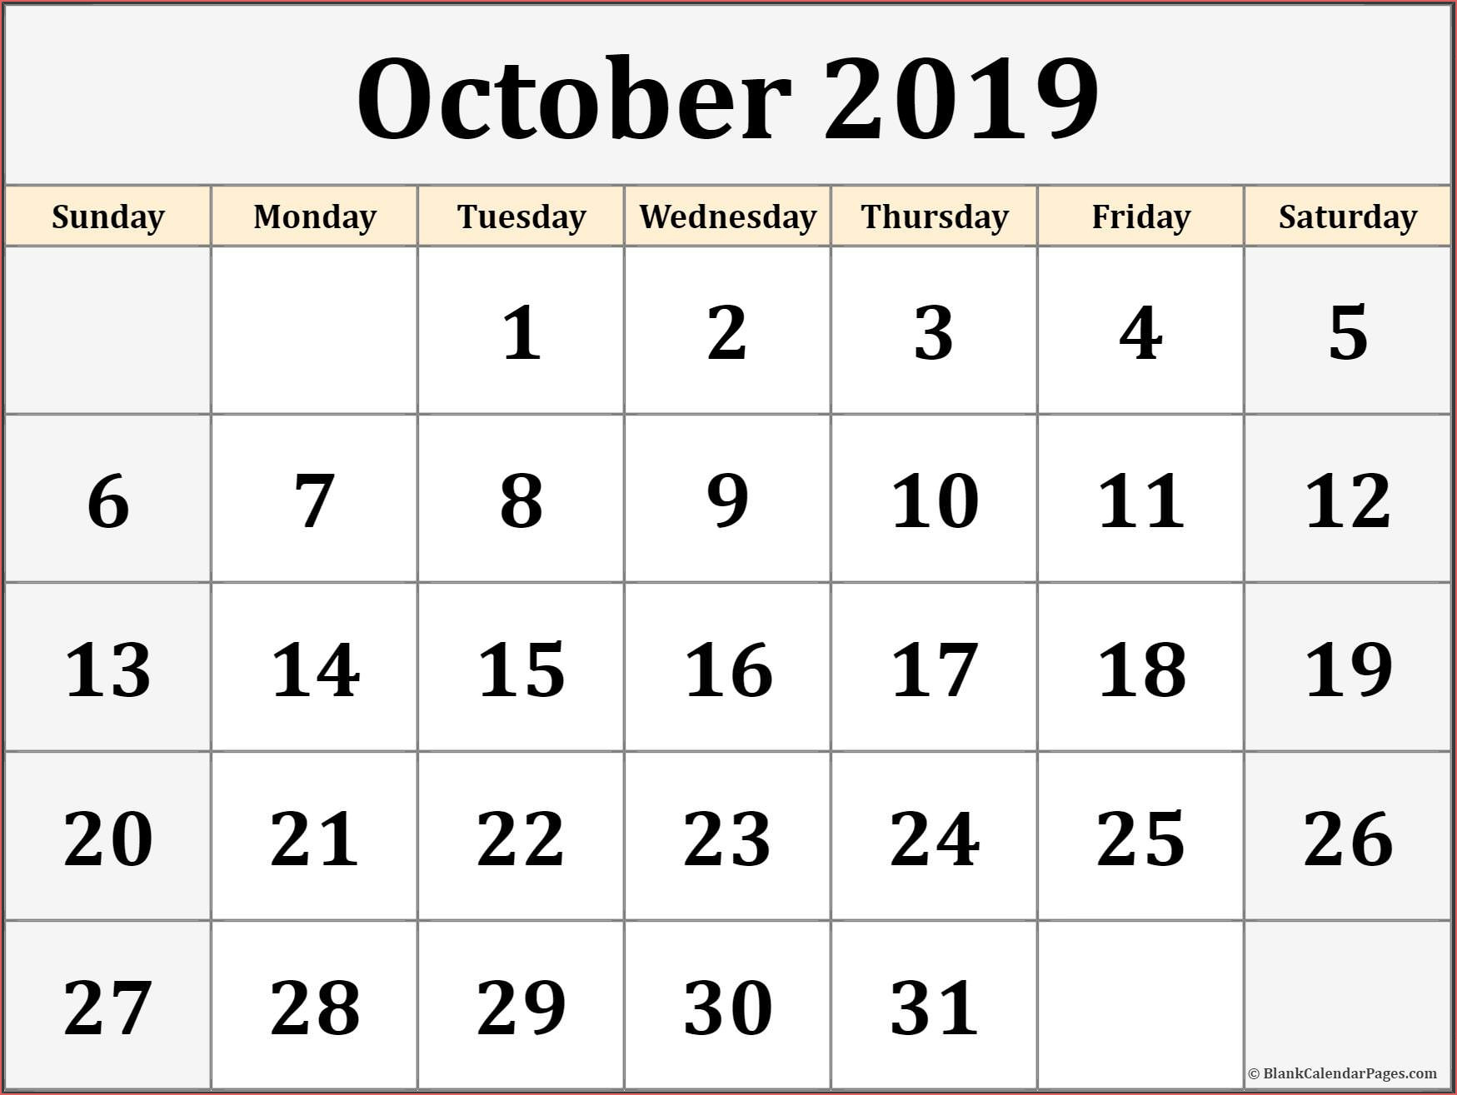


Water forecast systems: concept and context
Forcings
Operacional forecasts
Post processing, archiving and visualization
Comparison with real time data
Antecipate hazards support emergency
Support water economy daily tasks and leisure & recreation
Guide management to minimize risk
Require specialized teams to be built: Coastal processes, modelers, IT
Require automatic allocation of robust resources for daily operation

Slide 3

The OPENCoastS service
Implements forecast systems for a coastal site chosen by the user, using a user-friendly web interface
Flexible in its configuration (forcings, parameters,…)
Allow multiple actions over forecast systems (configure, manage, view)
Integrated with EOSC services
  Resource providers
    INCD: Portuguese National Distributed Computing Infrastructure
    IFCA: Spanish Physics Institute of Cantábria
  Usage: 807K cpu hours

Slide 4
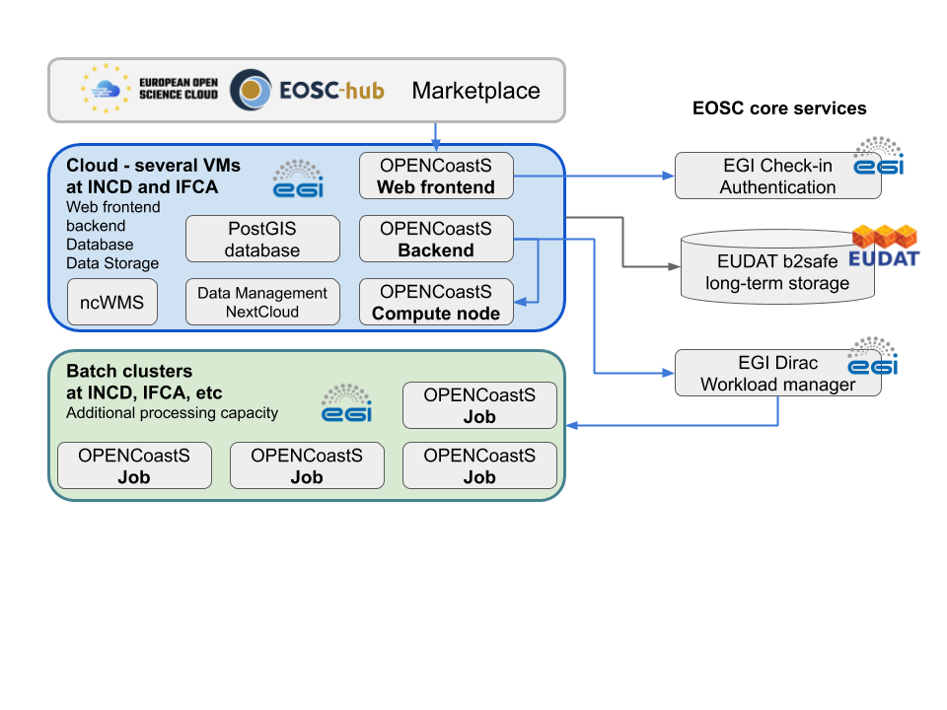
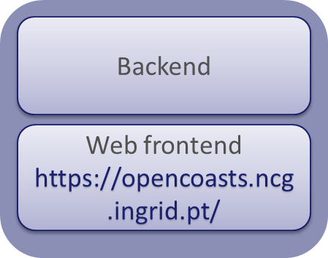
The OPENCoastS architecture
EGI Check-in: users authentication
EGI cloud compute: provide compute resources for frontend and backend
EGI Cloud Container Compute : run containers in a virtualized environment (udocker - INDIGO-DC)
EGI High-Throughput Compute: to run simulations and store data
EGI Workload Manager: for job submission to local resource providers

Slide 5
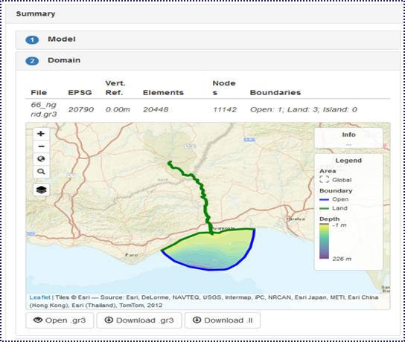
Web interface: 3 Building blocks
Configuration assistant: building a deployment step by step
Outputs viewer – visualize results:
  Adding data/model points on the fly
  Saving time series and model outputs in your PC
  Compare time series from several deployments
Live demo of OPENCoastS:
https://opencoasts.ncg.ingrid.pt/
Forecast manager – what can we do with our forecasts: check status, check details, clone it, freeze/restart it, delete it,…

Slide 6
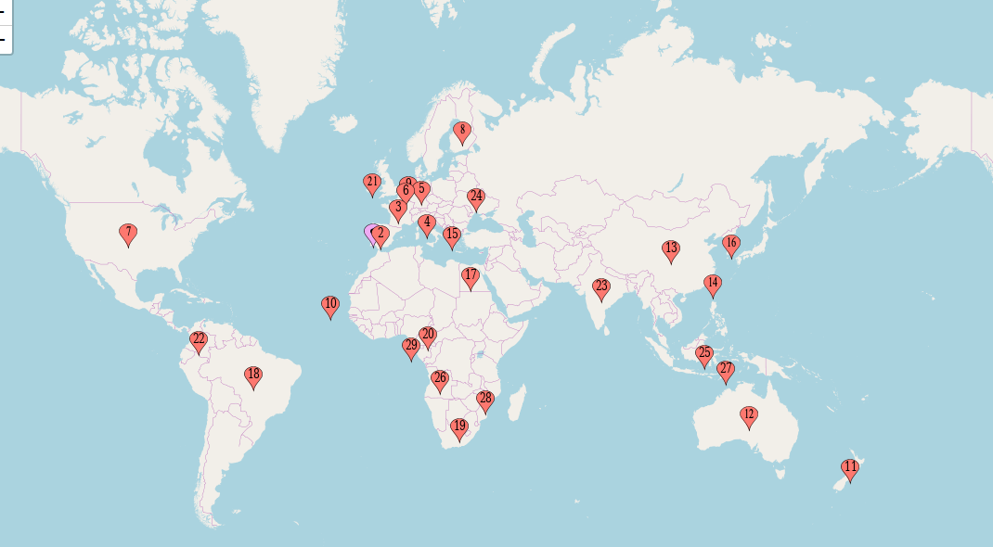
OPENCoastS users’ institutions geographic distribution (by order of service uptake)
Over 200 users, 200 deployments, 28 countries and 5 continents
The EOSC-hub services provided the resources and tools necessary to expand the OPENCoastS service.
The OPENCoastS thematic service is now available and being used by a wider European community

Slide 7
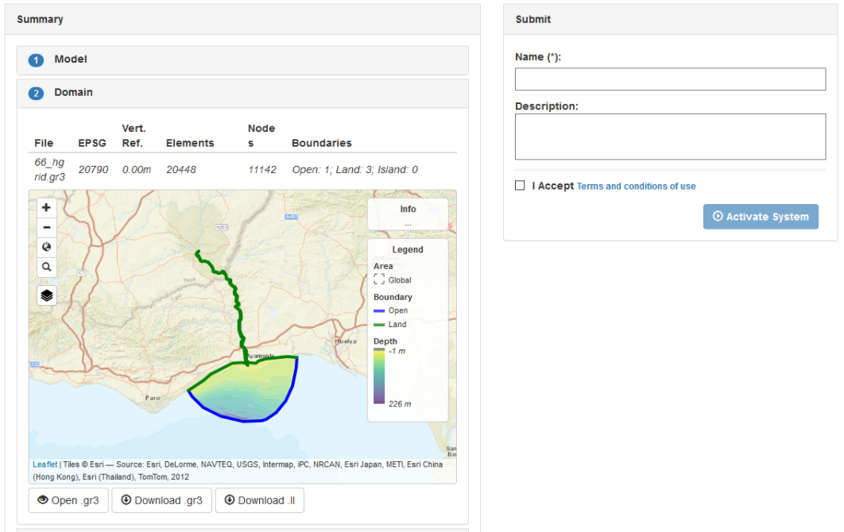
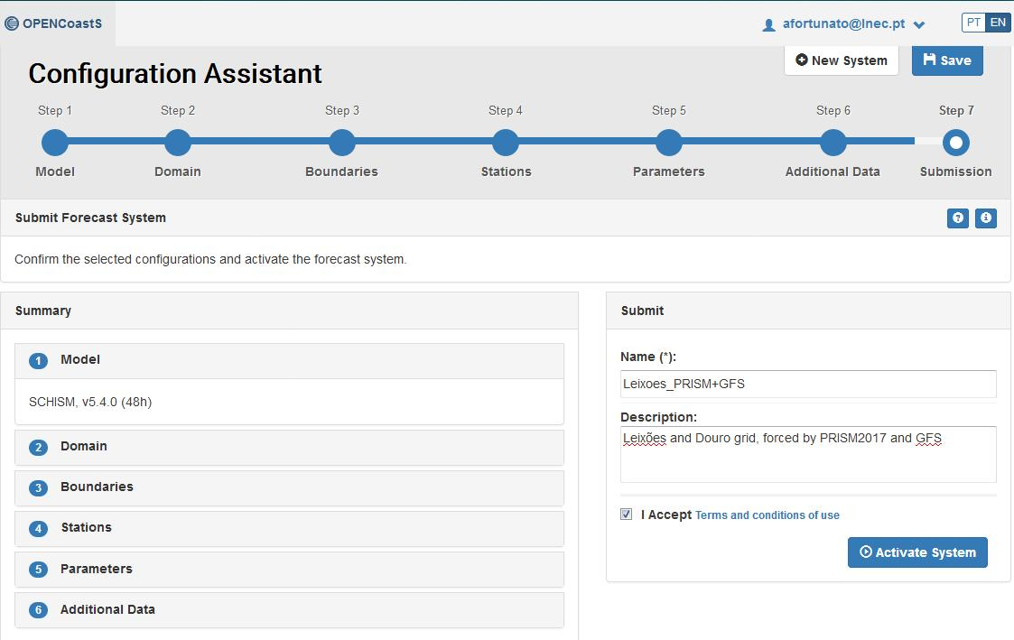
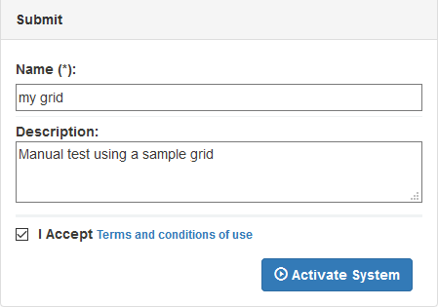
Web interface: 3 Building blocks
  Configuration assistant: building a deployment step by step
  Forecast manager – what can we do with our forecasts
  Outputs Viewer: visualization and more

Slide 8
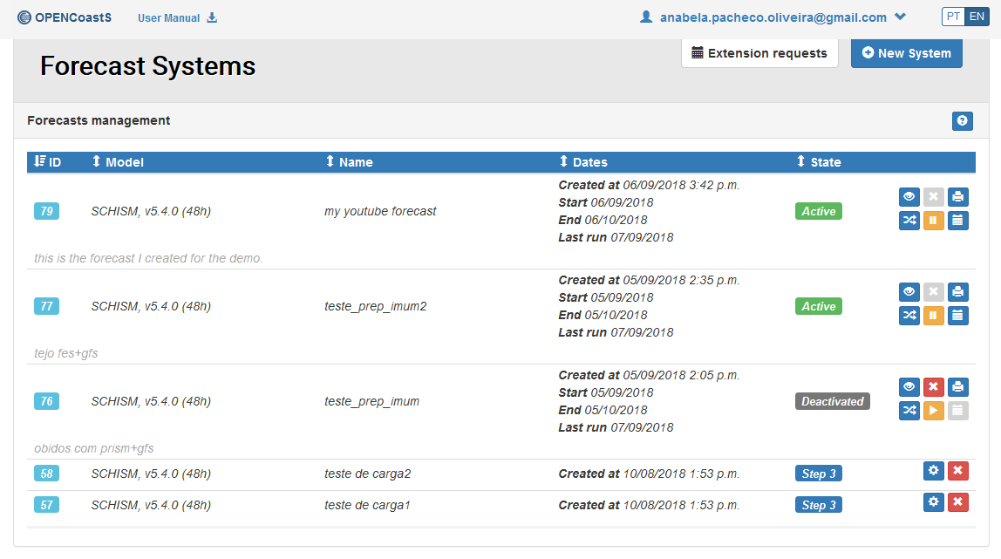
Forecast Systems Manager
Checking the status and the settings of my runs
Clone it – duplicate to change: b.c., parameters, outputs
Re-activate a deactivated system or eliminate it
Return to C.Assist. to continue to setup my forecast

Slide 9
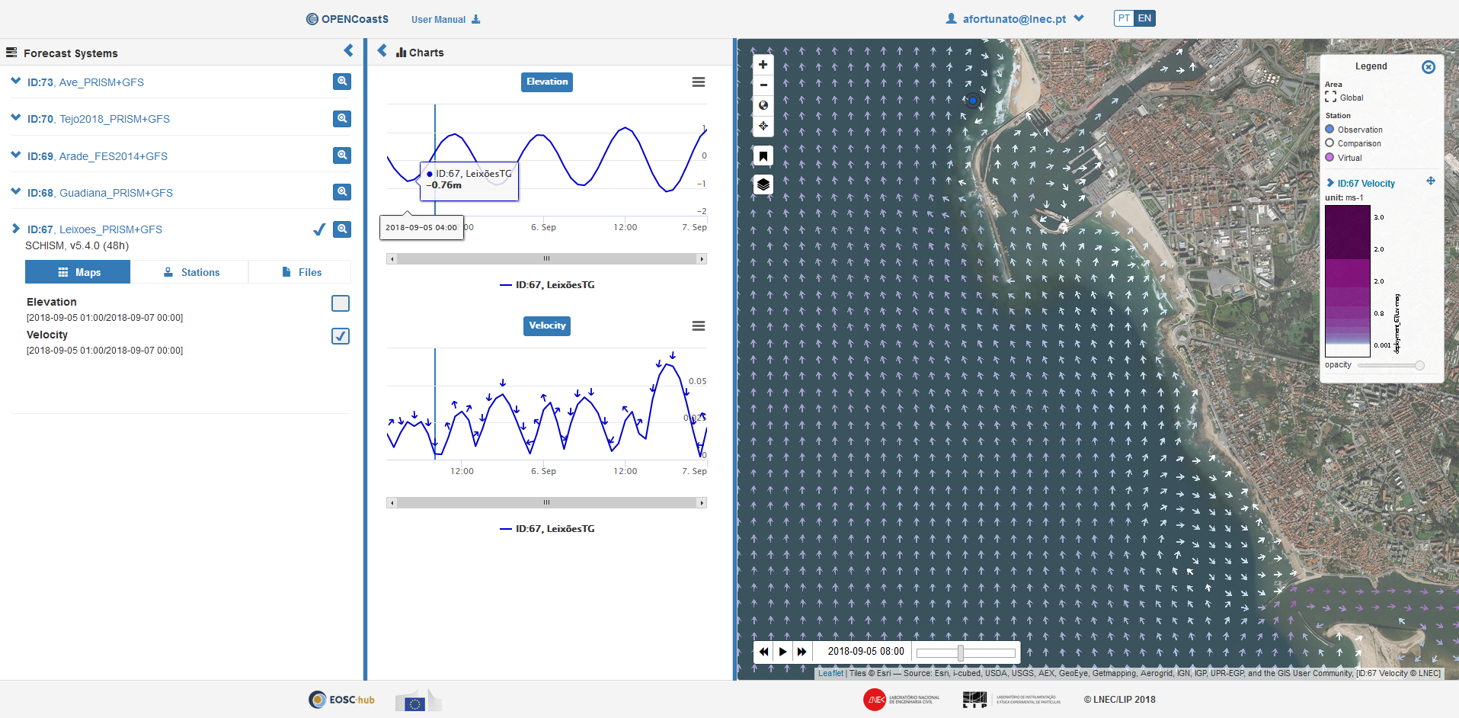
Outputs viewer
Adding data/model points on the fly
Saving time series and model outputs in your PC
Compare time series from several deployments

