Slide 1
Reproducible big data analytics
(with EGI Notebooks, GitHub, Zenodo and Binder)
Gergely Sipos, Enol Fernandez, Giuseppe La Rocca – EGI Foundation
Dissemination level: Public
EOSC-hub EC review, 9. October 2019.

Slide 2
Motivation: Reproducibility
Peng, Science, 2011

Slide 3
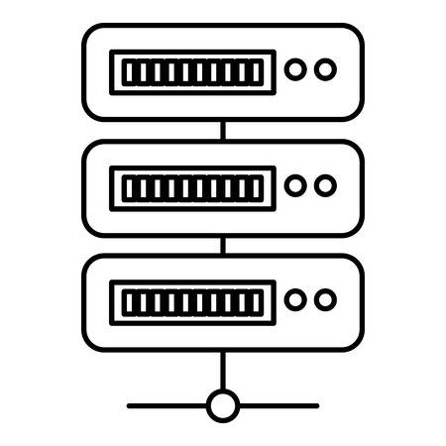
Our implementation of reproducible big data science
Distributed big data accessed via EGI DataHub
EGI Notebooks
EGI Binder
DEMO
1. Setup and perform data analysis and visualisation; Download notebook
PID minting
GitHub
Handle.net registry
6. Reproduce big data analysis
Your repository
2. Publish notebook and Generate DOI
5. Resolve DOI to Notebook and Data
Fellow researchers
3. Cite DOI
(e.g. in publication)
Journal paper
4. Discover DOI

Slide 4
Service dependencies
EGI Notebooks and Binder relies on/uses:
EGI Cloud Compute and Online Storage service
EGI DataHub
Monitoring (availability/reliability)
Main APIs:
Zenodo–GitHub import API
fs-onedatafs Python API (Data I/O)
OpenStack Nova API & Kubernetes API (Compute)
Handle service API

Slide 5
Conclusions
High demand for this type of ‘guide’:
March 2019: Tutorial in Taipei (ISGC) e-infrastructures
May 2019: Conference keynote presentation in Opatija (MIPRO) general public
September 2019: Conference technical talk in Prague (ParCO) big data researchers
September 2019: Demo in Porto (Open Science FAIR) scholarly communications
September: 2019: Tutorial in Yerevan (Eastern Partnership Connect conf) e-infrastructures
October 2019: Demo in Leipzig (CLARIN Annual conference) researchers
October 2019: Talk in Helsinki (RDA Plenary) data scientists
December 2019: Tutorial in Växjö (Big data conference) researchers
Working combination of services
The ‘story’ fits with existing research & publishing practices – And extends them!

Slide 6
Live demo
Analysing and visualising historical data from the Climate Change Knowledge Portal (CCKP)

