Slide 1
ENES Climate Analytics Service (ECAS)
Debora Testi (CINECA), on behalf of ECAS team
Luxembourg, 8-9 October 2019
Dissemination level: Confidential

Slide 2
Scientific use case example (I)
Global climate simulations (CMIP data)
Global Earth system experiments run by many modelling groups internationally
Resulting data is bulky - high replication costs:
>2 PB (CMIP5)
>20 PB (CMIP6 - current phase)
Valuable collection of state-of-the-art simulation data
Interesting to a wide range of users from different disciplines for data analysis

Slide 3
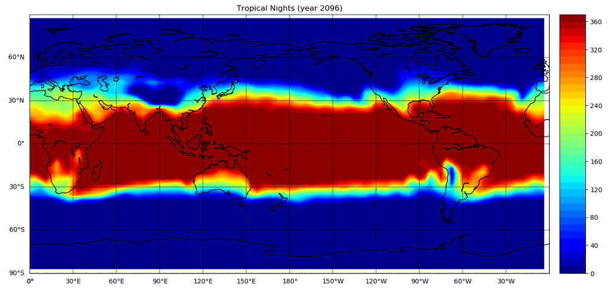
Scientific use case example (II)
Typical analysis task is calculation of a climate index to compare projected with current climate
Example: Number of tropical nights per year
Tropical night: Day with temperature T always >= 20°

Slide 4
What is ECAS?
Motivation:
Bring computing to data, not vice versa
induce cultural change!
Foster bottom-up use of interactive Python notebooks
Facilitate easier data and workflow sharing
Implementation:
2 instances (DKRZ, CMCC) with different computing and data resources
Integration with EOSC services (next slide)
Accompanied by extensive training programme

Slide 5
Service architecture and interfaces
Data Sources
ECAS Work Environment
Data Sharing
Supporting services
IAM
EGI CheckIn

Slide 6
Demo: outline
Log in to ECASlab
Jupyter environment
Example workflow (Jupyter notebook) with result map
B2DROP sharing showcase

Slide 7
ECAS training activities
EOSC-hub All-Hands Meeting, 18-20 April 2018, University of Malaga, 4 users
SOSC 2018 Second International PhD School Open Science Cloud, Perugia, September 19, 2018, 17 users
3rd ENES Workshop on Workflows, Brussels 13-14 September 2018, 7 users
EGU GA 2019, Vienna, 10 April 2019, 9 users
Introduction to ECAS for Data Science and Learning, 21/22/24 & 28 May 2019, University of Salento (Lecce), Italy, 22 users
EUDAT CDI - PRACE Summer School, International Centre for Theoretical Physics, Trieste, Italy, 20 users
Tutorial at IEEE eScience 2019 conference, San Diego, September 2019

Slide 8
Summary and impact
ECAS is newly integrated with wide range of EOSC services for data input and sharing
Integration with rich community repository (ESGF)
Computing supported via data cube concept of the Ophidia framework
Foster user-friendly uptake of FAIR Data Principles
ECAS is open to any user with an account for one of the EOSC AAIs
Easy access to remote computing and data
Reduce need for bulk data transfer, access unique data collections
Foster use of interactive Python notebooks bottom-up

Slide 9
Thank you for your attention!

