Slide 1
User engagement and training
Giuseppe La Rocca (EGI Foundation), WP11 Leader
Luxembourg, 8-9 October 2019

Slide 2
WP11 Training and Services for Service operators, Research and Higher Education
Objectives:
Define and coordinate the annual training plans for supporting research activities (T11.1)
Support the implementation of proper DMP for helping research communities to manage their research data efficiently
Delivery of IT service management trainings to learn the fundamentals of IT service management processes and support the professional development of EOSC-hub services
Define and deliver training contents about common and federated services for supporting scientific activities of TS, CCs and research communities, and domain-specific training for data providers and data scientists (T11.5)
Number of Tasks: 5
Number of Participations: 39
Efforts planned RP1: 71PMs
1st EOSC-hub review, Luxembourg 8-9 Oct 2019

Slide 3
Interaction with other WPs
WP11
Technical Support (T10.3)
WP5 – Federation & Collaborative Services
Facilitate training performed by other WPs
Operate technical services for training
Deliver training about DMP
Deliver training about ITSM
Position EOSC-hub training in EOSC
Liaison with other EOSC initiatives
WP6 – Commons Services
Communications (T3.3)
WP7 – Thematic Services
WP8 – Competence Services​
WP9 – Business Pilots
1st EOSC-hub review, Luxembourg 8-9 Oct 2019

Slide 4
Key Exploitable Results WP11
Researchers and
research communities:
Empower my research
Educate, inform and support my team and community
Services in the EOSC Service Portfolio
EOSC Portal
and
Marketplace
EOSC Hub Operators: Develop the EOSC landscape
Service Providers:
Provide services for
Researchers
Rules of Participation
Training courses and materials
Service Management System
Internal services in the Hub portfolio
Interoperability & Integration Guidelines
Business and sustainability models for services and the Hub
Digital Innovation Hub:
platform for industrial collaborations with EOSC
Enterprise: Develop, expose and grow my services
1st EOSC-hub review, Luxembourg 8-9 Oct 2019

Slide 5
The training strategy in EOSC-hub
Summary of the results in each WP11 tasks
Future plans
1st EOSC-hub review, Luxembourg 8-9 Oct 2019

Slide 6
Training strategy in EOSC-hub
Assessment
Identify gaps & training requirements
Training Programme
Design
Delivery & Monitoring
Development
Develop training components
Delivery of training events
1st EOSC-hub review, Luxembourg 8-9 Oct 2019

Slide 7
The training strategy in EOSC-hub
Summary of results in each WP11 tasks
Future plans
1st EOSC-hub review, Luxembourg 8-9 Oct 2019

Slide 8
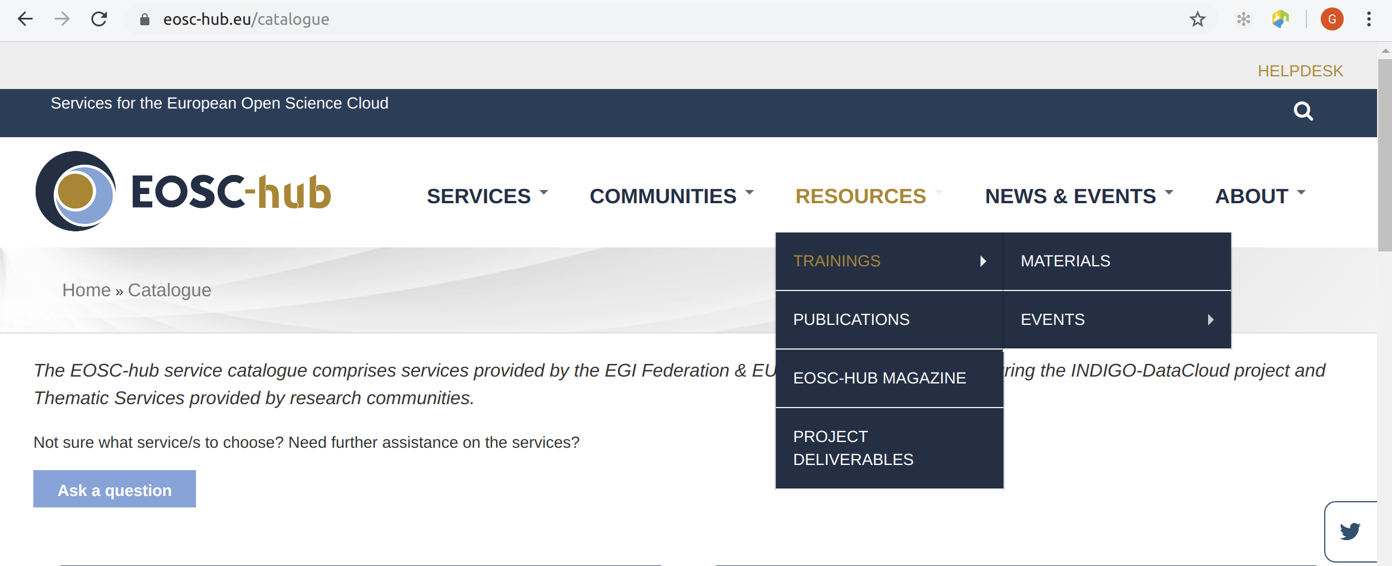
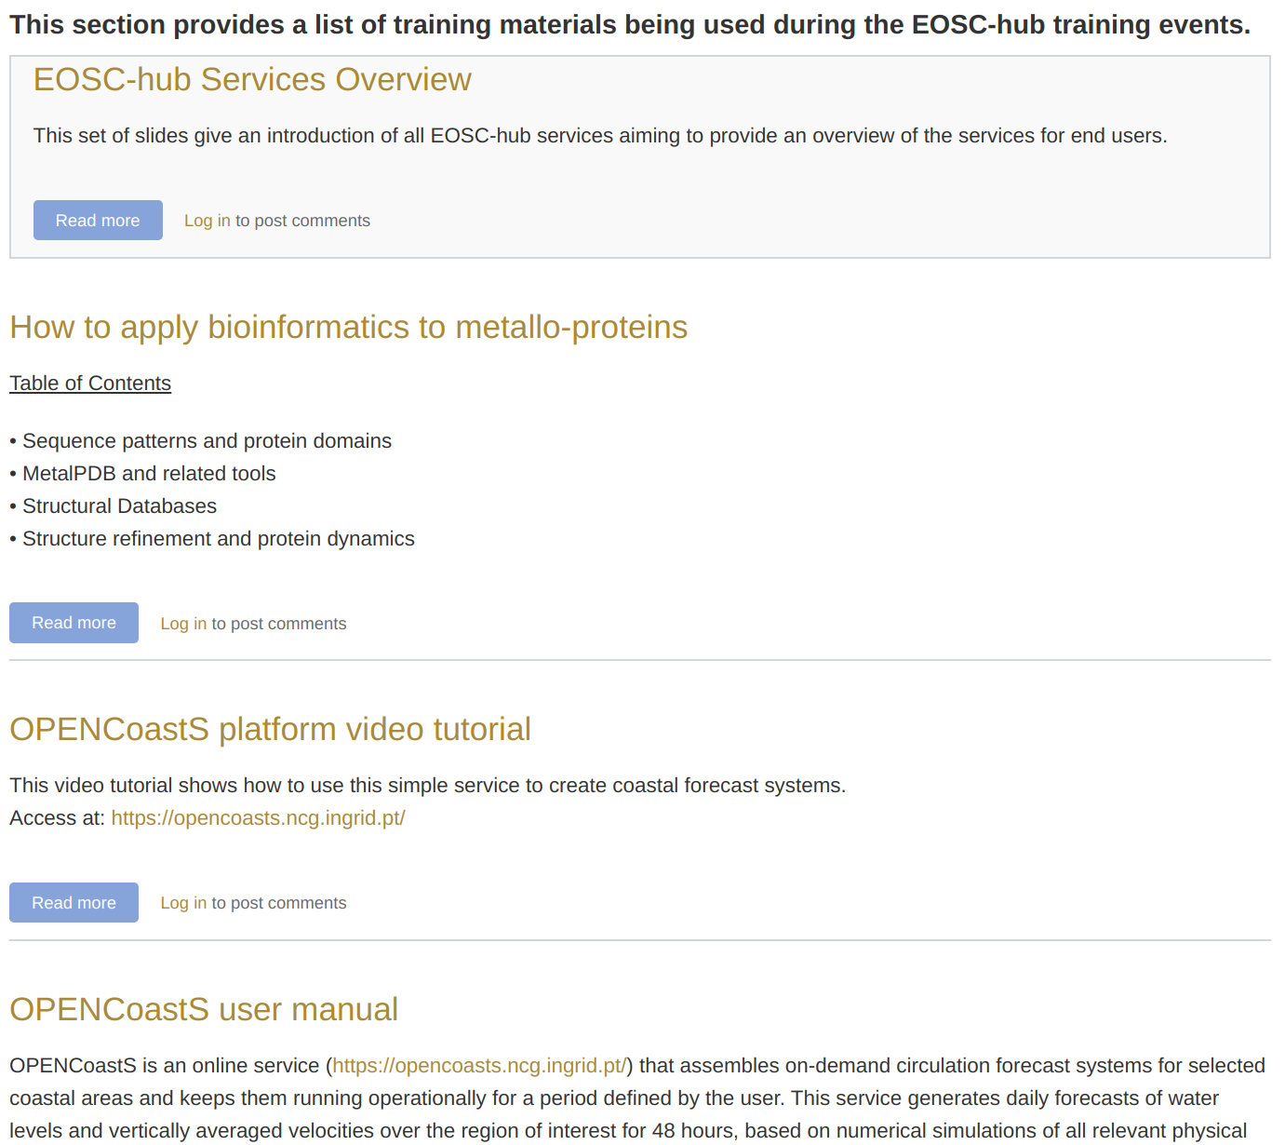
Training programme and online services for training
Set up of a Training Registry where members of the project can publish training events and upload training materials
Overall, the architecture is in line with the guidelines
1st EOSC-hub review, Luxembourg 8-9 Oct 2019

Slide 9
Training programme and online services for training
Allocated initial resources to operate a (cloud-based) Training infrastructure
CESNET-MCC | Czech Republic
INFN-CATANIA-STACK | Italy
IISAS-GPUCloud | Slovakia
IISAS-FedCloud | Slovakia
IFCA-LCG2 | Spain
B2SHARE instance for supporting training activities also available at:
https://trng-b2share.eudat.eu/
1st EOSC-hub review, Luxembourg 8-9 Oct 2019

Slide 10
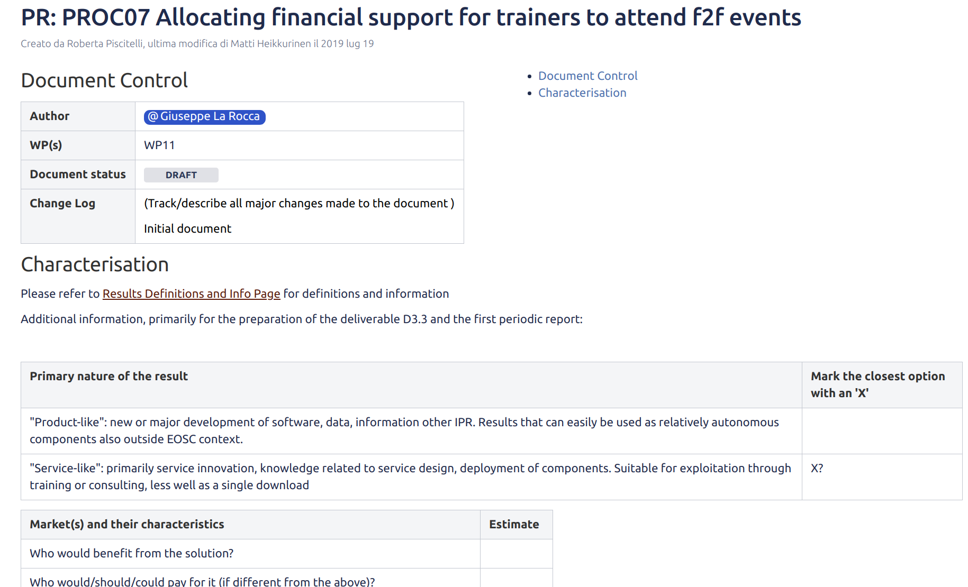
Training programme and online services for training
Defined a procedure to support the travel costs of trainers from WP5 and WP6 at high-impact events
1st EOSC-hub review, Luxembourg 8-9 Oct 2019

Slide 11
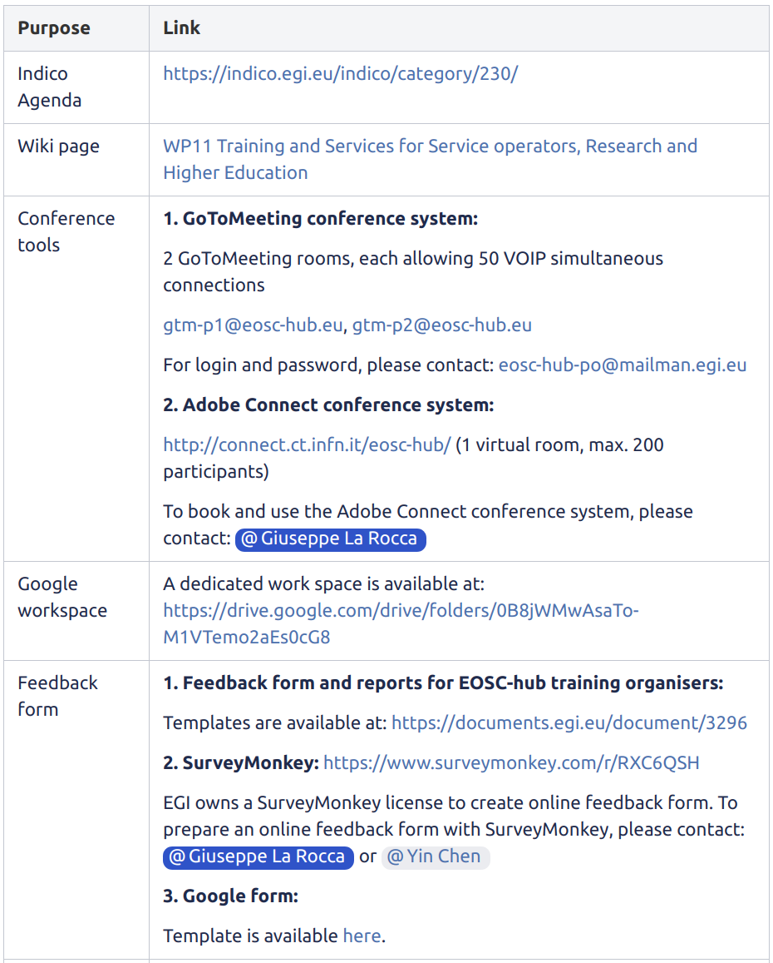
Training programme and online services for training
Provided online tools for supporting the delivery of training events
Prepared guidelines to develop training materials and deliver training events
Organized a webinar to facilitate the use and the adoption of the EOSC training registry
1st EOSC-hub review, Luxembourg 8-9 Oct 2019

Slide 12
Training topics in EOSC-hub
Training on Data Management Planning
IT Federated Service Management trainings to learn the fundamentals of IT service management processes
Training contents about Common and Federated services for supporting scientific activities of TS, CCs and research communities and IT Security Forensics training (T4.4)
Domain-specific training for data providers and data scientists
1st EOSC-hub review, Luxembourg 8-9 Oct 2019

Slide 13
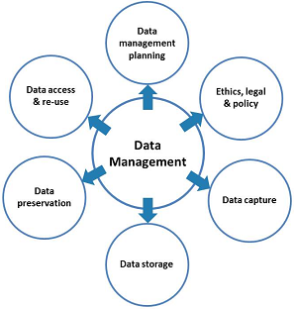
Data Management Planning
Focused on training and instructions on issues related to Data Management Planning in collaboration with the OpenAIRE-Advance project
1st EOSC-hub review, Luxembourg 8-9 Oct 2019

Slide 14
FitSM Training and Certification Programme
Delivering formal FitSM training and certification to any EOSC-hub member​
for the designing and operation of the EOSC Service Management System (SMS)
Requires to have all the previous levels
Building critical mass
Planned: Autumn 2020
Expert Level
2 days
Expert Training in IT Service Management
1st Advanced courses held in Jun. 2019
Next round: 18-22 Nov. 2019
Planned: first half of 2020
Advanced Level
2 days
2 days
Advanced Training in Service Planning and Delivery
Advanced Training in Service Operation and Control
Focus of the 1st half of the project to reach as many as possible
Mainly held as co-location at major events (will continue)
Foundation Level
1 day
Foundation Training in IT Service Management
1st EOSC-hub review, Luxembourg 8-9 Oct 2019

Slide 15
Training about Commons and Federated services
Focused on the development of training contents about the Common and Federation services published in the EOSC-hub service catalogue and
Collected training materials and documentations about the available services published in the EOSC-hub service catalogue
Deliver specialized training events for supporting scientific activities of TSs, CCs and external research communities
1st EOSC-hub review, Luxembourg 8-9 Oct 2019

Slide 16
Domain specific training to data providers and data scientists
Focused on the preparation, and delivery of training contents and events to target the data providers and data scientists within structured scientific communities linked to the CCs and TSs
DODAS
… and
OPENCoastS
1st EOSC-hub review, Luxembourg 8-9 Oct 2019

Slide 17
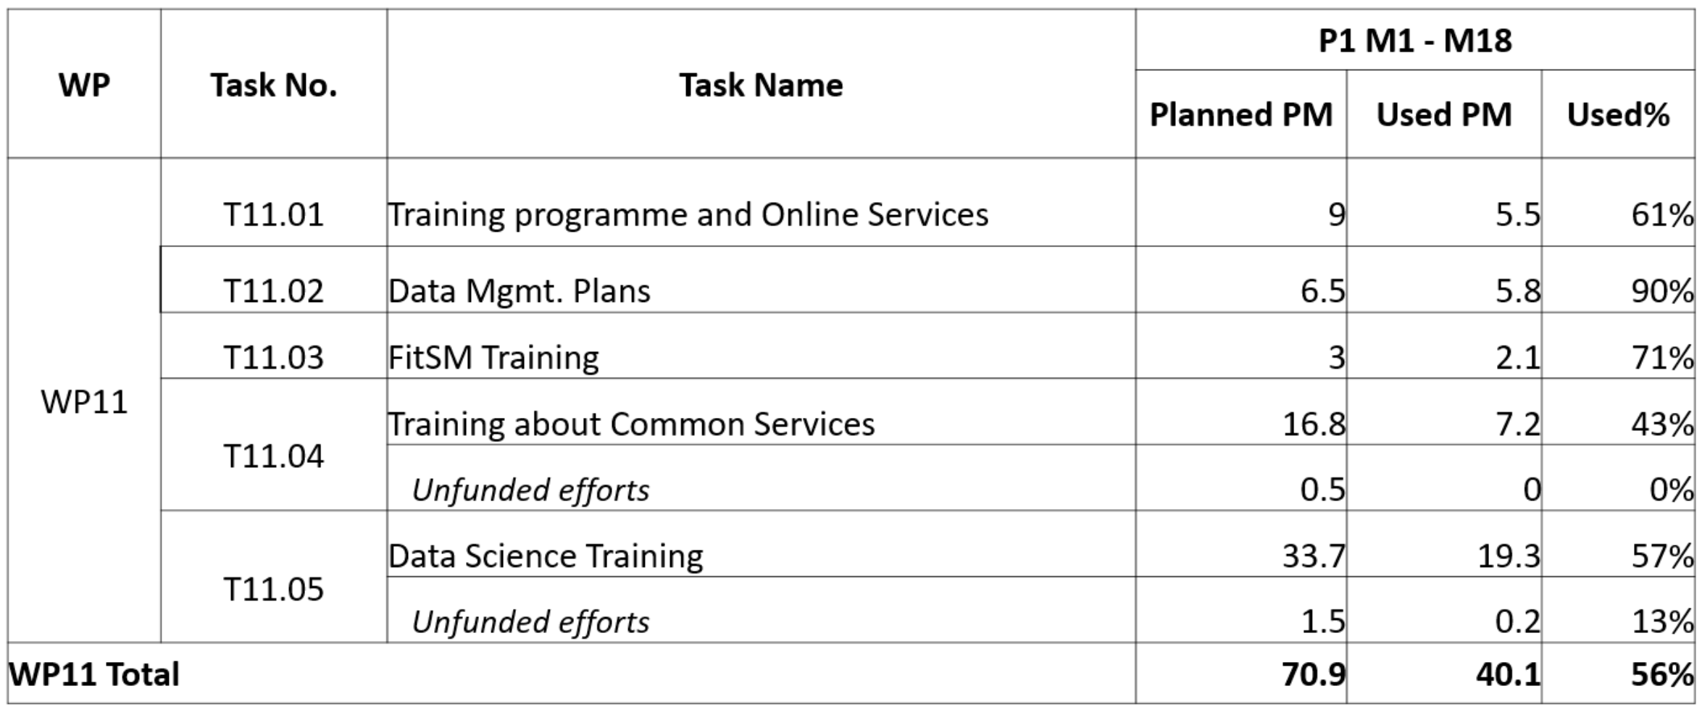
Effort usage in WP11
1st EOSC-hub review, Luxembourg 8-9 Oct 2019

Slide 18
External WP11 budget for FitSM training
 | Total Budget | Consumed Budget | Remaining Budget | # of Events Held
Trainer Travel | €5,750 | €1,000 | €4,750 | 1
FitSM Certifications | €20,000 | €13,469 | €6,531 | 8
Total Budget | €25,750 | €14,469 | €11,281
Target # of FitSM courses = 15​
Sufficient budget available to support remaining 7 targeted courses, taking unused travel travel​
1st EOSC-hub review, Luxembourg 8-9 Oct 2019

Slide 19
Deviations in WP11
USE:
LifeWatch thematic service will be provisioned from M19 to M36
Training activities will be moved forward
UPV:
Shift of efforts from T11.5 to T11.4
1st EOSC-hub review, Luxembourg 8-9 Oct 2019

Slide 20
Key results/Success stories
60
Training events
1 Webinar
1500+ people trained
250
training contents
2 stories published in the Magazine
12 FitSM trainings
10
DMP training
97 certified participants
Involved in the Community of Practices (CoP)
20 Domain- specific training
17 Common & federated training
"The training was really informative. I learned a lot, especially in the hands-on sessions!" , CODATA-RDA 2018 Summer School ​
"The three days of training were excellent, informative and helpful", INSTRUCT Training course on Advanced Integration of diverse structural data"​
“The training really helped to understand the big picture and understand how sustainable operations should be executed; it is much simpler than ITIL, but still useful!”. FitSM Foundation, April 2018
1st EOSC-hub review, Luxembourg 8-9 Oct 2019

Slide 21
A final take-away message from WP11
WP11 is involved to define and deliver a sound training programme for supporting research activities
The EOSC-hub Training Registry is open and offered for EOSC
Supported the training needs of CODATA-RDA, CORBEL, VIRGO, ENVRIplus, NGSchool, INSTRUCT and advanced courses for PhD students at Universities
The FREYA project already started to register event and material
1st EOSC-hub review, Luxembourg 8-9 Oct 2019

Slide 22
The training strategy in EOSC-hub
Summary work done in each WP11 tasks
Future plans
1st EOSC-hub review, Luxembourg 8-9 Oct 2019

Slide 23
WP11 future plans
Training:
Intensify Thematic Service and Competence Centre based events
Offer a Data Management Planning Support service for scientific communities
Link the Training Registry in the EOSC Portal
FitSM: Continue to co-locate Foundation courses; Run at least 2 more batches of Advanced (Nov’19; early 2020); Organize 1 Expert level (Autumn 2020)​
Collaborations:
Establish training synergies with other EOSC related projects (i.e.: FREYA and EOSC-Life projects)
Contributing to the collaboration with the FAIRsFAIR project
1st EOSC-hub review, Luxembourg 8-9 Oct 2019

