Slide 1
Results, Dissemination & Impact
(All WPs)
Sara Garavelli (Trust-IT Services), WP3 Leader
Luxembourg, 8-9 October 2019

Slide 2
Outline
EOSC-hub expected impact
Impact on design & implementation of EOSC
Optimised access to IT equipment and services
Avoid the locking-in to particular hardware or software platform
Extend the user base
More people trained in research and academic sectors
Increased incentives for scientific discovery
Establishing partnerships with industrial & private partners
Next Steps & conclusions

Slide 3
EOSC-hub expected impact
EOSC-hub is a first implementation step of the EOSC vision. The project is establishing the integration and operation layer to federate services and tools for scientific collaboration, experiments and analysis and make scientific knowledge more accessible.
Optimised access to IT equipment and services
No lock-in to particular hardware or software platforms
More scientific communities using storage and computing infrastructures
More people trained in research and academic sectors
Increased incentives for scientific discovery and collaboration across disciplinary and geographical boundaries
Establishment of partnerships with industrial & private partners
Further development of the European economic innovation capacity

Slide 4
Impact on design & implementation of EOSC

Slide 5
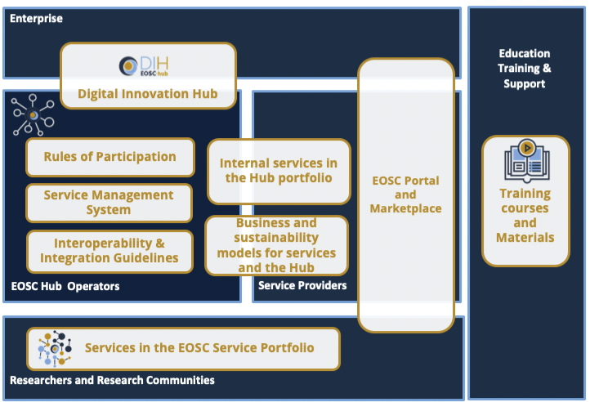
EOSC-hub: the “beta-version of the EOSC long terms structures”
EOSC Portal and Marketplace
EOSC Service Management System (SMS)
EOSC Rules of Participation (RoP)
Internal Services in the Hub Portfolio
External Services in the EOSC Service Portfolio
EOSC Digital Innovation Hub (DIH)
Business and sustainability models for services and the Hub
Interoperability and Integration guidelines
Training courses and material
9 KERs to contribute to the shaping of the EOSC building blocks

Slide 6
EOSC-hub: the “beta-version of the EOSC long terms structures”
Training & Skills subgroup of the EOSC EB
EOSC-hub is one of the main implementation vehicles for EOSC

Slide 7
Optimised access to IT equipment and services
The operation of a federated European data and distributed computing infrastructure for research and
education communities will optimise the access to IT equipment and services and will put all European
researchers and educators in equal footing to access essential resources to express their talent and creativity

Slide 8
Optimised access to IT equipment and services
An operational Marketplace adopting a service Integration and Management approach to managing suppliers and integrating them to provide a single business-facing EOSC Hub
76 Services in the Service Portfolio
+21 services onboarded since Nov 2018
24 under verification
66 providers
103 orders
64% fullfilled
2000 monthly users (avg)
6000 unique page views per month
Continuous onboarding of service providers (EOSC-hub weeks) & users (EaP)

Slide 9
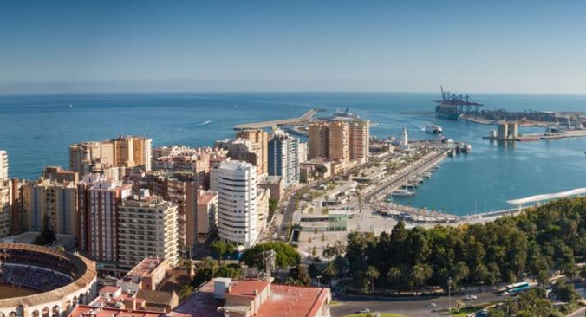
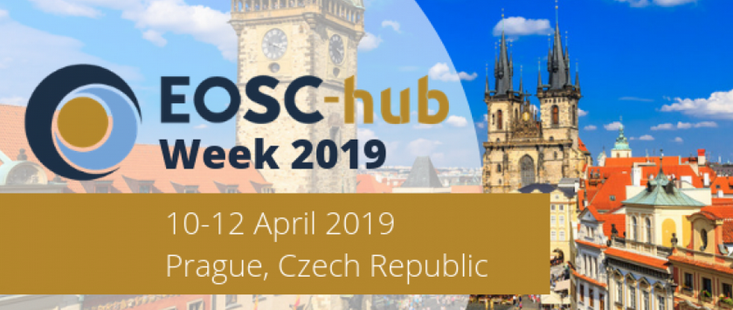
Optimised access to IT equipment and services
EOSC-hub weeks
EOSC-hub week 2018, 16-20 April 2018, Malaga
Over 170 participants
Sessions dedicated to users, service providers, policy and technology; e-infrastructures workshops, such as Computing and Data Management over Clouds, Coupling Data & HPC
EOSC-hub week 2019, 10-12 April 2019, Prague
Over 350 participants (the number has doubled compared to the 2018 edition)
Sessions engaging the cluster and the regional projects
Consultation with stakeholders on EOSC portal
Feedback provision to the EOSC Working Groups

Slide 10
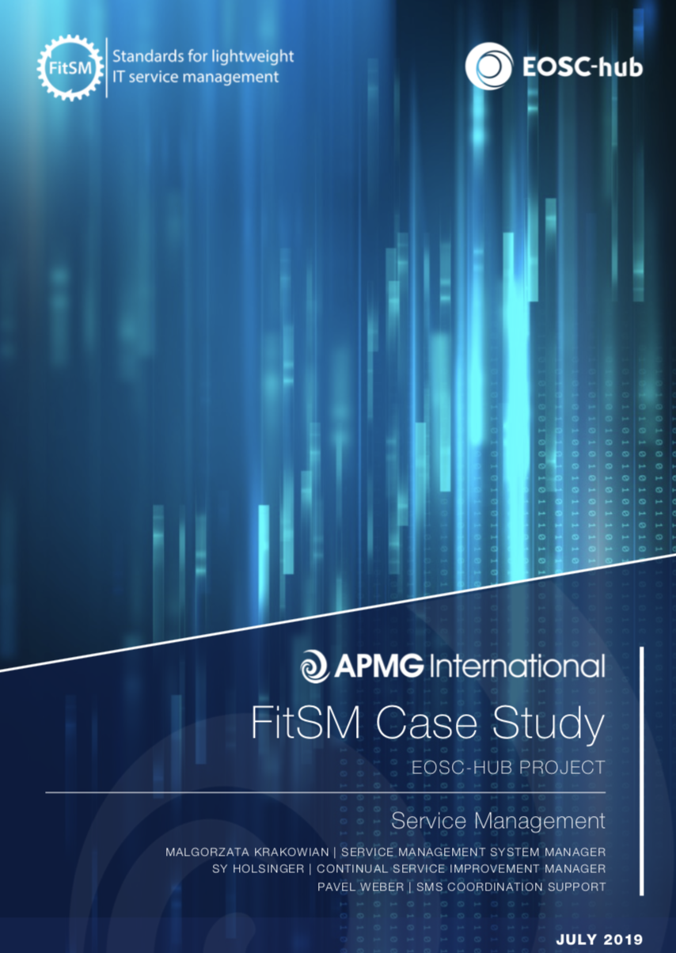
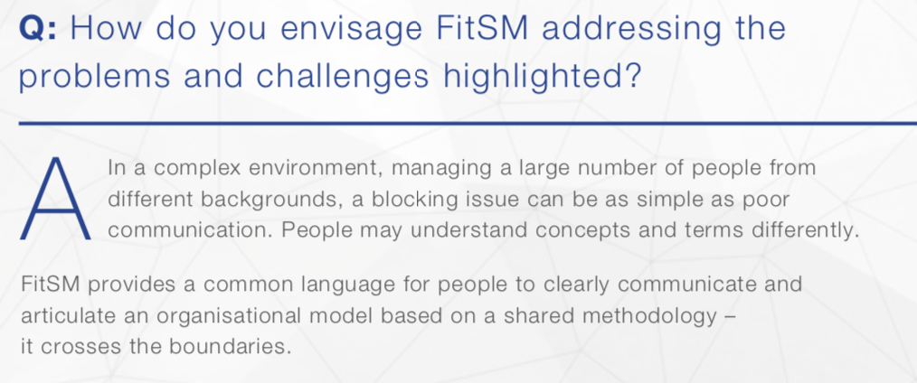
Optimised access to IT equipment and services
Harmonisation of service management processes for the operation of access enabling and federated services is progressing
107 trained people
> 90 individuals certified according to FitSM
Upcoming training courses with the INFRAEOSC 5b projects

Slide 11
Success Story: WeNMR for Life Sciences
Optimised access to IT equipment and services
“Our online services are used by thousands of researchers studying molecular forces and biomolecular interactions to guide drug design, treatments and diagnostics. To give an example, HADDOCK has over 11500 registered users worldwide and in 2017-2018 was acknowledged in 350 papers.
We need to hide the complexity of the computing resources used to power the services, and on the other side, to ensure sufficient resources to operate those”
A. Bonvin
Professor of Computational Structural Biology at Utrecht University
6100 new users (+230%)
+300% simulations submitted

Slide 12
Avoid the locking-in to particular hardware or software platforms that would jeopardise the long-term planning for capacity upgrades
Increase service interoperability by exposing well-defined interfaces based on open specifications that improve reusability and develop technical and service roadmaps to ensure a coherent evolution of the technical solutions and service offering

Slide 13
Avoid the locking-in to particular hardware or software platform
EOSC-hub proposal for the EOSC Technical Architecture (public consultation) (D10.4)
Technical specifications for the building blocks of EOSC including interoperability guidelines enabling the end-to-end composition of services in EOSC
identification of services that can already work together because they support the same standards and/or interfaces (e.g. DIAS & Copernicus map services)
federation of common and thematic services according to identified users’ requirements (e.g. DODAS & EGI Fed Cloud)
Putting the basis for an EOSC open by default, transparent, trustworthy and community-driven

Slide 14
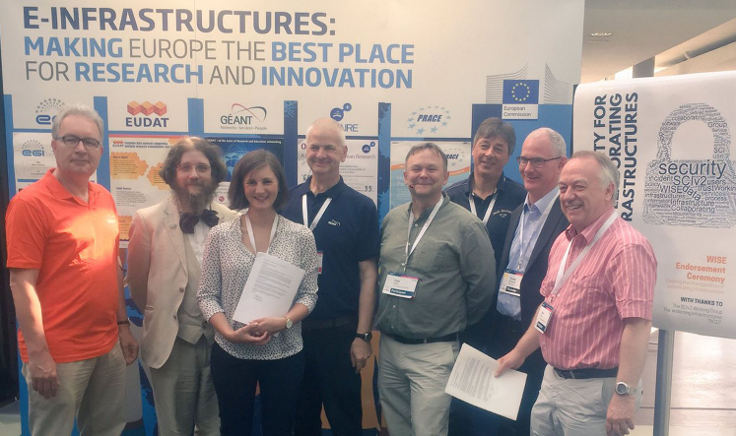
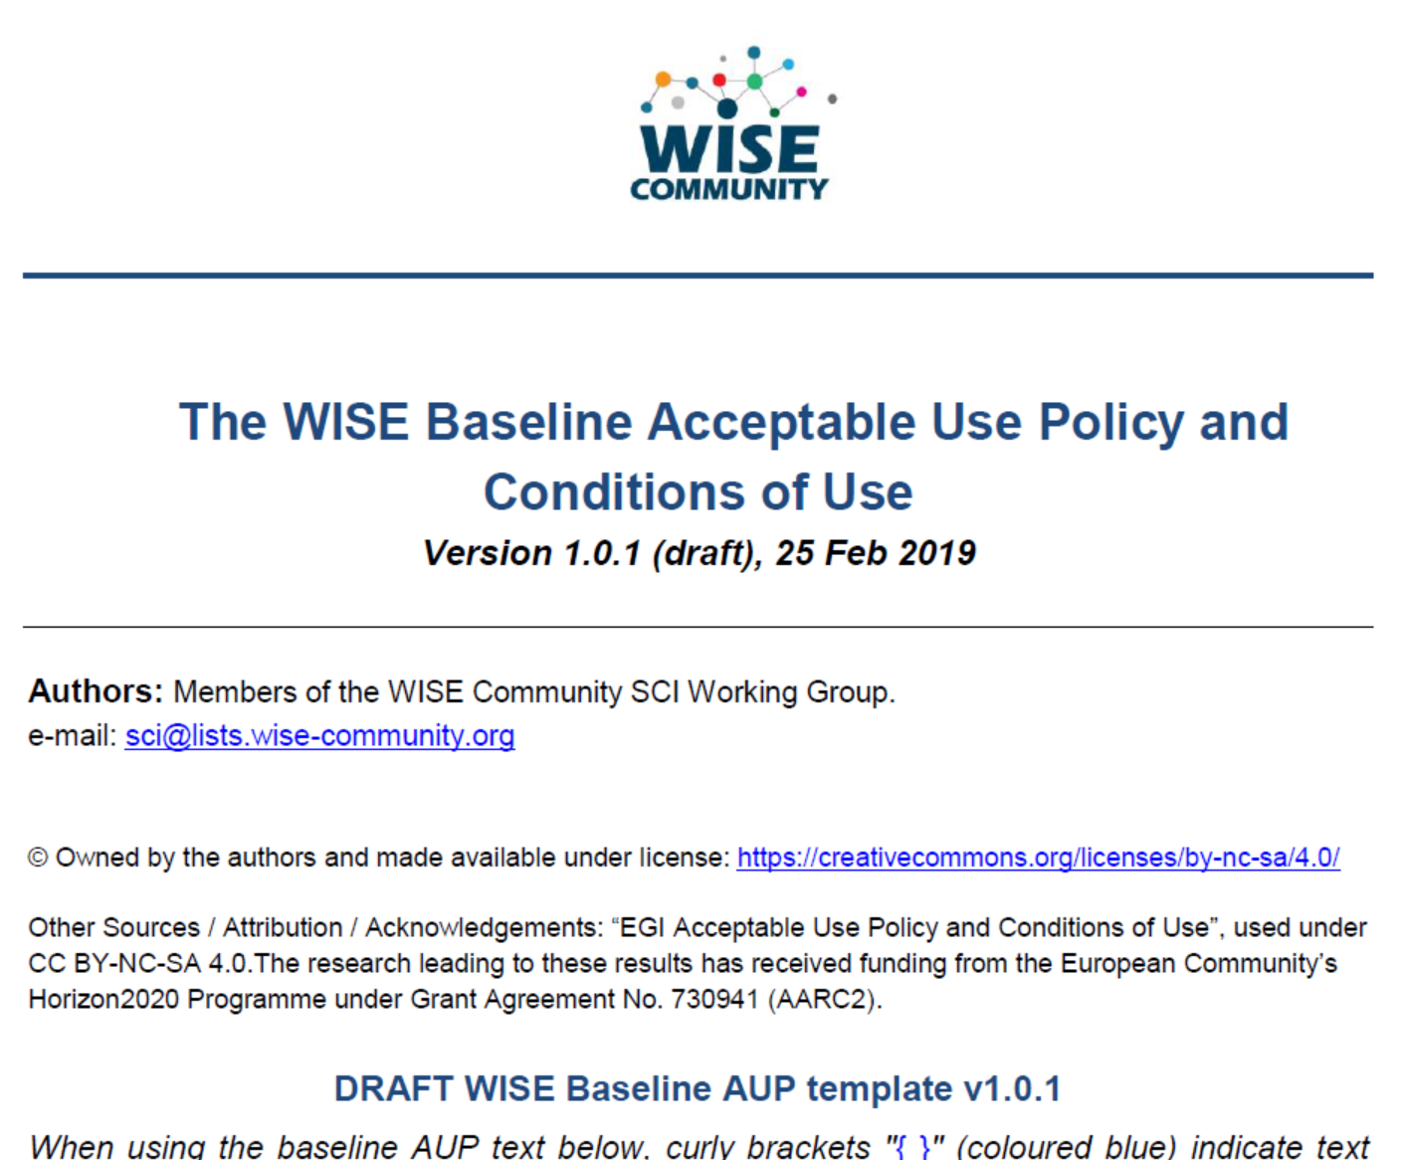
Avoid the locking-in to particular hardware or software platform
WISE success story: Security for Collaborating Infrastructures SCI
Common Acceptable Use Policy baseline in research communities& e-Infrastructures
Transparent and clear: ‘10 commandments’
Simplify load on users: ‘accept’ only once
Users can move seamlessly between service providers and infrastructures
Developed in WISE-SCI jointly by EOSC-hub, AARC, GEANT, EGI, EUDAT, …
Global interoperability: within Europe (NL, DE, UK, …), XSEDE (US), communities like SKA, WLCG, life sciences …
More joint policy templates being prepared!
Moving between all major infrastructures – endorsement of SCI, starting the AUP work
In NL: SURF Science Collaboration Zone, DE: Helmholtz Data Federation, UK-IRIS & GridPP

Slide 15
Extend the user base
More scientific communities will use storage and computing infrastructures with state-of-the-art services for their research and education activities; the open nature of the infrastructure will allow scientists, educators and students to improve the service quality by interacting with data, software and computing resources

Slide 16
Extend the user base
Publication of the e-infrastructure services in the EOSC Portal and Marketplace to expand the access outside the traditional user base
60 new communities ordered services in the EOSC portal
The 8 CCs experimented integration with 15 common services (3 are already in mature state)
Collaborations are ongoing with the INFRAEOSC04/05 projects
5 new use cases selected via the EaP; a new call is currently open
Scientific communities are benefitting from the EOSC-hub effort on fostering the adoption of advanced IT services

Slide 17
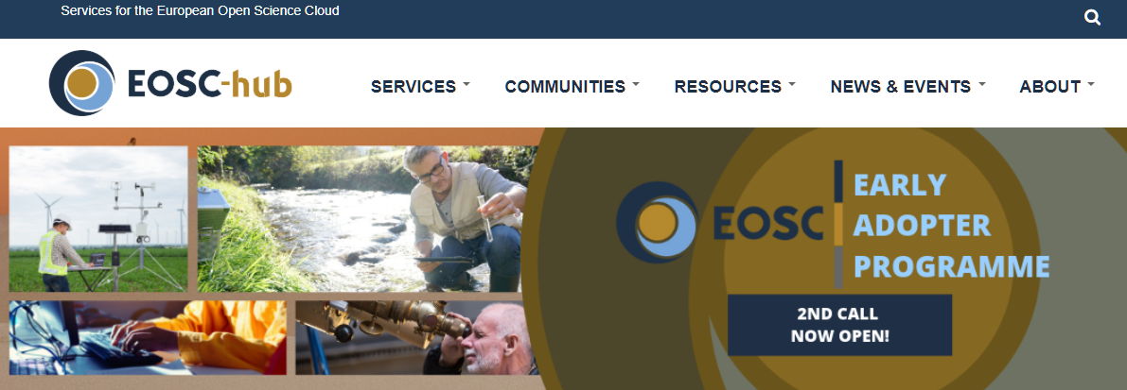
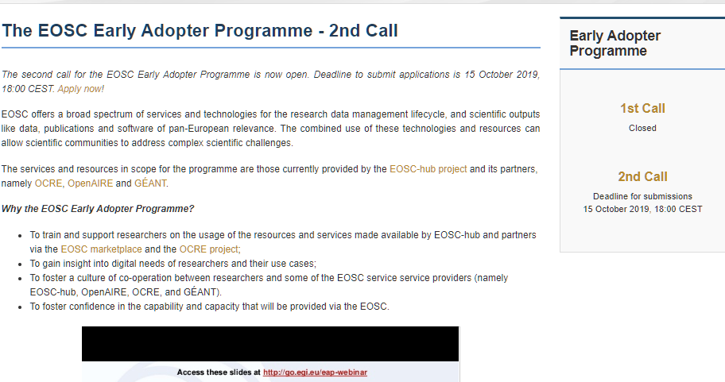
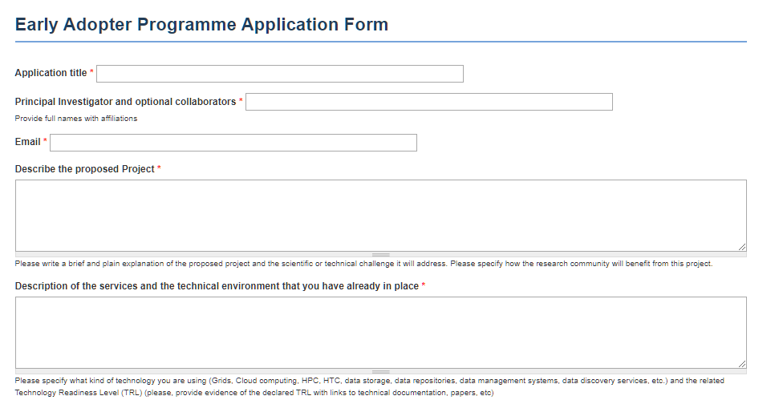
EOSC Early Adopter Programme
Active promotion campaign through:
Dedicated EAP section on the website
Conducted an EAP webinar
Open line of communication through early-adopter@mailman .eosc-hub.eu
Email campaign promoting applications
Social promotion
Promotion in EOSC-Portal and partner projects i.e. OCRE

Slide 18
5 Selected Early Adopters (1st Call) and 2nd call
Towards an e-infrastructure for plant phenotyping (Agricultural sciences)
Mapping the sensitivity of mitigation scenarios to societal choices (Earth and related Environmental sciences, business)
STARS4ALL Photometer Network (Astronomy)
Transitioning EMSO ERIC data management platform to production (Earth and related Environmental sciences)
Big Data Analytics for agricultural monitoring using Copernicus Sentinels and EU open data sets (Earth and related Environmental sciences, Agriculture, computer and information sciences)
Deadline: 15 October 2019
www.eosc-hub.eu/eosc-early-adopter-programme-2nd-call

Slide 19
Extend the user base
EGI User Statistics (Sep 2019) ➔ > 71,000 users +16% PY1
Physical Sciences > 41500 users
LHC, BELLE, ICECUBE,
LOFAR, VIRGO, CTA, XENON,
LSST, SKA, KM3NET, ..
Of which
Biological Sciences > 750 users
LifeWatch
Earth Science > 16700
EISCAT, EMSO
Chemical sciences > 550
Medical & Health Sciences
> 24300 users
Bioinformatics
Neuroimaging
Structural Biology
Hematology

Slide 20
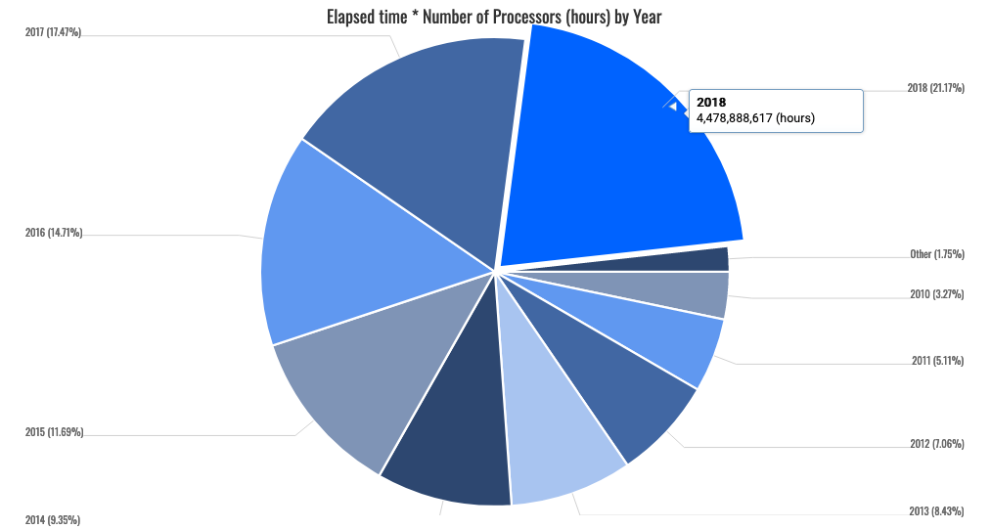
Extend the user base
CPU wall time consumed 2009-2018
The EGI Federation crossed
1 M CPU cores in 2019
+20% annual increase (2018)

Slide 21
EUDAT CDI Users and usage statistics
Extend the user base
Status July 2019; growth within last 18 months
Amount of long term storage used: 1.6PB; + 60%
Users registered on B2ACCESS IdP: 2300; + 110%
# services connected to B2ACCESS: 36; + 200%
# data objects/PIDs in the EUDAT CDI: 100M; + 20%
# B2FIND harvested repositories: 22; + 15%
# B2FIND findable data collections: 810k; + 35%
# user accounts on B2DROP: 1800; + 35%
# registered customers: 80; + 60%
# projects demanding EUDAT services 140; + 40%
# data scientists trained via special 70; EUDAT courses on data management and HPC
1100 new B2ACCESS users since 1/2018
20M new registered data objects/PIDs since 1/2018
600TB new long-term archived data since 1/2018
210k new data collections findable since 1/2018
3 additional repositories harvested since 1/2018
40 new data projects since 1/2018
30 new registered EUDAT customers since 1/2018

Slide 22
More people trained in research and academic sectors
Train people in research and academic organisations preventing lack of skilled and specialised infrastructure operators

Slide 23
More people trained in research and academic sectors
Established a network of training experts in different areas: access enabling and federation services, common services, data management planning, federated services management, domain-specific trainings
60 training events
1512 trained people
250 training modules in catalogue
Supporting EOSC by building the needed skills jointly with other intiatives to maximize impact

Slide 24
Success story: OPENCoastS
More people trained in research and academic sectors
OpenCoastS: an innovative and free platform to generated on-demand forecasts
First national EOSC-hub thematic service provider which joined the Marketplace, opening access to international user communities thanks to VA funding
International cooperation with the Atlantic Interactions Research Centre
After the start of EOSC-hub, 46 international deployments (forecast systems) of the service were created while, previously, it was only used in Portugal
"The OPENCoastS service used to analyse the extreme water levels associated with storm Gabriel" - A. Oliveira, A.B. Fortunato, J. Rogeiro, J. Teixeira, A. Azevedo, L. Lavaud, X. Bertin, J. Gomes, M. David, J. Pina, M. Rodrigues, P. Lopes -Environmental Modelling & Software journal
+100% cloud utilization in 2019
2 events, 150 participants from 14 countries
1 hands-on in the 14th SILUSBA conference, a major conference for water in the Portuguese speaking countries of Africa

Slide 25
A Community of Practice for Training Coordinators
Scope
To map out the training activities of various pan-European EOSC-related initiative
To strengthen training capacity by sharing experiences and good practices
To initiate cross-infrastructure training activities
A set of specifications collected (also for the EOSC portal training section)
Several workshops held in 2018/2019 (the next one will be part of the EOSC Symposium)
Consolidated synergies among EOSC related projects (OpenAIRE, FAIRsFAIR, regional projects, etc.)

Slide 26
Increased incentives for scientific discovery and collaboration across disciplinary and geographical boundaries and further development of the European economic innovation capacity
Engage adjacent but fragmented scientific communities and promote the uptake of services from multiple sectors and geographic locations
Stimulate opening up of services with the virtual access funding mechanism

Slide 27
Increased incentives for scientific discovery, cross-disciplinary/geographical collaboration & innovation
In the reporting period, access enabling and federation (+1800 users), common (+1700 users) and thematic (+1700 users) services enlarged their user base
8 Competence Centers are sharing IT best practices in different thematic areas gradually expand their respective knowledge
107 Countries supported by Virtual Access
The initial engagement phase with EOSC stakeholders has been followed by provisioning of support and dedicated webinars on EOSC-hub solutions
A series of workshops was organised to align activities and strengthen synergies at national level in collaboration with GÉANT, OpenAIRE, PRACE, and RDA
An effective stakeholder engagement strategy including outreach, training & co-design

Slide 28
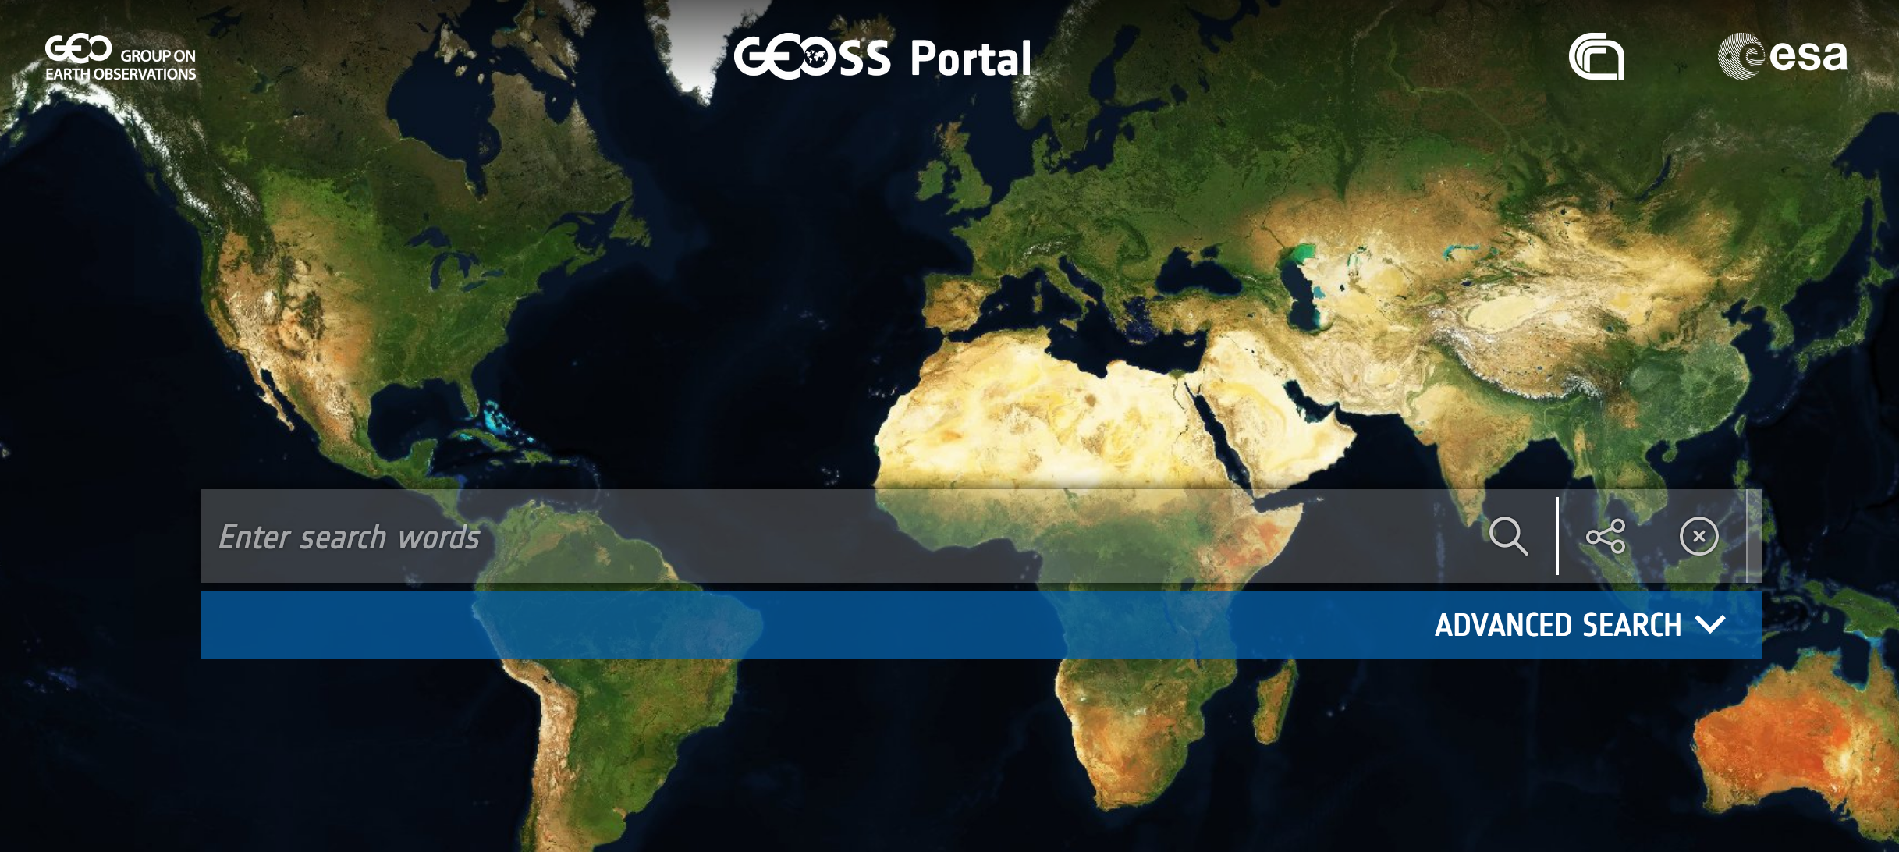
Success Story – GEOSS Portal
Increased incentives for scientific discovery, cross-disciplinary/geographical collaboration & innovation
The EOSC-hub version of the GEOSS Web Portal is connected also to the ECOPotential Virtual Laboratory, allowing users to execute available models utilizing GEOSS data as inputs.
The GEOSS (Global Earth Observation System of Systems) Web Portal is the main entry point for discovering and accessing GEOSS data.
The GEOSS portal was ported to the EGI Federated Cloud in Oct 2018, and will be followed by the GEO DAB
The GEOSS Portal is now available in the EOSC Marketplace

Slide 29
Establishing partnerships with industrial and private partners

Slide 30
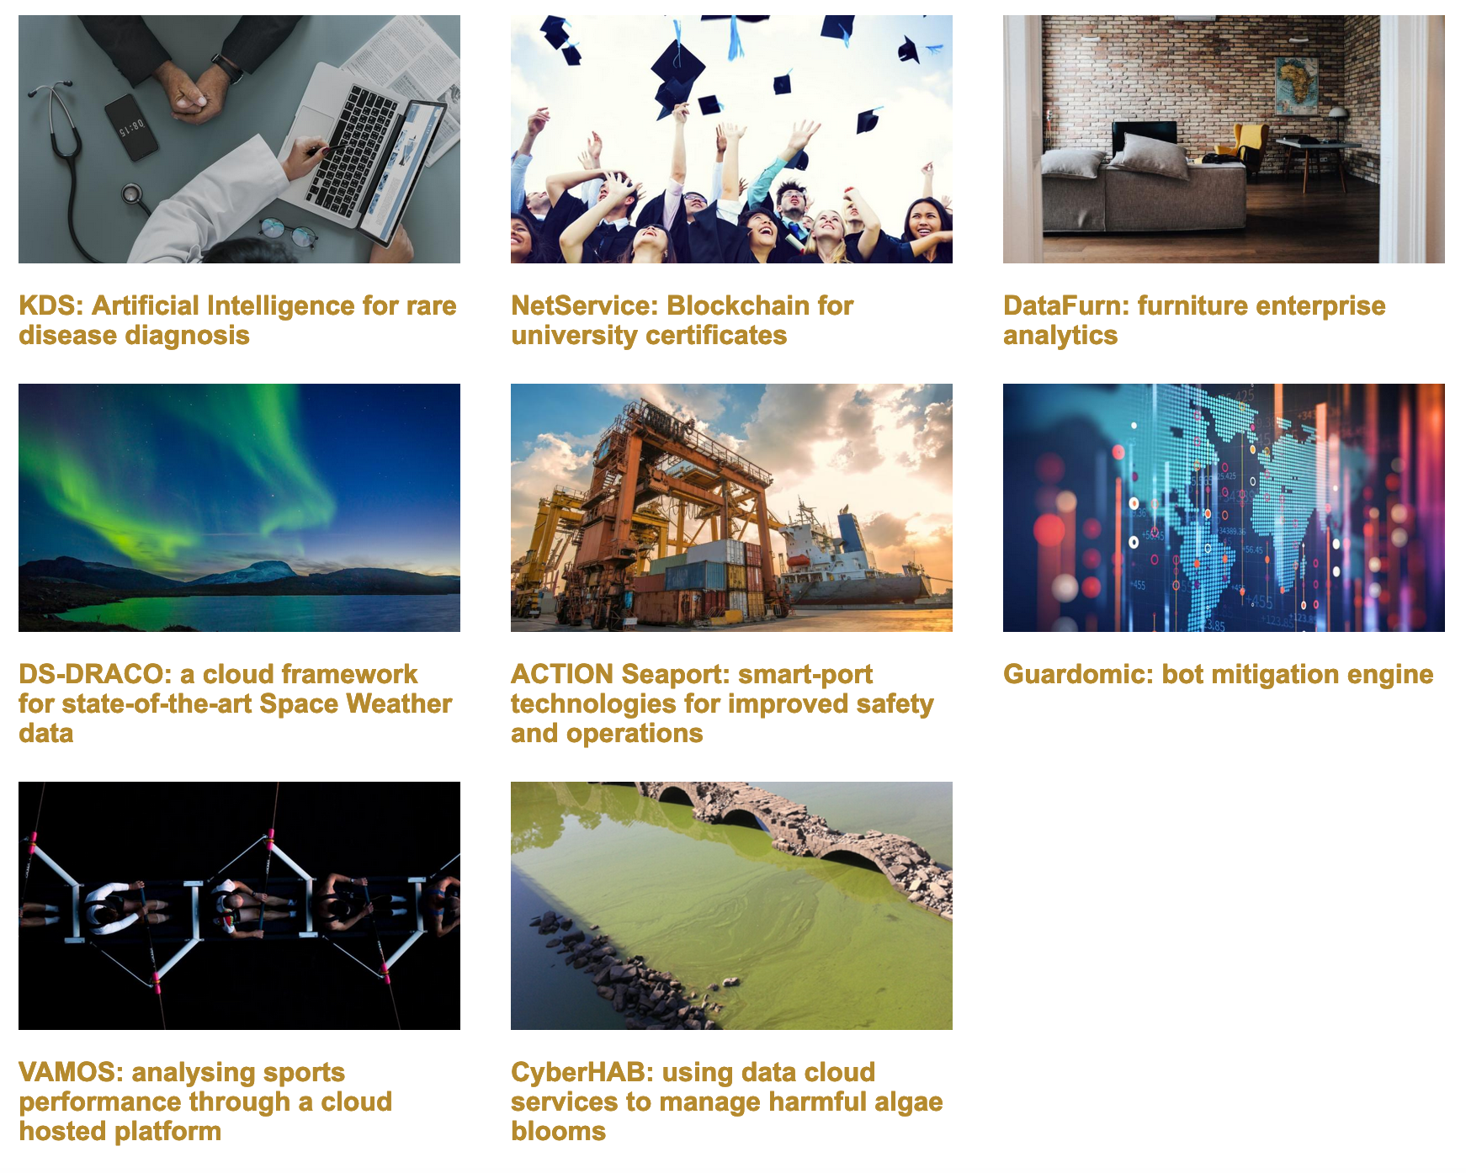
Establishing partnerships with industrial and private partners
The EOSC Digital Innovation Hub (DIH) was successfully established at the end of 2018 and is now officially part of the EU Digital Innovation Hub catalogue
6 pilots with SMEs have been kick-started and integrated with EOSC-hub services and now have been finalising their technical solutions, starting to use more intensively the EOSC-hub infrastructure
3 of the business pilots have applied to join the EOSC Portal Marketplace

Slide 31
Establishing partnerships with industrial and private partners
10 SMEs/Industry partners in the Marketplace
Voucher programme for free cloud services
+16 partnerships/collaborations with other DIHs
Piloting the SMEs engagement instruments for the future EOSC

Slide 32
Establishing partnerships with industrial and private partners
Success story – The Seaport Business Pilot
Improved port efficiency, competitiveness and safety
Seaport- Smart-port technologies for improved safety and operations
The pilot used Cloud Computing provided by PSNC for implementation of different tiers with redundancy, using Windows environment
The pilot deployed two Virtual Machines with 20 VCPU and 40 GBytes of memory to perform scalability tests and get perspective for the increasing number of potential customers
Bentley Systems designed and implemented ACTION Seaport, an advanced cloud-based and mobile-friendly platform to support decision-making for port authorities
Testing and validating products in the infrastructure environment
Human support from EOSC-hub experts on how to use/combine company solutions with the EOSC ones
Through the pilot, SMEs have implemented innovative services that can extend the capabilities of their offer

Slide 33
Next Steps – Priorities for 2019
Onboarding of new services: second call for EaP & OCRE & EOSC-Portal collaborations
Continuous contribution to the EOSC Working Groups
Further engagement of EOSC-hub key stakeholders: EOSC Symposium, EOSC-hub week 2020
Close interaction with the ESFRI clusters projects & INFRAEOSC05 projects
Publication of the first business pilots success stories & close collaboration with the Open Cloud for Research Environments (OCRE) project
Continuous training of users and service providers – joint trainings in collaboration with OpenAIRE
Focussed dissemination and communication activities in order to improve uptake of EOSC-hub services within target groups

Slide 34
Conclusions
The results achieved in terms of Impact are positive and some project KPIs have already been achieved
The collaborative work performed by the partners has been key in achieving these early results
The dissemination activities put in place by the project seem adequate for boosting impact in the upcoming years

