Slide 1
WP12 - Business Models and Procurement
Sergio Andreozzi, Strategy and Policy Manager (EGI Foundation), WP12 Leader
Luxembourg, 8-9 October 2019
Dissemination level: Confidential

Slide 2
WP12 Business Models and Procurement
Objectives:
Analysis
Demand-side market research to understand needs of digital services for research
Identification of business models to acquire them in the EOSC context
Procurement and purchasing framework design and validation
Development and piloting of procurement and purchasing frameworks
Evaluation and roadmap
Evaluation of the experience and definition of a roadmap for future activities
Number of Tasks: 3
Number of Participants: 6
Efforts planned RP1: 36PMs

Slide 3
Key Exploitable Results WP12
Researchers and
research communities:
Empower my research
Educate, inform and support my team and community
Services in the EOSC Service Portfolio
EOSC Portal
and
Marketplace
EOSC Hub Operators: Develop the EOSC landscape
Service Providers:
Provide services for
Researchers
Rules of Participation
Training courses and materials
Service Management System
Internal services in the Hub portfolio
Interoperability & Integration Guidelines
Business and sustainability models for services and the Hub
Digital Innovation Hub:
platform for industrial collaborations with EOSC
Enterprise: Develop, expose and grow my services

Slide 4
Market research
Business model analysis
Collaborations
Use of resources
Plans for the second period & deviations

Slide 5
Market Research: Objectives
Understand
Identify
Current usage and foreseen demand of digital services for researchers
Current challenges in using/offering digital services
Preferred delivery models of digital services for researchers
Funding streams and procurement strategies
Areas of improvements for business models
Current delivery models

Slide 6
Market Research: Target stakeholders
Survey organisations that need to acquire/procure digital services in order to serve research communities
Organisations serving large organised research communities (e.g. EIRO, Big lab, ESFRI)
Private sector / business organisations with significant research focus
Public sector organisations with significant research focus
Organisations serving small research groups / individuals (e.g. universities, research centres)
Scientific-service provider or consumer institutes
National Research and Education Networks (NREN)
H2020 projects

Slide 7
Market Research: Methodology
3 main roles targeted:
Researchers or research managers: to identify user requirements
Internal IT service provision & support: to understand how services are delivered
Procurement and finance managers: to understand current funding streams and approaches to procurement
N=32
N=33

Slide 8
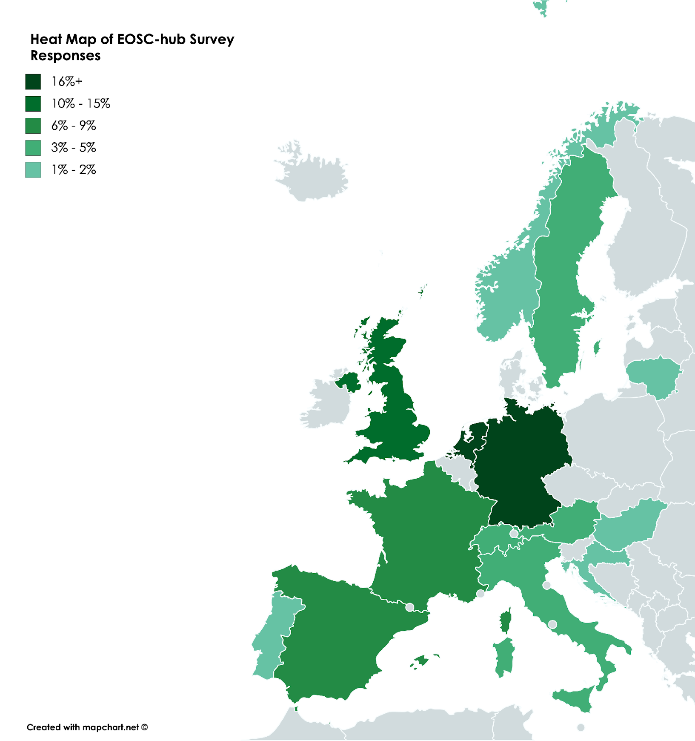
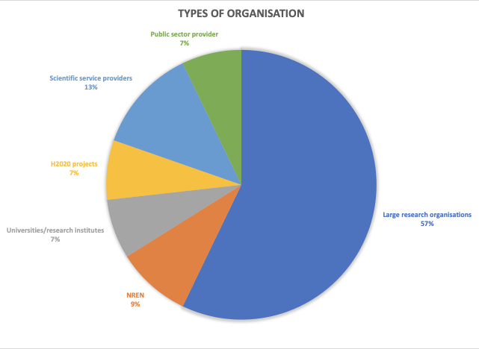
Respondents: Type of Organisations & Location

Slide 9
Services for researchers: usage and challenges (Highlights)
Usage
Store/share research data, software or knowledge (data repositories, ~80%)
Discover data and associations with software/publications (data registries, ~60%)
Extract information from data (data analytics, ~60%)
e-infrastructures already being used (~60%), welcome addition (~30%), no need (~10%)
Challenges in using/offering services
FAIR principles: researchers vs providers reported divergence in readiness
Data Management Planning needs to be supported
Lack of a complete service and data catalogue for the EOSC
Single Sign-On (also applies to accessing distributed data sources)
Interoperability and integration is a recurring topic (also applied to data)
Free-at-point-of-use for services is expected

Slide 10
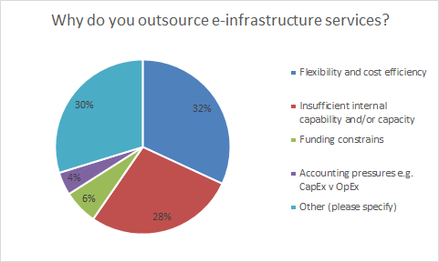
Out-/in-sourcing strategic considerations
Reasons for not outsourcing:
Internal skills development
Retention of control (especially over lifecycle)
Survival during financial squeezes
Risk reduction (buyout, shut down, etc.)
Flexibility to integrate into the researcher workflow
Low latency and high bandwidth requirements
Other: temporal scarcity of resources, combine financial resources

Slide 11
Funding and procurement of outsourced services
Funding streams
Mainly national/EU public funds (92%), mostly via competitive selection
Access policies for offered service
Membership-by-affiliation (56%), open/free access (26%), excellence-driven (21%), market-driven (14%)
Type of procurement used
Open (50%), restricted (40%), negotiated (30%), competitive dialogue (20%)
Lead time
1 month -> 1 year; negotiations used by > 80%
Other conditions:
Standards compliance, geographical location, reliability/availability/quality

Slide 12
Market research
Business model analysis
Collaborations
Use of resources
Plans for the second period & deviations

Slide 13
Motivation
Use cases
Individual researcher acquiring services for limited-scale access - researcher led
Organisational unit acquiring services for user base - organisational unit led
Lead buyer acquiring services for a consortium - consortium led
Forces at play
‘Free at the point of use’ vs ‘compensation for services rendered’
‘Agile procurement’ vs. ‘compliance in cross-border, many-to-many relationship matrix’
‘Economies of scale’ vs ‘community dynamics’
Foundations for growth
Number of researchers: tens of thousands -> 1.7M -> 70M
Complexity: number of communities, international and sectoral aspects
Compliance challenge: VAT, GDPR, public procurement rules, …

Slide 14
Business model landscape
Researchers
Business model
Diversity of transactional
patterns
Voucher/Cloud Coin
Organisational type
Sponsored Use
Organisational Units, departments
Lead buyer/demand aggregation
Organisations and
Consortia
Organisational
granularity

Slide 15
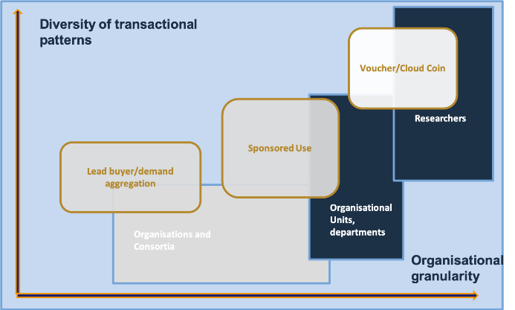
#1: Cloud Coin/Voucher Access Model
Considerations
Suitable for limited-scale access to services
”Calling off” capacity from pre-arranged commercial agreement
Access and accounting mechanism
Previous experiences from the HNSciCloud project, more from collaboration with the OCRE project
Benefits
Ease of use
Users are choosers
Providers paid based on use
Challenges
Several fundamental regulatory, policy and contractual issues open
Complexity in handling the lifecycle (e.g.: expirations, unused credit)
Scope of eligible providers and users

Slide 16
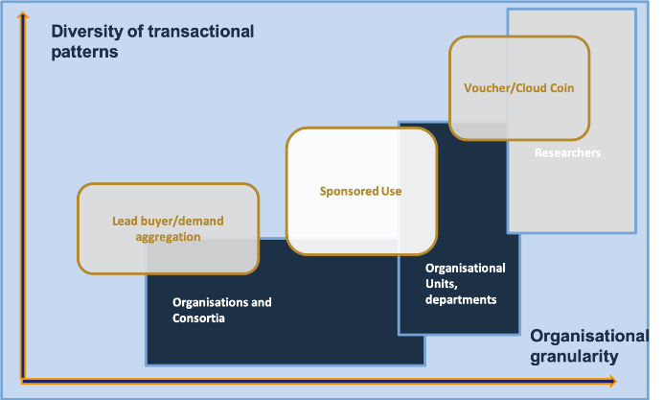
#2: Sponsored use
Considerations
Bilateral relationship between an organisation and a service provider
EOSC Portal supports matchmaking, but has no contractual role
Contractual and technical (e.g. AAI) details specific to be organised
Benefits
Flexibility in negotiating services and conditions to meet organisational needs
Smoothing the marginal cost function
Challenges
Limited economies of scale
Potential vendor lock-in
Complexity: end-user workflow may need to deal with different, provider-specific interfaces
Notes:
- Check why potential vender lock-in in D12.1

Slide 17
#3: Lead buyer/demand aggregator
Considerations
One legal entity represents a consortium to acquire commercial services
Build negotiating power to get preferential terms
Reduce the number of tendering processes needed
Benefits
Lead-buyer will have the transaction volume to build competences, visibility and contacts -> efficiency
Simplified procurement for other members
Collective bargain power
Challenges
Managing commercial risk
Added value services to be developed
Notes:
Check ”channels” business models in D12.1 (p. 34)

Slide 18
Market research
Business model analysis
Collaborations
Use of resources
Plans for the second period & deviations

Slide 19
The evolving EOSC landscape
EOSC Governance established and related Working Groups
EOSC Sustainability Working Group published a strawman document focusing on financing model, legal vehicle, governance structure, regulatory and policy environment
OCRE project designed and funded
Goal: stimulate the adoption of commercial digital services by the European Research community
Main milestone: Q3 2020 “Recommendations on strategic and financing orientations and organisational settings for the future of the EOSC
Dedicated budget available to procure Cloud and EO services for research

Slide 20
Contributions to the EOSC sustainability WG
Disseminated EOSC-hub D12.1 deliverable
Part of the content referenced in the EOSC Sustainability Strawman document
”Minimum Viable Product” based on EOSC-hub analysis
Feedback on EOSC Sustainability Strawman document
WP12 drafted a feedback that was validated by the EOSC-hub PMB
Key messages:
‘Public good’ vs. ‘commons’
Federating core and shared resources
Digital marketplaces approach vs. cross-pollination and cross-provider integration
Co-existence of publicly-funded services providers vs. commercial service providers
Governance model and inclusiveness

Slide 21
Collaboration with the OCRE project
Agreed and signed collaboration MoU
Aggregate requirements and demand of the research community into a public procurement / tender to establish ready-to-use agreements with capable cloud and earth observation suppliers
Support individual institutions and buyer groups to buy cloud resources via dedicated budget
Provided feedback to tender requirements
Agreed and signed voucher distributions MoU

Slide 22
Market research
Business model analysis
Collaborations
Use of resources
Plans for the second period & deviations

Slide 23
WP12: M1-M18 Efforts Planned & Used
WP | Task No. | Task Name | P1 M1 - M18
 |  |  | Planned PM | Used PM | Used%
WP12 | T12.01 | Business Model Analysis | 30 | 30 | 100%
 | T12.02 | Procurement and Purchasing Framework | 6.4 | 1.6 | 25%
WP12 Total |  |  | 36.4 | 31.6 | 87%

Slide 24
Market research
Business model analysis
Collaborations
Use of resources
Plans for the second period & deviations

Slide 25
Optimising the Workplan and Impact
According to the DoW, T12.2 is expected to
Development and piloting of procurement and purchasing frameworks
Changes in the landscape
The establishment of the new EOSC governance
The planned work of the EOSC Sustainability Working Group and strawman document
The work defined and being carried out by the OCRE project
Re-scoping T12.1 to maximise impact
Further development of the identified business models
Contribute to forming ToRs for EOSC Central demand aggregators
Feed recommendations into EOSC Sustainability WG
Interface with OCRE and Archiver projects
Collaboration with FAIRsFAIR and EOSC-Synergy projects

Slide 26
Key Results & Success Stories
Market research
Methodology & questionnaire defined
Extracted insights from collected data
Business models
Identification and high-level analysis of 3 business models
EOSC Sustainability WG
Referenced by the EOSC Sustainability WG in the Strawman document
Feedback collected and sent
OCRE project
Agreed and signed collaboration MoU and voucher distributions MoU
Provided feedback to tender requirements

