Slide 1
EOSC Architecture and Interoperability Guidelines
Giacinto Donvito/INFN, EOSC-hub Technical Coordinator and WP10 Leader
Luxembourg, 8-9 October 2019
Dissemination level: Confidential

Slide 2
WP10 Technical Coordination
Objectives:
Define the technical roadmap, with external and internal input from user and service providers’ requirements, existing and planned services, technologies, standards, frameworks.
Contribute to external standardisation bodies and relevant initiatives.
Define the criteria for inclusion of new services into the catalogue and asses conformance.
Identify solutions to community requirements and lead their integration into the service portfolio.
Provide support WP13 service operators/managers about technical solutions.
Number of Tasks: 4
Number of Participants: 10
Efforts planned RP1: 101 PMs

Slide 3
Key Exploitable Results WP10
Researchers and
research communities:
Empower my research
Educate, inform and support my team and community
Services in the EOSC Service Portfolio
EOSC Portal
and
Marketplace
EOSC Hub Operators: Develop the EOSC landscape
Service Providers:
Provide services for
Researchers
Rules of Participation
Training courses and materials
Service Management System
Internal services in the Hub portfolio
Interoperability & Integration Guidelines
Business and sustainability models for services and the Hub
Digital Innovation Hub:
platform for industrial collaborations with EOSC
Enterprise: Develop, expose and grow my services

Slide 4
Landscape and Service Composability
Overarching concepts
Landscape & EOSC Architecture Working Group
End-to-end service composition
EOSC Interoperability Guidelines & Interoperability Framework

Slide 5
Landscape
Analysis of EOSC Pilot recommendations on Service Architecture
Commission Staff Working Document on the implementation roadmap for the European Open Science Cloud
‘Architecture’ Action Line
EOSC Architecture WG
EOSC-hub representative contributing to the WG
The WG will propose the technical framework required to enable and sustain an evolving EOSC federation of systems
EOSC interoperability layer: standards, APIs and protocols that will facilitate interoperable services

Slide 6
End-to-end Composition of Services
Fostering service composability to create new added-value solutions for research
Promote the adoption of standards
Perform service integration activities
Typical service combinations
Re-using federation services to implement basic features (e.g. AAI, monitoring, accounting)
Adopt common services to better exploit compute, storage and data resources (e.g. EGI Cloud Compute, EUDAT B2FIND, INDIGO Orchestrator)
Create new scientific workflows as combination of more services

Slide 7
EOSC Interoperability Guidelines
Technical Interoperability Guidelines in terms of suggested EOSC standards and interfaces/APIs
Lower the barriers to allow services to interact and work together
Benefits:
Scientists can rely on e-Infrastructures and EOSC-compliant services for implementing the basic features
Federated and common services can interoperate (e.g. AAI or accounting services from different initiatives)
Interoperability guidelines as implementation of the EOSC interoperability layer (--> EOSC Architecture WG)
Based on existing community practices, well-known standards and interfaces
Adoption should not be forced but as a natural consequence of the advantages for a service

Slide 8
Service composability - Examples
EOSC Technical Support enables integration working with the community
EGI FedCloud
DODAS Analytics
EGI Check-in
+
+
Service already interoperable thanks to the adoption of a common standard (OGC WMS).
Standard adoption reduces the cost of the integration work
Developer
CREODIAS DATA HUB¹
+
Sentinel Hub²
+
B2Access
DODAS thematic service
Solution of integrated services can be reused in similar use cases
OGC WMS
OGC WMS
EOSC Technical Support can support community for the integrated usage
Developer
New workflow for scientific analysis

Slide 9
EOSC Technical Architecture
The approach
Reference architecture
Define the EOSC Building Blocks
EOSC Technical Architecture
Access Enabling and Federation Tools Building Blocks
Common service Building Blocks
Thematic services Building Blocks
Technical Roadmap

Slide 10
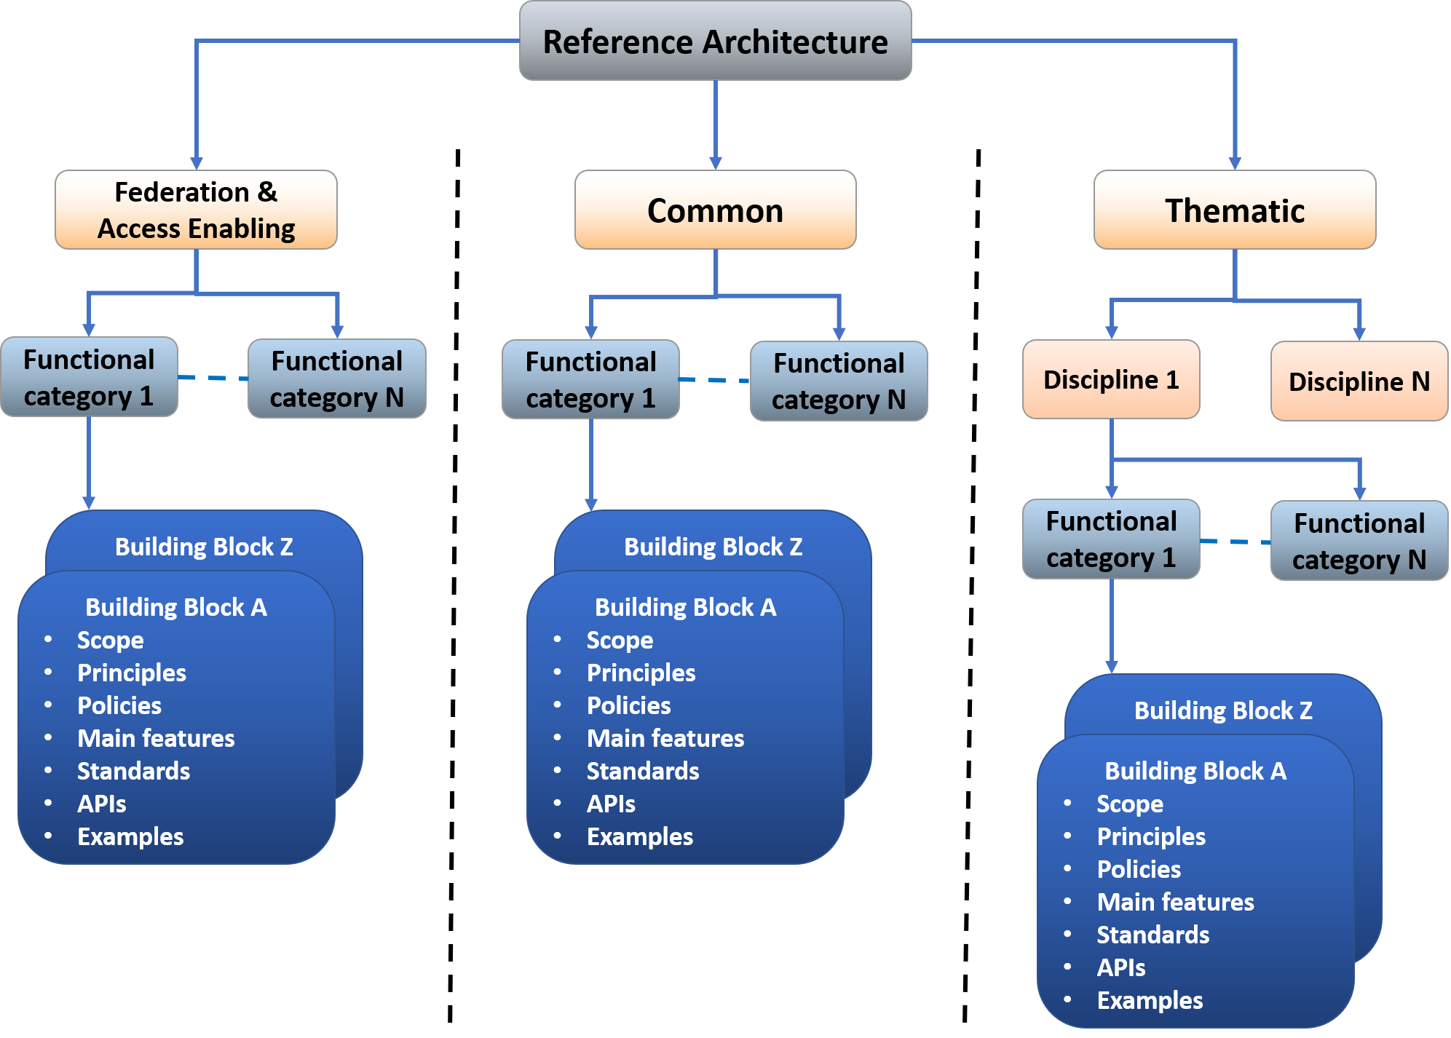
EOSC Reference Architecture
Reference architecture: template solution for an architecture
common vocabulary
list of functions and some indication of their interfaces (or APIs)
internal/external interactions
EOSC Technical Architecture
Infrastructure level
Working on defining:
Main blocks, functions, interfaces, APIs, standard as technical concepts, common vocabulary

Slide 11
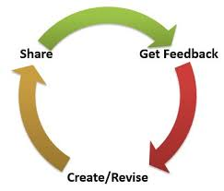
Define the Building Blocks of the EOSC architecture
Identify and define EOSC architecture building blocks for Access Enabling and Federation, Common and Thematic services
Common approach for all service categories
Mapping the features to Technical Specifications including High-level architecture & Interoperability guidelines
Iterative approach to identify building blocks and improve the technical specification
Start from the most relevant use cases
Define the technical specification and get feedback
Involve external people with expertise in the area

Slide 12
Family of EOSC Compliant Services per Block
Services in a Building Block
Follow the EOSC technical specification
Are interoperable
Examples:
AAI services compliant with the AARC Blueprint
Monitoring/Accounting systems able to exchange/share information
Building Block

Slide 13
Technical specification template per Block
Introduction
Short description of the building block highlighting its main functions
High-level Service Architecture
Reference architecture of the building block highlighting the interfaces towards the other building blocks
It does not refer to any specific service
Adopted Standard
List with references of the main adopted standards and protocols/API
Interoperability guidelines
Describe how similar services can be made interoperable with this macro-feature
Examples of solutions implementing this specification
Services compliant with this specification

Slide 14
EOSC Technical Architecture - Functional view
Users
GUI/API
Thematic services
Common services
EOSC Portal
Federated Discovery and Brokerin,/supporting (Federated AAI)
Federations tools
AAI, Accounting, monitoring, Helpdesk, etc.
Other Portals and Marketplace
Data/Compute/Storage Resources

Slide 15
Access Enabling and Federation Services

Slide 16
Access Enabling and Federation services
Building block as any key access-enabling and federation function needed to operate the EOSC.
Leveraged on experiences from large European e-infrastructure to identifies the needed services
Part of the EOSC Hub Portfolio
Technical specifications for each of these services
Hub Portfolio
AAI
Helpdesk
Accounting
CMDB
Monitoring
Order Management
Hub Portfolio
EOSC Portal
Operations portal
Service Portfolio Management Tool
Collaboration software & platforms
Messaging
Security Monitoring

Slide 17
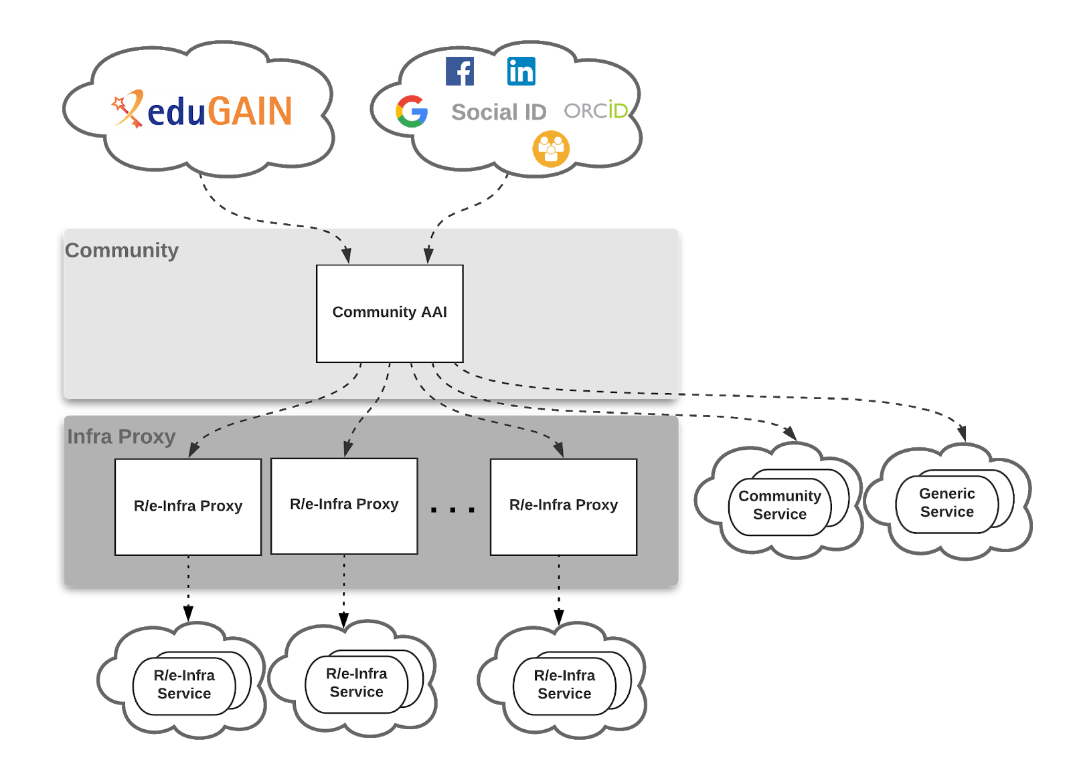
Access Enabling and Federation services – Technical Specification An example: AAI
Standards
Standard | Short description | References
Security Assertion Markup Language (SAML) 2.0 | OASIS standard for exchanging authentication and authorisation data between parties. | https://www.oasis-open.org/standards#samlv2.0
OAuth 2.0 | Standard for authorisation that enables delegated access to server resources on behalf of a resource owner | "The OAuth 2.0 Authorization Framework", RFC 6749, https://www.rfc-editor.org/info/rfc6749
OpenID Connect 1.0 | Identity layer on top of the OAuth 2.0 protocol. It enables Clients to verify the … | “OpenID Connect Core 1.0”, https://openid.net/specs/openid-connect-core-1_0.html
X.509 | ITU-T standard for a public key infrastructure (PKI), also known as PKIX (PKI X509) | https://www.rfc-editor.org/info/rfc5280 https://www.rfc-editor.org/info/rfc3820
Lightweight Directory Access Protocol (LDAP) | Provides access to distributed directory services that act in accordance with X.500 data and service models. | https://tools.ietf.org/html/rfc4511
Technical specification ready for public comments
High-level Service Architecture
Interoperability Guidelines

Slide 18
Common Services

Slide 19
Building Blocks in Common Services (1/2)
In Common Services, a building block is a technical function that
offer added value on top of the EOSC resources (computing, storage, etc.)
can be adopted by multiple thematic services
Examples of building blocks
IaaS VM/Container management, Cloud Orchestration, metadata management, making scientific artefacts FAIR, etc.
A macro-feature can be offered by one or more generic services
Number of relevant building blocks in Common Services can be huge
Different technical areas
Need to prioritise
Starting from the most relevant for users -> use cases requirements

Slide 20
Building Blocks in Common Services (2/2)
Split the work leveraging on technical areas
EOSC-hub technical areas
Other tech areas suggested by other initiatives
E.g. OpenAIRE suggested to add Scholarly Communication
Technical Areas
HTC/HPC Compute
Cloud Compute (inc Containerisation and orchestration)
PaaS Solutions
Workflow management and user interfaces and Data analytics
Technical Areas
Data Platforms for Processing
Data Publishing and Open Data
Data Preservation/Curation/Provenance
Metadata Management and Data Discovery

Slide 21
EOSC Technical Architecture
Users
GUI/API
Thematic services
Common services
Scholarly Communication
Workflow Management
EOSC Portal
Std interfaces
Std interfaces
Std interfaces
Std interfaces
Feature 5
Feature 6
Feature 7
Feature 8
Federated Discovery and Brokerin,/supporting (Federated AAI)
Federations tools
AAI, Accounting, monitoring, Helpdesk, etc.
Compute
Data Management
Std interfaces
Std interfaces
Feature 1
Std interfaces
Feature 4
Feature 3
Other Portals and Marketplace
Std interfaces
Feature 2
Data/Compute/Storage Resources

Slide 22
Common Services Building Blocks per technical area
Technical Area | Building Blocks
HTC/HPC Compute | Multitenant job submission Multitenant container based job submission HTC / HPC clusters on demand
Cloud Compute (inc Containerisation and orchestration) | IaaS: VM Management IaaS: Orchestration IaaS: Containers
PaaS Solutions | PaaS Solution for Cloud service automation and federation of hybrid Cloud resources

Slide 23
Common Services Building Blocks per technical area
Technical Area | Building Blocks
Data Platforms for Processing | Transparent data processing using POSIX in distributed and hybrid cloud environment including Dockers and Kubernetes and Jupiter Data Ingesting and movement for processing in hybrid cloud environment Metadata Management in processing workflows QoS based data access optimization and tight integration with preservation services Authorization based on attributes from IdP Results sharing and experiment repeatability Distribution of software for the processing tasks
Data Publishing and Open Data | Data Repository
Data Preservation/Curation/Provenance | Data Preservation Tracking of provenance metadata Data Curation
Metadata Management and Data Discovery | Data Discovery and Access Metadata cataloguing and indexing Annotation service

Slide 24
Common Services Building Blocks per technical area
Technical Area | Building Blocks
Workflow management and user interfaces and Data analytics | Portals Big data analytics ML/DL analytics services Cloud based IoT Platforms interoperability
Scholarly Communication | Data Management Plans Digital Preservation Overlay platforms: Peer-review Anonymization Aggregator Broker Entity Registry Metadata validation Annotation Usage stats VRE: RI Services for experiments

Slide 25
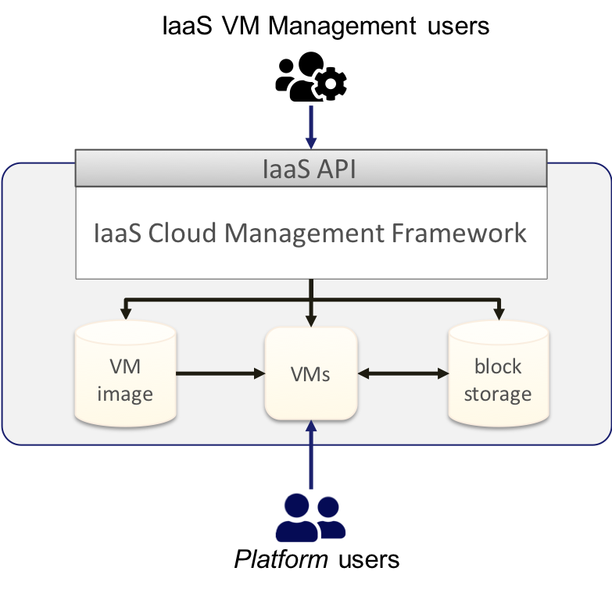
Common services – Technical Specification An example: Cloud IAAS VM Management
Standards & API
Standard | Short description | References
Open Virtualization Format (OVF) | Packaging format for software solutions based on virtual systems (VM image format) | OVF 2.1.1
OpenStack | OpenStack is an Open Source cloud operating system that controls large pools of compute, storage, and networking resources throughout a datacenter… | OpenStack API
Amazon EC2/EBS/VPS & AWS VPN | Provide management of Virtual Machines and associated block storage and network features | AWS EC2 API
Azure Virtual Machines/Disks/Vnet | IaaS VM management services from Microsoft Azure | Azure Virtual Machines API
Google Cloud Compute Engine | IaaS VM management service from Google Cloud Platform | Google Cloud Compute Engine API
OGF OCCI | Open community-lead specifications delivered through the OGF | OCCI Specification
DMTF CIMI | Model and protocol for management interactions between a cloud Infrastructure as a Service (IaaS) provider and the consumers | CIMI 2.0.0
Technical specification ready for public comments
High-level Service Architecture
Interoperability Guidelines

Slide 26
EOSC Technical Architecture
Users
GUI/API
Thematic services
Common services
APIs and std interfaces
APIs and std interfaces
APIs and std interfaces
APIs and std interfaces
EOSC Portal
Workflow Management
Big Data Analityics
Data Annotation
Making science products FAIR
APIs and std interfaces
APIs and std interfaces
APIs and std interfaces
APIs and std interfaces
Federated Discovery and Brokerin,/supporting (Federated AAI)
Federations tools
AAI, Accounting, monitoring, Helpdesk, etc.
APIs and std interfaces
APIs and std interfaces
APIs and std interfaces
APIs and std interfaces
Cloud IaaS
Cloud Orchestrator
Data Discovery
Metadata management
Other Portals and Marketplace
APIs and std interfaces
APIs and std interfaces
APIs and std interfaces
APIs and std interfaces
APIs and std interfaces
Data/Compute/Storage Resources

Slide 27
EOSC Technical Architecture
Users
GUI/API
Thematic services
Common services
APIs and std interfaces
APIs and std interfaces
APIs and std interfaces
APIs and std interfaces
EOSC Portal
Workflow Management
Big Data Analityics
Data Annotation
Making science products FAIR
APIs and std interfaces
APIs and std interfaces
APIs and std interfaces
APIs and std interfaces
Federated Discovery and Brokerin,/supporting (Federated AAI)
Federations tools
AAI, Accounting, monitoring, Helpdesk, etc.
APIs and std interfaces
APIs and std interfaces
APIs and std interfaces
APIs and std interfaces
Cloud IaaS
Cloud Orchestrator
Data Discovery
Metadata management
Other Portals and Marketplace
APIs and std interfaces
APIs and std interfaces
APIs and std interfaces
APIs and std interfaces
APIs and std interfaces
Data/Compute/Storage Resources

Slide 28
Thematic Services

Slide 29
Thematic Services
A building block in the Thematic Services is a technical function that
is discipline oriented
can be re-used in multiple thematic services within one thematic domain
Discipline oriented building blocks need to be identified and specified by experts of disciplines
EOSC-hub will start this effort with communities participating to the project
Community oriented projects need to be involved (e.g. Cluster projects)

Slide 30
EOSC Technical Architecture
Users
GUI/API
Thematic services
APIs and std interfaces
APIs and std interfaces
APIs and std interfaces
APIs and std interfaces
Discipline feature 1
Discipline feature 2
Discipline feature 3
Discipline feature 4
EOSC Portal
APIs and std interfaces
APIs and std interfaces
APIs and std interfaces
APIs and std interfaces
Federated Discovery and Brokerin,/supporting (Federated AAI)
Federations tools
AAI, Accounting, monitoring, Helpdesk, etc.
Generic services
APIs and std interfaces
APIs and std interfaces
APIs and std interfaces
APIs and std interfaces
Cloud IaaS
Cloud Orchestrator
Data Discovery
Metadata management
Other Portals and Marketplace
APIs and std interfaces
APIs and std interfaces
APIs and std interfaces
APIs and std interfaces
APIs and std interfaces
Data/Compute/Storage Resources

Slide 31
Technical Roadmap
Built to facilitate the service composition
Adoption of standards and participation to standardisation bodies (RDA, OGF, etc.)
Develop new solutions as result of integration activities
Fostering the integration of thematic services with federation and common services
Enhance the EOSC-Hub access channels to improve
Discoverability, access and combined usage of services
See EOSC Portal in particular
Establish and further enhance collaborations with other EOSC projects
OpenAIRE Advance, GNT4-3, ESFRI Clusters, regional and national projects, implementation projects, etc.

Slide 32
EOSC-hub Liaison with external bodies
Collaboration with RDA
Other bodies

Slide 33
Collaboration with RDA
FAIR Data Maturity Model WG
EOSC-hub regularly contributing to meetings providing expertise on the assessment criteria for FAIR data that the WG is developing, and their validation against known use cases.
Software Source Code Identification WG
Software code sharing through collaborative platforms like the Application Database
Array Database Assessment WG
Supported by Task T7.3 (ECAS, climate research)
Health & privacy IG/WGs
Contributions from WP2.4
Meeting and workshops
RDA11th Plenary (at Berlin), EOSC-Hub, FREYA, and OpenAIRE-Advance projects together organized a "EOSC-related European Projects getting Global: Engaging with the RDA - RDA 11th Plenary BoF meeting" to:
share interests in RDA activities for each of the three projects,
identify new activities relevant to the RDA context,
discuss RDA recommendations and outputs of interest,
liaise with interested RDA members from all regions.

Slide 34
Collaboration with RDA (cont) and other bodies
“Research Data Repository Interoperability” WG
“Metadata” IGs
“Sensitive Data in the Open Science” WG
“Data Usage Metrics” WG
“Data Management Plans (DMP) Common Standards”
Together with OpenAIRE: RDA WG “Make Data Count”
Contribution to TOSCA standard: for the orchestration of Cloud services
OGC standard: in the field of the Earth Observation cases, and the GLUE standard
Strict correlation with AARCH for the AAI implementation

Slide 35
EOSC-hub Technical Support
Users’ requirements gathering

Slide 36
Workflow for users’ requirements gathering (T10.3/T10.4 to be completed)
Technical support is provided to all potential EOSC-hub users (internal and external) by T10.3 and T10.4 in collaboration with other technical work-packages (WP5, WP6, WP7)
TS / CC / DIH
Community requirements DB
Task 10.3,10.4
Requirements analysis and feedback on them
Compiles
Cases from EOSC Portal + eng. activities
Scouting on external projects/tools
Technical Teams
WP5, WP6
TCOM
External projects / tools
Interaction with technical WPs

Slide 37
Technical Support
22 Communities recorded in the Community Requirements DB
Thematic services, competence centers, business pilots, cases from EOSC Portal or engagement activities
Around 100 user stories and 120 use cases recorded and analysed
109 technical requirements for technical teams (WP5, WP6, WP7) recorded → new service releases
T10.3 is supporting the Early Adopter Programme
Technical reviews of proposals
Shepherding of shortlisted proposals
Identify service and resource providers
Define a technical plan for integration

Slide 38
WP10 Effort Planned & Used

Slide 39
WP10: M1-M18 Efforts Planned & Used
WP | Task No. | Task Name | P1 M1 - M18
 |  |  | Planned PM | Used PM | Used%
WP10 | T10.01 | Technical Roadmap | 21 | 13 | 62%
 |  | Unfunded efforts-- Technology Coordination | 5.5 | 0 | 0%
 | T10.02 | Service Catalogue Technical Evolution | 15 | 12.9 | 85%
 | T10.03 | Community Requirement Analysis and Technical | 47.5 | 41.1 | 86%
 | T10.04 | Common Service Building Requirements and Gap Analysis | 12.5 | 8.6 | 69%
WP10 Total |  |  | 101.5 | 75.6 | 74%

Slide 40
WP10: Deviations
Deliverable D10.1 “EOSC-Hub Technical Roadmap v1” was delayed (M21) to give priority to define a generic framework to work on EOSC interoperability and integration guidelines
Technical Reference Architecture provided to the EOSC Architecture WG
Framework described in D10.3/D10.4
Proposed changes for the future:
Deliverable D10.2 “EOSC-Hub Technical Roadmap v2” [M24]
We will ask in the next Amendment to move this to [M32]
Deliverable D10.6 “Requirements and gap analysis report v2” [M24]
We will ask in the next Amendment to move this to [M35]
Milestone MS39 “M10.2 Technical Roadmap v2 revision” [M30]
We will ask in the next Amendment to move this to [M34]

Slide 41
WP10 Conclusions

Slide 42
Highlights and main results
First EOSC Technical Architecture (proposal)
Input to the “EOSC Architecture WG” → EOSC Interoperability layer
Feedback collection on-going → survey in the EOSC Secretariat platform
Cross-project Workshop on technical architecture with OpenAIRE and GEANT (June 2019)
Initial specifications for a number of building blocks
Federation services: AAI, Monitoring, Accounting, etc
Common Service: Cloud IaaS, Cloud Container, PaaS, Data Repository, etc
First EOSC Hub Technical Roadmap
Ongoing collaborations with RDA
22 internal & external user communities supported
> 100 user stories & use cases analysed
> More than 100 technical requirements defined for WP5/WP6,WP7

Slide 43
Future plans
Enhance the proposal for the EOSC Technical Architecture
Feedback from relevant stakeholders
Liaison with EOSC Architecture WG
Organise a Workshop to discuss an enhanced version of the EOSC Technical Architecture
Release the first set of EOSC Technical Specifications for external comments
Involve other key actors in the definition of the EOSC Technical Specifications
Updated Technical Roadmap
Continue the collaboration with RDA
Continue Technical Support activities

Slide 44
donvito@infn.it

