Slide 1
Operations, Service Management and Rules of Participation
Matthew Viljoen (EGI Foundation), WP4 Leader
Luxembourg, 8-9 October 2019
Dissemination level: Confidential

Slide 2
WP4 Federated Service Management
Objectives
Implement ITSM best practice across the federation
Coordinate federated operations for the service providers in the project to ensure QoS and security
Support the Service Providers joining the federation, enable new users to access the service and ensure the quality
Collect usage statistics
Collaborate with other initiatives, for example GÉANT, to exchange best practice, knowledge and mutually improve best practice
Number of Tasks: 6
Number of Participants: 15
Effort planned RP1: 558 PMs

Slide 3
Key Exploitable Results WP4
Researchers and
research communities:
Empower my research
Educate, inform and support my team and community
Services in the EOSC Service Portfolio
EOSC Portal
and
Marketplace
EOSC Hub Operators: Develop the EOSC landscape
Service Providers:
Provide services for
Researchers
Rules of Participation
Training courses and materials
Service Management System
Internal services in the Hub portfolio
Interoperability & Integration Guidelines
Business and sustainability models for services and the Hub
Digital Innovation Hub:
platform for industrial collaborations with EOSC
Enterprise: Develop, expose and grow my services

Slide 4
Outline
Operations activities (frontend and backend)
Integration and production delivery of EOSC-hub partners and 3rd parties
Order Management, Helpdesk and Security
Creation of 13 processes from scratch (*)
Harmonized Policies for EOSC-hub
Rules of participation
Activities, onboarding operations and its approach
(*) (SPM,SFRM,SOCRM,SLM,SRC,SACM,CAPM,ISM,ISRM,PM,CONFM,CHM,RDM,CSI)
For explanation of acronyms please see https://www.fitsm.eu

Slide 5
Operations activities Front-end and Back-end

Slide 6
Front-end operations activities: Operations coordination + Integration activities
Achievements
Day-to-day delivery of essential EGI and EUDAT service delivery and service management
Contribution to the onboarding shifter rota
Integration of new services and communities (provision of new resources, supporting new communities etc.)
Setup a Service Provider Forum as a communication channel between the project and providers of services
Plans
Increasing alignment of service delivery, procedures and policies
Closer future collaboration of operations tools and ensure complementary funding and development

Slide 7
Front-end operations activities: Service Provider Forum
SERVICE PROVIDER FORUM
Aims
lightweight communication (Mailing list)
Face to face communication (conferences)
requirements gathering
increasing awareness of services
Indirect access to users
Communication needs
Project
Service Providers
News
project news
major operational news
security threats
upcoming events
Increasing awareness of Hub services
Requirements collection
General concerns
Feedback to project (SPs and users)

Slide 8
Front-end operations activities: Ordering Services
Achievements
Creation of the order management workflow, roles and shifter rota
Plans
Closer alignment with the Marketplace
Further development of the Customer Relationship Management
Challenges
Harmonizing orders for different types of services (different access models)
Ensuring scalability

Slide 9
Service order workflow
Request for combined or integrated services from multiple providers?
Order contains all required information?
Status -> New
no
Assignee -> shifter
Status -> In progress
yes
Assignee -> service provider
no
no
yes
Is the service open access?
WP10 Team
Discuss with user/provider on the order details if not clear
no
Order ticket created from MP
WP10 team
Status -> Approved
Clarification provided by user?
yes
no
yes
Needs for development?
yes
Service ready to be used?
Status -> Approved
no
yes
Status -> Waiting for response
Status -> Ready
< 2 weeks
How much time without response?
no
Conditions or duration of provisioning completed?
> 2 weeks
Status -> Rejected
yes
Status -> Closed

Slide 10
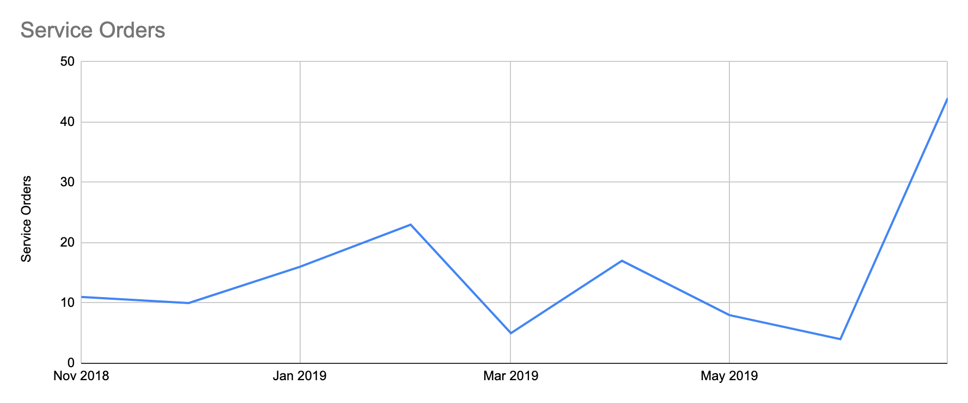
Service orders over time

Slide 11
Front-end operations activities: Helpdesk
Achievements
Deployment of a common EOSC-hub helpdesk system
Creation of the 1st line support team rota with documentation
Plans
Provide a fully managed Helpdesk as a Service
Improved usability and better guidelines
Improved user interface
Challenges
Integrating with existing solutions used by participating e-Infrastructures
User
XGUS
External service
EGI
EUDAT
Thematic
Service

Slide 12
Back-end operations activities: Consistent service delivery – Availability, Continuity and Capacity
Achievements
Process definitions which are being followed for Hub services
Plans
Completion of continuity/capacity plans for all Hub services
Comprehensive monitoring of all Hub services
Challenges
Process integration problems due to services being run by different e-Infrastructures and needing to avoid overlaps with processes

Slide 13
Back-end operations activities: Trust assurance – Information Security
Achievements
Coordination of security incidents (IRTF) and handling software vulnerabilities (SVG)
Streamlining IRTF procedures and leadership/participation of IGTF/EUGridPMA
Security risk management, training, SSC and security monitoring
Creation and promotion of harmonized policies for EOSC (WISE* AUP, security policies)
Plans
Further alignment of policies, procedures and coordination
Promotion of Information Security best practice to external providers
Challenges
Understanding the scope of EOSC-hub Information Security (assisted by Rules of Participation Task Force)
* WISE https://wise-community.org/sci/

Slide 14
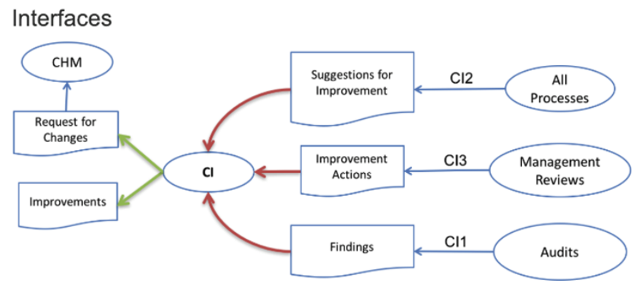
Evolution of operations activities: Continuous Service Improvement
Achievements
Process setup with interfaces defined
Internal Audit program established
First audit 11-15 Mar ‘19
Plans
Follow-up audit next year
Evolution of operations processes via CI
CI – Continuous Improvement

Slide 15
Rules of Participation (RoP) Activities of Workgroup (wp1-6, 9, 13)

Slide 16
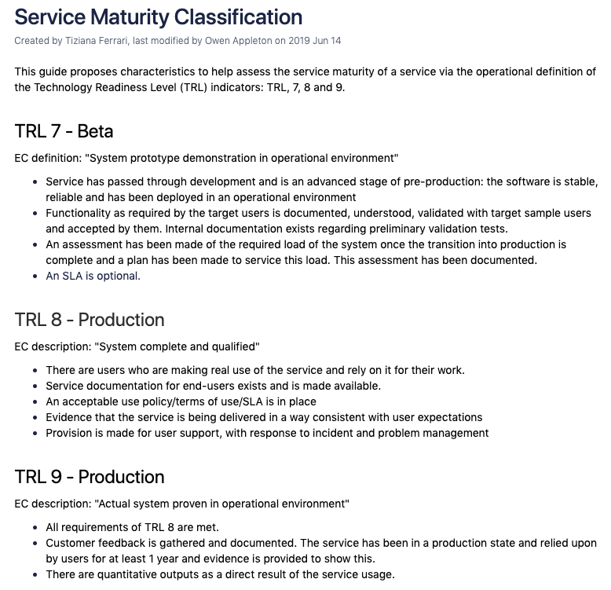
Rules of Participation
Cross-project taskforce (wp1-6,9,13) on criteria for participation
Areas of work
Service maturity classification (including harmonization across e-Infrastructures)
Service Description Template (SDT)
Providing guidance for security policy work
Classification, onboarding of services (next slides)
Provides input to EOSC RoP WG

Slide 17
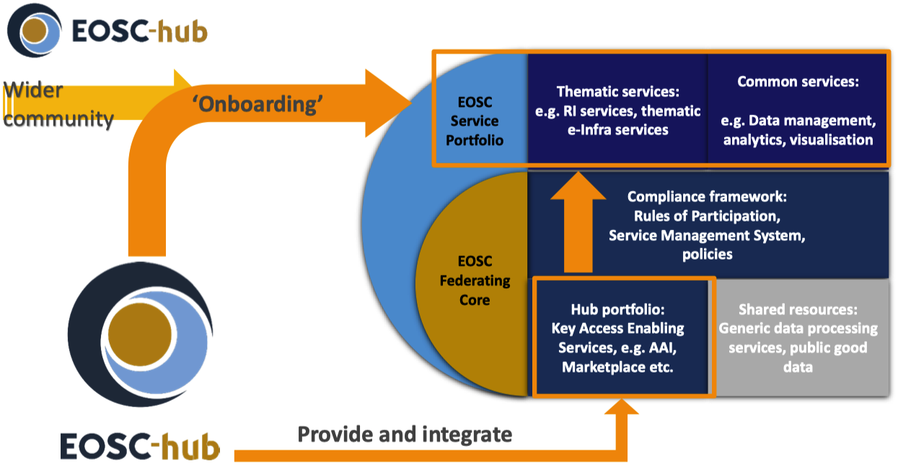
Onboarding procedure
RoP – Onboarding within EOSC-hub

Slide 18
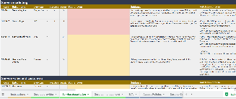
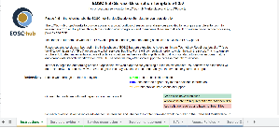
RoP – Onboarding Workflow
EOSC Service Portfolio
ACS:
A Chemistry
Service
Service Catalogue
Thematic
Services
EOSC Portal
EOSC Portal
Request onboarding
Fill SDT
Onboarding Shifter
Service Validator
Service in Portfolio
Published
8 people in
weekly rota
(T4.1)
5 people in
weekly rota
(T2.2)
1 person
(WP3)

Slide 19
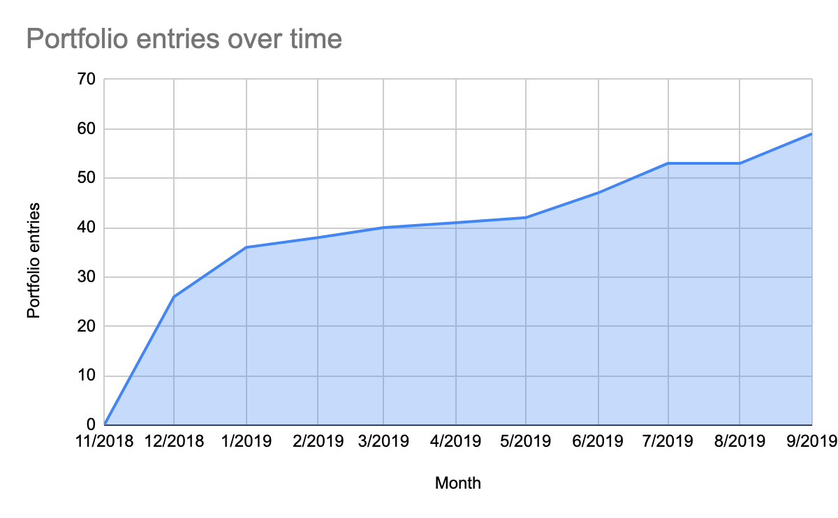
RoP – Onboarding activity and challenges
Challenges
Manual process with little scope for software development
Continuity of onboarding individual services across multiple people
Acceptable types of services to onboard?
only scientific? DBs/data?
IaaS service providers?

Slide 20
RoP – General approach for onboarding EOSC Portfolio services
Original approach – 3 levels of integration
Level of provider’s SMS maturity
Based on which EOSC-hub SMS integration
HIGH-level required following EOSC-hub SMS
Too course-grained and rigid
New approach – package-based onboarding
Package: AAI, helpdesk etc.
Pragmatic – addresses provider needs from EOSC
Under active development
Onboarding requirements based on package(s) chosen
Details still under discussion
Possible packages & onboarding requirements
AAI
Trusted IdP
SIRFTI compliance
Helpdesk as a Service
2nd line support
SLAs defined
SLA
Marketplace for listing
§
Minimal SDT information
Completed OLA
Monitoring present
Capacity, continuity plans
Marketplace for ordering
Order management

Slide 21
WP4: M1-M18 Efforts Planned & Used
WP | Task No. | Task Name | P1 M1 - M18
 |  |  | Planned PM | Used PM | Used%
WP04 | T04.01 | Ops coordination | 50.1 | 26.1 | 52%
 |  | EGI CA- 70% funded by EC | 36.5 | 39.9 | 109%
 |  | Unfunded efforts (planned in P2) | 18 | 0 | 0%
 | T04.02 | Order and Customer Mgm | 9 | 6.9 | 77%
 |  | EGI CA- 70% funded by EC | 12 | 2.5 | 21%
 | T04.03 | Availability, Continuity, Capacity | 1.5 | 1.2 | 78%
 |  | EGI CA- 70% funded by EC | 3 | 3 | 100%
 | T04.04 | Security | 5.5 | 1.8 | 33%
 |  | EGI CA- 70% funded by EC | 51 | 51.9 | 102%
 | T04.05 | Incident problem and service req mgm | 12 | 12.5 | 105%
 |  | EGI CA- 70% funded by EC | 36 | 20.2 | 56%
 | T04.06 | Configuration Change Release and Deployment mgm | 11.5 | 21.1 | 184%
 |  | EGI CA- 70% funded by EC | 36 | 52.1 | 145%
WP04 Total |  |  | 282.1 | 239.3 | 85%

Slide 22
Conclusions
Main results
EOSC-hub aiming to “lead by example” by:
Consistent approach to Service Management using common vocabulary and methodology (FitSM)
Development (from scratch) of EOSC Service Management System
Contributing to training (Security)
Providing generic light-weight policies suitable for all
Harmonized, efficient + quality service delivery - blueprint for EOSC sustainable into the future
Common challenge
Achieving coordinated & consistent high-quality service delivery across multiple organizations and research domains
Future plans
Complete remaining aspects of the EOSC Service Management System
Further alignment + streamlining of Operations
Promoting adoption of harmonized policies

