Slide 1
Policy Issues for Identity Management (and other attributes)
EGI Technical Forum (Sep 2010) NRENs & Grids workshop
David Kelsey

Slide 2
Outline
Identity Management for Grids
The Grid security model - history
The PMA approach
(Some) Lessons learned
Recent developments
How can Grids and NRENs/Federations work together?

Slide 3
The Grid security model
Started to build an X.509 PKI in 2001
The only feasible solution at the time
EU DataGrid, CrossGrid, LCG, EGEE, USA, Asia ...
Single electronic ID to be used everywhere
All Grids, All VOs (needs Trust)
Single registration at VO (AuthN independent)
Single Login (per session)
Require (identity) Delegation
AuthZ attributes come from a VO authority
Shared security policies (JSPG -> EGI SPG)

Slide 4
The PMA model
Policy Management Authority
Started as “The CA Coordination Group”
2001-03 and already global in scope
EUGridPMA started in 2004
International Grid Trust Federation (IGTF) – Oct 2005
3 PMAs (EU, Asia and Americas)
Minimum standards for operating a CA
And the various Registration Authorities
Peer review (accreditation) by other CA operators
PMAs include Relying Parties (important aspect)
Regular self audit and peer review

Slide 5
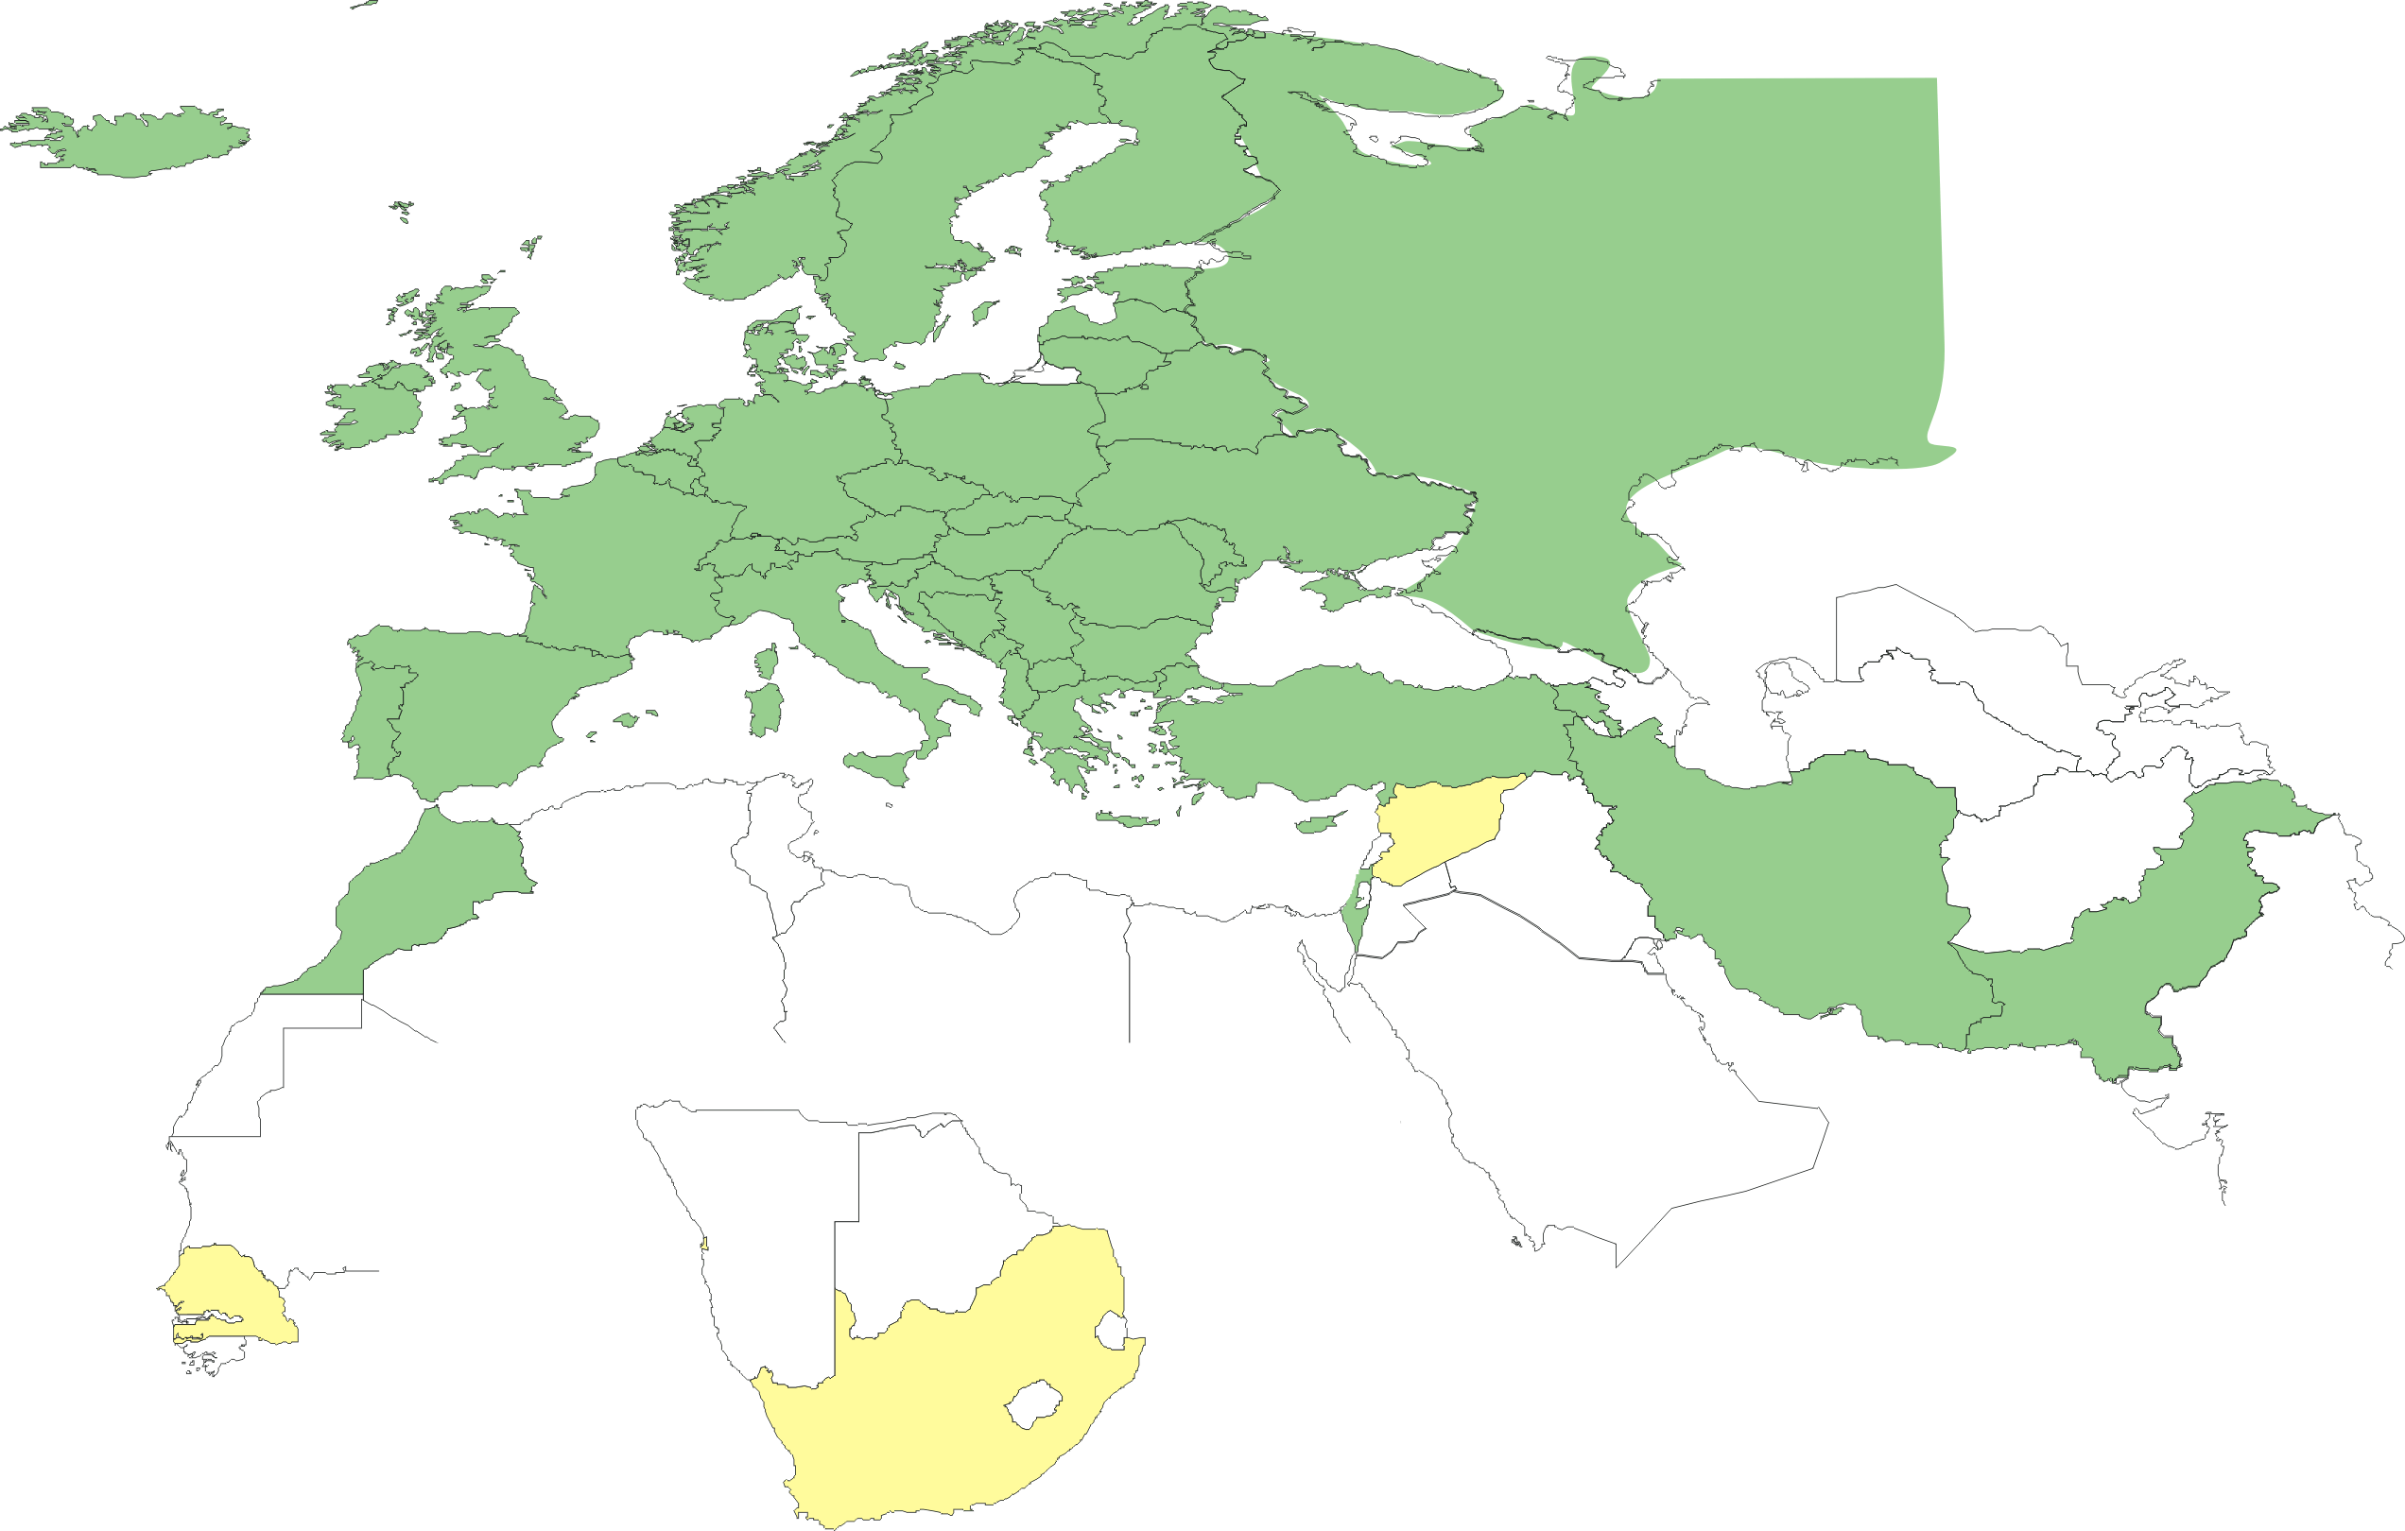
Geographical coverage of the EUGridPMA
25 of 27 EU member states (all except LU, MT)
+ AM, CH, HR, IL, IR, IS, MA, ME, MK, NO, PK, RO, RS, RU, TR, UA, SEE-GRID + CERN (int), DoEGrids(US)*
Pending or in progress
SY, ZA, SN
Notes:
5

Slide 6
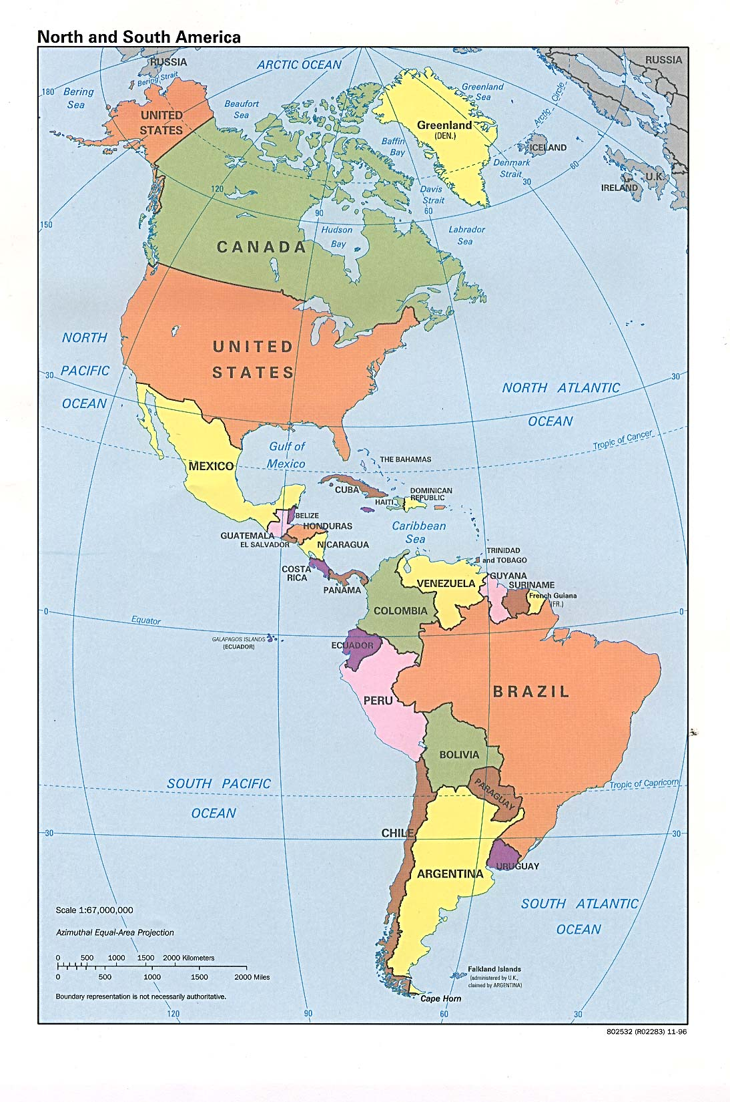
TAGPMA Membership
ANSP - Brazil
NRC – Canada
ESnet (DOEGrids) – USA
EELA – International
Fermi National Accelerator Laboratory - USA
HEBCA/USHER/Dartmouth College – USA
IBDS (ANSP) - Brazil
WLCG – International
NCSA – USA
NCSA CILogon
NERSC – USA
NICS UT/ORNL– USA
NIH Dorian - USA
Open Science Grid – International
Purdue University – USA
REUNA – Chile
San Diego Supercomputer Center – USA
SENAMHI – Peru
TACC – USA
TeraGrid (PSC) – USA
Texas High Energy Grid – USA
University of Virginia – USA
UFF – Brazil
ULA – Venezuela
UNAM – Mexico
UNIANDES - Colombia
UNLP – Argentina
IGTF Accredited CA Operators
CA Accreditation in progress
Interested in accreditation
Relying Party

Slide 7
APGridPMA Members (15 + 1)
15 Accredited CAs
AIST (JP)
APAC (AU)
ASGC (TW)
CNIC (CN), SDG
IGCA (IN)
IHEP (CN)
KEK (JP)
KISTI (KR)
NAREGI (JP)
NCHC (TW)
NECTEC (TH)
NGO/Netrust (SG)
PRAGMA-UCSD (US)
HKU (HK)
Mongolia - under accreditation
Coverage by RAs
Philippine, Vietnam, Malaysia, Indonesia, New Zealand & Sri Lanka (soon)
CA: 9 Countries
RA: + 6 Countries
New: +1 Country
Notes:
7

Slide 8
(some) Lessons learned
Grids multi-national right from the start
And meeting needs of many communities
Impossible to agree to a single root CA
Which level of assurance should we aim for?
But had to satisfy e.g. Life Sciences
Decided on one level with face-to-face identity vetting with photo ID (like NIST 800-63 level 2)
No way we could use bilateral contracts between IDPs and relying parties
Trust must come from the IGTF & Grid sec policies

Slide 9
Recent work
Scale-up by building on other Identity Management systems
Does not make sense to duplicate work done by others
Identity is best managed by the home institute
“Member Integrated Credential Services” and “Short-Lived Credential Services” issue Grid certificates on the basis of other well-managed IDPs
Kerberos, Active Directory, Academic federations, ...

Slide 10
Policy issues - federations
E.g. New TERENA eScience Personal Certificate Service
Issues Grid certificates on basis of membership of national federation
IGTF can no longer audit all identity vetting processes and RAs
We need to be sure that the “Level of Assurance” is as expected
Addressed by contract TERENA/NREN/Inst

Slide 11
Other attributes?
Identity best managed by Home Institute
Authorisation Attributes (VO groups, roles, rights ...) must be managed by the appropriate application community (VRC)
Attributes need to come from multiple authorities and then should be “merged”
All-round Trust is needed
Standards are needed for AuthZ attributes too (work started)

Slide 12
NRENs & Grids?
Or “Academic Federations” and “Grids”
Some personal thoughts
We should encourage more Grid participation in the Federations activities (e.g.“REFEDS”)
Co-location of meetings in Prague May 2011
We could jointly work on best practices for Registration Authorities (identity management)
More work also required in:
LoA: should IGTF align with NIST 800-63?
merging attributes, audit procedures

Slide 13
Questions?

Slide 14
Links
EUGridPMA http://www.eugridpma.org/
IGTF http://www.igtf.net/
REFEDS http://refeds.terena.org/
EGI SPG https://wiki.egi.eu/wiki/SPG

