Slide 1
Application and User Support in Asia
Eric Yen
ASGC, Taiwan

Slide 2
e-Science Collaborations in Asia
Discipline | Applications | Partners | Going DG
HEP | ATLAS, CMS, ALICE, BELLE, CDF, GEANT4 | TH, TW, CESNET, INFN | X
BioMedical | Virtual Screening for Drug Discovery – Avian Flu, Dengue Fever | MY, TW, VN, CESNET, INFN | X
 | Pandemic disease analysis | VN, FR
Bioinformatics | Grid enabling phylogenetic inference | SG, TW, VN, CESNET, INFN
 | SVM Parameter optimization for prediction of Caspases
 | Genome search to identify T3SS effect |  | X
 | Autodock ligand-receptor docking |  | X
 | Complex diseases studies
Earth Science | Disaster Mitigation on Earthquake | ID, MY, PH, TH, VN, TW, CESNET, INFN | X
Comp Chemistry | Chemical compound property analysis | TH, TW, CESNET | X
Climate Change | Weather simulation, sea level rising | ID, PH, TH, VN, TW
Social Sci. | Social Simulation | TW, UK | X

Slide 3
Application Repository
Idea taken from the collaboration with the EELA-2 project
A database to monitor, disseminate, and share the progress of application porting and availability in the EUAsia VO environment
Technical background
Web application developed by INFN
PHP and MySQL database
Currently run and managed by INFN
Manages a complete life-cycle of an application in a grid environment
Modules available to deal with particular aspects
Only two modules used in Application Repository for EUAsiaGrid, namely the application list and statistics

Slide 4
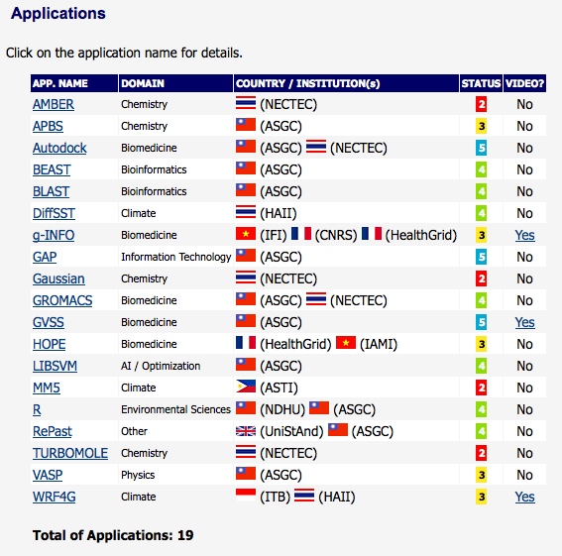
Application Repository
Application Status: S1 (in consideration), S2 (running but not ported to gLite yet), S3 (ported to gLite, unavailable in EUAsia VO), S4 (available in EUAsia VO), S5 (ready for production)

Slide 5
EUAsiaGrid Portal
Convenient access to grid infrastructures for individual users
Provides, through the portal interface, support to:
Submission of jobs
Specific forms for individual applications
Helping to prepare the job description and input data
Data management
Allow sharing with other users
Job Monitoring
Life Sciences
Autodock 4, Beast, Blast, Gromacs, MrBayes, Muscle, Prodist
GVSS*
Earth Science: Earthquake*
Weather Simulation: WRF*
Statistics: R
Other User Defined Applications

Slide 6
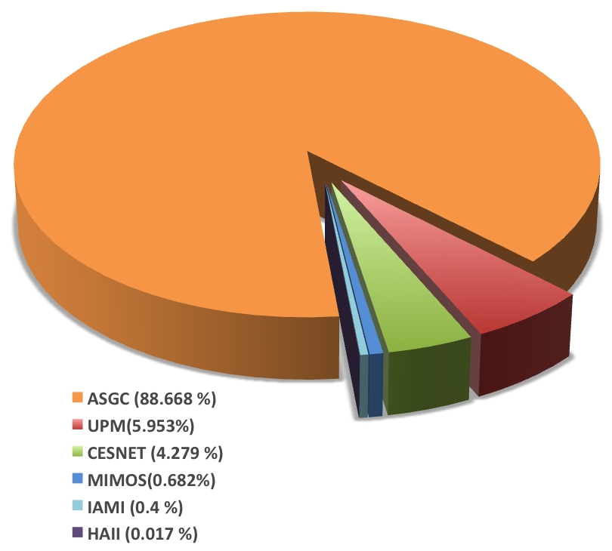
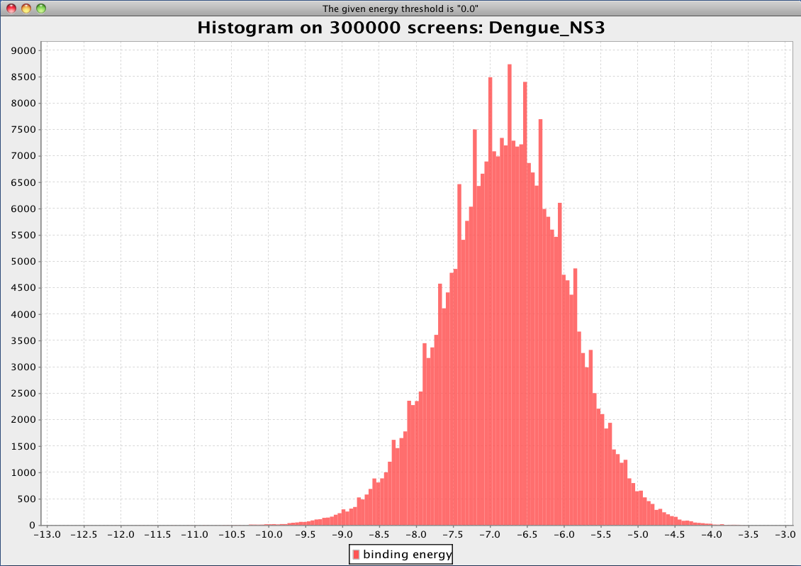
Dengue Fever Data Challenge in 2009
Total number of completed docking jobs | 300,000
Estimated needed computing power | 4,167 CPU*days
Duration of the experiment | 60 days
Cumulative computing results | 42.5 GB
Total Computing Recourses in EUAsia VO | 268 Cores
Number of used Computing Elements | 6
Collaborators:
UPM, MIMOS, MY
IAMI, VN; HAII, TH
Cesnet, CZ; GRC, TW

Slide 7
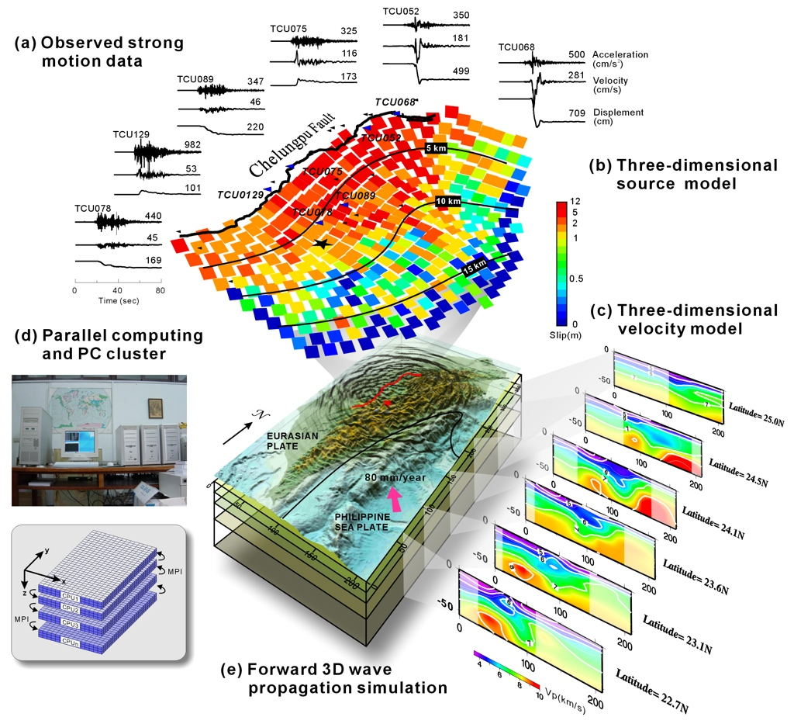
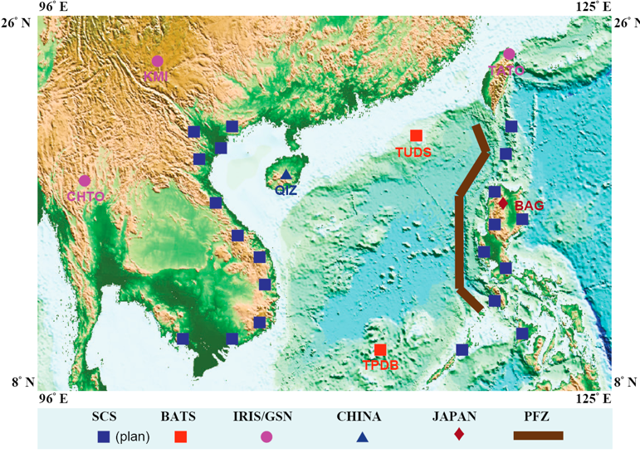
e-Science for Earthquake Disaster Mitigation
Collaborators: PH, VN, TW, ID, MY, TH
Seismic Sensor Networks
Local Sensor & Observation Data
High Resolution Source & Rupture Process Analysis
Global/Regional Sensor Data
Fast Reporting System
Archive
Ref. Historical Events Data
Forward Simulation & Event Construction on Grid
Archive
Risk Analysis & Reduction
Earthquake Data Center (SeisGrid)

Slide 8
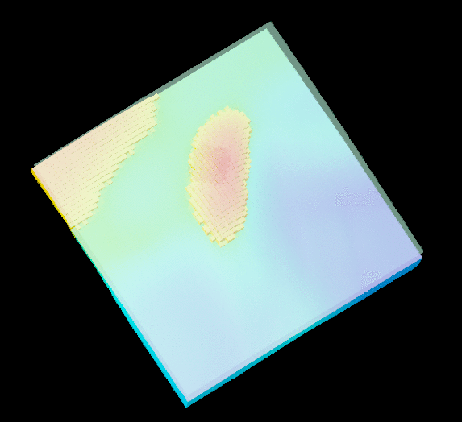
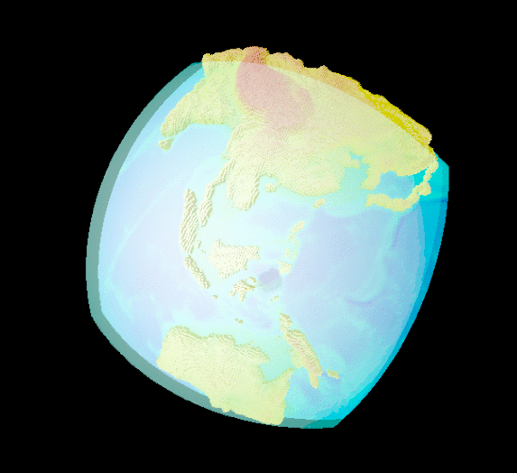
Seismic Wave Propagation Analysis
SWPA Application Porting and Data Challenge
Porting of both SPECFEM3D and FDM packages
Verification of application environment at each partner sites
Finish the simulation (from 1 to 144 cores) by end March’10
Seismogram Simulation Application Development
Develop Simulation Wizard for the whole process
Location and tomography model: global, South East Asia and Taiwan
Earthquake source
Upload Event Source
Search from Global CMT Historical Data (and Map Visual.)
Seismogram Visualization at Stations
From established station or any identified virtual sites

Slide 9
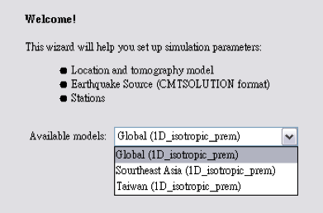
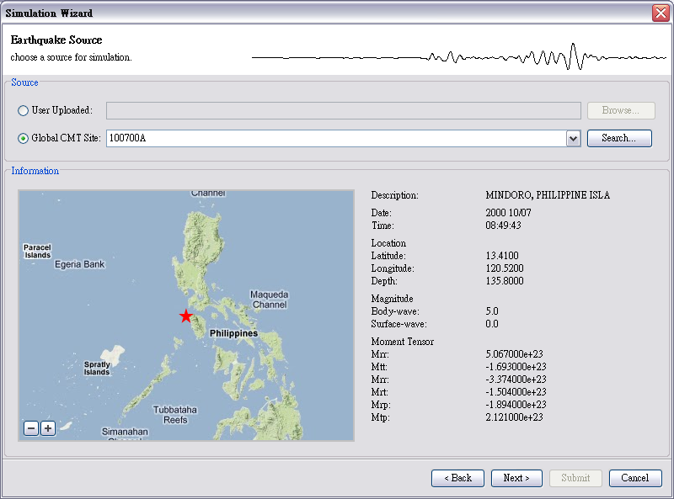
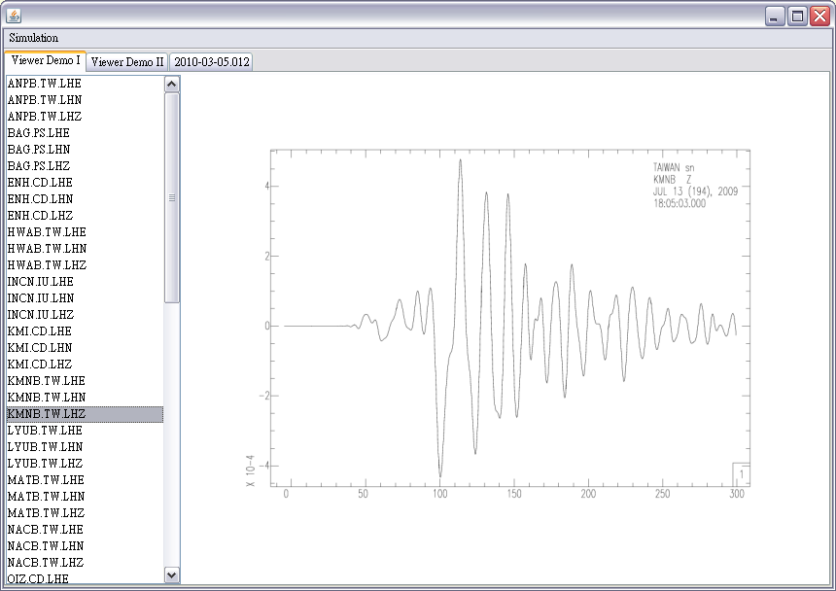
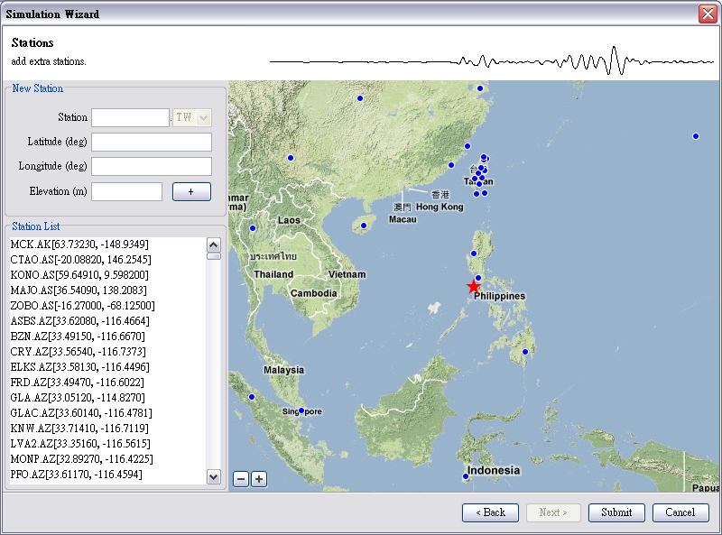
Seismogram Simulation Services
1. Location and Tomography Model Selction
2. Epicenter Data Preparation
4. Seismogram Access & Visualization
3. Choose Position for Seismogram

Slide 10
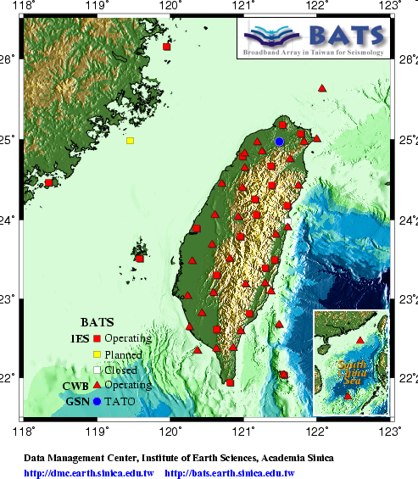
Building Strain Green’s Tensor Database
50 stations are chosen for SGT calculation, based on Taiwan 3D velocity model of Taiwan
The simulation scope covers the main Taiwan island only
230 x 390 x 80 km³
The side length of a grid is 200 m
About 9 x 10⁸ grids
Challenges (for one-minute propagation running by a 64-thread MPI job)
Total time: 50 (sites) x 3 (phases) x 1 (day) = 150 days
CPU Time: 150 * 64 * 24 hours= 230,400 CPU Hours
Total space: 50 x 3 x 15 = 2250 GB (about 2 TB)

Slide 11
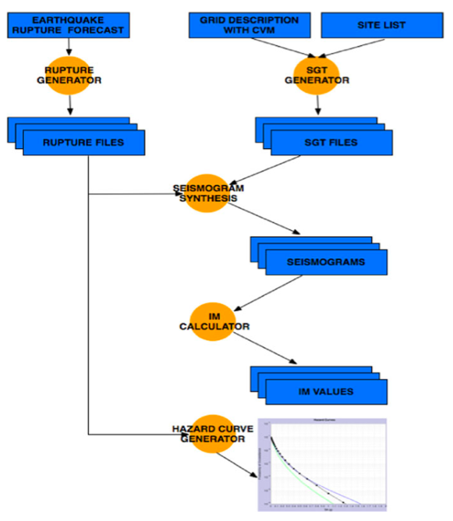
Future Works – Hazard Maps
Achieving full process of quantitative seismic hazard assessment
Collecting and analyzing event data
Understanding fault characteristics in details
Facilitating accurate simulation on seismic waves
Assessing anticipated earthquake and potential damages by the correct seismic and engineering models
Maps of disaster coverage, risk and also evacuation are pragmatic to better preparedness
Seismologist
EUAsiaGrid

Slide 12
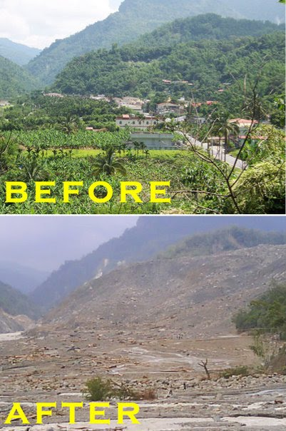
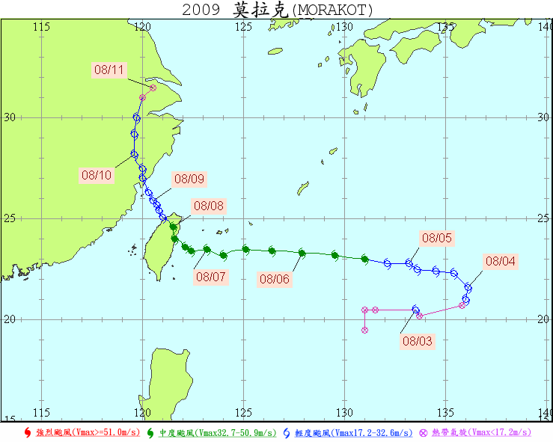
Typhoon Morakot (2-11 August, 2009)
Highest winds: 140 km/h (10-minute sustained)
Fatalities : 789 total
Rainfall : 2777 mm (total)
Damage : $6.2 billion (2009 USD)
Jhiben (知本), Taitung, Taiwan
Xiaolin village (小林村), Taiwan
12
Notes:
12

Slide 13
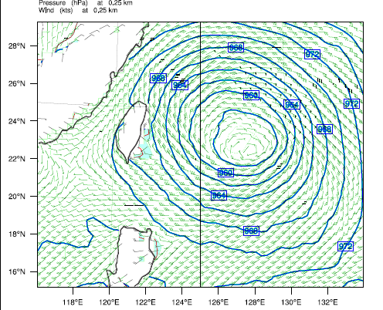
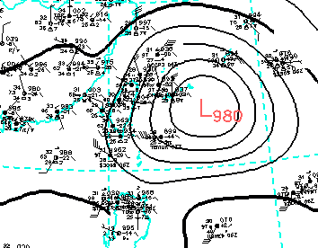
Isobaric Contour (Morakot)
Simulation during (2009-08-05-12 ~2009-08-07-12)
2009-08-06-06:00:00
CWB surface analysis
WRF Simulation (at 0.25 km)
Central presure
deviation≈(980-956)/980=2.5%
Notes:
13
Isobaric contour is simulated for the path and also intensity of typhoon typically. Here you can have WRF Simulation result (left panel) compare with CWB(Central Weather Bureau) (right panel), The deviation of Central pressure is about 2.5%

Slide 14
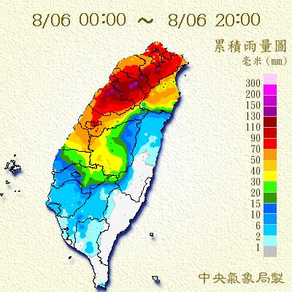
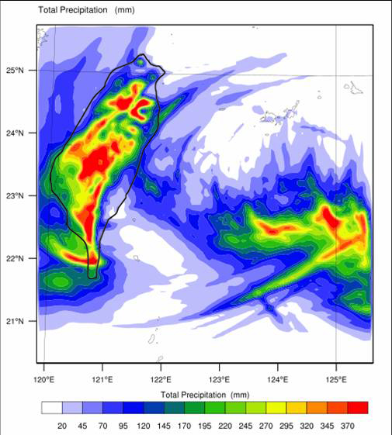
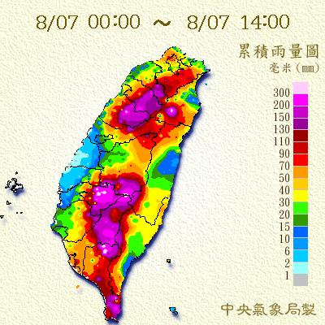
Precipitation (Morakot) Simulation (2009-08-06-00:00~2009-08-07-12:00)
WRF Simulation
CWB history data
14
Notes:
14

Slide 15
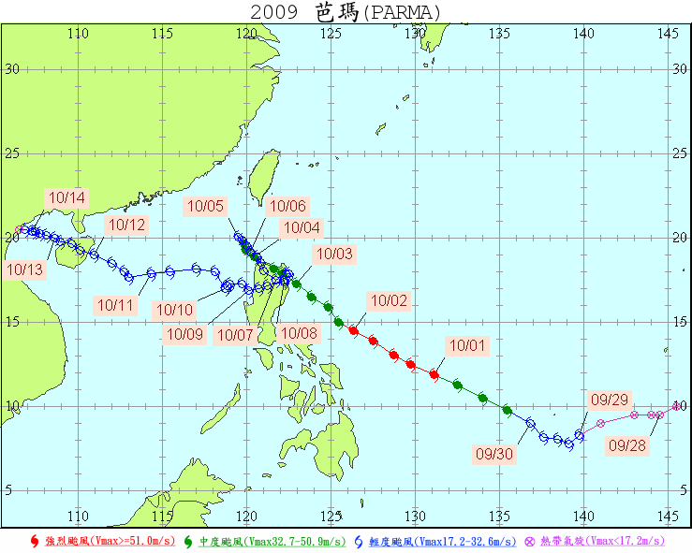
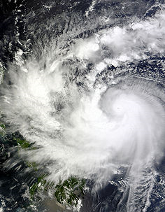
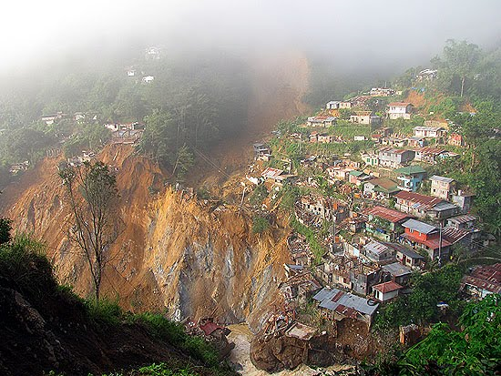
Typhoon Parma (27 Sep.’09-14 Oct.’09)
Highest winds: 195 km/h(10-minute sustained
Fatalities: 500 total
Damage: $617 million
Areas affected: Caroline Islands, Philippines, Taiwan, China and Vietnam
landslides triggered by typhoon Parma (Pepeng)
Ref. DAVE’S LANDSLIDE BLOG
(http://daveslandslideblog.blogspot.com/)
15
Notes:
15

Slide 16
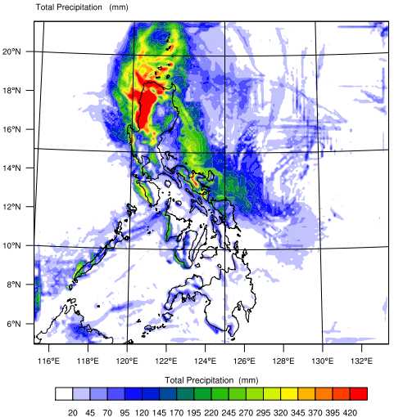
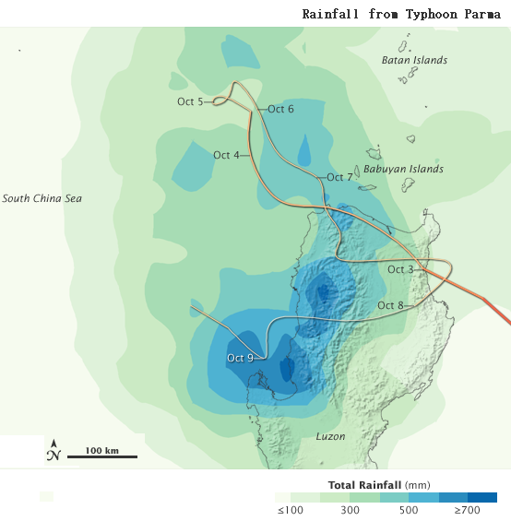
Precipitation (Typhoon Parma)
WRF simulation (Oct. 1 ~ 5)
NASA history data (Oct. 2 ~ 8)
16
Notes:
16

Slide 17
Requirements in General
Value of e-Science is to share methodology, tools across domains/boundaries
Three Dimensional: User, Application Developer, and Infrastructure Operator
Different metrics should be defined for variant stakeholder in terms of
Reliability
Sustainability: identify the critical mass
Accountability
Making requirements drive the evolution path of infrastructure and technology
Single out the gaps, optimize the whole organization and track the long term changes

Slide 18
Tentative Metrics
Community/Metrics | Reliability | Sustainability | Accountability | Tools
User | Failure rate, barriers to access Grid and Services, data access quality | #user, #VO, Job types, Res Utilization, #publication/Impact, New findings | Community/VO, data archive & sharing model, | Portal, CLI, GUI,
Application Developer | Bugs reported, performance metrics, user expectation | #user, #VO, roadmap, interoperability, funding scheme | Helpdesk, VO management | Framework, API, Ganga, Diane, AMGA, etc
Infrastructure Operator | Availability, res utilization, waiting time, security & privacy, op auto | Roadmap/capacity planning, funding scheme, | NGI, accounting system,
Tools

Slide 19
Summary
Indispensable stakeholders: User Community, Application Developer and Infrastructure Operator
Target of application and user support is to minimize the barriers of users
Application drive + Technology push
Users Need: get results quickly, utilize all the available resources, wherever they are
It’s a long term activity to be evolved with user community

