Slide 1
Operational Tools at OLA Workshop
D.Cesini (INFN/IGI)

Slide 2
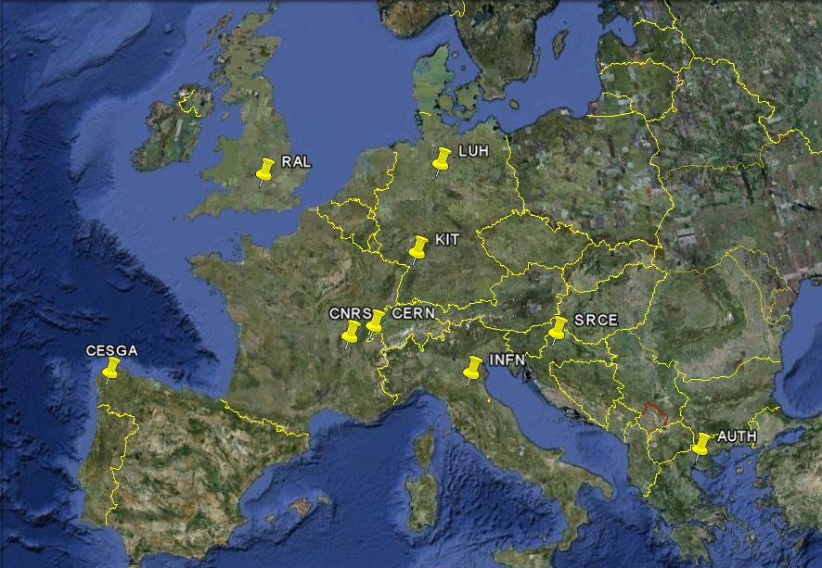
Tools developed by EGI-JRA1
Operation Portal (CNRS)
EGI Helpdesk (KIT)
GOCDB (RAL)
Accounting Repository (RAL)
Accounting Portal (CESGA)
SAM/MyEGI (CERN/SRCE)
Metrics Portal (CESGA)

Slide 3
Tools involved in OLAs
Provided by EGI (JRA1)
Currently Provided by WLCG (CERN/BARC)
Service Availability Monitor
Nagios execution framework for the probes
DB components (ATP, MDDB,MRDB)
myEGI portal
Metrics Portal
Availability Calculation Engine (ACE)
GridView Portal
- display availability numbers
m/w probes for SAM provided by EMI

Slide 4
ACE and GridView
ACE component is now included in SAM
Provided by CERN/BARC for WLCG with no funding from EGI
Need to understand if we have different requirements
GridView may move into MyEGI as a view
In any case availability plots will be available in myEGI
But the timeline is still not defined

Slide 5
EGI Tools Requirements
Requirements for the development roadmap to be agreed at the Operational Tools Advisory Group (OTAG)
Will start its work during the next weeks
JRA1 funding can be a limit

Slide 6
Metrics Portal
The main objective of the portal is to provide a set of metrics that can help to measure project performance
EGEE-II: Metrics Implementation Group
EGEE-III: Metrics Portal
http://www3.egee.cesga.es/gridsite/metrics/CESGA/egee_view.php

Slide 7
Metrics
Four groups of metrics:
Size metrics (from GOCDB and GSTAT)
# countries, # resource centers, # job slots, Total available computing power
Usage metrics (from Accounting Portal)
#submitted jobs, CPU usage, job efficiency …
Operations metrics (from GridView)
A/R numbers
User support metrics (from GGUS)
Stats on operational tickets, user tickets, response times, unsolved tickets…

Slide 8
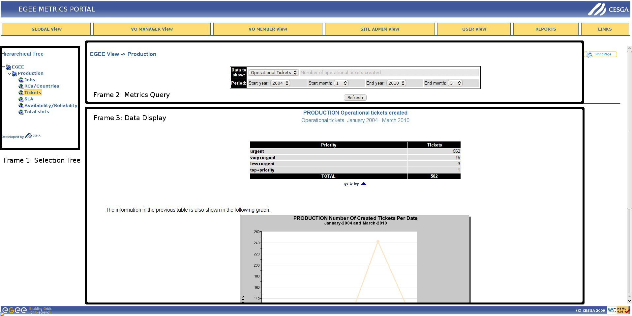
Metrics Portal Interface

Slide 9
InSPIRE-JRA1 Contacts
JRA1 Wiki
https://wiki.egi.eu/wiki/EGI-InSPIRE:Main_Page#WP7:_Operational_Tools
Documentation Links
https://wiki.egi.eu/wiki/WP7:_Operational_Tools#Documentation
JRA1 Mailing List
inspire-jra1<at>mailman.egi.eu
OTAG Mailing List
Otag<at>mailman.egi.eu
OAT Mailing List
egee3-operations-automation-discuss@cern.ch
Tool Admins mailing List
tool-admins<at>mailman.egi.eu

