Slide 1
Operational Tools Roadmap Introduction
D.Cesini (INFN/IGI)

Slide 2
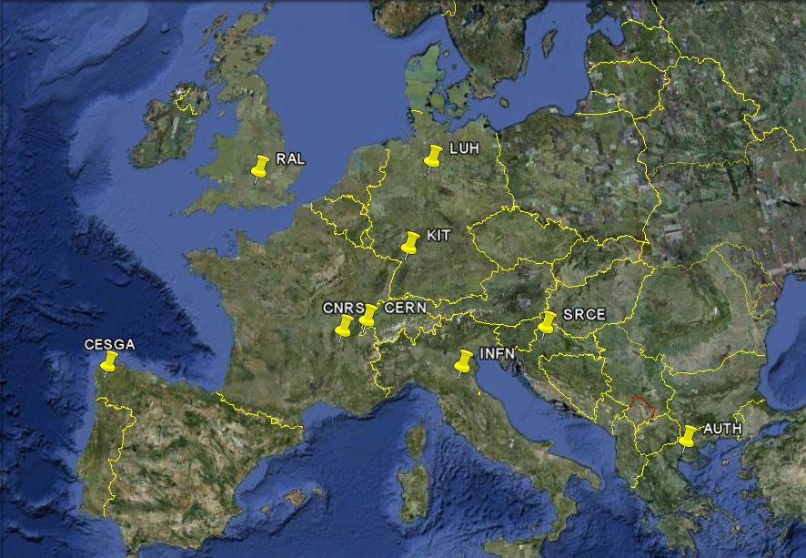
Tools developed by EGI-JRA1
Operation Portal (CNRS)
EGI Helpdesk (KIT)
GOCDB (RAL)
Accounting Repository (RAL)
Accounting Portal (CESGA)
SAM/MyEGI (CERN/SRCE)
Metrics Portal (CESGA)

Slide 3
Other activity tasks
Message Broker Configuration to support tools and operation (AUTH)
Accounting for different resource types (LUH/INFN/RAL)
Billing
Accounting of application usage
Accounting of data usage
Accounting of capacity and cloud computing usage

Slide 4
Focus during the first months
Setup of the activity and the development infrastructure
Group, wiki, mailing list, PPT info, RT, etc…
New Releases
3GGUS, 3NAGIOS, Reg. Dash, GOCDB4
Regionalisation
Nagios probes to measure tools availability
Documentation review
Migration to egi.eu domain of the central tools URLs and mailing lists

Slide 5
Tools developed outside EGI
GSTAT2.0 (CERN)
Availability Calculation Engine (CERN/BARC)
GridView (CERN/BARC)
Network Monitoring tools
DownCollector
perfSONAR
MyOSG Portal
Interaction through the OAT with the new mandate of cross projects forum

Slide 6
Requirements Collection
Roadmap open to accept project requirements
Prioritized by the Operational Tools Advisory Group (OTAG)
ToR available at: https://documents.egi.eu/secure/ShowDocument?docid=103
RT queue available containing previous OTAG open issues
Group, wiki and mailing list already defined
The first EGI OTAG during the next weeks

Slide 7
Contacts
JRA1 Wiki
https://wiki.egi.eu/wiki/EGI-InSPIRE:Main_Page#WP7:_Operational_Tools
Documentation Links
https://wiki.egi.eu/wiki/WP7:_Operational_Tools#Documentation
JRA1 Mailing List
inspire-jra1<at>mailman.egi.eu
OTAG Mailing List
Otag<at>mailman.egi.eu
OAT Mailing List
egee3-operations-automation-discuss@cern.ch
Tool Admins mailing List
tool-admins<at>mailman.egi.eu

